Slide 1
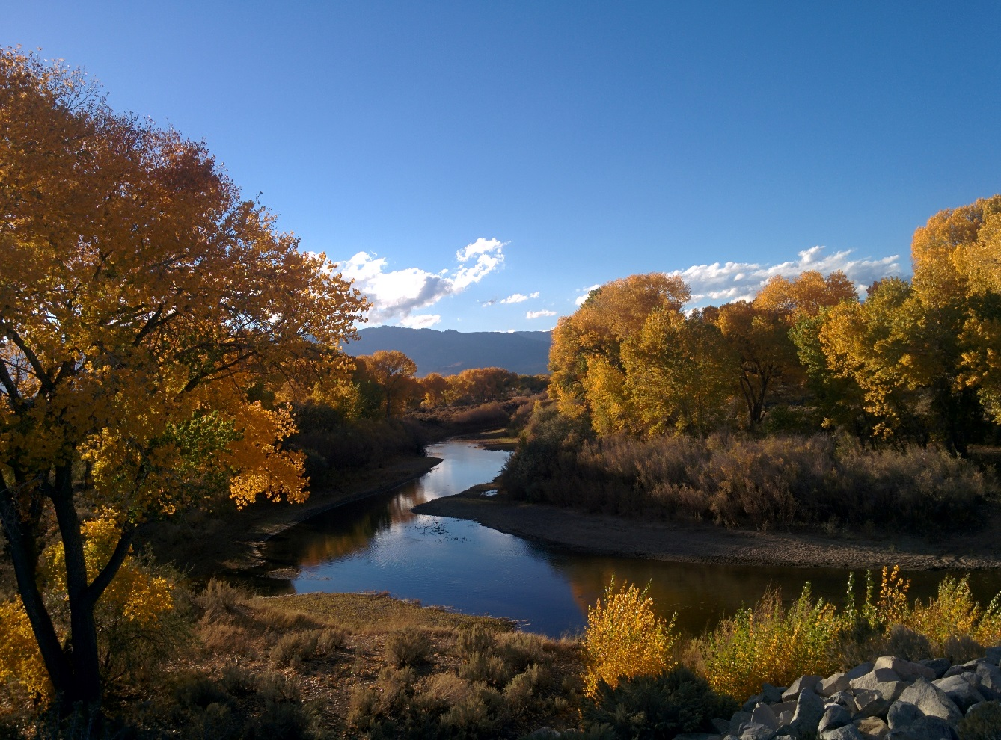

USGS Middle Carson River Groundwater Levels and Water Quality Monitoring
David Smith - dwsmith@usgs.gov
USGS Nevada Water Science Center

Slide 2
Cooperators
Carson Water
Subconservancy District
Lyon County

Slide 3
Outline
(1) USGS Online Database - Background on how to access data
(2) Water Resource Snapshot - Latest Groundwater Levels, Water Quality, and Precipitation

Slide 4
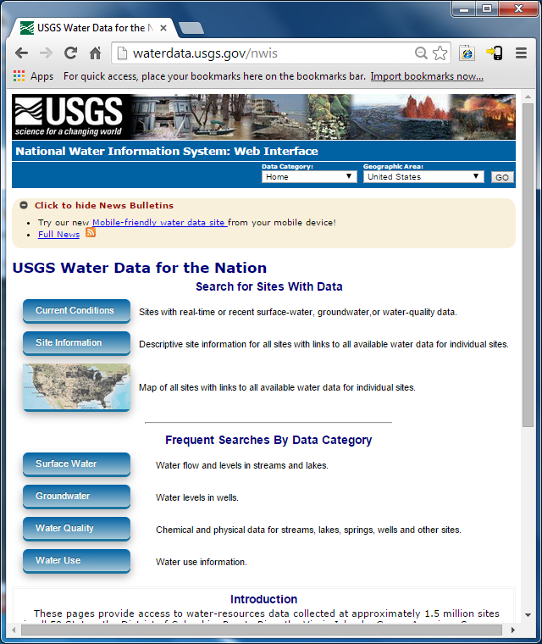
Online Resources
National
Water
Inventory
System
(NWIS)

Slide 5
Water Resource Information
Online

Slide 6
Water Resource Information
Online
Interactive
Mapper

Slide 7
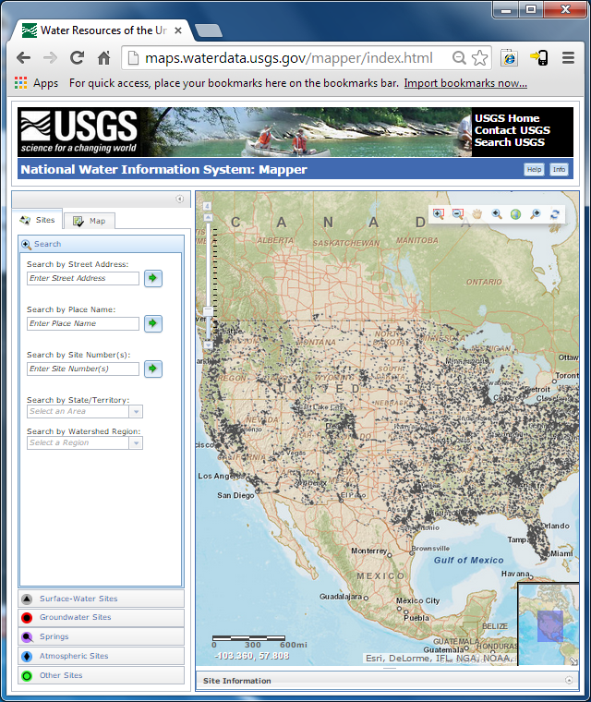
NWIS Mapper
Maps Feature
  Zoom in to area of interest.
Surface Water sites are the default selection.

Slide 8
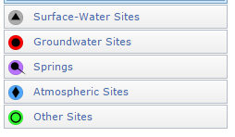
NWIS Mapper
Maps Feature
  Zoom in to area of interest.
Surface Water sites are the default selection.
5 data site types available.

Slide 9
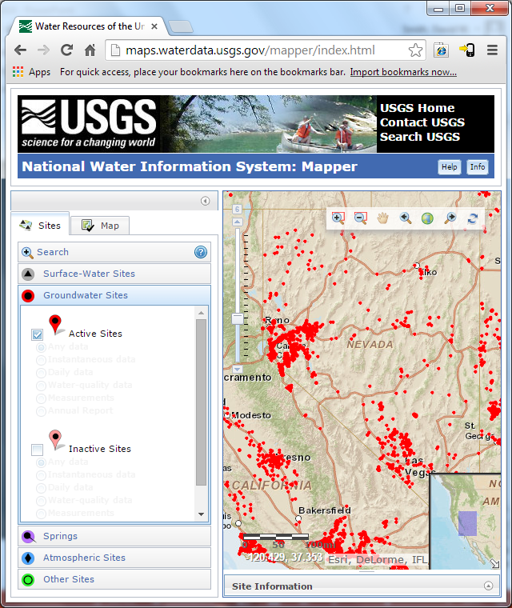
NWIS Mapper
Select Groundwater
  Active Sites - Data entered in the past year
  Inactive Sites – Historical Data >1 year

Slide 10
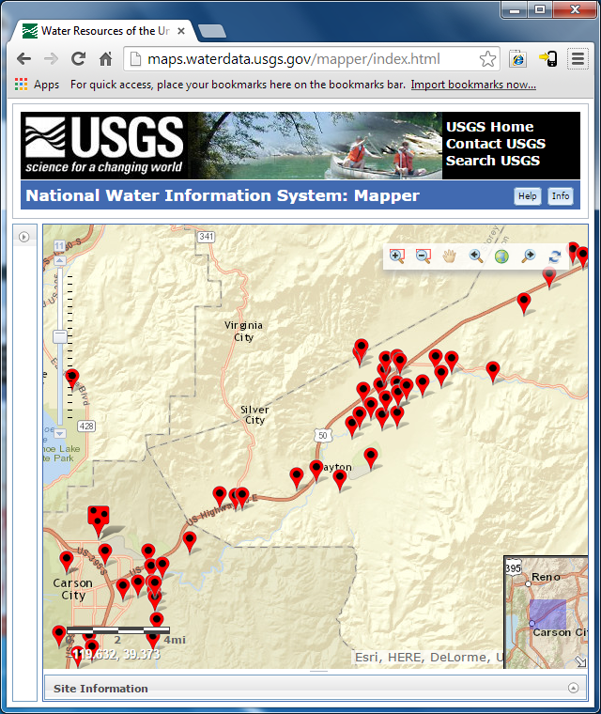
NWIS Mapper
Active Groundwater
Wells

Slide 11
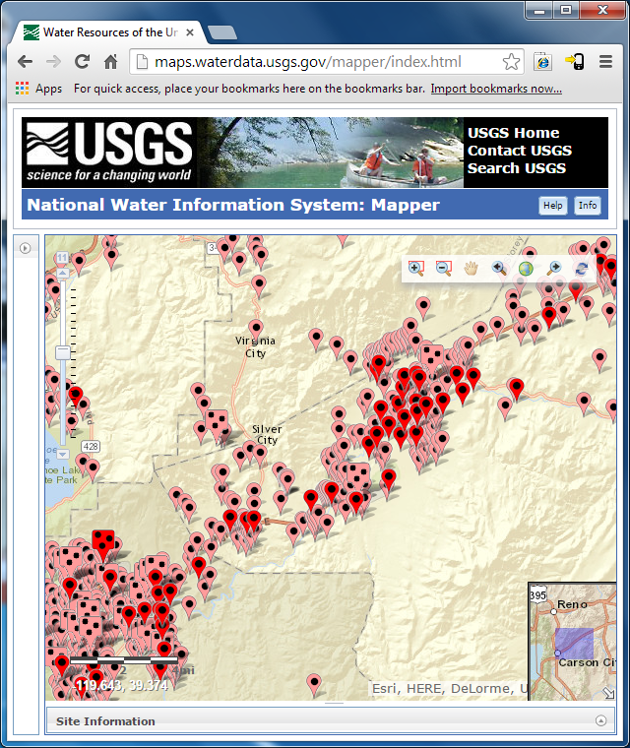
NWIS Mapper
Active and Inactive Groundwater Wells
Data available from 2000-2010 is used for the calibration of Middle Carson Model

Slide 12
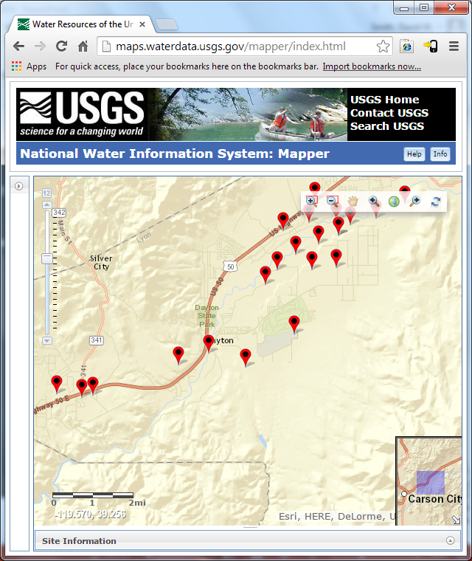
NWIS Mapper
Dayton Project Area
Monitoring is focused on wells near the Carson River.

Slide 13
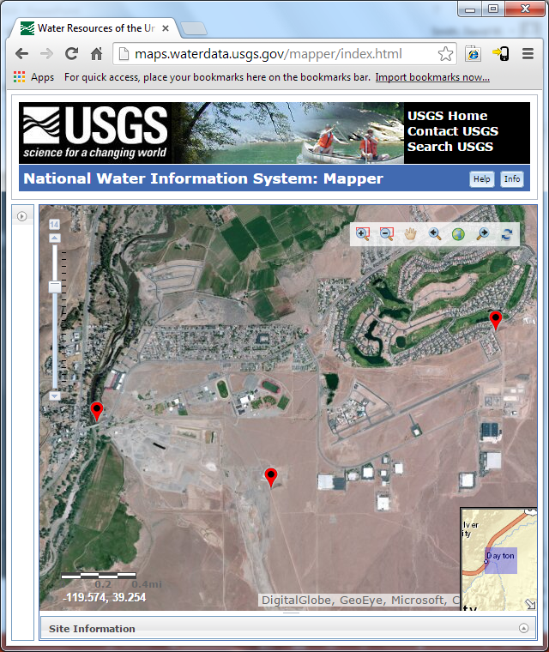
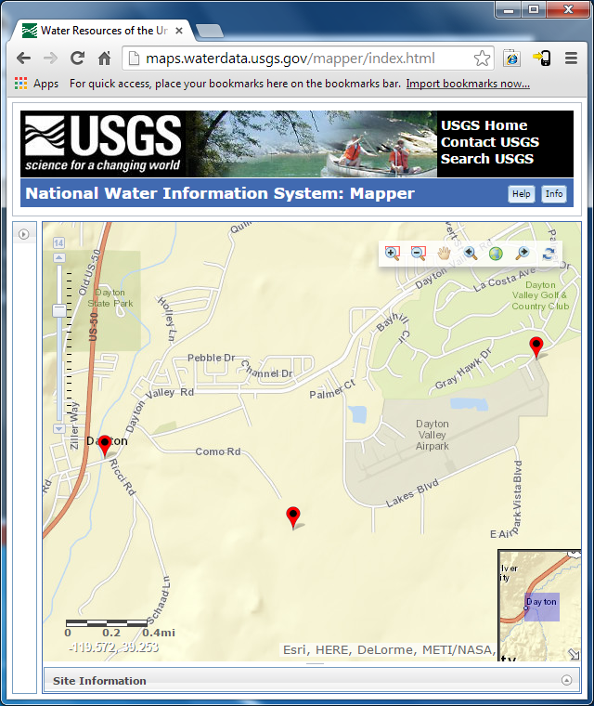
NWIS Mapper
Switch Basemaps to Aerial Imagery

Slide 14
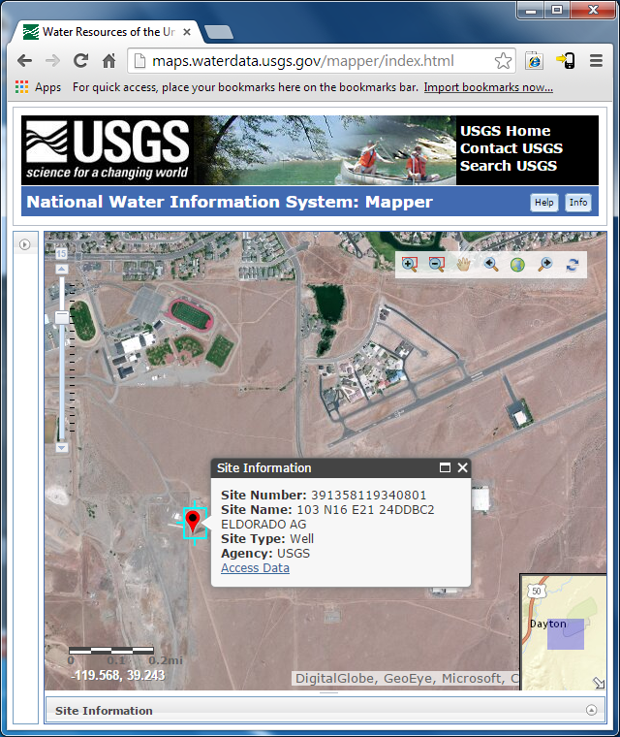
NWIS Mapper
Access Data – link to well construction information, water-level and water-quality data
Graphs, and tables available.
Example- ELDORADO AG WELL

Slide 15
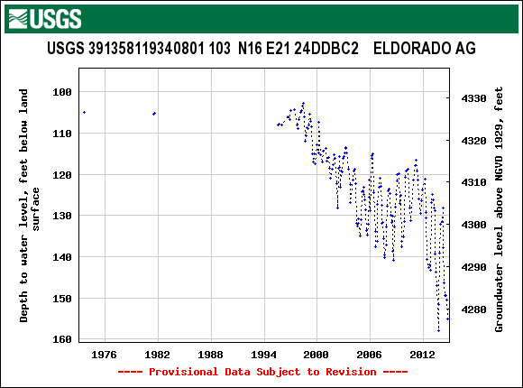

Slide 16
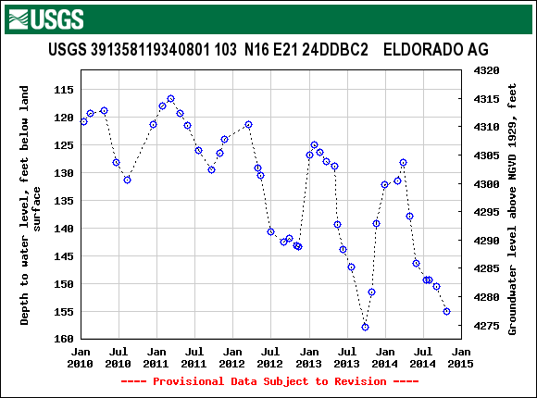

Slide 17
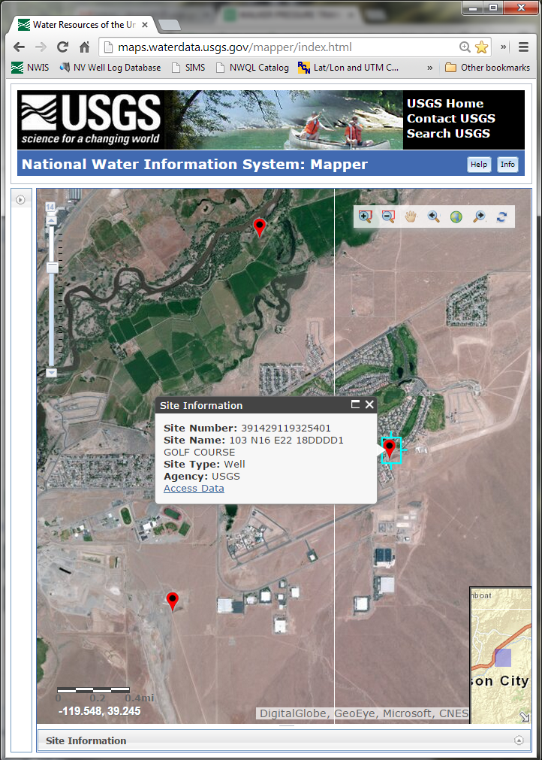
NWIS Mapper
Long Term Trends: GOLF COURSE Well

Slide 18
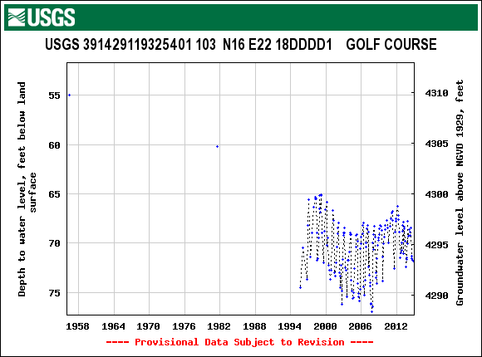

Slide 19
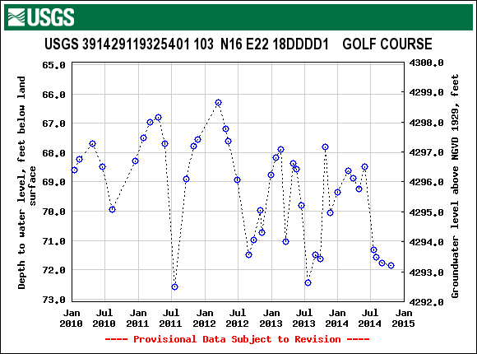

Slide 20
Objectives/Scope: Dayton Valley Project
  (1) Groundwater-levels, monitor Carson River stage for wells near the river Monitor 60 wells monthly, 15 locations collect River Stage (instantaneous)
  8 pressure transducers continuous water level data collection
  (2) Collect precipitation data throughout the Dayton Valley
  Bulk Precipitation Data measured quarterly, Precipitation Recharge for GW Model
  (3) Collect annual water-quality samples for nitrate monitoring, influence of septic tanks.

Slide 21
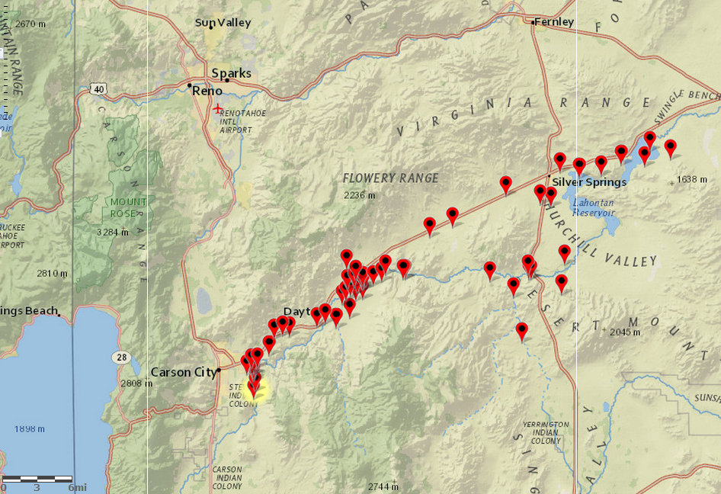
Groundwater Water Monitoring Network

Slide 22
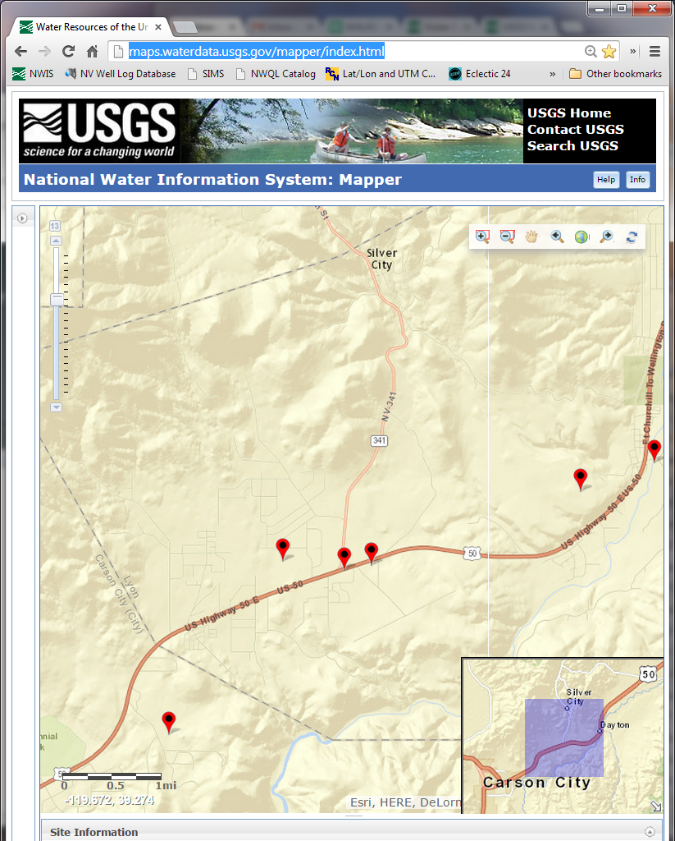
Groundwater Levels
Mound House
Bunkhouse Well

Slide 23
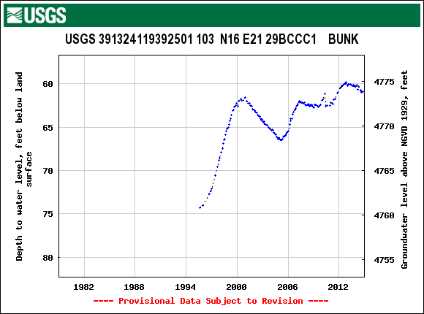

Slide 24
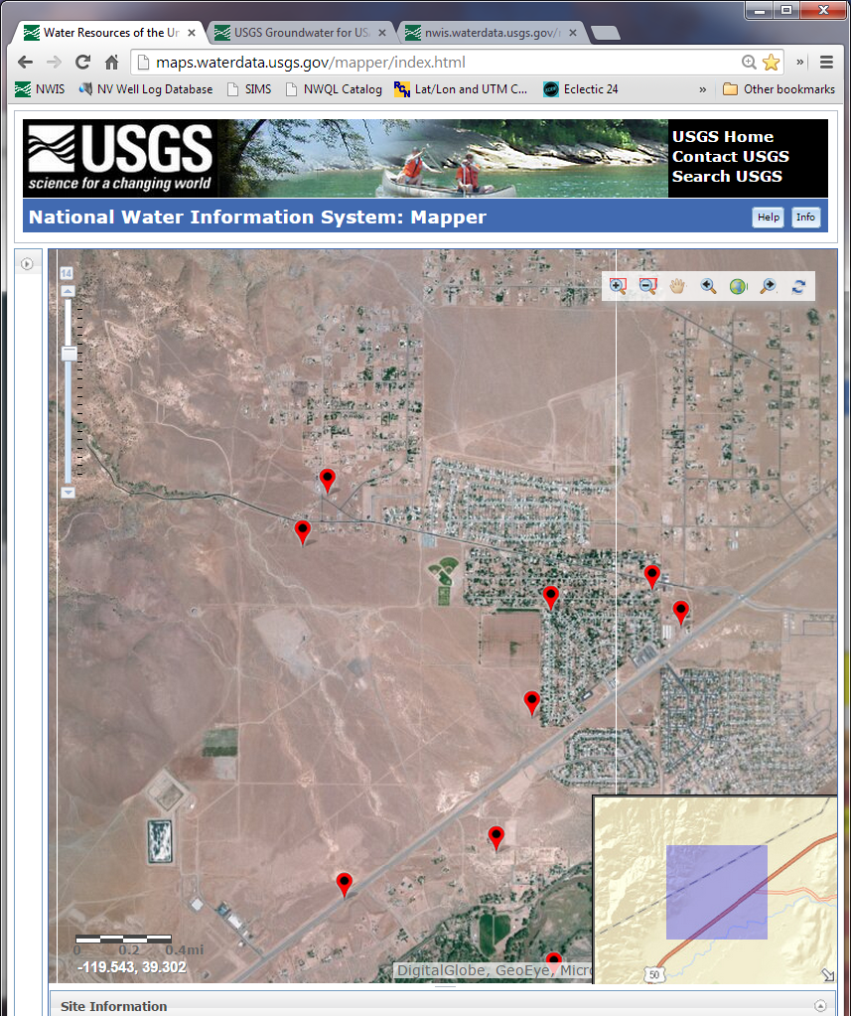
Groundwater Levels
Mark Twain Community
Center Well

Slide 25
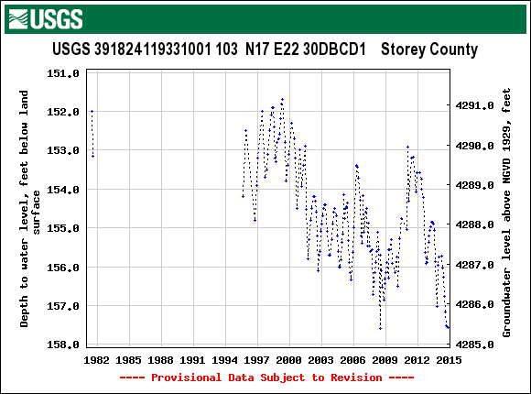

Slide 26
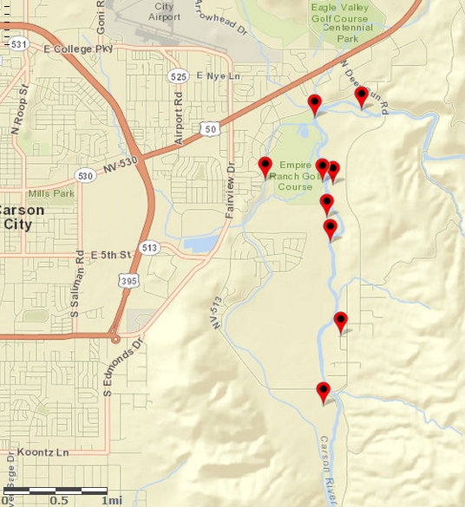
Groundwater Surface Water Gradients -Instantaneous River Stage Data
Induction Well

Slide 27
MW-2 (1,500 ft from Induction Well)
Nearby
Pumping

Slide 28
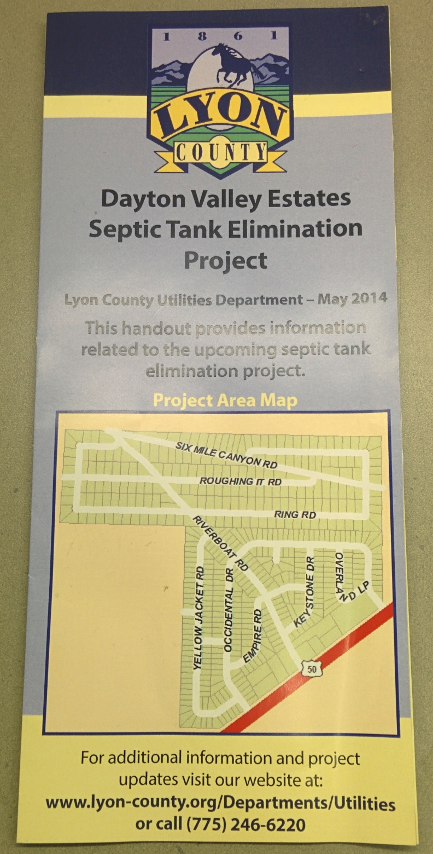
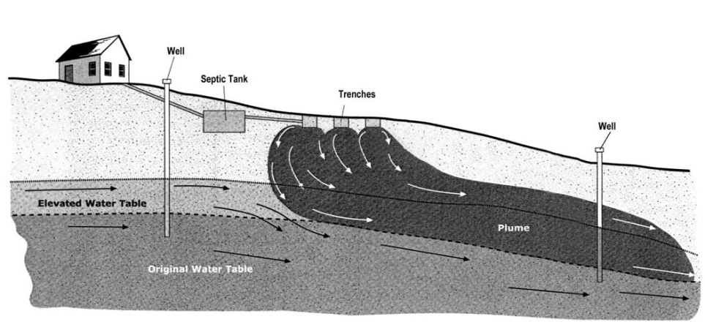
Groundwater Quality
Biological conversion of urea/waste into NH₄
  Nitrification of NH₄ into Nitrate in unsaturated Zone
    Health impacts, biological impairment
Household chemicals and pathogens
(USEPA,2002)

Slide 29
Groundwater Quality
12 different wells sampled throughout Middle Carson Area
  Varying Frequency, 8 wells are sampled annually
  Samples collected from 2010-2014
2014 collected samples for Nitrogen Isotopes (Michael Rosen)
  Samples included collection of Aquifer Nitrate concentrations
  Data will be used by UNR Master Student

Slide 30
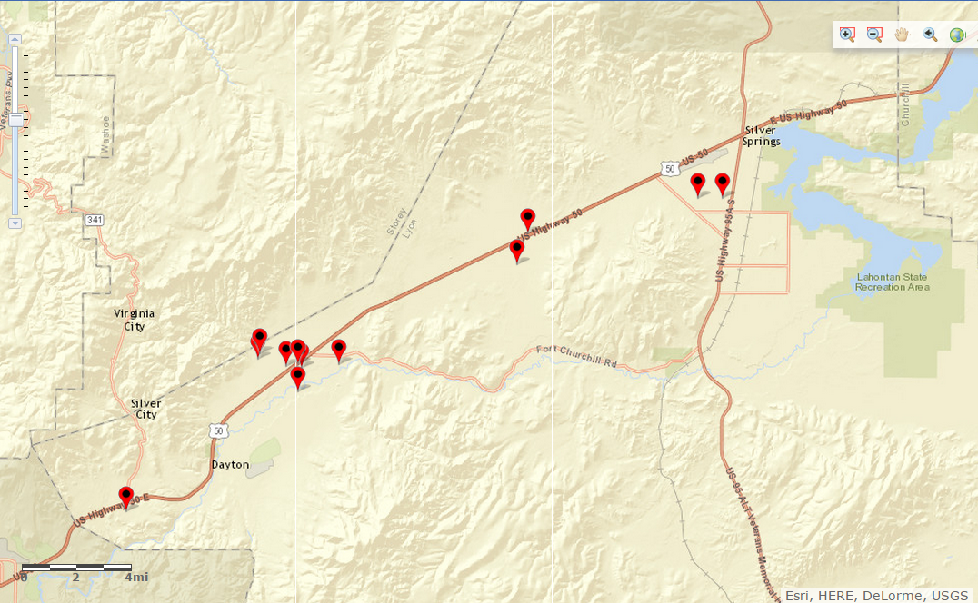
Groundwater Quality Monitoring

Slide 31
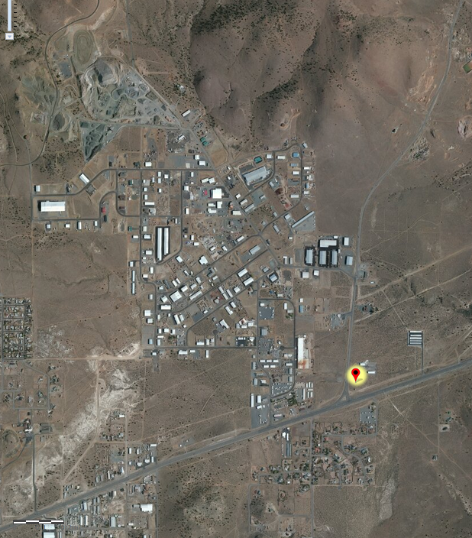
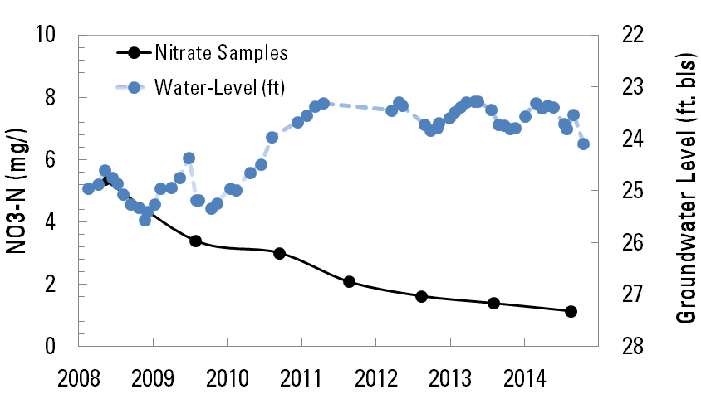
Water Quality: Mound House Area

Slide 32
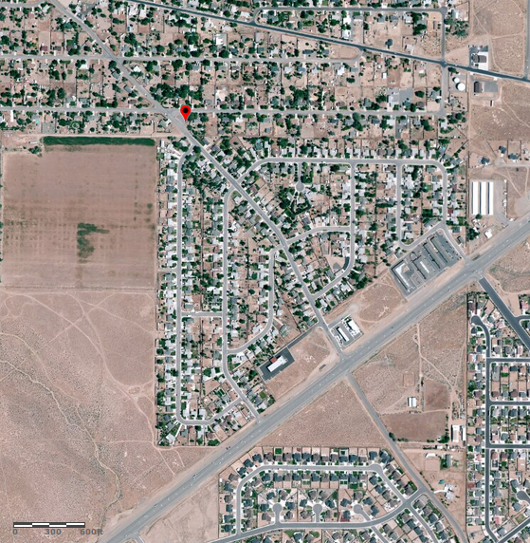
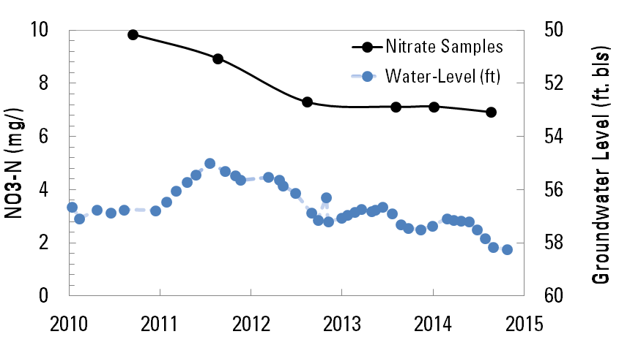
Water Quality: East Dayton 6 Mile Canyon Rd
Chloride Decline 73.8 mg/l in 2010 to 47.8 mg/l 2014
Sulfate Increase 561 mg/l in 2010 to 799 mg/l 2014
  Odor and Taste EPA Secondary Standard ~250 mg/l

Slide 33
Project Summary
Groundwater-levels and water-quality data is available online through NWIS.
Decline or stabilization or very slight increase aquifer nitrate concentrations from 2010-2014 in monitoring network.
Identification of elevated nitrate concentrations (~18 mg/l-N)
  In the Mark Twain Community Center (will sample in January for Nitrate)
Questions on how to get data, email dwsmith@usgs.gov

Slide 34

Questions?

Slide 35
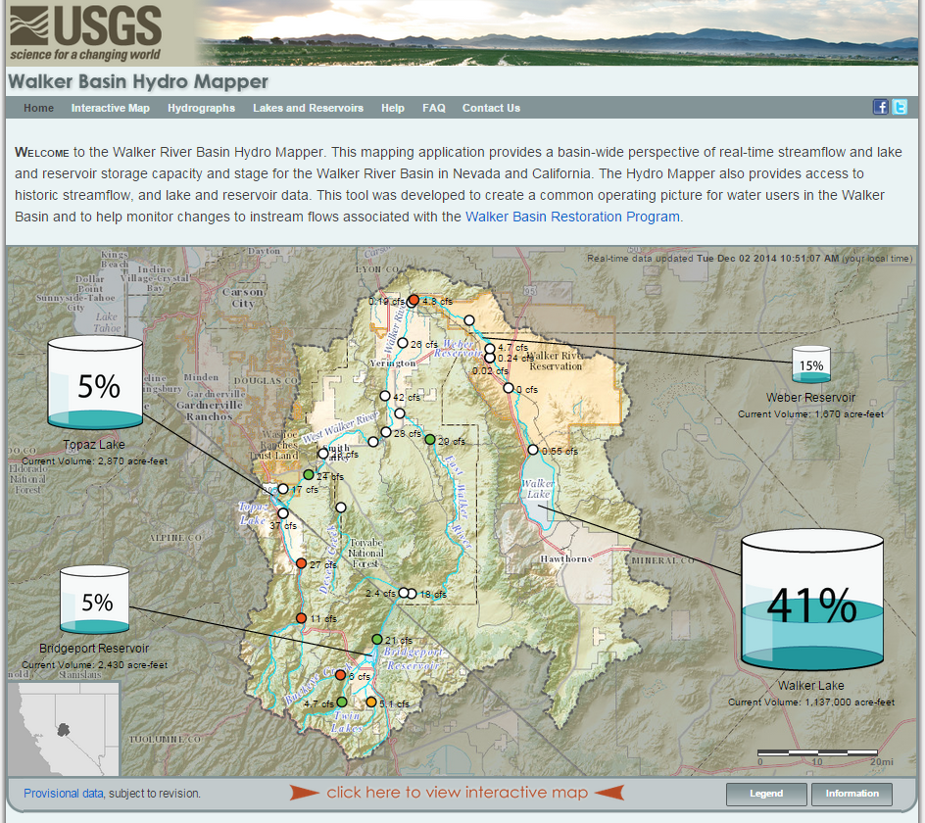
http://nevada.usgs.gov/walkerbasinhydromapper

Slide 36
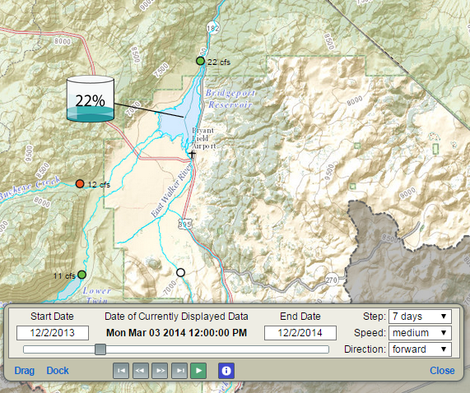
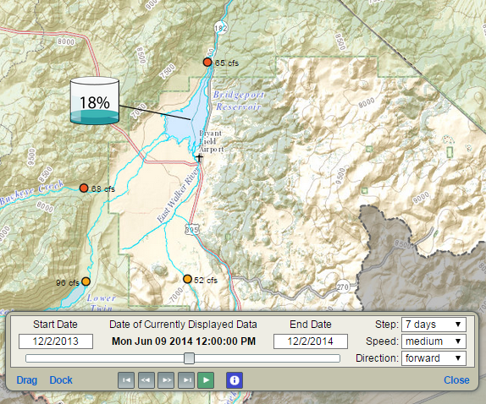
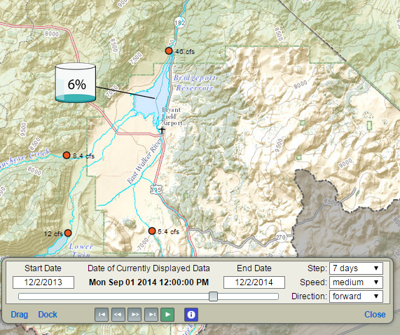

Slide 37
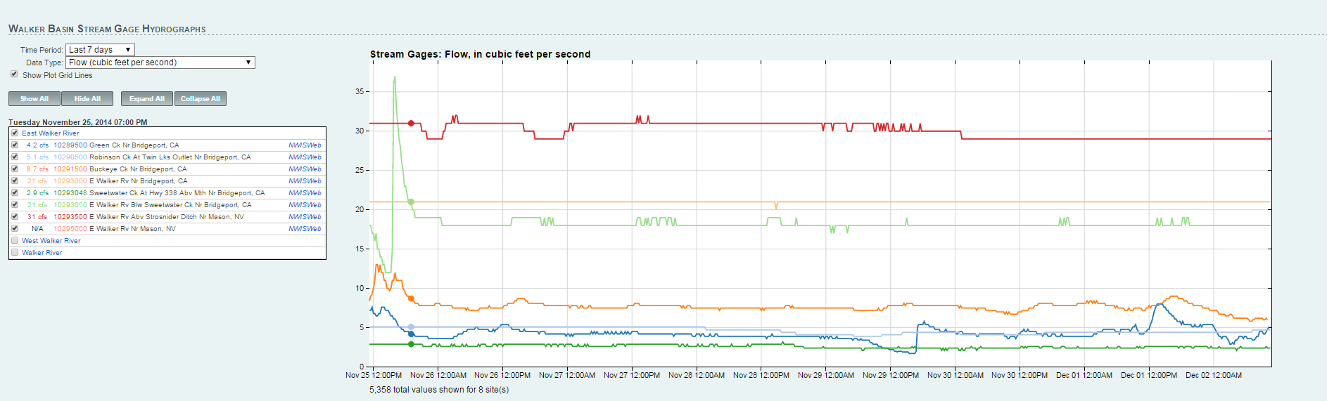

Slide 38
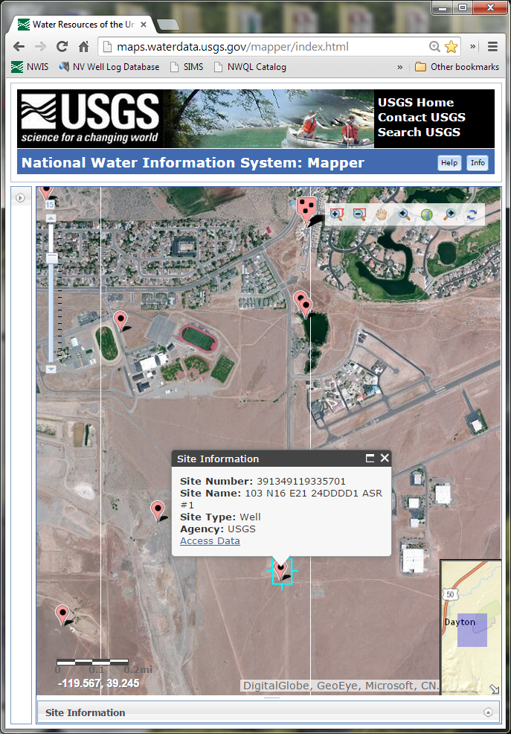
NWIS Mapper
Inactive sites Example
  Aquifer Storage and Recovery well

Slide 39
