Slide 1
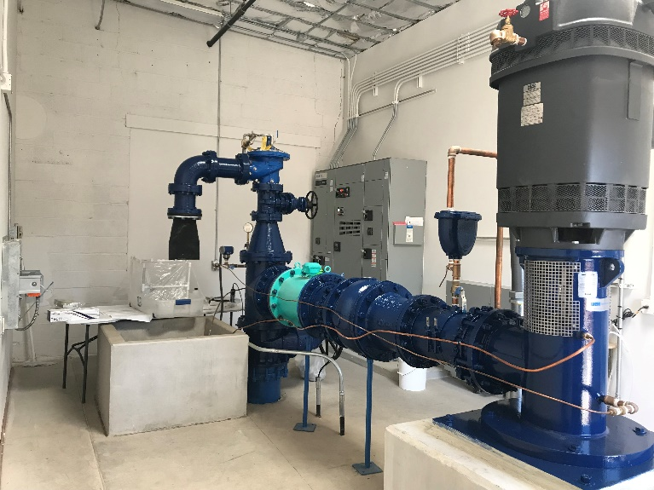
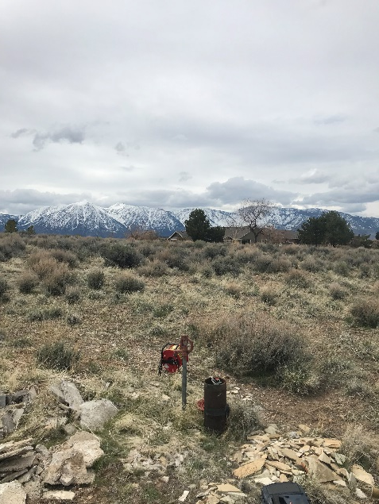
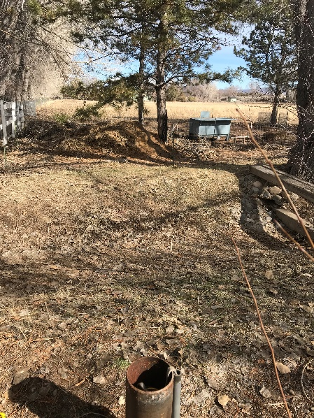
Carson Valley Arsenic
Phase II -- Data Collection
Preliminary Characterization of the Distribution of Arsenic in Southern Carson Valley
Angela Paul
USGS, Nevada Water Science Center
Douglas County Water Purveyors Meeting
September 16, 2019

Slide 2
PROBLEM
Water supply wells in northern Carson Valley were decommissioned due to elevated arsenic concentrations (Carl Ruschmeyer, January 2013, Douglas County Public Works Director, verbal communication).
Town of Minden is currently providing water from their production wells to supply water lost to consumers by the decommissioning of the wells in northern Carson Valley
Ultimate Question: Will increasing pumping rates from water supply wells in Minden mobilize arsenic toward them thereby degrading water quality?

Slide 3
Phase I – Recap & Phase II Objectives/Scope
Limited arsenic concentration data exist over the past 10-20 years for areas upgradient and surrounding production wells: Update arsenic concentration distribution assessment within the target study area (n = 9 wells)
Redox conditions may be mixed and above what might be reducing for arsenic but speciation data are unavailable: Analyzed each sample collected from domestic wells for redox chemistry (DO, N-species, Mn, Fe, As-species, SO₄-H₂S), DOC, and chloride
Collect samples during minimal pumping pressure (March/April 2019)
Notes:
Redox is shorthand for Reduction Oxidation. Certain constituents are able to undergo redox reactions whereby electrons are exchanged. Oftentimes redox reactions are mediated by bacteria. Generally, as bacteria feed on organic carbon the bacteria transfer electrons to constituents susceptible to receiving these electrons within the system; for example, arsenic. If arsenate (the oxidized form of inorganic arsenic) is present and accepts the electrons from the bacteria it becomes reduced to arsenite (the reduced form of arsenic). Bacteria generally prefer to transfer electrons to dissolved oxygen, if present; therefore, if sufficient dissolved oxygen is present in the system conditions are considered to be oxidizing to redox-sensitive constituents. However, if dissolved oxygen is sufficiently low or absent (anoxic), this doesn’t necessarily mean the system is reducing to all constituents in the system. There is a general favorability to certain constituents over others; this favorability is usually described using was is termed a redox ladder. Generally, bacteria will transfer electrons to constituents in the following order: Dissolved Oxygen (O2)>Nitrate/Nitrite>Manganese>Iron> Arsenic>Sulfate. If the system is incredibly reducing, methane gas will be formed. A mixed redox condition indicates that a couple or a few constituents may be susceptible to redox reactions in the system.
Species is used to indicate the form a constituent takes in the system. For instance, the inorganic arsenic species are arsenate (H3AsO4) and arsenite (H3AsO3).

Slide 4
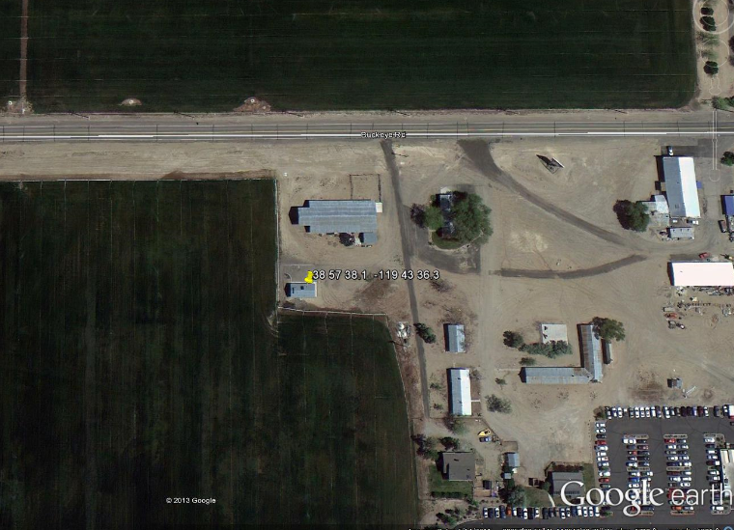
Minden Well #8
Collaboration with water purveyors (FY2018) –
Which wells are you most concerned with respect to arsenic?
Arsenic concentrations above 10 µg/L (MCL) before purge; after purge, concentrations fall below MCL (Jeff Cady, Town of Minden, Water Operations Manager)
Arsenic in-situ remediation study (2010) with speciation data just north of Well #8
Well #8 Sampled for a suite of analytes in 2013 as part of the USGS NAWQA Program
Buckeye Rd.
110 – 170
250 – 270
310 – 330
430 - 510
Arsenic = 9.0 µg/L
Screened intervals (below land surface)
USGS 2013 (source water)

Slide 5
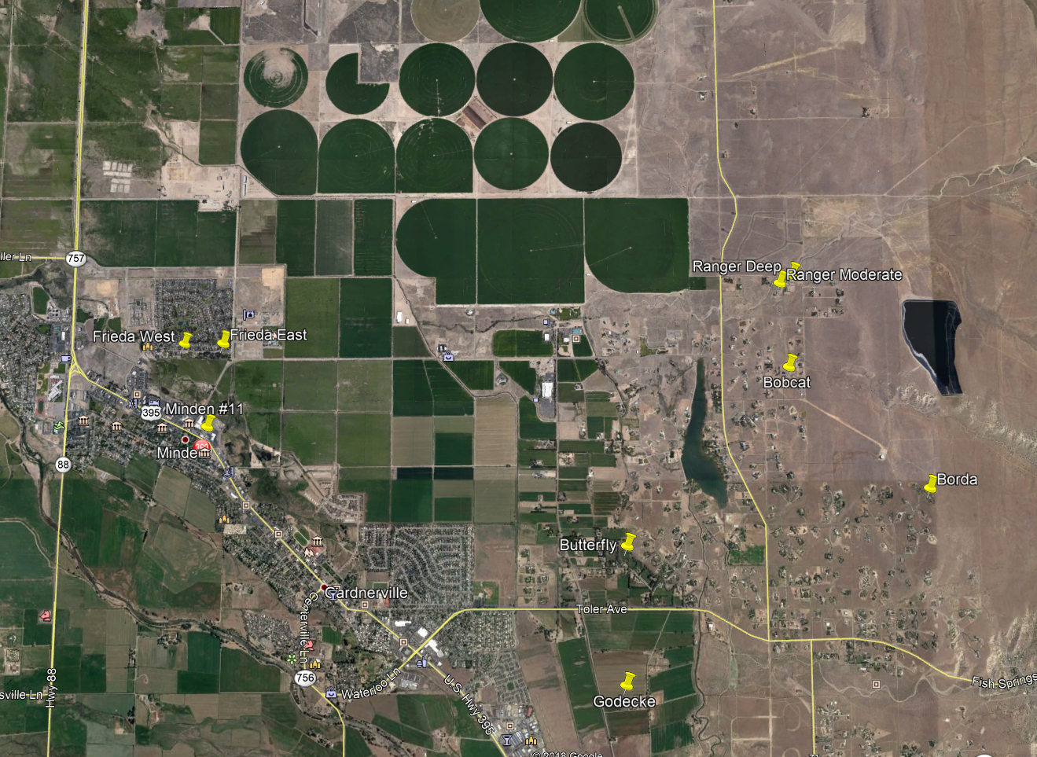
Domestic Well Selection Process
Aquifer Penetration Depth
Proximity to municipal supply well
Location within general groundwater flow path
Permission by well owner to sample well
Minden Well #8
General GW Flow (Yager et al, 2012)
Sample Well
2010 In-situ remediation study

Slide 6
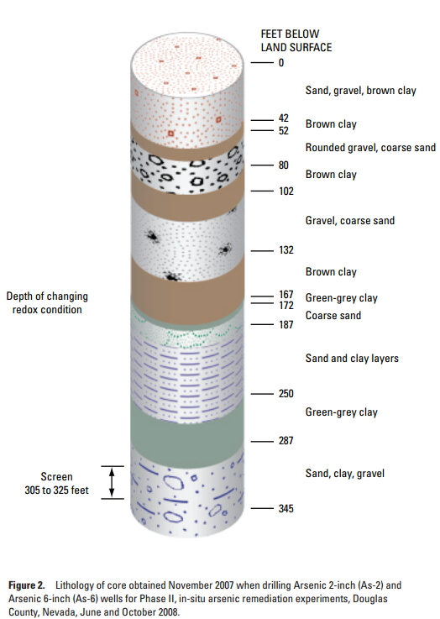
Depth Within Aquifer Representation
South End Douglas County Airport, 2010
Target Aquifer Penetration Depth
Shallow: ≤100 ft
Moderate: 101 to 299 ft
Deep ≥300 ft
Feet Below Land Surface
As(V)
“49, 106, 107 ft
Shallow
144 ft
Redox Change
143, 178, 200 ft
Moderate
As(III)
Deep
As (III)
392 ft
Minden Well #11; Multiple Screened Intervals (100 to 397 ft) – Aquifer Pen. Depth = 289 ft
From Paul and others, 2010. In-situ arsenic remediation in Carson Valley, Douglas County, west-central Nevada: U.S. Geological Survey Scientific Investigations Report 2010-5161, 24 p

Slide 7
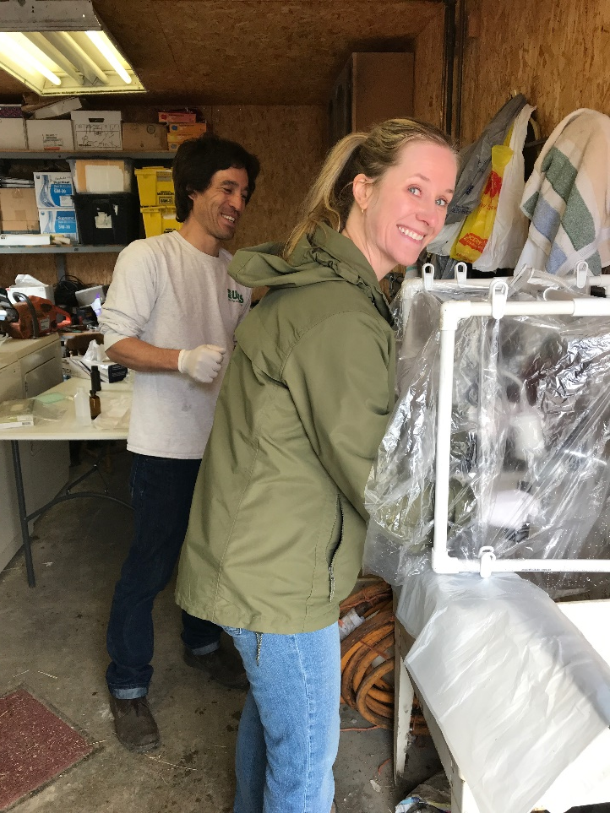
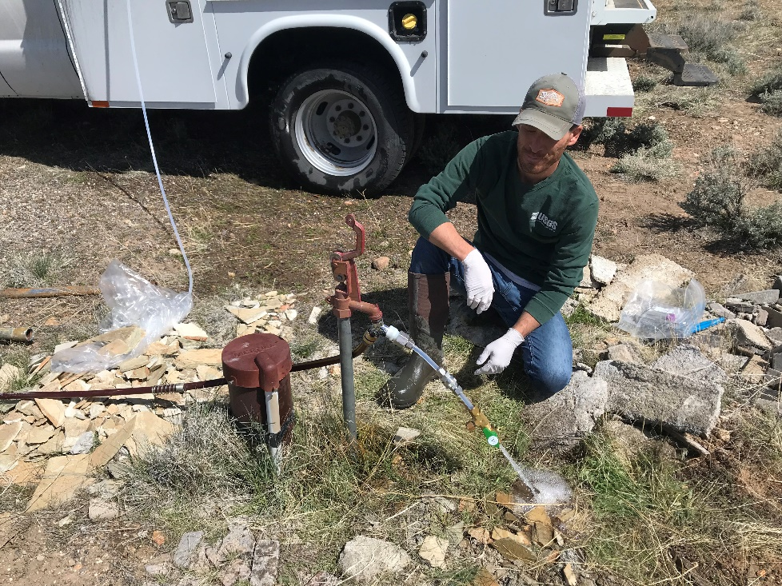
Samples Collected
9 Environmental Samples
1 Field Blank (no speciation)
3 Sequential Replicates (all parameters)
Arsenic Oxidizing Bacteria (Farah Ansari, Pakistan/CSU)
Farah
Jonathan preparing to sample for arsenic speciation. Septum used to preserve redox conditions during sampling.
Jena and Jonathan processing samples in domestic pump house.

Slide 8
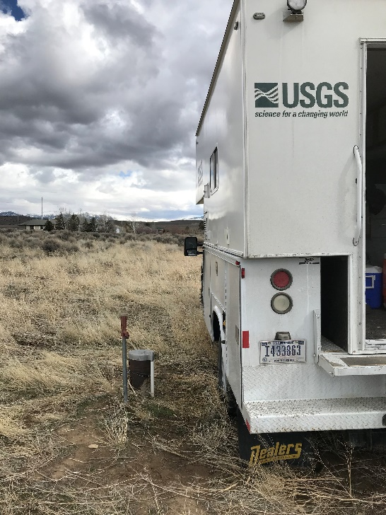
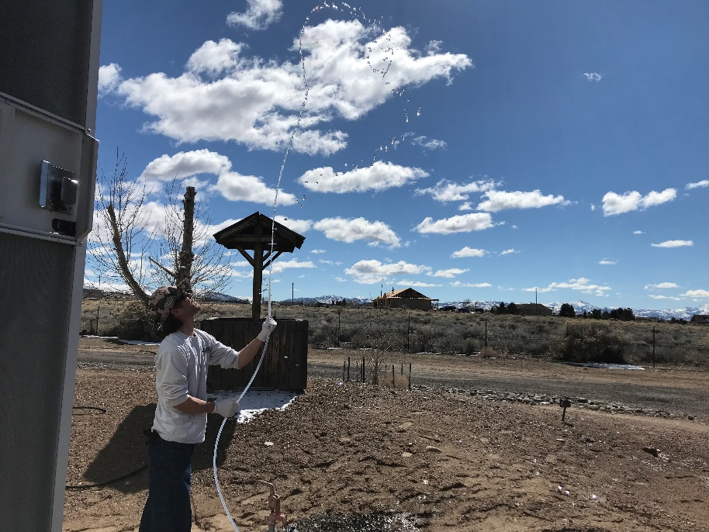
Analyses
Field Parameters (DO, pH, SC, temp)
Nitrogen Species (NO3/NO2/NH3)
Manganese and Iron
Arsenic Speciation (AsV/AsIII)
Sulfate (+H2S sniff test)
Chloride, Phosphate, and DOC
Samples were analyzed by USGS NWQL, USGS Trace Element Lab, and Brooks Applied Labs
Rinsing the sampling line

Slide 9
During this sampling effort, higher As along eastern edge of S. Carson Valley
Minden #8
General GW Flow
As < 5 ug/L
5 ug/L < As <10 ug/L
As ≥ 10 ug/L
Yager and others, 2012
Provisional data, subject to revision

Slide 10
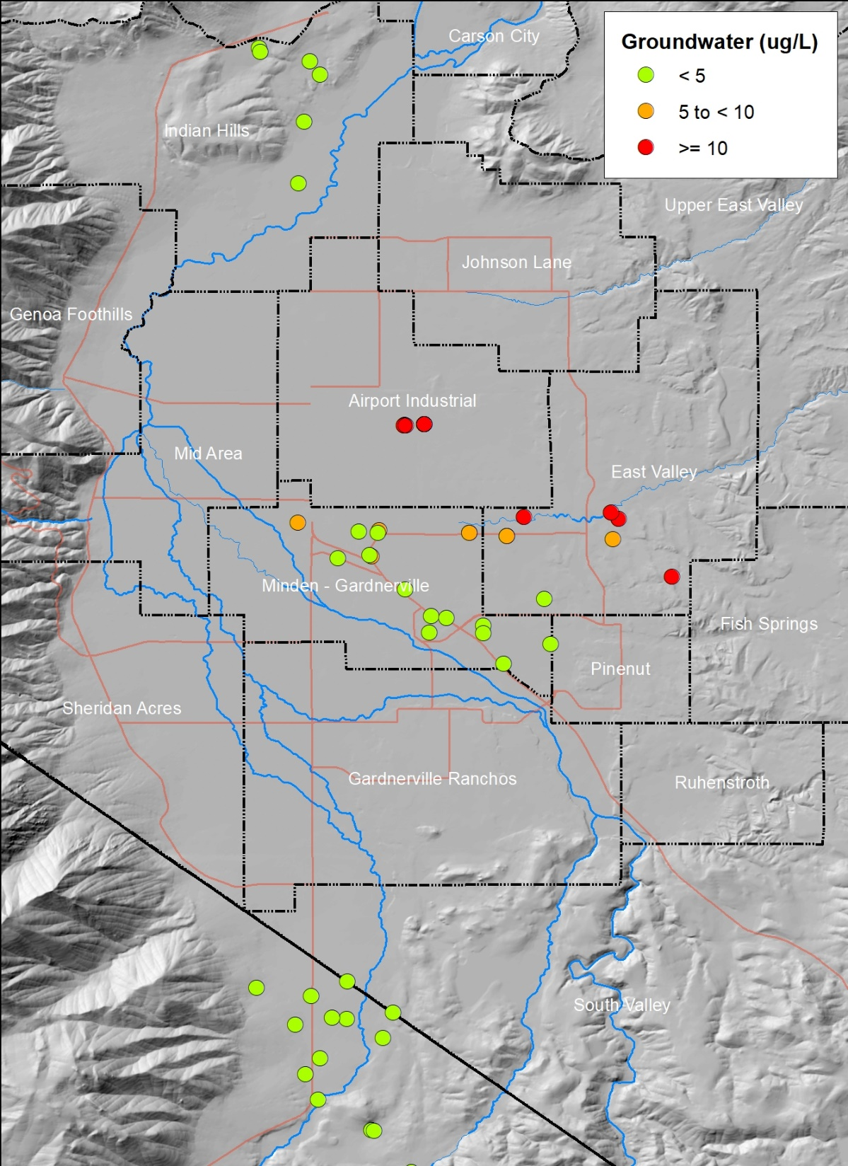
Water Years
2006 – 2019
Arsenic Concentrations
Filtered and Unfiltered
Municipality
and
USGS As Remediation Study and 2019 Data
2007 As Remediation Study
Minden Well #8
Provisional data, subject to revision

Slide 11
<5 ug/L As
Higher arsenic concentrations observed along
the east side of the valley
>10 ug/L As
Saturated Zone
Unsaturated Zone
107 ft
Aquifer Penetration Depth (APD) =
289 ft
As (V)
106 and 200 ft
As (V)
49 to 178 ft
As (V)
392 ft
Not sampled in 2019
August 2013 = 9 ug/L As
(mid-screen 570 ft below land surface)
Provisional data, subject to revision
As (III)

Slide 12
Arsenic Concentration with Depth – Phase I & II
As(III)
Provisional data, subject to revision

Slide 13
Arsenic Concentration with Depth – with 2019 Data
As(V)
150
As(V)
As(V)
As(V)
300
As(V)
As(V)
450
East Valley Redox Boundary?
600
As(III)
750
900
Provisional data, subject to revision

Slide 14
Change in redox conditions within the aquifer occur at:
South end of the airport: 170 feet deep within the aquifer
East side of the valley: somewhere between 178 and 392 ft APD West side of valley: unknown
<5 ug/L As
>10 ug/L As
Note: Depths of changing redox conditions will not be the same throughout the basin.
Saturated Zone
Unsaturated Zone
107 ft
Aquifer Penetration Depth (APD) =
289 ft
As (V)
106 and 200 ft
As (V)
49 to 178 ft
As (V)
Redox Change ?
392 ft
?
Not sampled in 2019
August 2013 = 9 ug/L As
As (III)
Provisional data, subject to revision

Slide 15
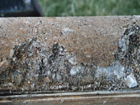
As = 0.109(Fe) + 6.35, R²=0.58, p=0.048
Arsenic and Iron (Fe)
As (III)
Arsenic is attracted to iron oxide. Iron oxide is the rust colored material observed as a coating in basin-fill aquifer material (picture below). Under conditions oxidizing to iron, the arsenic will not be as mobile; under conditions that do not support iron rust, arsenic can have greater mobility in the groundwater (Thiros and others, 2014, USGS Circular 1358).
Data provisional, subject to revision
As = 0.555(Fe) + 3.36, R²=0.28, p=0.282
Photo Credit: Core of basin-fill sediment, Susan Thiros, USGS, 2014.
Data provisional, subject to revision
Note: Relation in top figure is dominated by As(III) data point; reductive dissolution of metal oxides is likely liberating As into groundwater. Relation in bottom figure is not significant (p>0.05) but suggests that iron may be undergoing some degree of dissolution and releasing As(V) into groundwater (further data needed to confirm hypothesis).

Slide 16
Study Findings
Higher arsenic concentrations appear to be occurring along east side of valley; upgradient from many public supply wells
All samples collected were analyzed for parameters known to be important to the mobility of arsenic
Iron may be influencing the mobility of arsenic in some areas/portions of the aquifer
Arsenic primarily observed as As(V); except in the deepest well, screened below 500 ft below land surface, which was found to support As(III)
Importance: Generally, As(III) has greater mobility than As(V)

Slide 17
Further Work Needed
Installation of piezometers near target municipal wells during periods of irrigation and non-irrigation to evaluate groundwater levels during periods of low, moderate, and high pumping conditions
Collection of water chemistry samples from municipal supply wells and piezometers to evaluate changes in chemistry during varying pumping conditions
Additional characterization of arsenic and important geochemical parameters in shallow, moderate, and deep water producing zones within southern Carson Valley; determine critical chemical and redox zones.
Create mixing models to characterize which zones (and associated chemistries) are contributing to the chemistry observed in samples collected from water supply wells

