Slide 1
CARSON RIVER WATERSHED 30-YEAR REGIONAL WATER PLAN
Presented By: Lindsay Marsh, CWSD
2/22/2024

Slide 2
Overview
Planning for the Future
Stream Flow Through the Carson River Watershed.
Trends of the stream gauges and historical water levels.

Slide 3
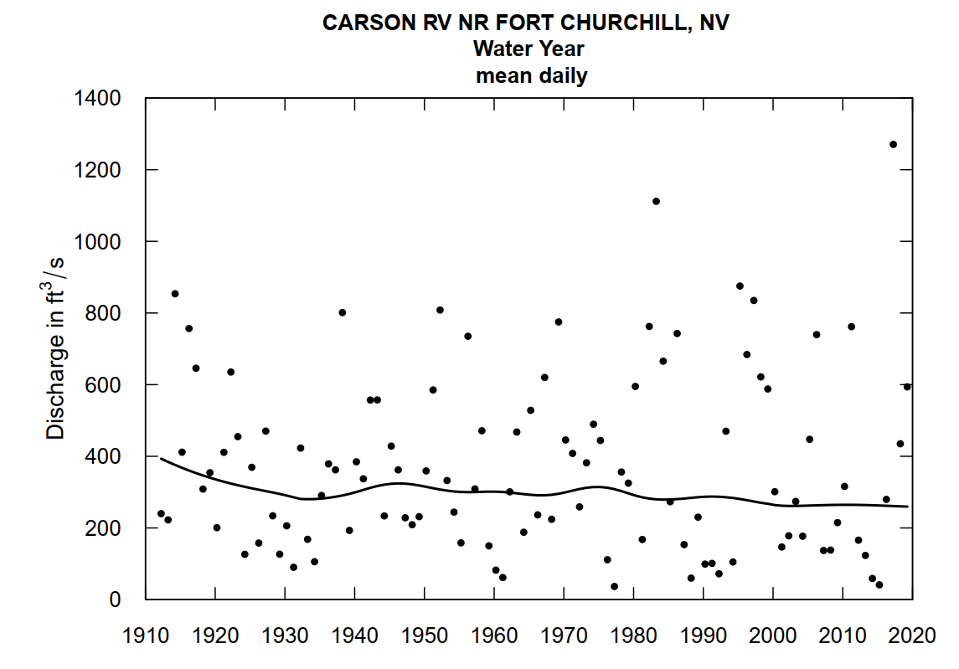

Slide 4
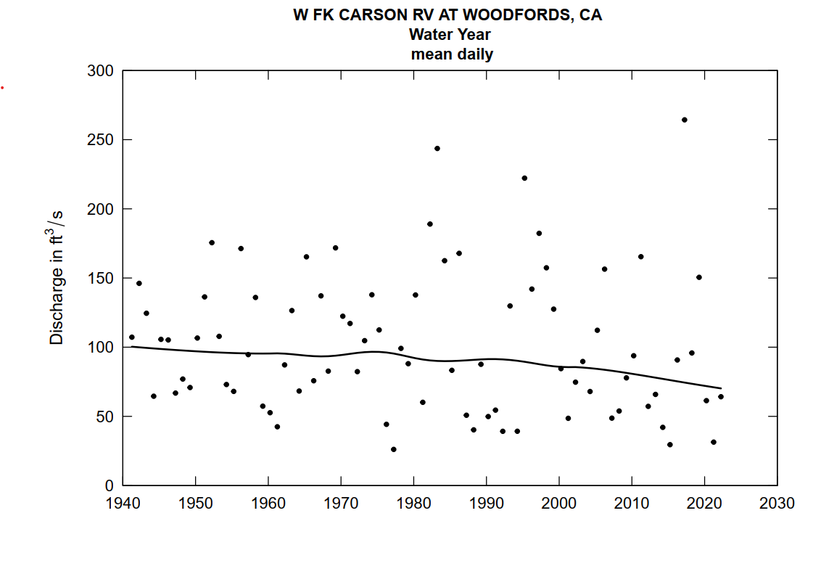

Slide 5
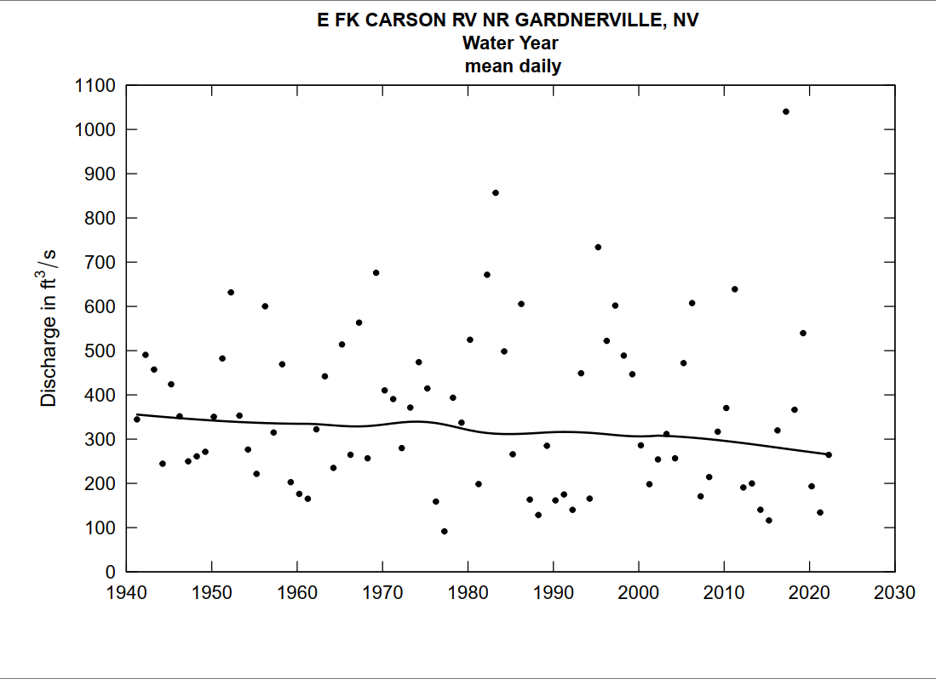

Slide 6
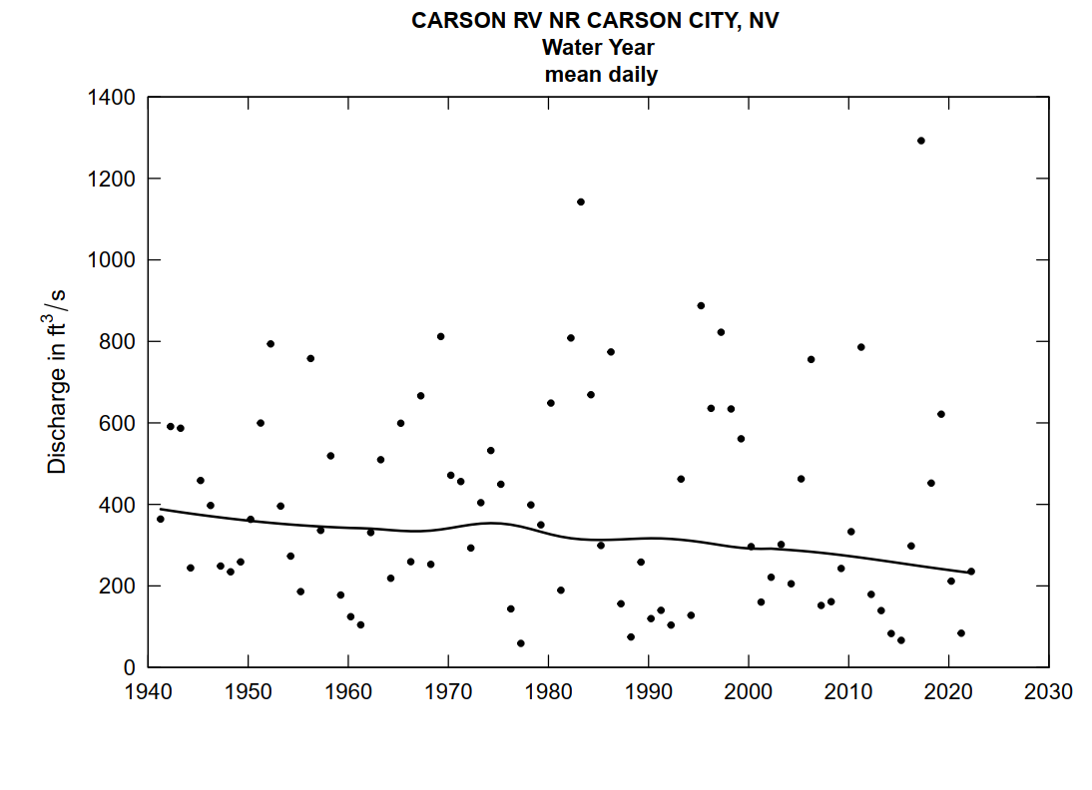

Slide 7
Instream Flows - 1940 to 2018
Flows are highly variable
On average, flows are slowly decreasing in each river stretch
Location | WF at Woodfords | EF near Gardnerville | EF +WF | CR near Carson City | CR near Fort Churchill*
USGS Station # | 10310000 | 10309000 |  | 10311000 | 10312000
Annual Average Flow, CFS | 103.0 | 365.4 | 468.3 | 401.1 | 377.4
Annual Flow Standard Deviation, CFS | 50.2 | 181.3 |  | 256.4 | 258.4
Average Peak Day Flow, CFS | 1,150.7 | 3,599.5 |  | 4,178.8 | 3,278.8
Peak Day Flow Standard Deviation, CFS | 1,253.8 | 3,579.0 |  | 5,544.0 | 3,700.5
% Average Annual Change in Flow | -0.10% | -0.05% | -0.06% | -0.12% | -0.05%
% Average Change in Flow between 1940 and 2018 | -7.91% | -4.03% | -4.88% | -8.99% | -3.74%
*Data trends from Ft Churchill gauge are not statistically significant and should be interpreted as such

Slide 8
Plan Overview:
Background
To meet the needs of the watershed in the next 30 years, CWSD has partnered with Lumos & Associates and USGS to do a deep dive in to water demand, water rights, and water production - pertaining to the 13 water purveyors in the watershed.

Slide 9
Process
Lumos & Assoc. gathers information and data to estimate M&I demand for each purveyor in the watershed.
demand in the Carson Watershed.
Accumulated data will be given to USGS to be inserted into their model. USGS will cultivate model and run a multitude of scenarios.
Results will be assessed to provide mitigation plans that can potentially circumvent issues based on the findings of USGS model.
Data Collection

Slide 10
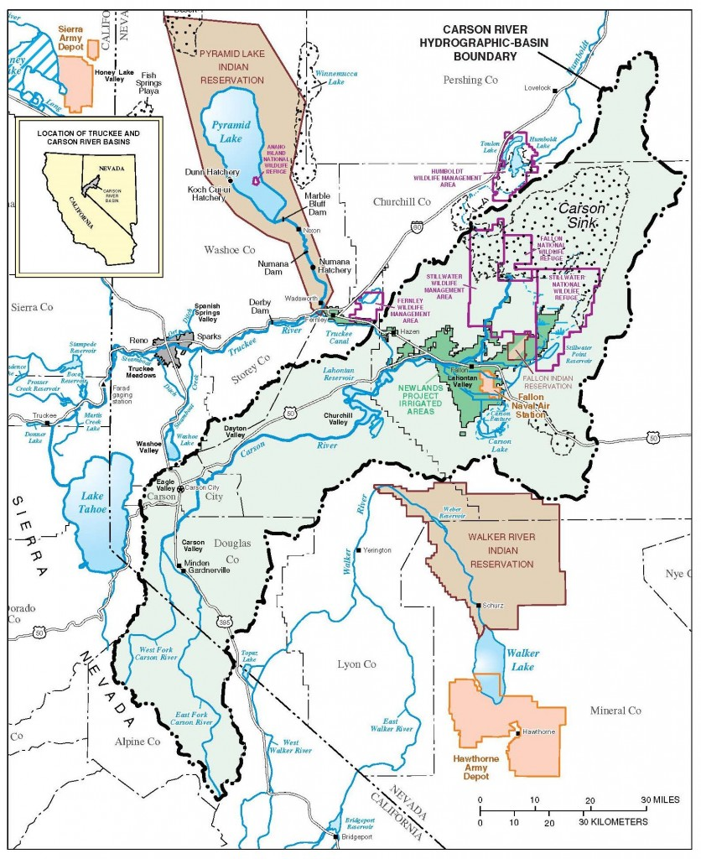
Upper Watershed
&
Lower Watershed
Notes:
This references all the demands and their effects. From up stream all the way to the bottom. Carson, Eagle, Dayton and Chruchill Valley. Not forgeting about Carson Desert/sink - those will come later. We are focusing on upper and middle thorough Stagecoach.
We will look at upstream agriculture, municipal, and industrial water demand in the future and understand the effects on the Carson River.

Slide 11
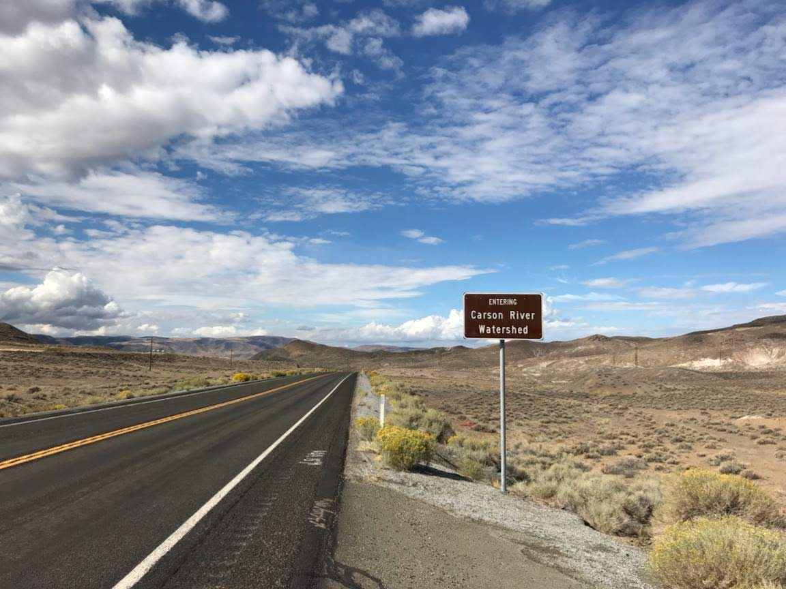
Purveyors
Minden Gardnerville Sanitation District
Town of Minden
Lyon Counties Utility - Dayton/Moundhouse
Indian Hills General Improvement District
Gardnerville Water Company
Gardnerville Rancheros General Improvement District
City of Fallon
Douglas County Public Works
Churchill County Public Works
Carson City Public Works
Silver Springs Mutual Water Company
Stagecoach General Improvement District
Storey County Public Works
Range of population growth
0.1-0.8%

Slide 12
Historical Trends In River Discharge and Preliminary Projections

Slide 13
CARSON VALLEY

Slide 14
Historical Pumping

Slide 15
Preliminary Projection

Slide 16
EAGLE VALLEY

Slide 17
Historical Pumping

Slide 18
Preliminary Projection
Notes:
Carson Growth Primarily from Marlette System.

Slide 19
DAYTON VALLEY

Slide 20
Historical Pumping

Slide 21
Preliminary Projection
Notes:
Most growth opportunity in Lyon County

Slide 22
Churchill Valley

Slide 23
Historical Pumping
Notes:
There may be a bigger increase of domestic wells

Slide 24
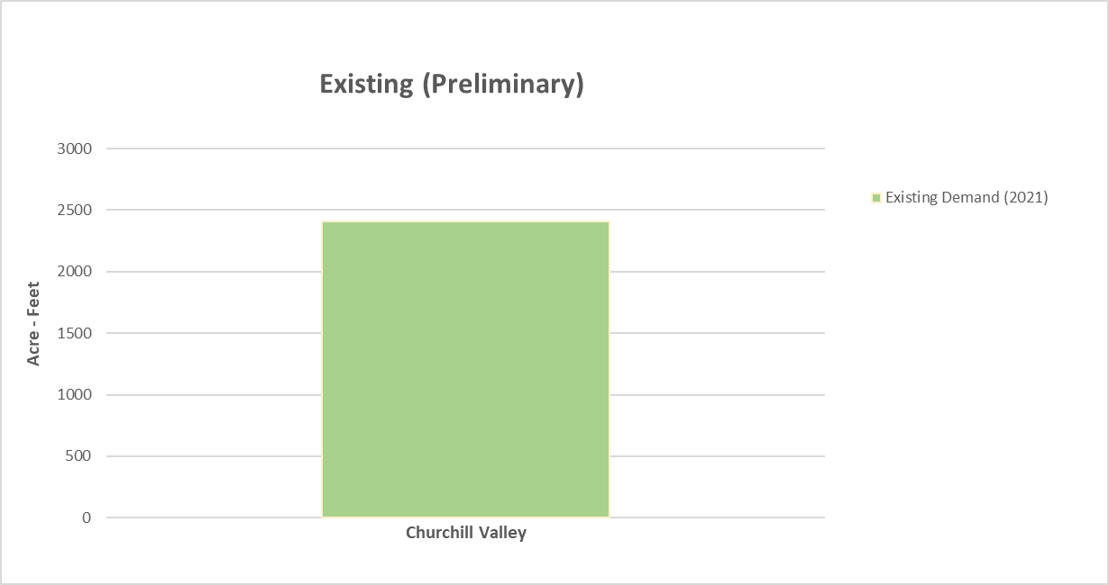
Preliminary Projection
There is little (75ac-ft) predicted growth that will come from the service area in Silver Springs.
Domestic wells are predicted to increase following current trends (undetermined amount)
A new water source will have to be considered in order to see growth in Churchill Valley
Notes:
Most growth opportunity in Lyon County

Slide 25
OTHER CONSIDERATIONS
AGRICULTURE
Changes in agriculture and agriculture management.
Model Accuracy
This is an estimation – needs will have to be revisited frequently and updated
WEATHER TRENDS
Consecutive dry years
Abundant changes in the seasonal mean

Slide 26
Irrigation Pumping in Carson Valley
1987-2020

Slide 27
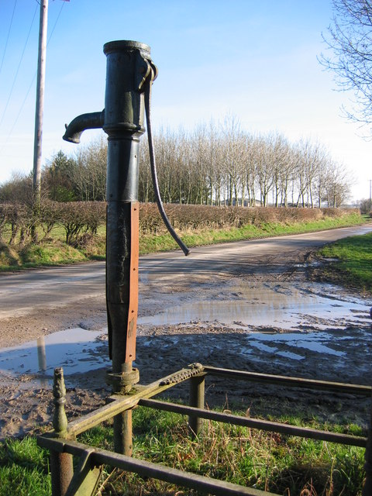
Plan Goals
Determine if there are sufficient water rights and infrastructure in place.
Understand the effects of future demand and river discharge
Recommend possible mitigation on related to future water demands

