Slide 1
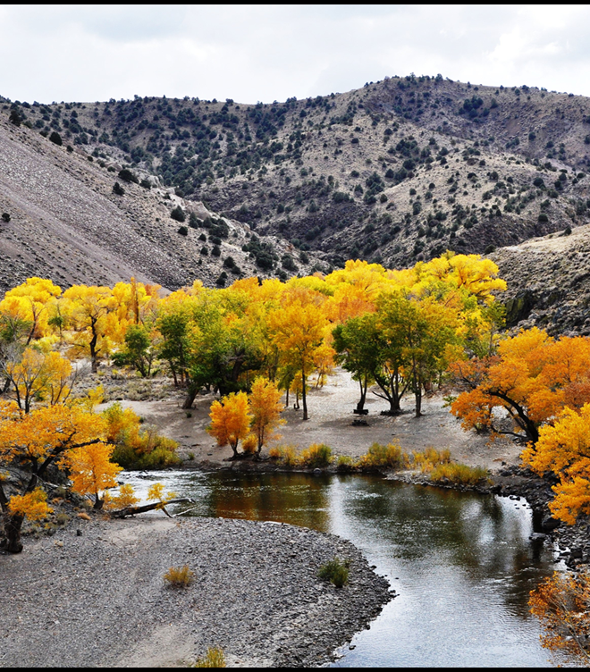
Carson River Master Plan Amendment
Lyndsey Boyer, Open Space Manager Marenna Lovejoy, Senior Natural Resource Specialist Carson River Watershed Forum, March 5-6, 2024

Slide 2
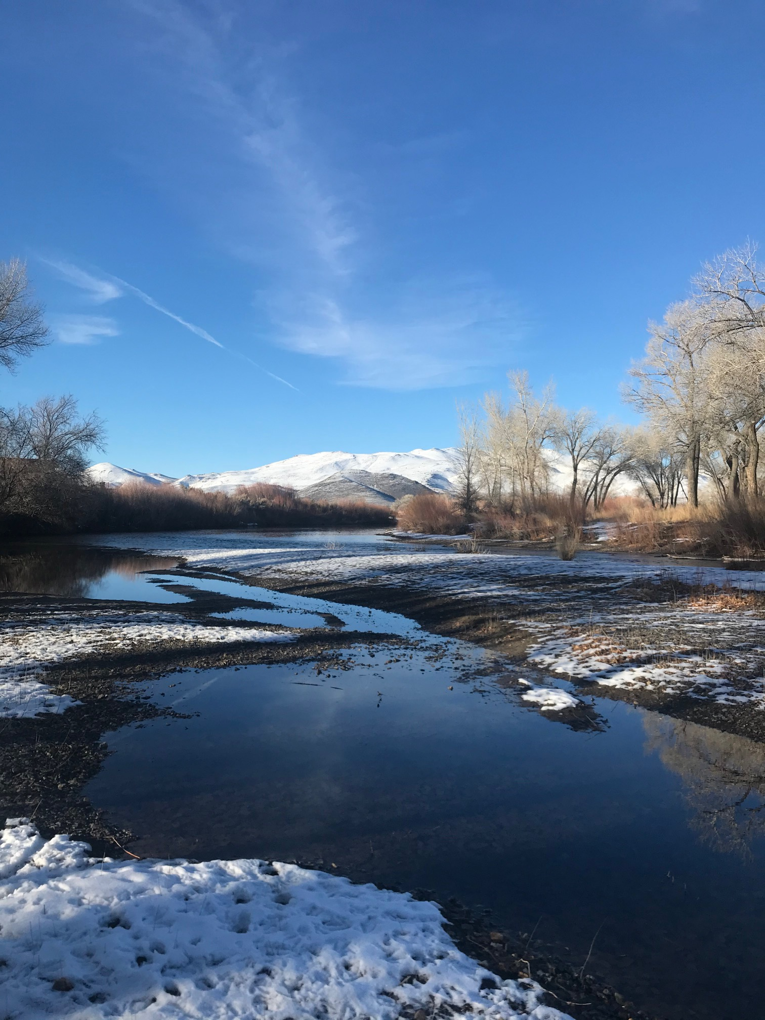
History – “Carson River Corridor”
Planning
1993 - Proposed by a Carson City Board of Supervisor (BOS)
13-member steering committee.
Theme: public access to River
1994 - Carson River Workshop
Over 100 attendees
April 7, 1994 - BOS adopted A Resolution of Support of Planning for the Future of the Carson River
Led to the creation of the Carson River Advisory Committee.
In memory of Kay Bennett, BOS and visionary for the Carson River

Slide 3
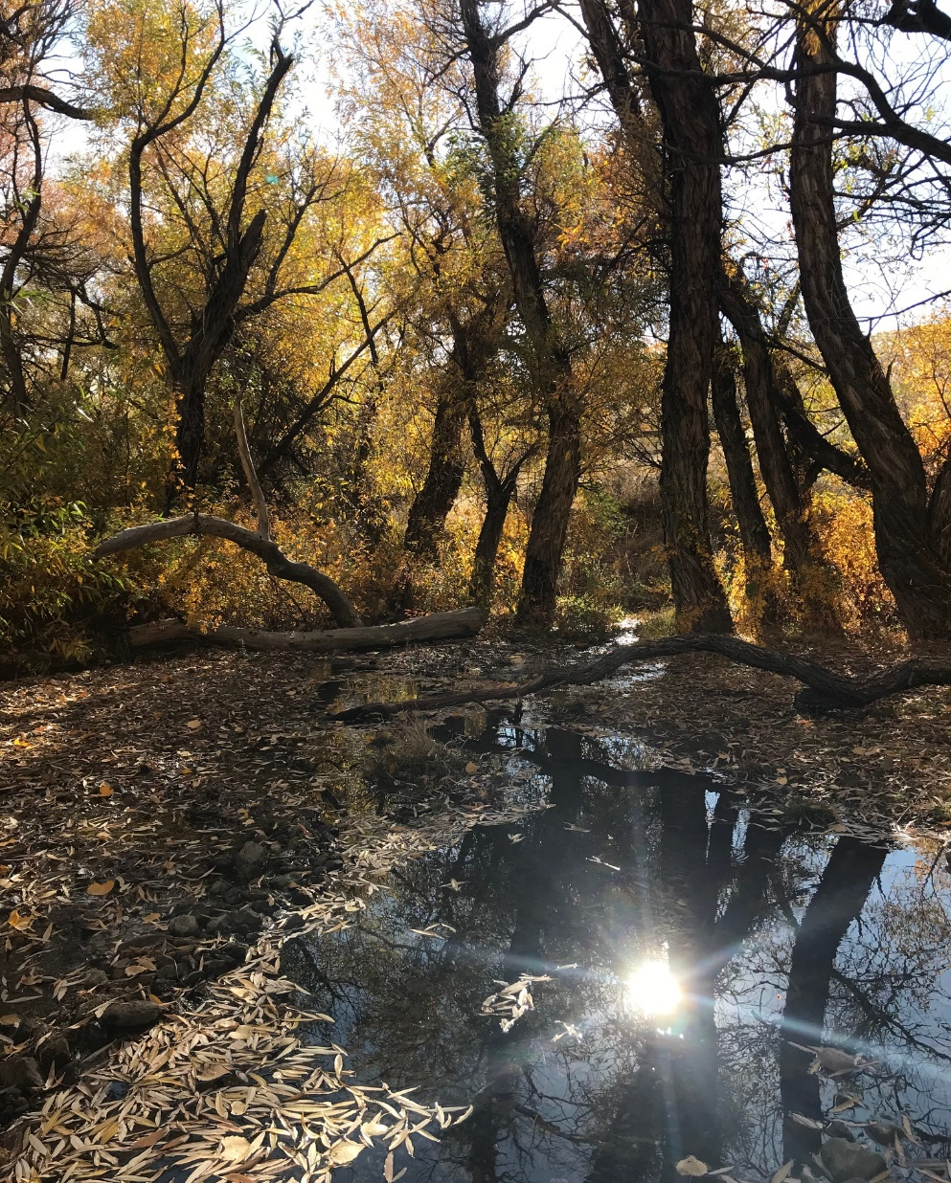
Carson River Advisory Committee
1994 resolution - 9 members
Committee Goals:
Promote committee
Develop plans for”
Safety /security for the public
Wildlife
Natural resources on public and private lands
Private land policies
Funding sources
Protect & enhance wildlife habitat
Protect cultural resources

Slide 4
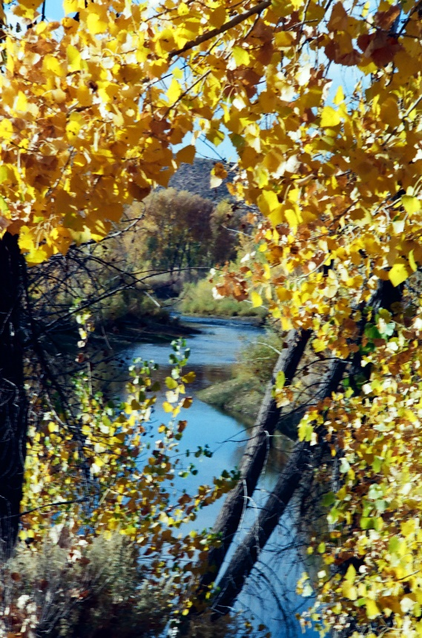
Carson River Advisory Committee
Committee Goals Continued:
Review and recommend ordinances, laws, or regulations related to River
Review development plans
Establish interpretation/ environmental education programs
Promote/ establish working relationships with all other agencies/ groups

Slide 5
Carson River Advisory Committee
Dissolved in 2013 after
17-year operation
Duties now under the Open Space Advisory Committee (OSAC)
Carson River Master Plan
written 1996

Slide 6
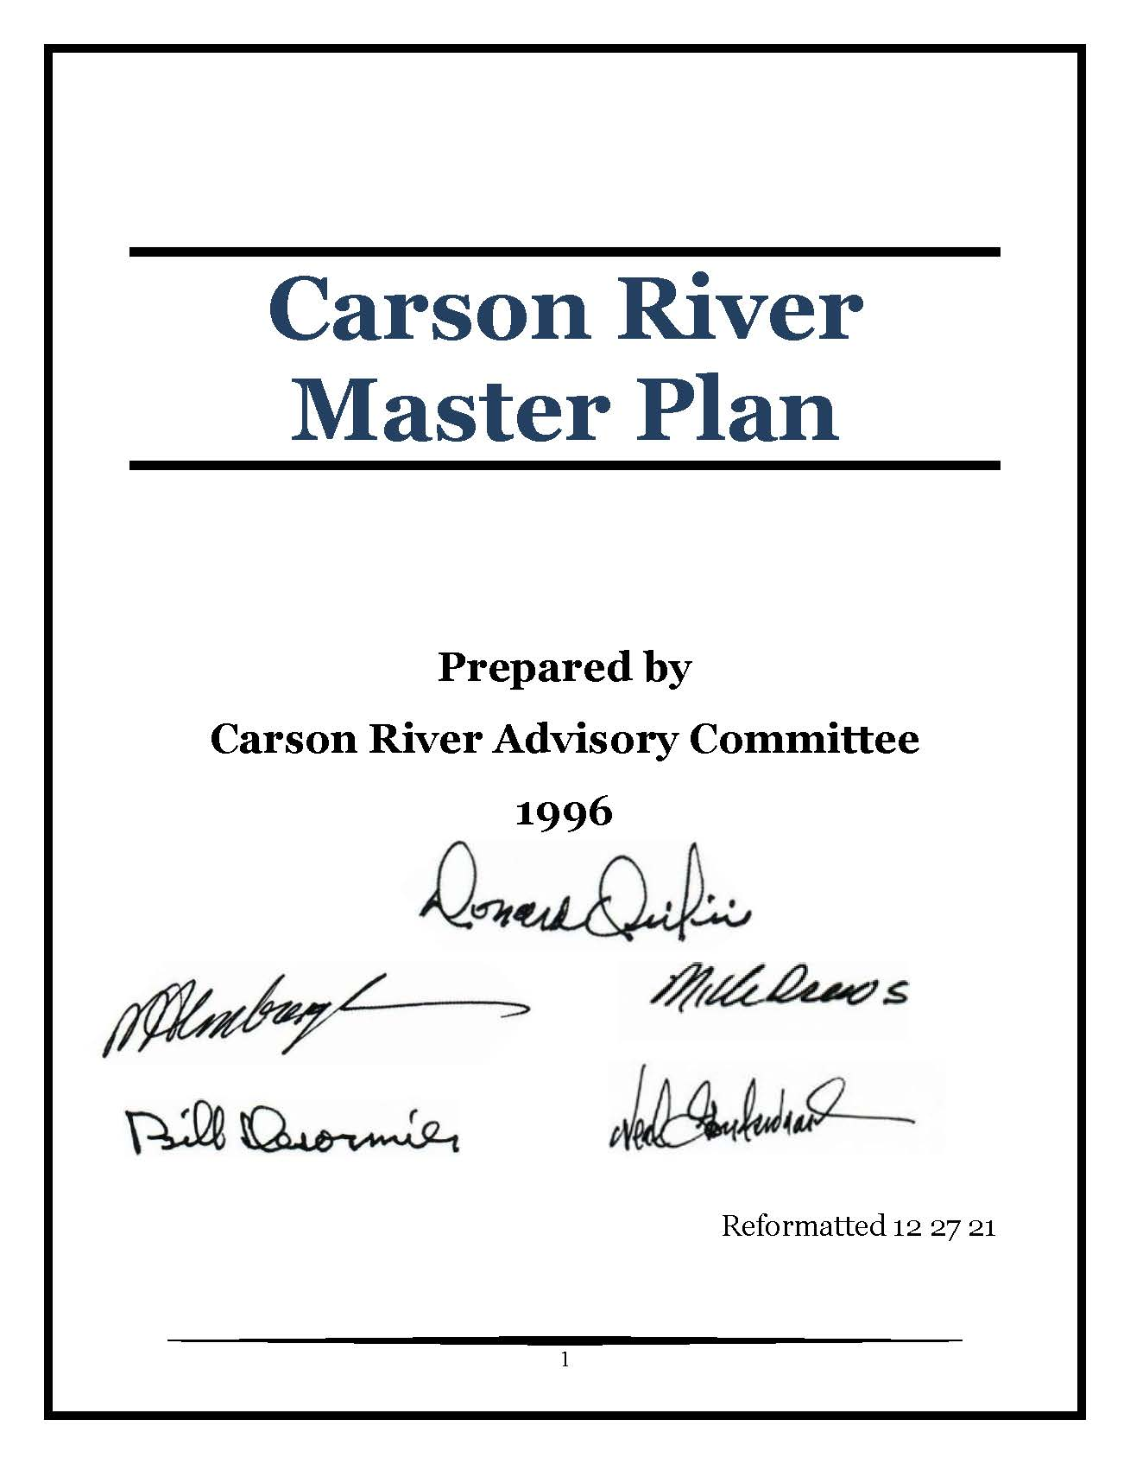
Carson River Master Plan Goals
“Carson River Corridor”
Land acquisitions → Open Space program
ID wildlife conservation opportunities
Balance recreation with natural/cultural resources conservation
Minimize impacts to water quality/river health from urbanization
Environmental education opportunities

Slide 7
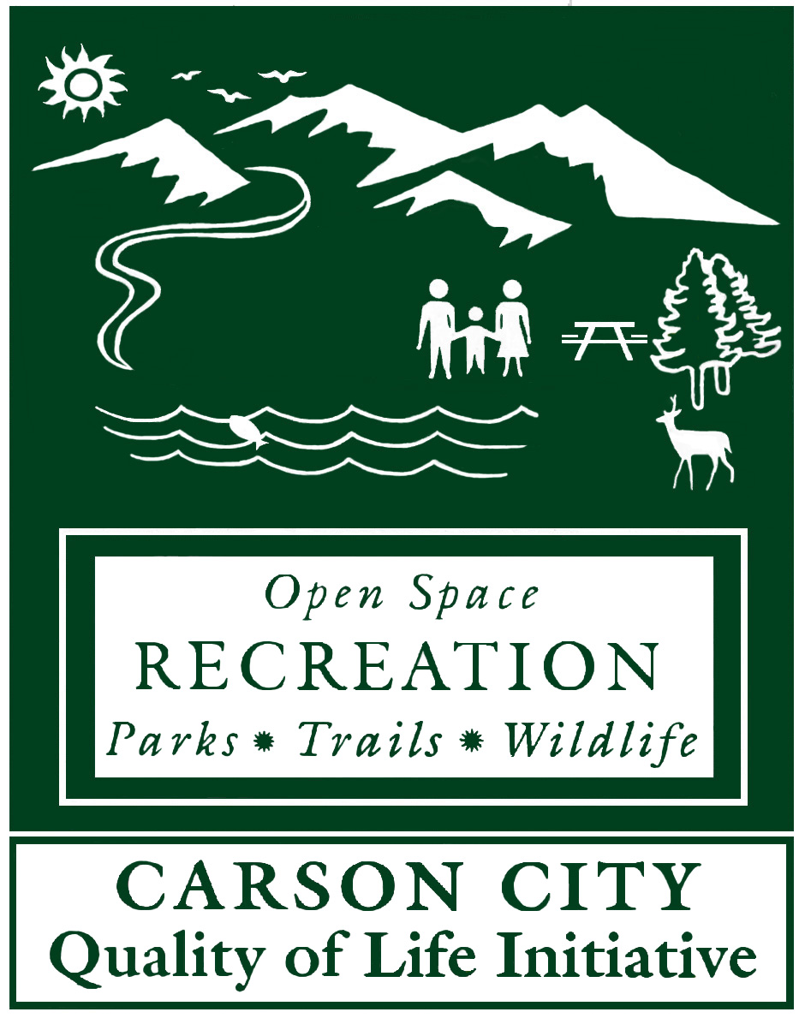
Open Space Program est. 1996
Quality of Life Initiative “Question 18”
Passed by Carson City voters in 1996.
Grassroots effort
Increased sales tax by ¼ of 1%
40% - open space
40% - parks capital
20% - park maintenance

Slide 8
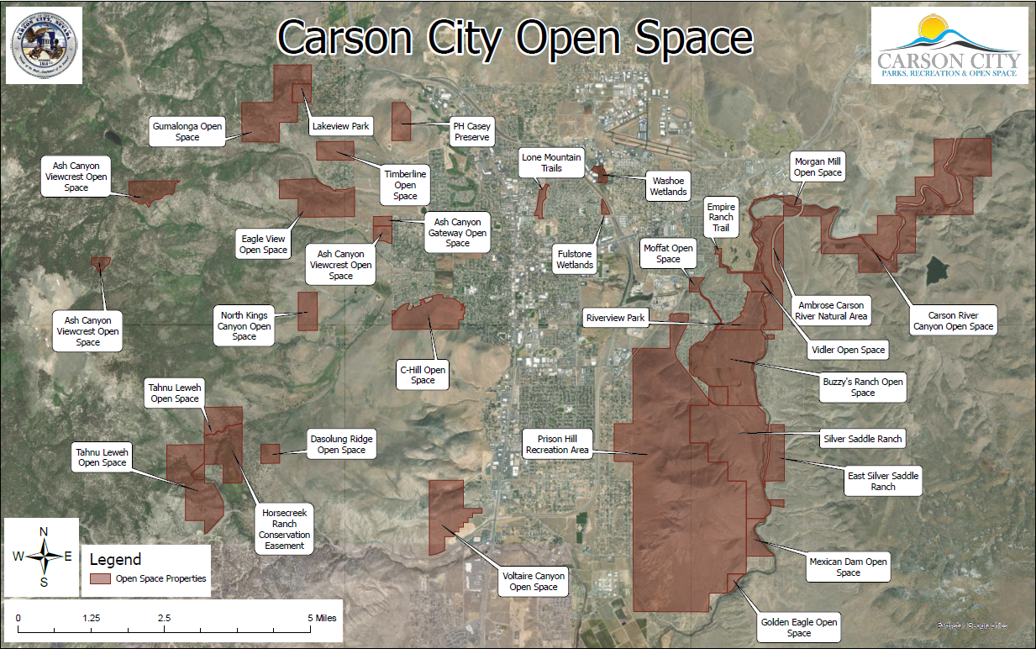
Open Space Program est. 1996
Since 1996 Carson City has worked to preserve and protect over 7,000 acres of undeveloped open space lands, including ~11 miles of Carson River corridor.

Slide 9
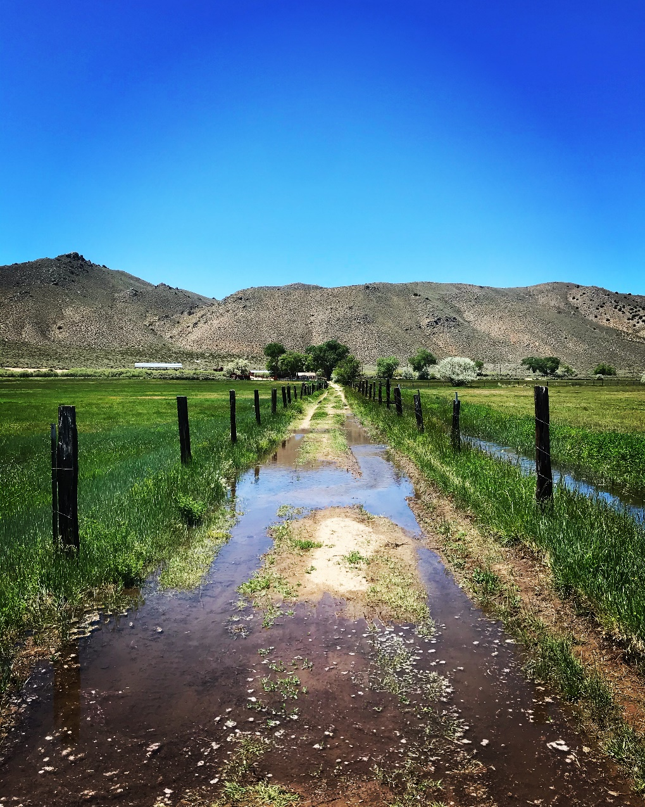
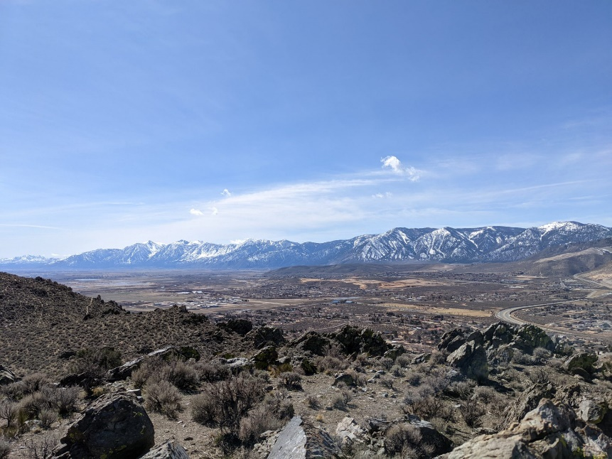
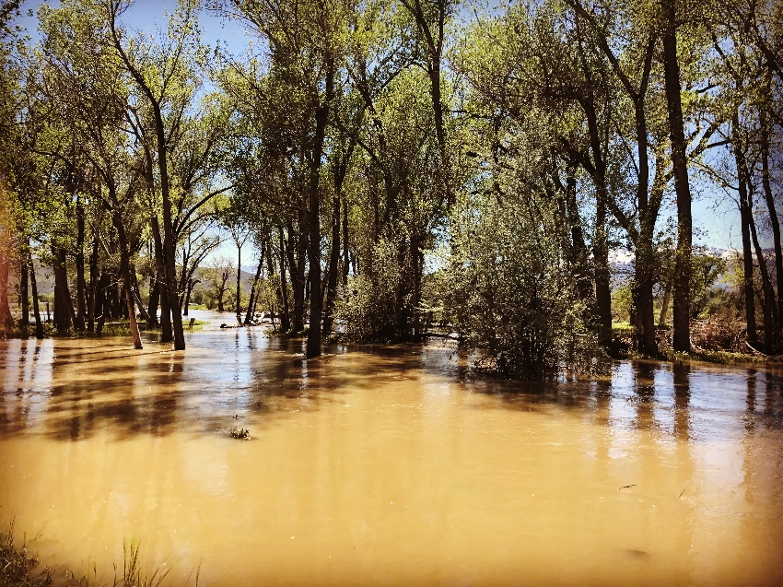
Open Space Program est. 1996
Agricultural lands
Viewsheds
Floodplains

Slide 10
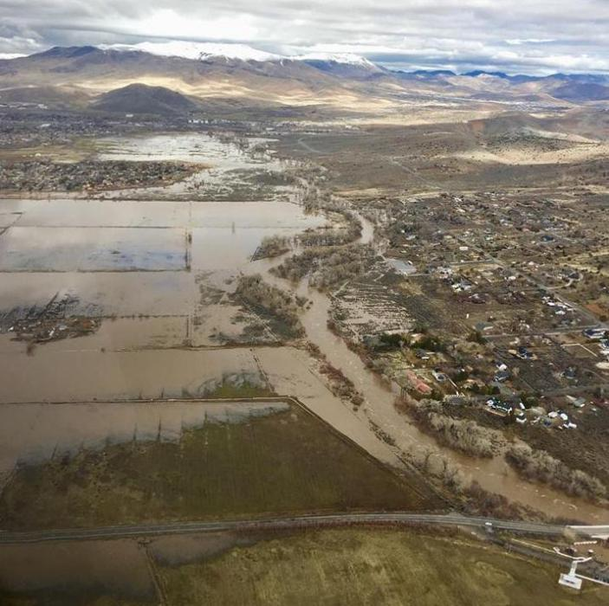
Open Space Prevents flood damage

Slide 11
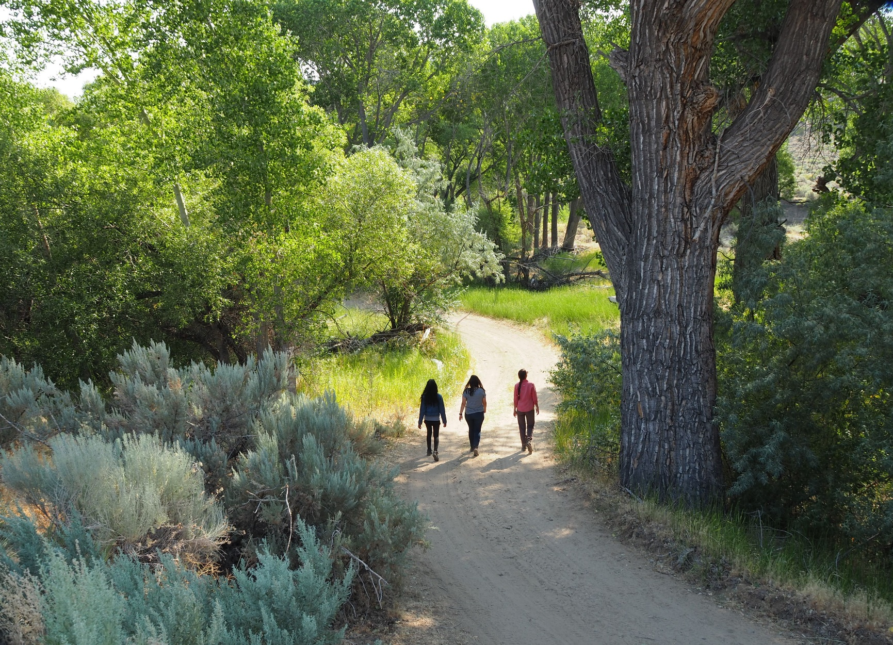
Terrestrial Recreation
Notes:
Good morning, everyone! My name is Gregg Berggren and I’m the Trails Coordinator for Carson City. Thank you for inviting me to talk about my favorite subject!.

Slide 12
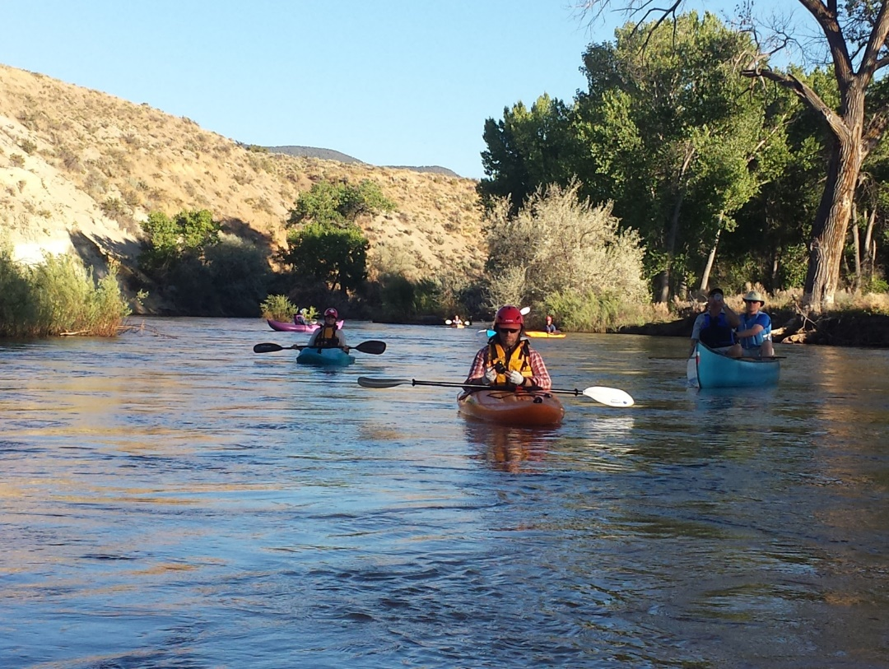
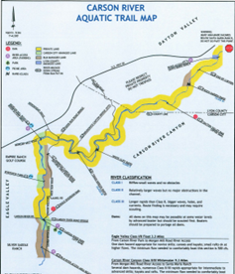
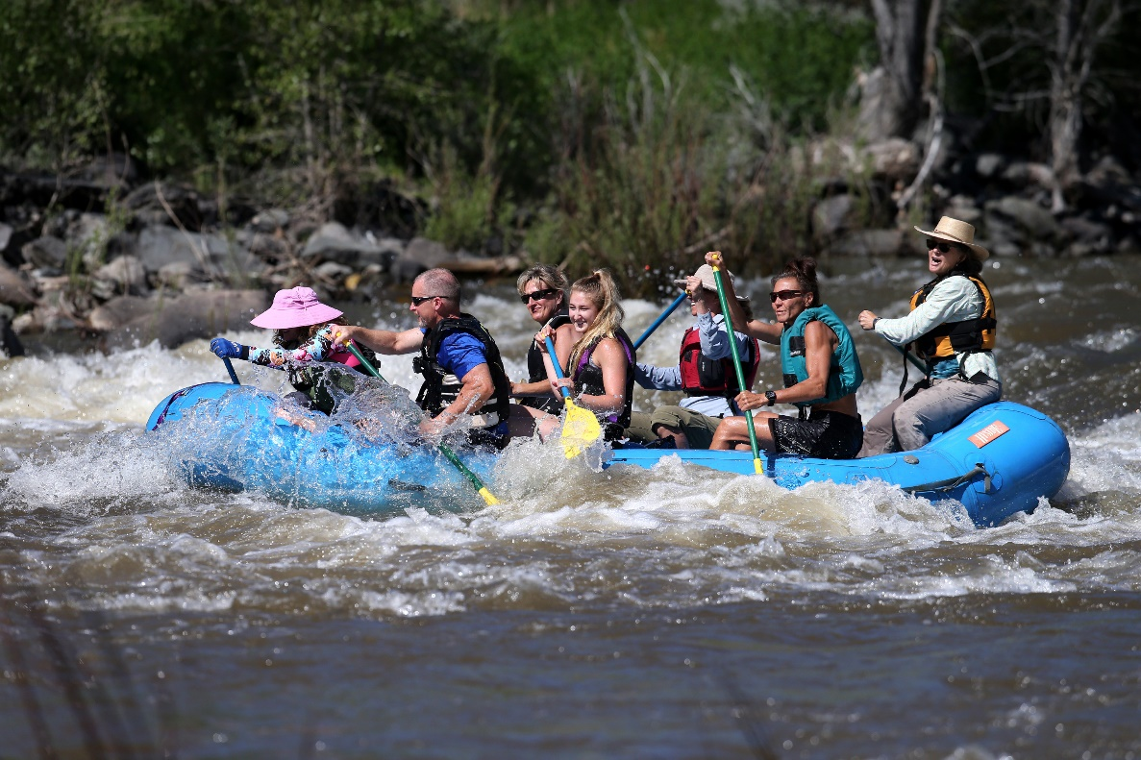
Carson River Aquatic Trail
Almost 14 miles from the Mexican Dam to Dayton…
…4.4 miles of flatwater and 9.3 miles of Class II and III rapids
Notes:
And of course, even here in the Great Basin Desert, we are fortunate to have an aquatic trail.
From Mexican Dam to Dayton, 4.4 miles of flatwater and 9.3 miles of Class II/III rapids.
Some of you here today likely helped establish this trail - some Andy Aldex Award recipients…Bruce Scott, Lynn Zonge, Juan Guzman, Mark Kimbrough. Show of hands...who was a part of establishing the Aquatic Trail?
CWSD has RTP grant funding to construct a take-out just above the dam to enable portage using the new bridge with the hope of someday expanding the trail into Carson Valley.

Slide 13
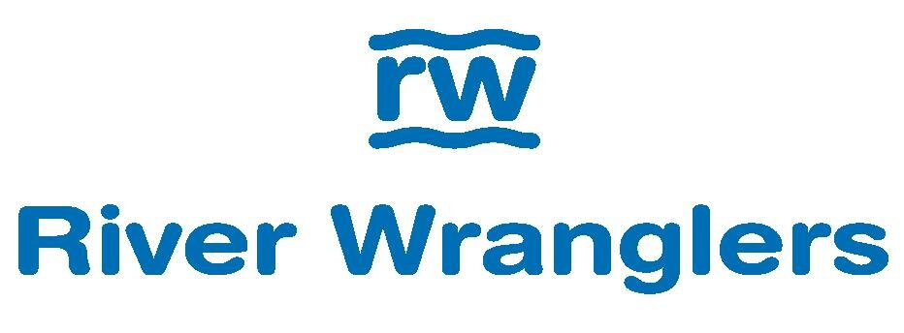
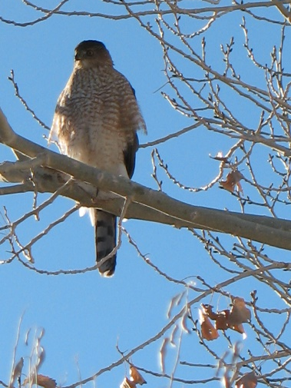
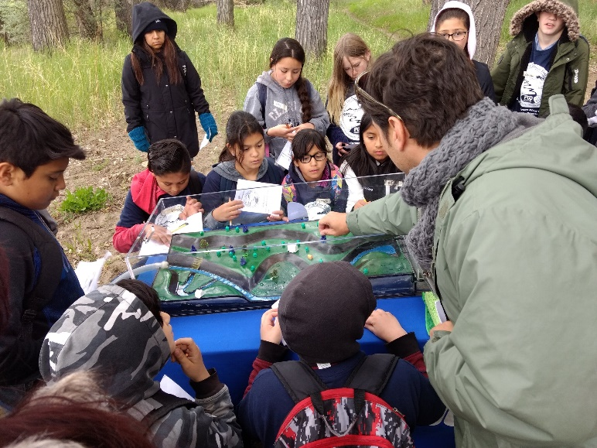
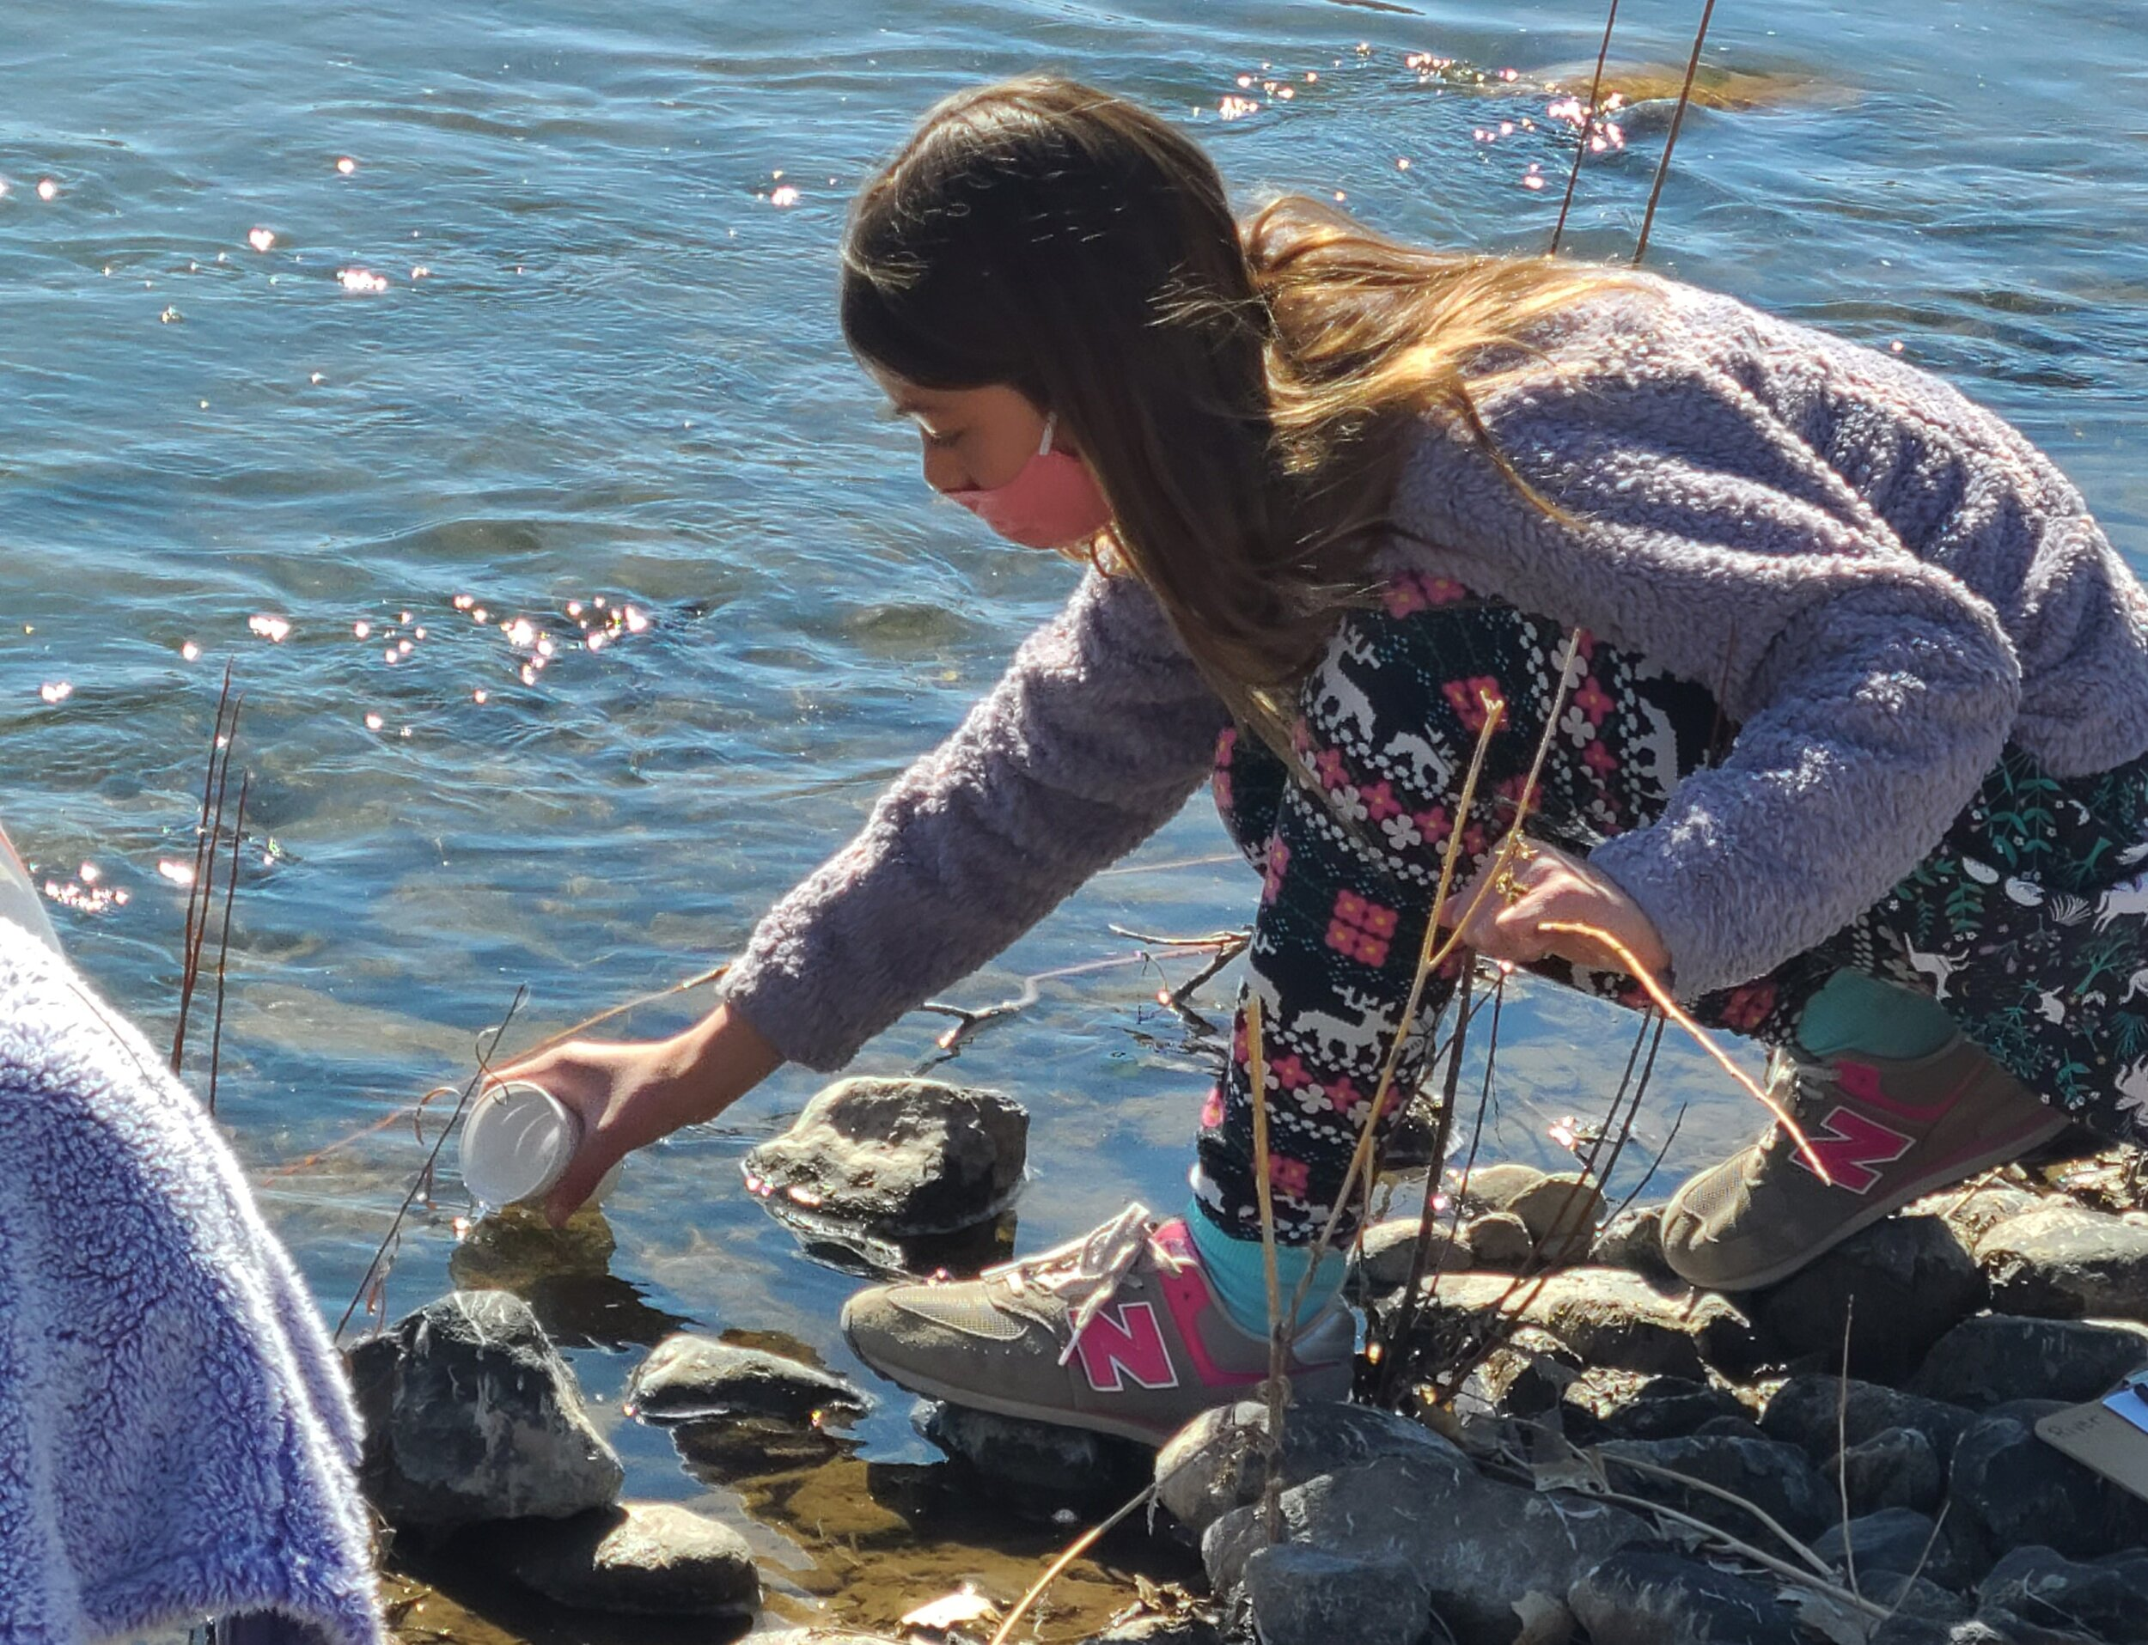
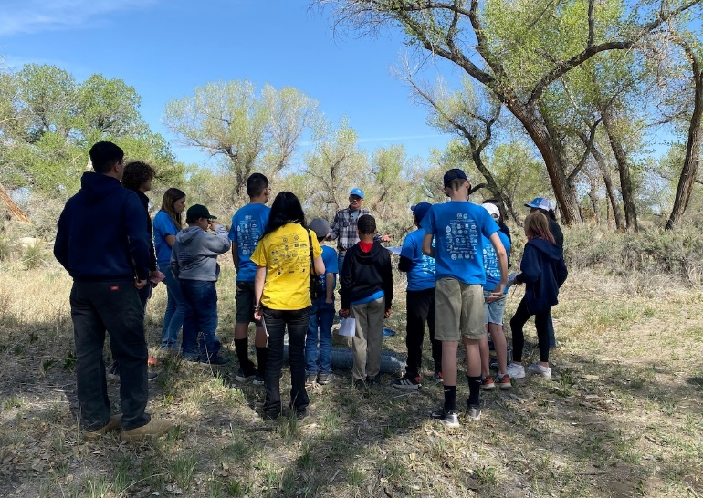
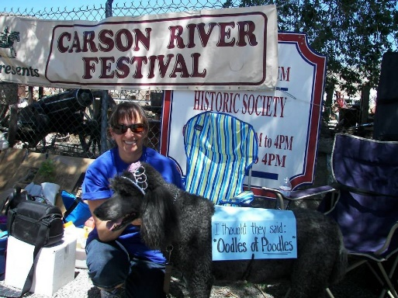
Carson River Conservation and Education
Many safe, accessible & diverse education sites
Snap Shot Days on the River
River Clean-up days

Slide 14
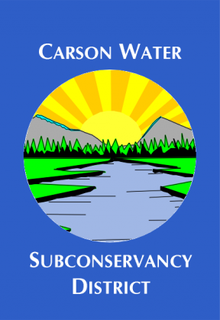
Carson River Master Plan Update
Technical assistance grant; NPS- Rivers, Trails Conservation Assistance Program
Process development & organization (2023/2024)
Partner/public engagement (2024)
Consultant (hybrid model)
Assistance with Field surveys/ technical components (2024)
Assistance with Writing of new plan (2024/2025)

Slide 15
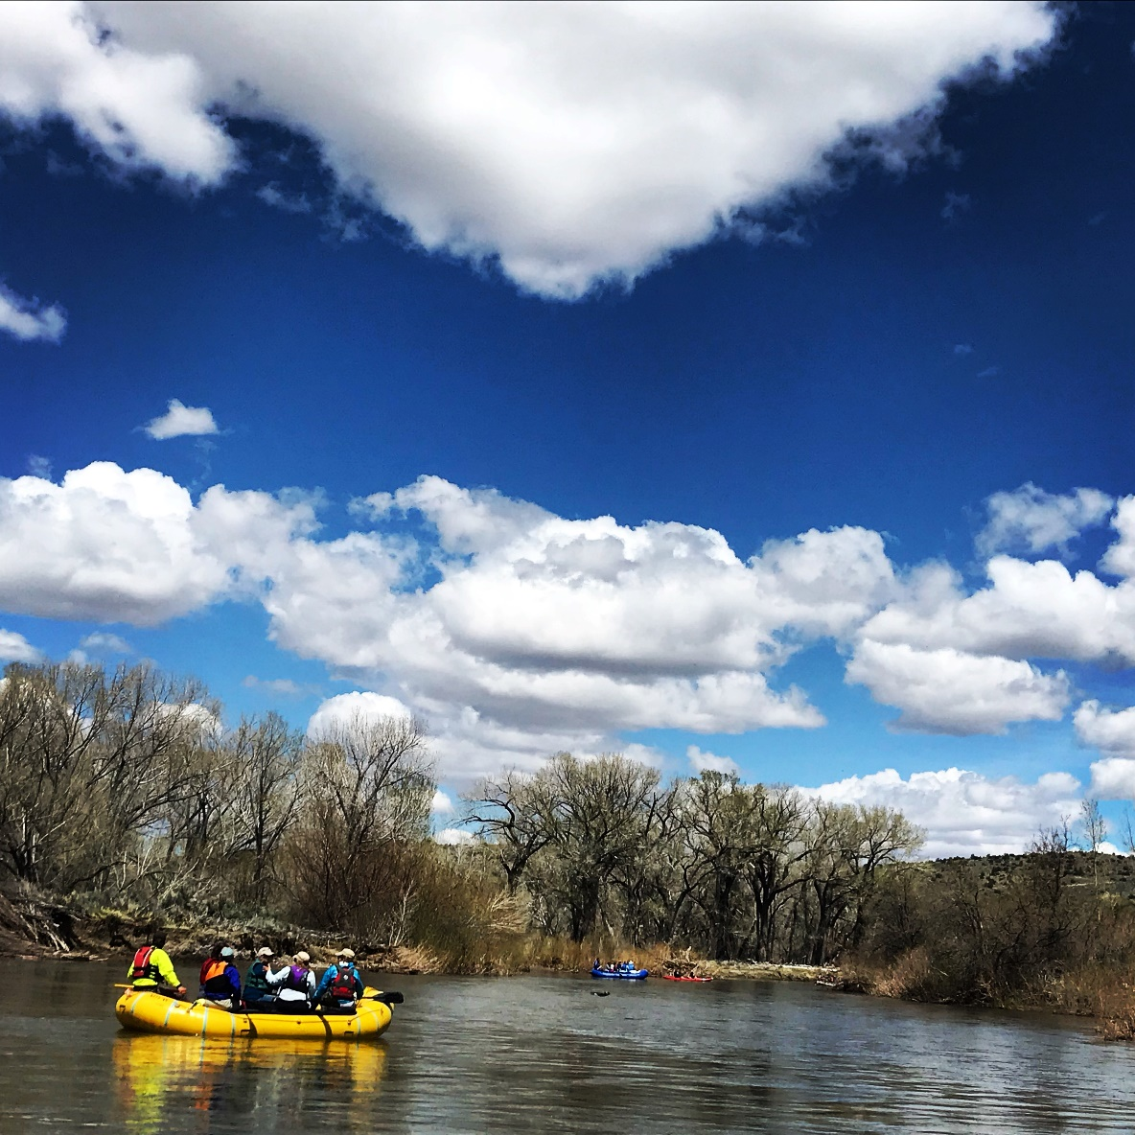
Carson River Master Plan
Elements to add to updated Carson River Master Plan
current condition of river (2024/2025)
Areas for restoration
Current recreation uses & demand (2024/2025)
How public concerns from 1996 workshop have been addressed
How environmental/natural and cultural resource concerns identified in 1996 have been addressed
Notes:
This slide should discuss:
- geomorphology of river/ areas that need attention/restoration
Carson river canyon has whole network of roads where you can drive right into river
Bank stabilization (e.g. buzzy’s ranch trail)
Recreation opportunities/impvorements (access, limiting access, etc); what we’ve done and what could be done
Aquatic trail enhancements (take out built above Dam, signage, awareness)
Updating the status of recreation (since plan was made we have added tons of trails)
*** won’t be much emphasis/updsates on wildlife & their habitat because that likely hasn’t changed; though we may want to discuss certain species like western pond turtles; more imperiled species compated to 1996 plan (e.g. fish species)

Slide 16
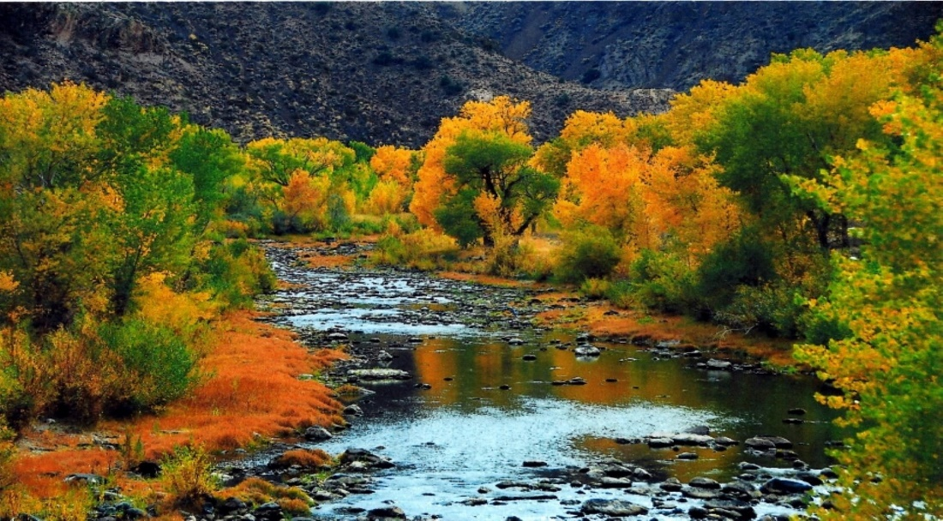
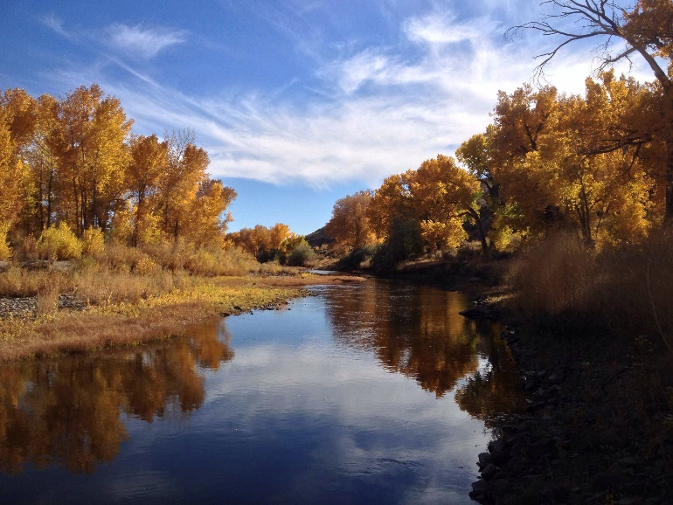
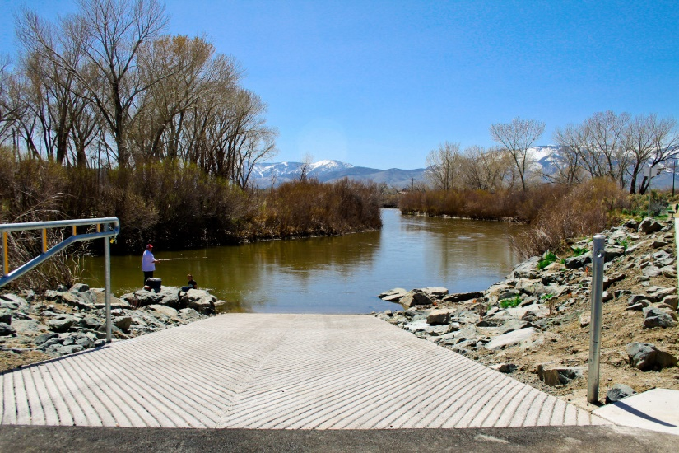
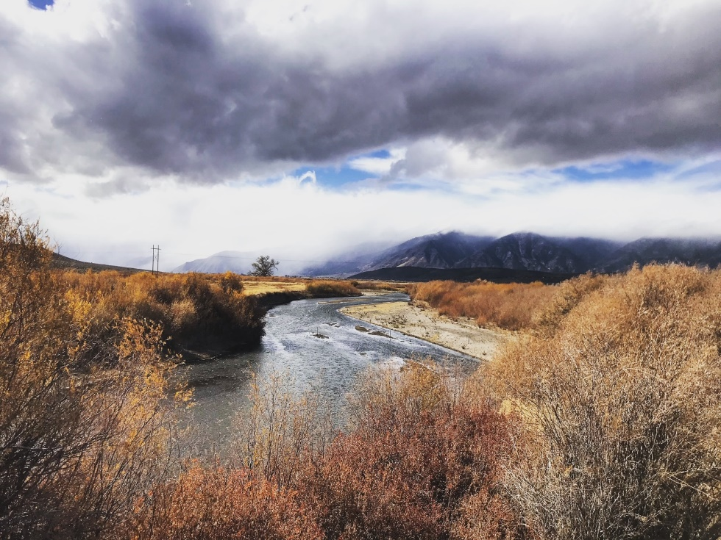
Questions?
Notes:
Thank you for inviting Lyndsey and me here today. Are there any questions for either of us?

