Slide 1
Lompa Ranch Flood Volume Mitigation – A Multi-Benefit Carson City / Developer Partnership
Carson City, NV
March 5, 2024

Slide 2
The Project
September 5, 2023

Slide 3
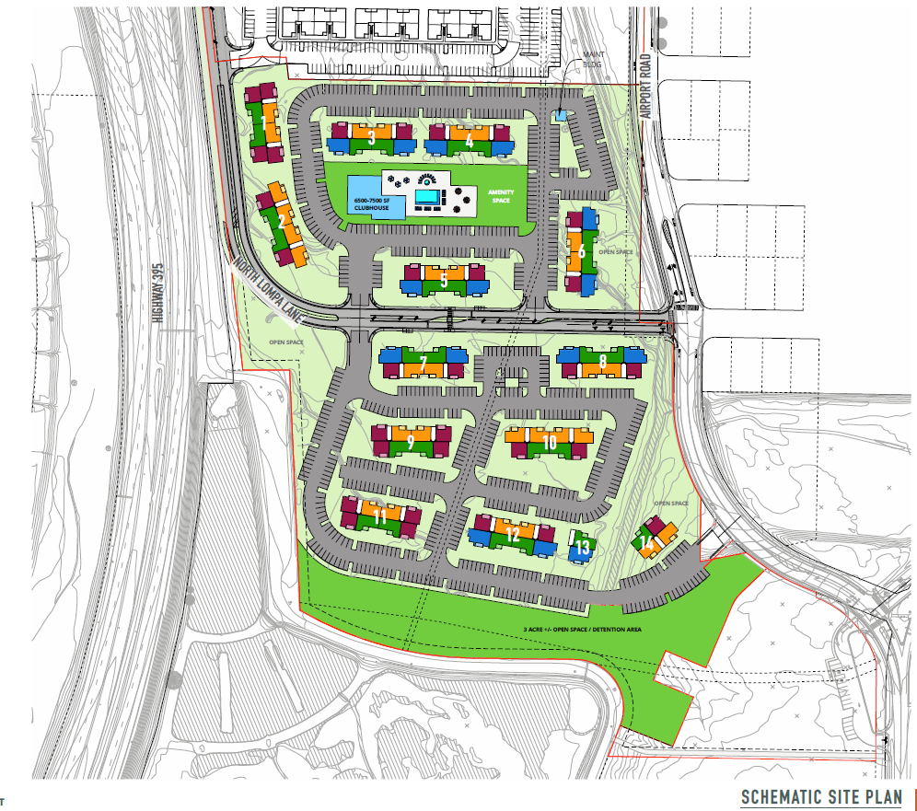
Lompa Ranch Apartments

Slide 4
Floodplain Development Criteria
September 5, 2023

Slide 5
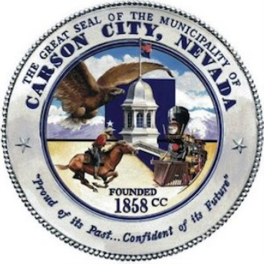
Carson City Requirements
12.09.080 Provisions for flood hazard reduction.
Elevation Requirements for Lowest Floor
1.c.(3)In all other zones, elevated at least two (2) feet above the base flood elevation.
9.Protection of Floodplain Storage Capacity. …the space occupied by the authorized fill or structure …shall be compensated for and balanced by a hydraulically equivalent volume of excavation...

Slide 6
Volume Mitigation Options
Notes:
Due to the project location and fill in the floodplain, we had to look into different volume mitigation options and find the best way to proceed.

Slide 7
West of town…
Several potential mitigation sites
Three preferred mitigation sites
Are preliminary jurisdictional determinations necessary?

Slide 8
Site 1A
No hydrophytic vegetation
No hydric soils
No wetland hydrology
Site 1B and 1C
Visual observation determined these sites were not in wetland areas.
Notes:
Two soil pits were dug, one in a clearly upland area, and one in a depressional relief that had ponded water and presented uncertainties as to whether the area would meet the three parameters.

Slide 9
Kings Canyon Overbank Area
Opportunity for volume mitigation here
Field visits conducted and site was analyzed –
Four cross sections along the site were analyzed
Encompassed depressional areas that may possess wetland features
Determination that there are no wetland indicators
Notes:
- City idea
Specify no wetland indicators in ‘mitigation area’

Slide 10
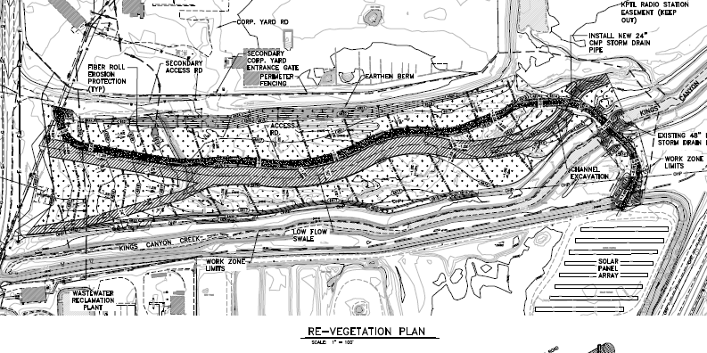
Kings Canyon Overbank Area
Previous Kings Canyon Channel Restoration Plans prepared by Robb Fellows, Dave Rosenkoetter
Notes:
City decided that they didn’t need this volume mitigation area to compensate for City projects

Slide 11
Refinements to Kings Canyon Restoration
Notes:
We had a great starting point with the plans we received from the City, but we did want to make some changes and refinements to tie this into our project…

Slide 12
KC Restoration Plan Refinements
Lower for greater connection to groundwater
Better connection between channel and overbank
No improvements in WOTUS
Notes:
- Lower for greater connection to GW
- Larger capacity for crossing of our overbank flow area
- No improvements within WOUS (inc channel crossing)
- Better connection between channel and overbank (per zoomed in above) – locations are previous washouts but now hardened (prior plans had repair to previous elevation)

Slide 13
Results

Slide 14
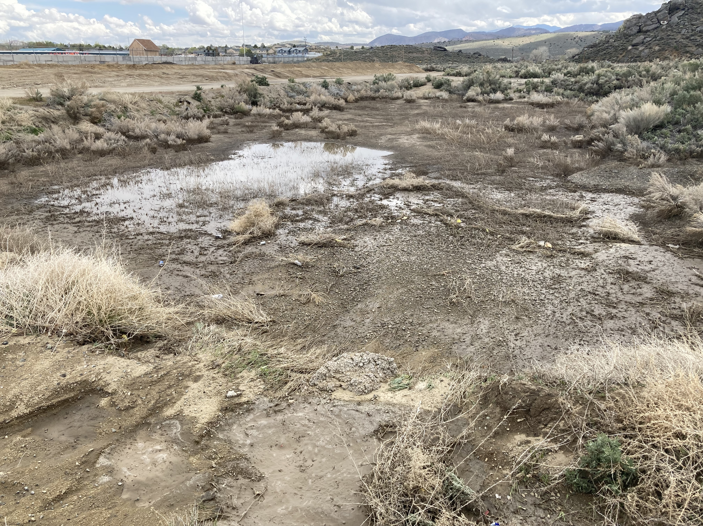
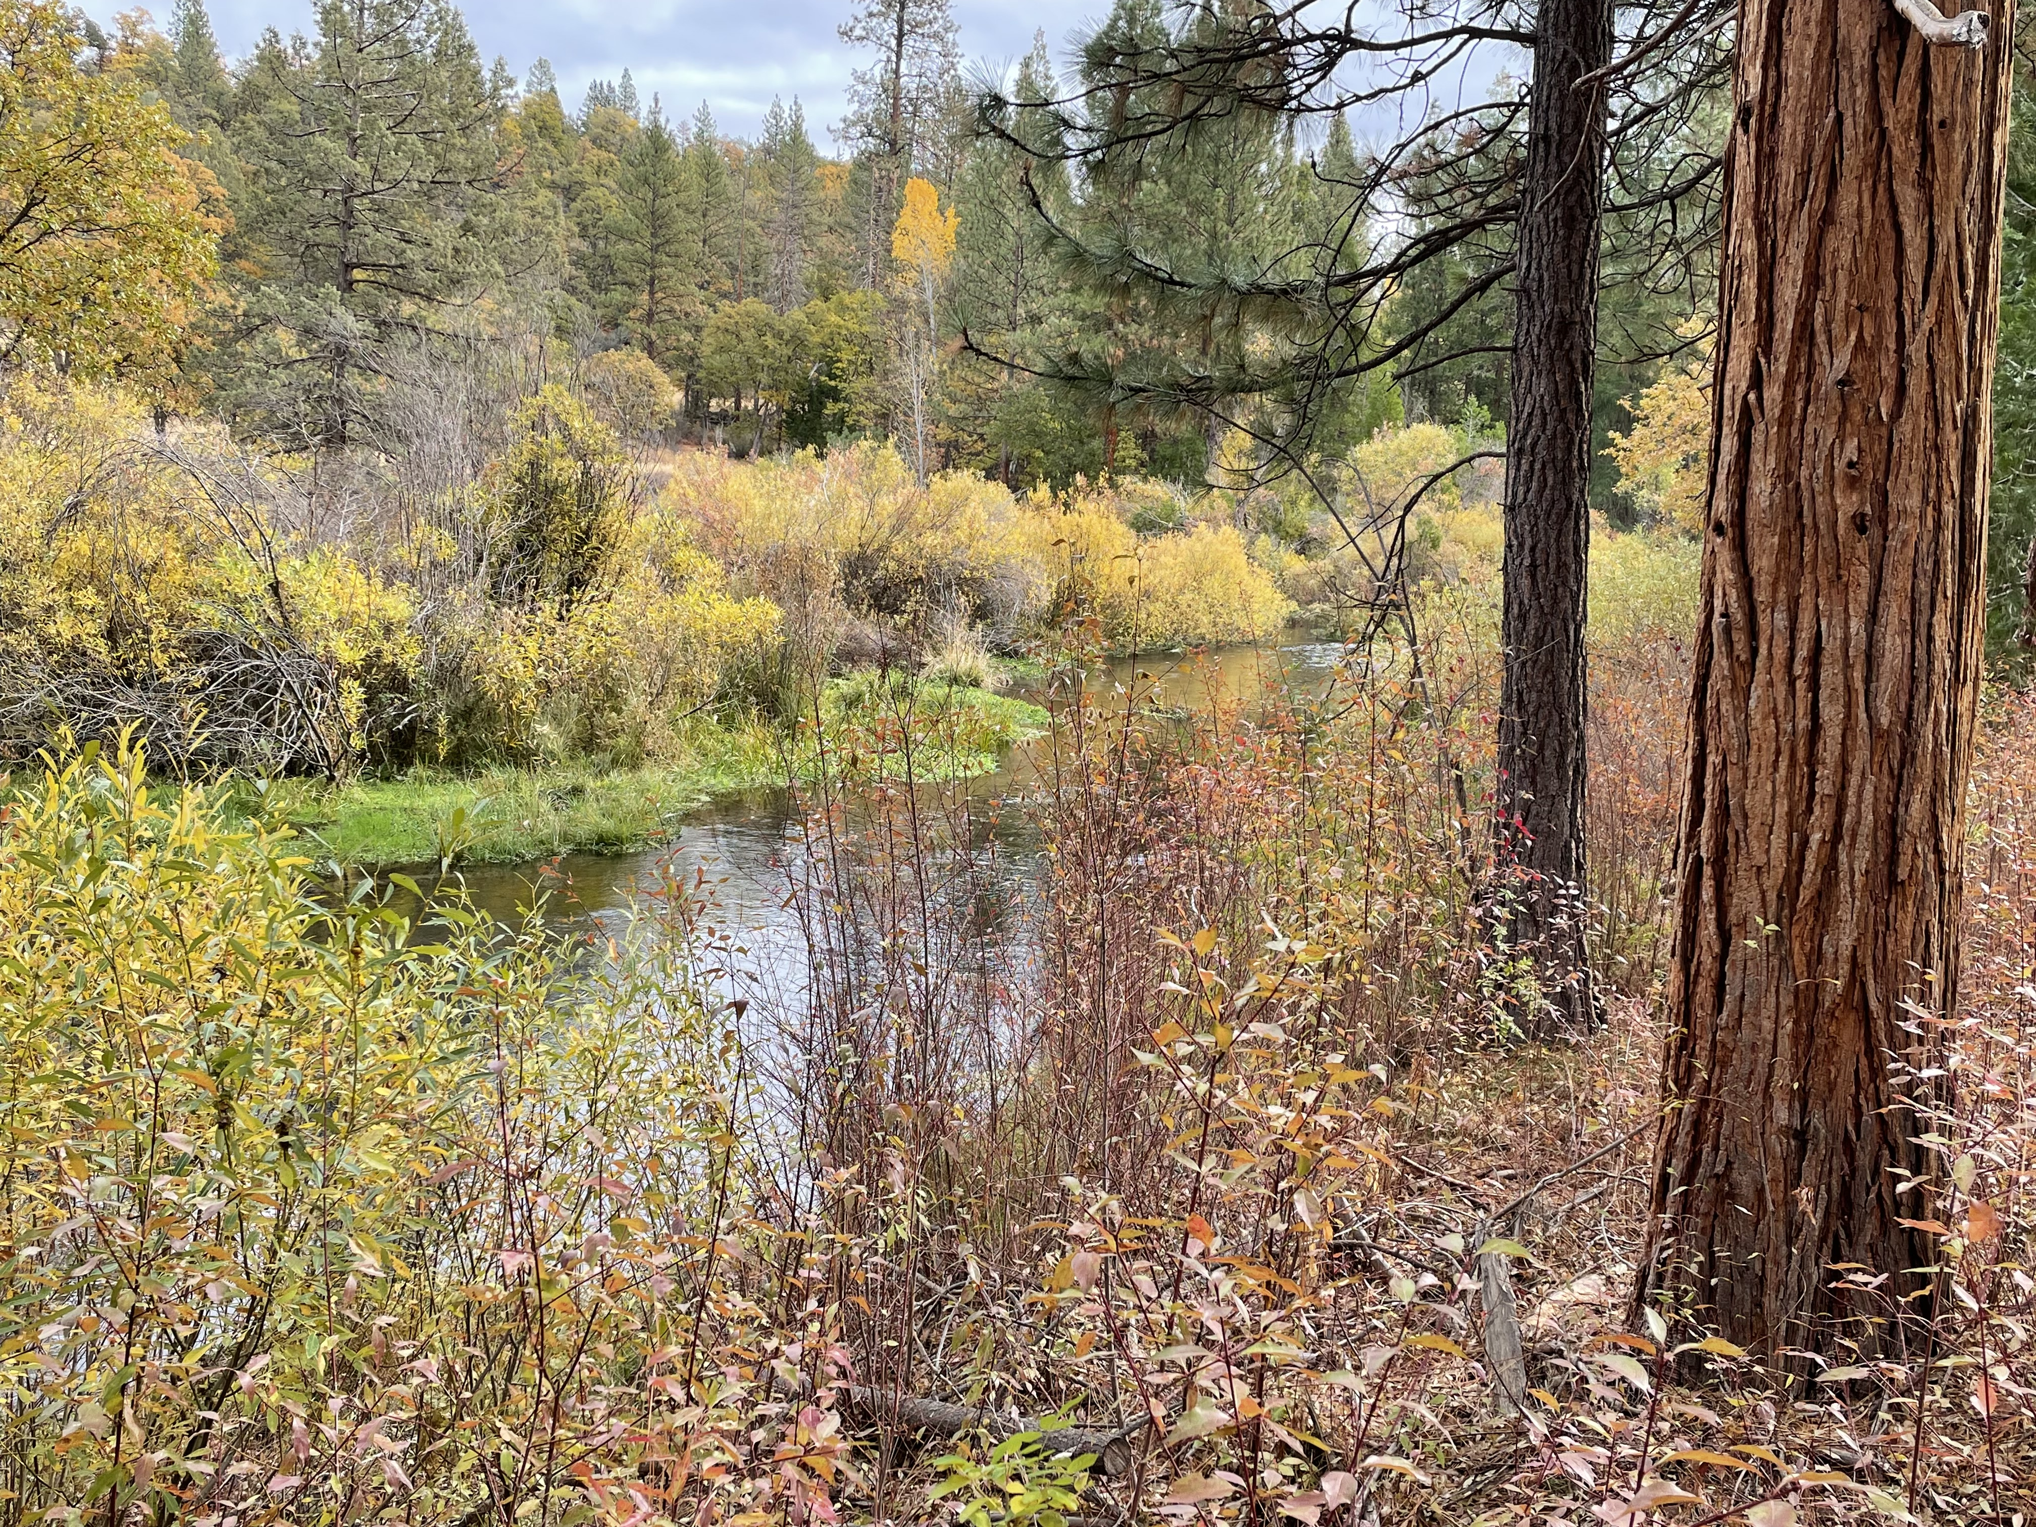
Notes:
THIS IS INTENDED TO BE FUNNY. BETTER PIC OF PRE PROJECT CHANNEL OVERBANK ON LEFT COMES UP FIRST THEN PIC ON RIGHT POPS UP NEXT. THIS IS A JOKE – PROJECT HASN’T BEEN CONSTRUCTED, DISTURBED SITE WITH RUBBLE, BUT SHOULD BE IMPROVEMENT.

Slide 15
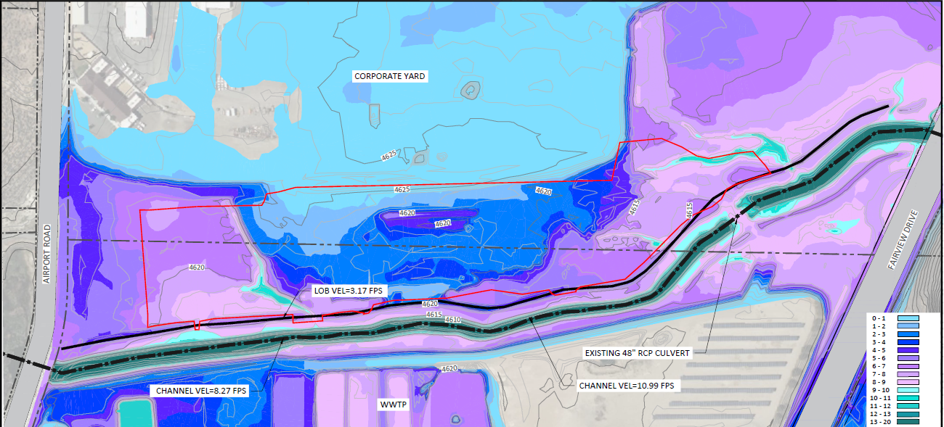
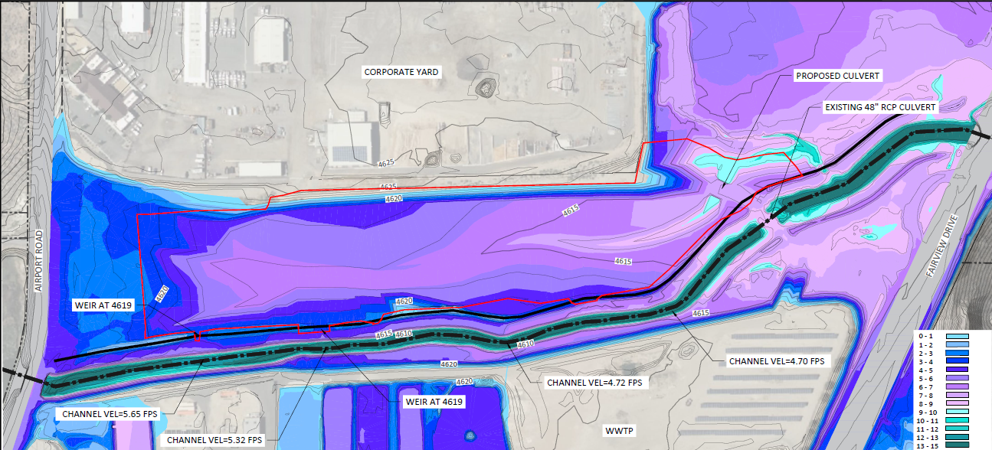
EXISTING 100-YEAR RESULTS
PROPOSED 100-YEAR RESULTS
Notes:
SHOW REVISED FLOW INUNDATION

Slide 16
What’s next?
CONSTRUCTION SUMMER 2024

Slide 17
Thank You
amy.miecznikowski@terraphase.com
mark.gookin@terraphase.com
www.terraphase.com
Notes:
DIFFERENT PIC/GRAPHIC

