Slide 1
A Success Story for the Clear Creek Watershed
Improving Water Quality

Slide 2
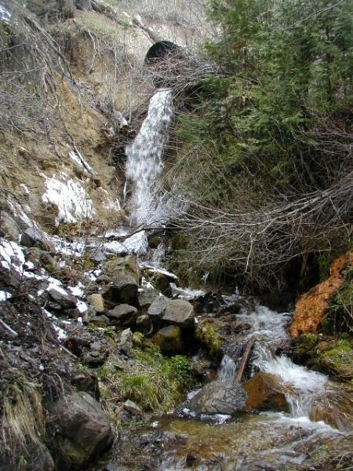
Eric Yount, P.E.
NDOT Hydraulics Section

Slide 3
Clear Creek Erosion Control Program
US 50 Storm Drain Projects
USGS Water Quality Monitoring Data
NDOT Ground Water Monitoring

Slide 4
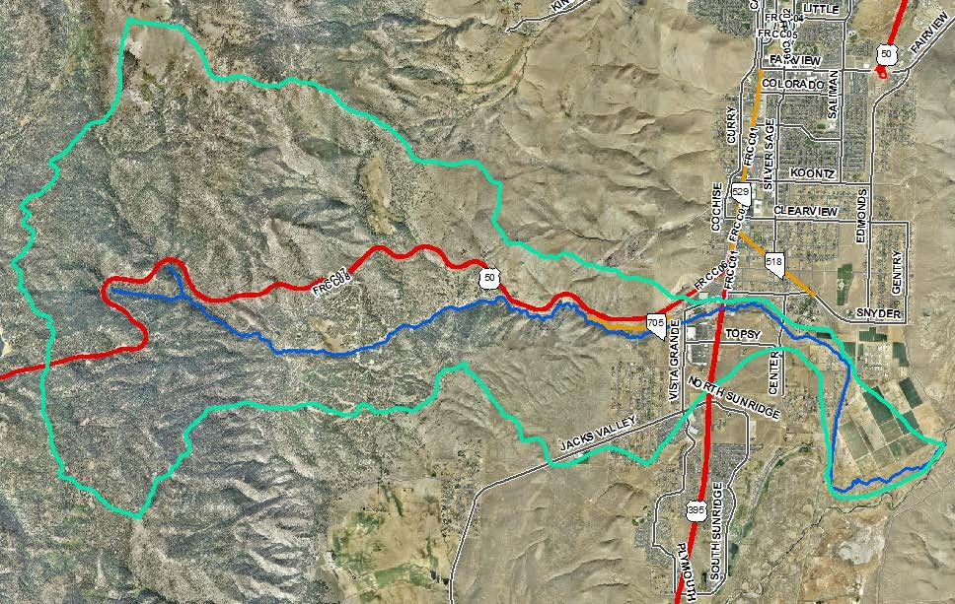
Watershed Boundary (Roughly 19 mi²)
Carson
City
Clear
Creek
Spooner
Summit
Carson
River
Almost 200 agency, tribal, and private properties are within the watershed

Slide 5
Kings Canyon toll road was main lake access around the turn of the century
Old Clear Creek road was popular with toll dodgers and wasn’t paved till 1928 ($230,000)
In 1956, US 50 construction began through the Clear Creek Watershed
Roadway opened October 4th, 1957 in preparation for 1960 Winter Olympics in Squaw Valley

Slide 6
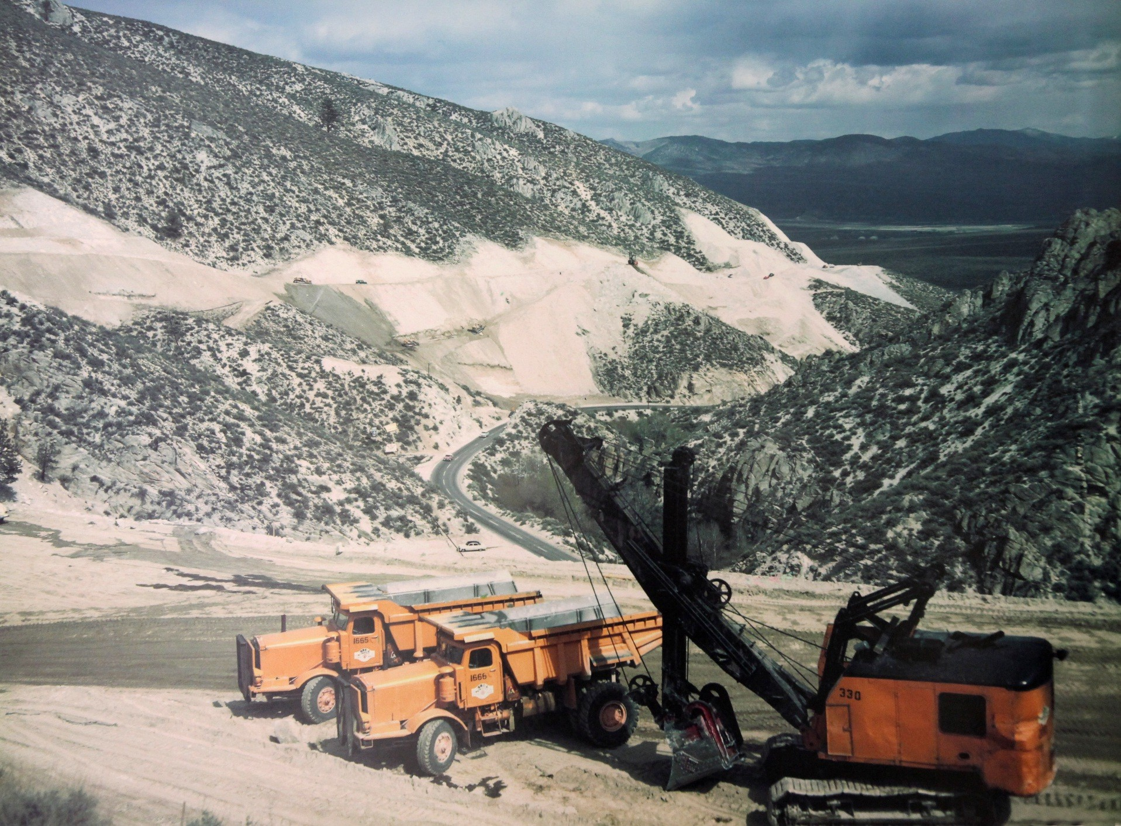

Slide 8
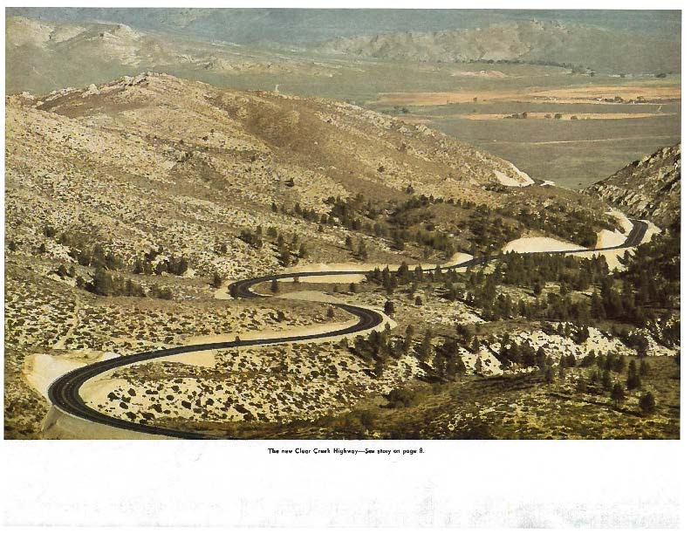

Slide 9
9 mile trip to the summit
200’ above Old Clear Creek Road
$2.5 million – most expensive NDOT project in the 40 year history of NDOT at the time
3.5 million CY of earth displaced
100,000 CY handled in a single week
Completed by Isbell construction in 1 year (ahead of schedule)

Slide 10
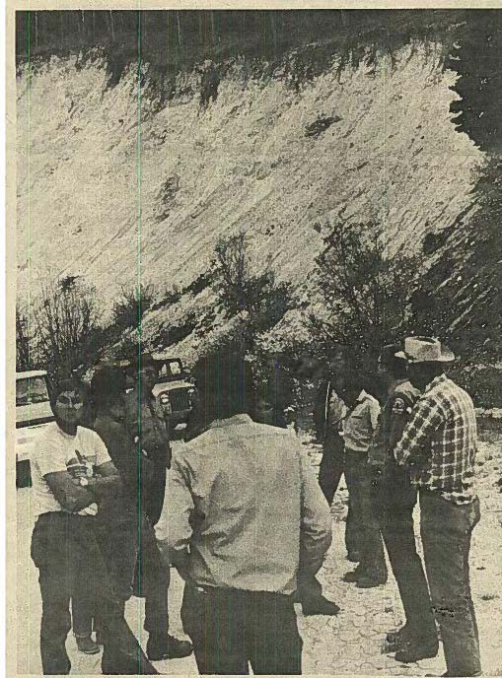
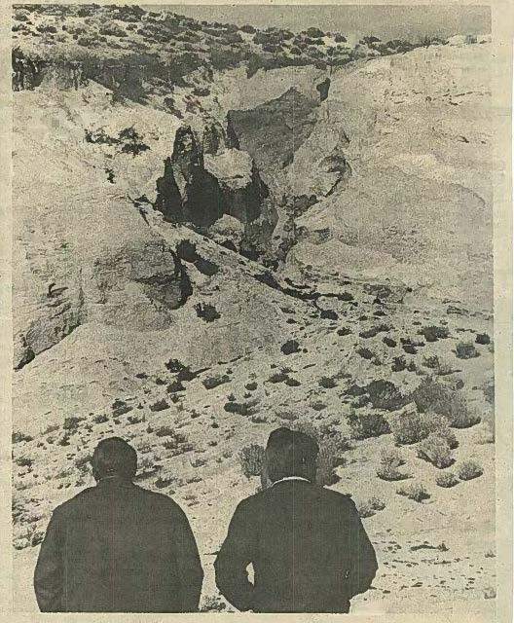

Slide 11
Concentrated flows to about 100 discharge points on steep, highly erosive slopes, causing severe erosion downstream of US 50.
Eroded drainages and transported sediment began to impact the more than 200 private properties, tribal parcels, and agency owned land.
Impacts extended well beyond the NDOT R/W
Property impacts were vocalized, broadcast through media, and lawsuits threatened.

Slide 12
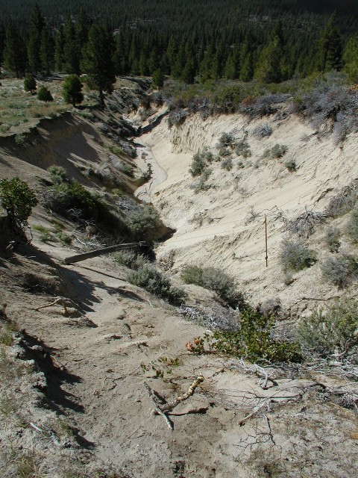
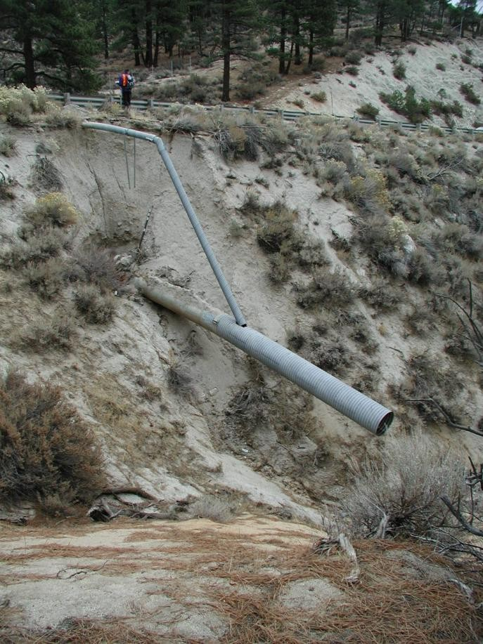

Slide 13
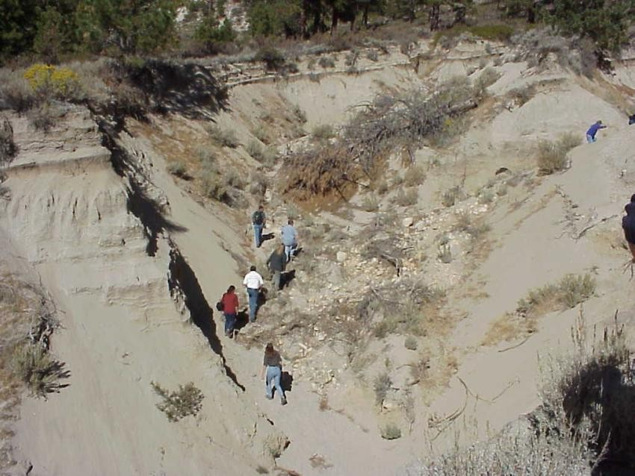
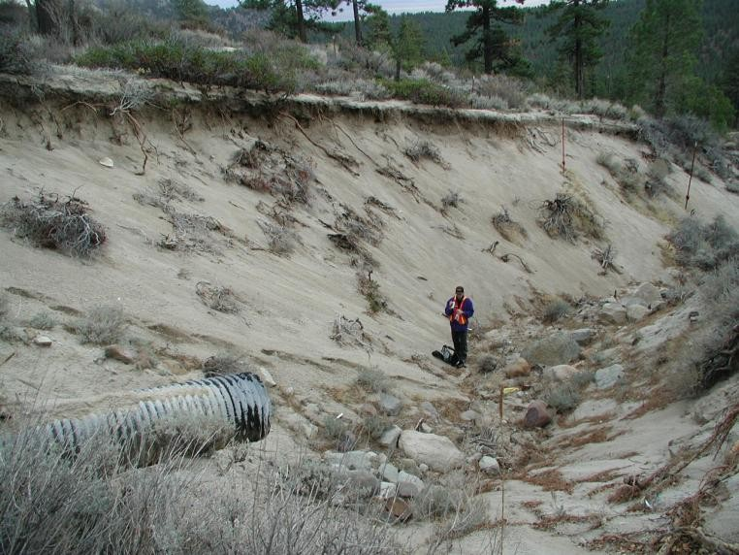

Slide 14
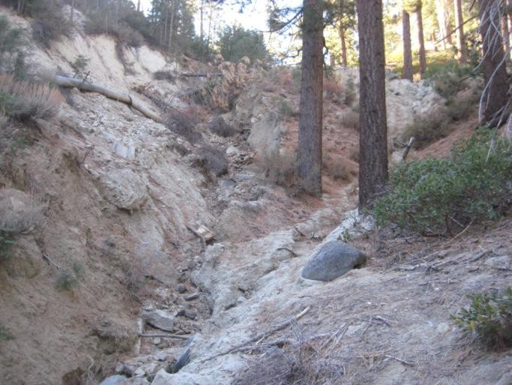
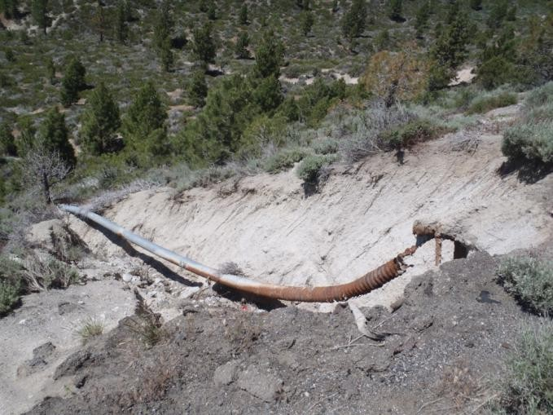

Slide 15
Erosion occurs naturally – accelerated downstream of 50 only
The nature of the runoff to the natural drainages was completely changed.
Pavement (impervious on-site) drainage was introduced to drainages that had never experience this type of runoff before.
The area of the pavement is relatively small; however:
Steep Slopes
Decomposed Granite – very erosive like sand
Run off volume increased for small storm events
Run off peak increased for small storm events
Run off frequency increased to almost every storm event
Upset the natural balance that had developed over millions of years.

Slide 16
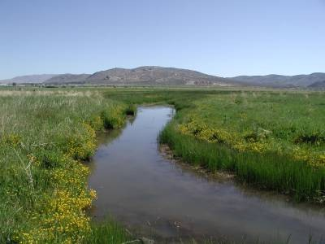
Because of severe Erosion Problems in the Watershed mostly outside of NDOT R/W, Specific Protection Area in NDOT’s MS4
Permit (2nd only to Tahoe)
The program is intended to protect and mitigate impacts to:
NDOT R/W
Old Clear Creak Road Private property Tribal Property
US Forest Service Other public property
Protect the health of Clear Creek and the rest of the watershed

Slide 17
In 2003, a study was completed by PBS&J evaluating the scour susceptibility of 47 miles of drainages tributary to Clear Creek below US 50.
8.3 miles of these tributaries were determined to be moderate to severely erosive.
We have expanded on this initial assessment to kick off our statewide GIS asset management and facility inventory effort
Resulting GIS Database:

Slide 18
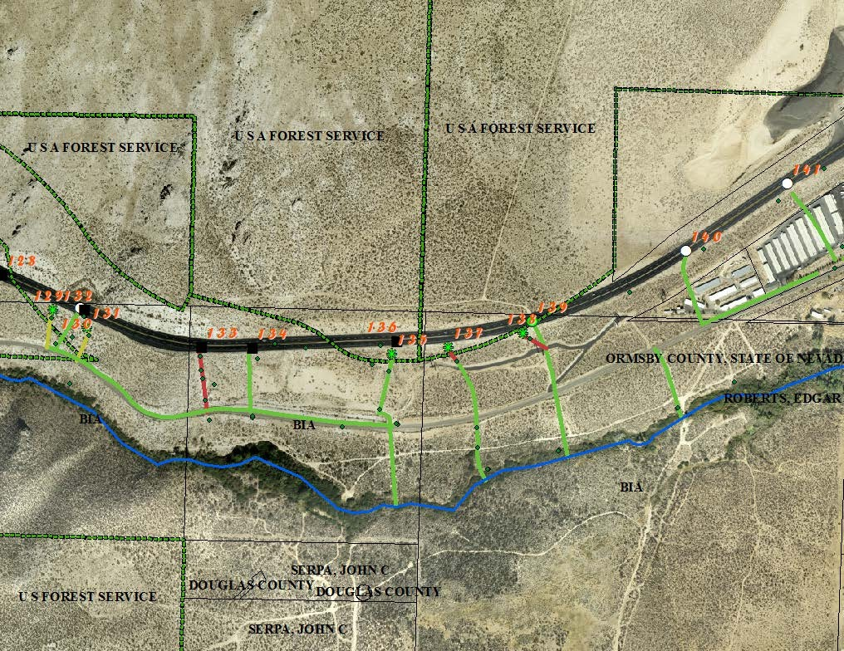
Drop Inlets
Cross Culverts
Land
Owners
Photo Locations
Slope Erosion / Land Slides
Flow Paths
with Severity of Erosion

Slide 19
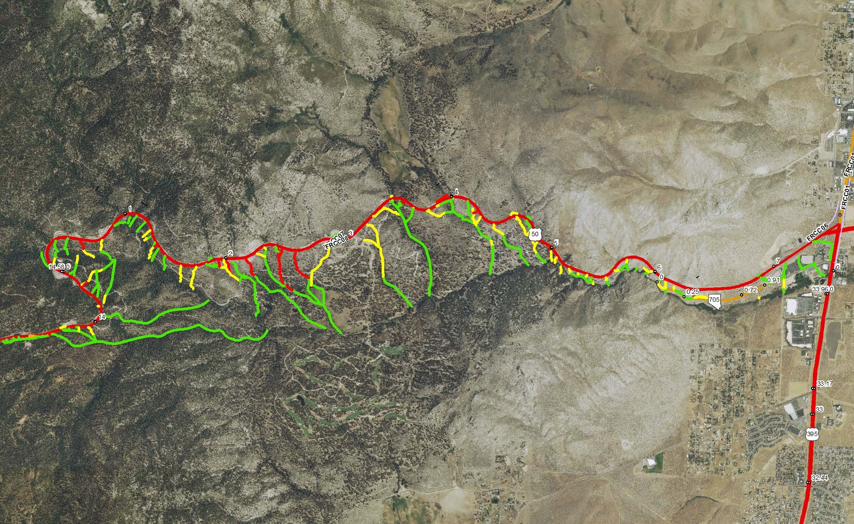

Slide 20
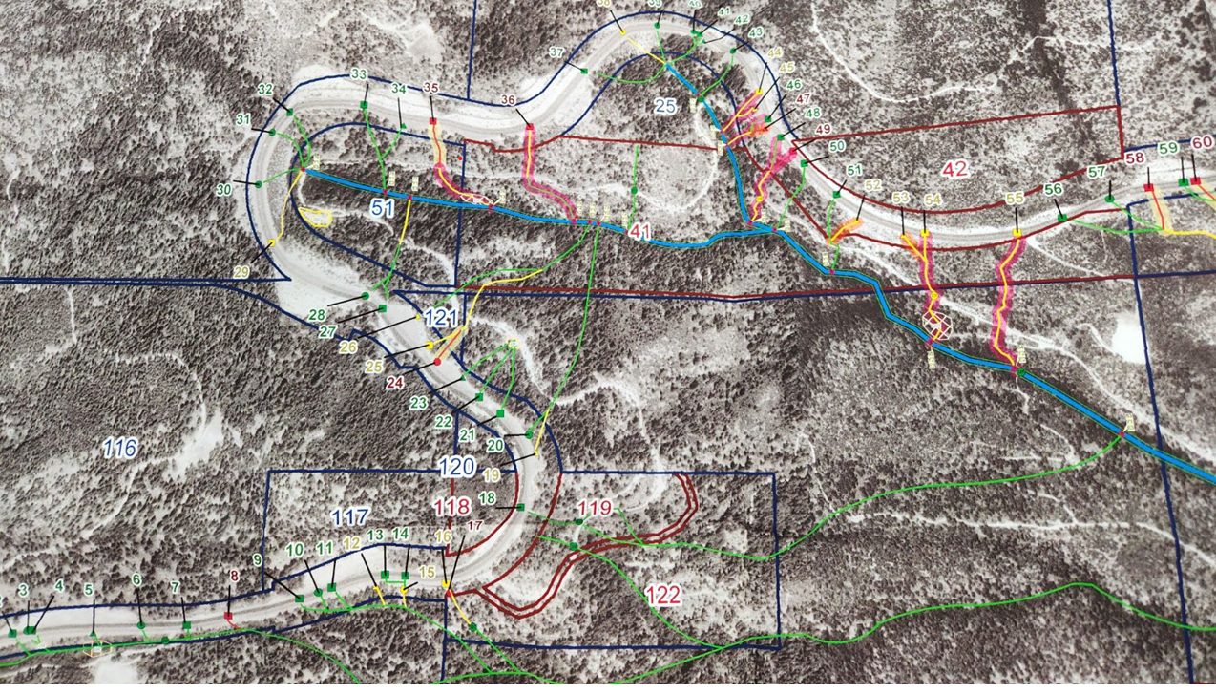
Clear Creek Assessment

Slide 21
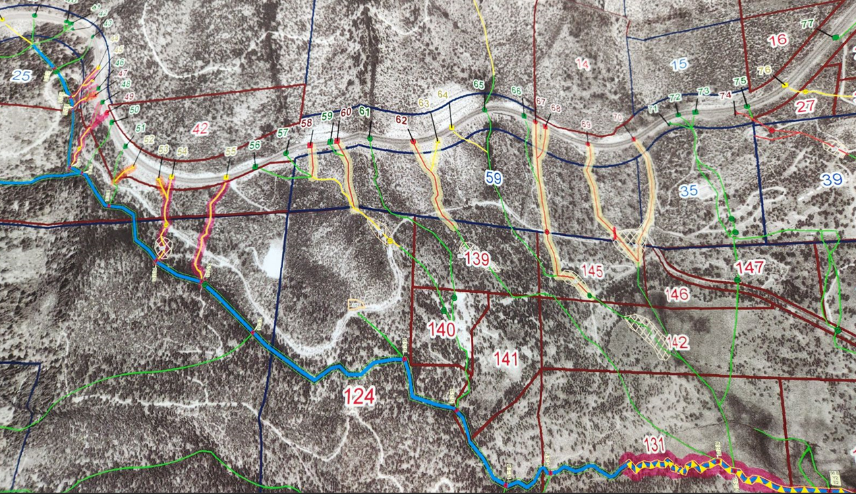
Clear Creek Assessment

Slide 22
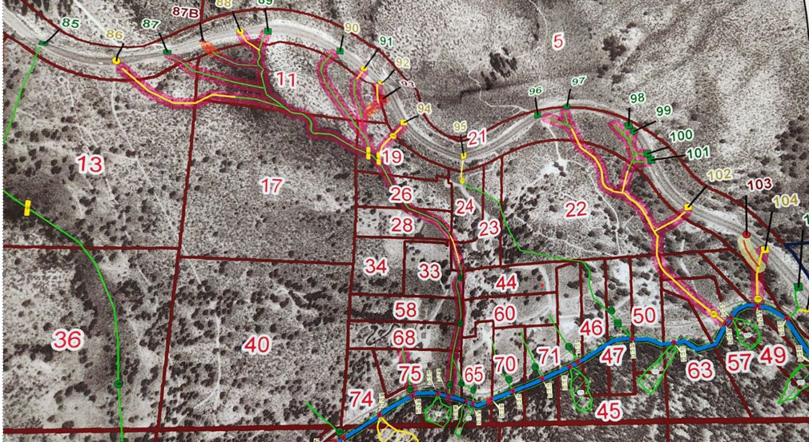
Clear Creek Assessment

Slide 23
August 2004, NDOT executed agreement with CVCD
Aid in mitigation efforts throughout the watershed
Work began spring of 2005
1st agreement for 2005 – 2014 (extended once)
$3.7 mill committed and spent
Mitigated 90% of drainages directly impacting private property
Critical in mitigating our impacts that otherwise wouldn’t have been possible
Great cooperative effort between CVCD, Other Local Agencies, Private Property owners, & NDOT
2nd agreement for 2015-2018
$2 mill committed

Slide 24
Permanent, Low Maintenance Solutions
Armor – Preferred Rip Rap channel lining (Water Quality Benefit)
Pipe flow down steep slopes where Rip Rap isn’t feasible
Stabilize to a logical terminus/stable point
Distribute/Bleed flow off at numerous points along US 50.
Remove on-site pavement contributions from problem drainages to stable drainages
Perpetuate off-site run off in historic flow paths
Monitor and correct as necessary.

Slide 25
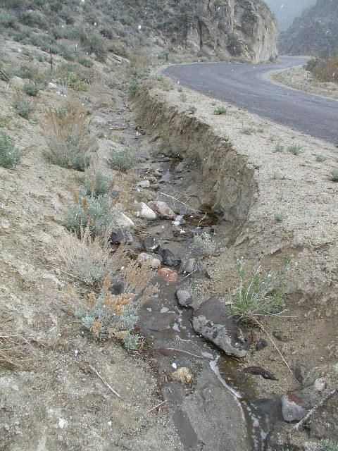
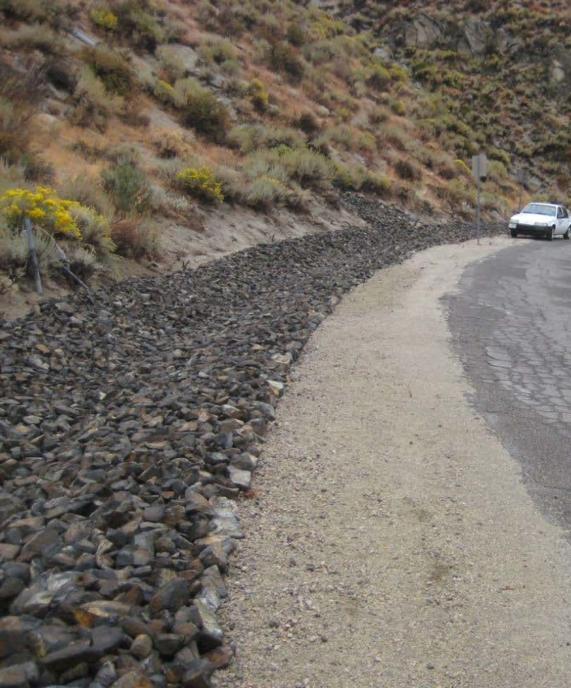
After
Before

Slide 26
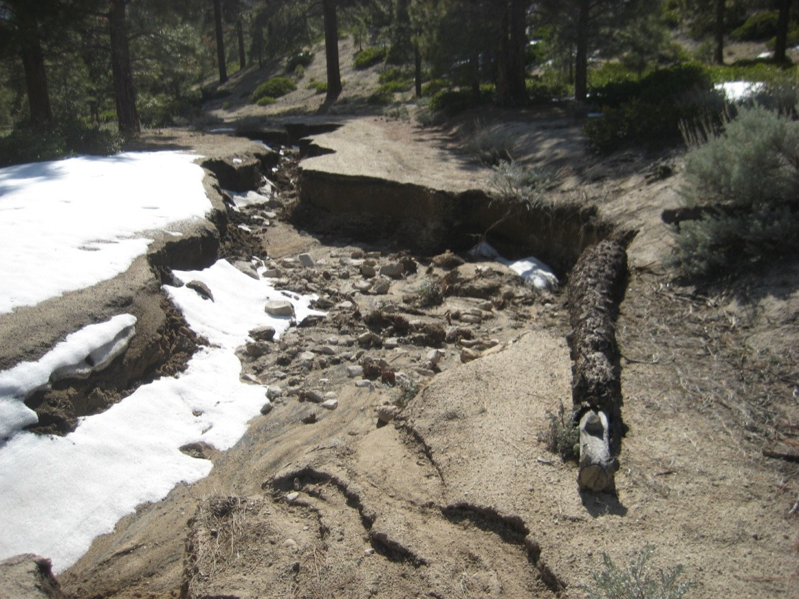
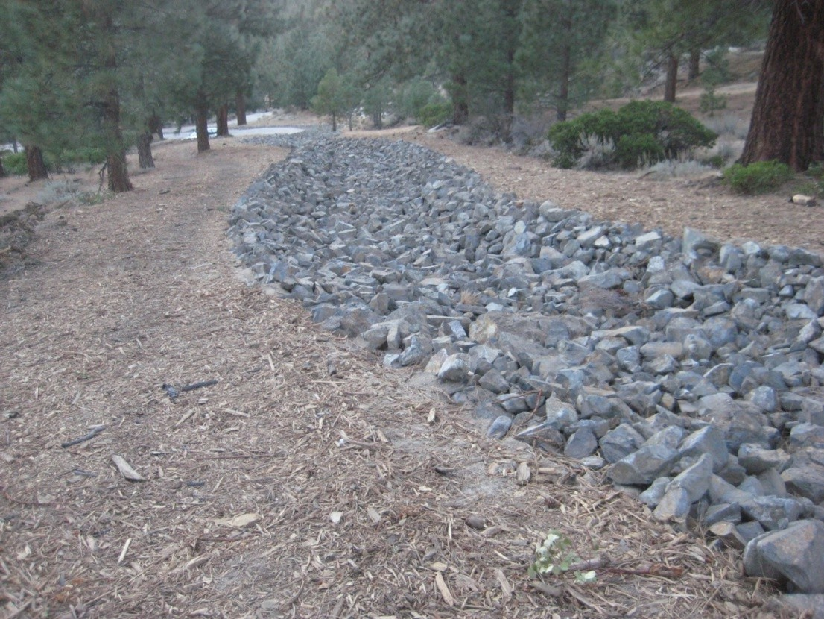
Before
After

Slide 27
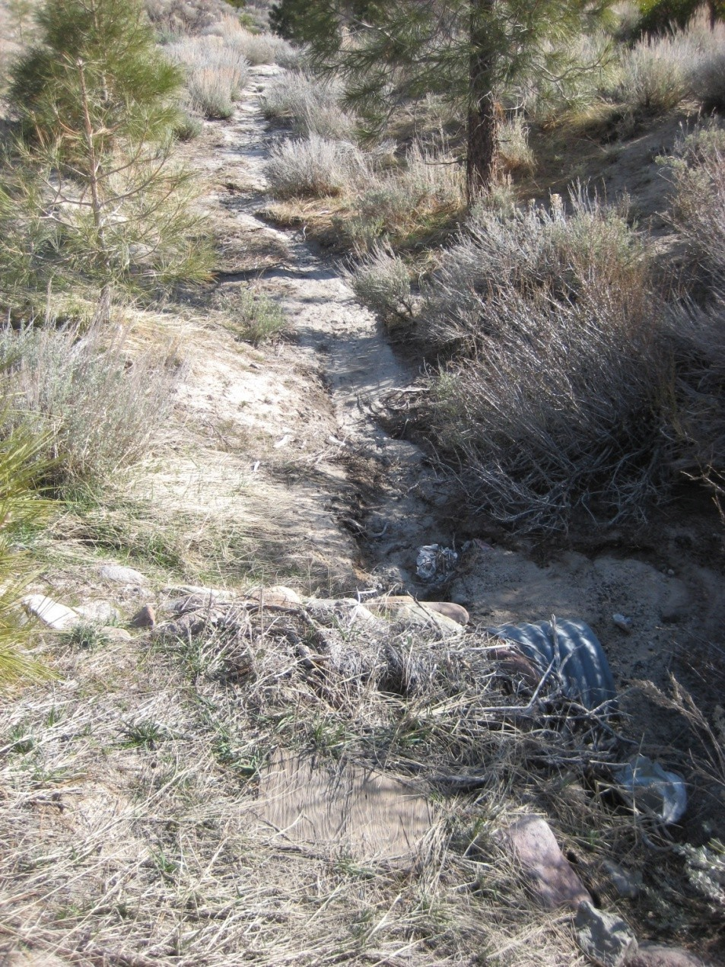
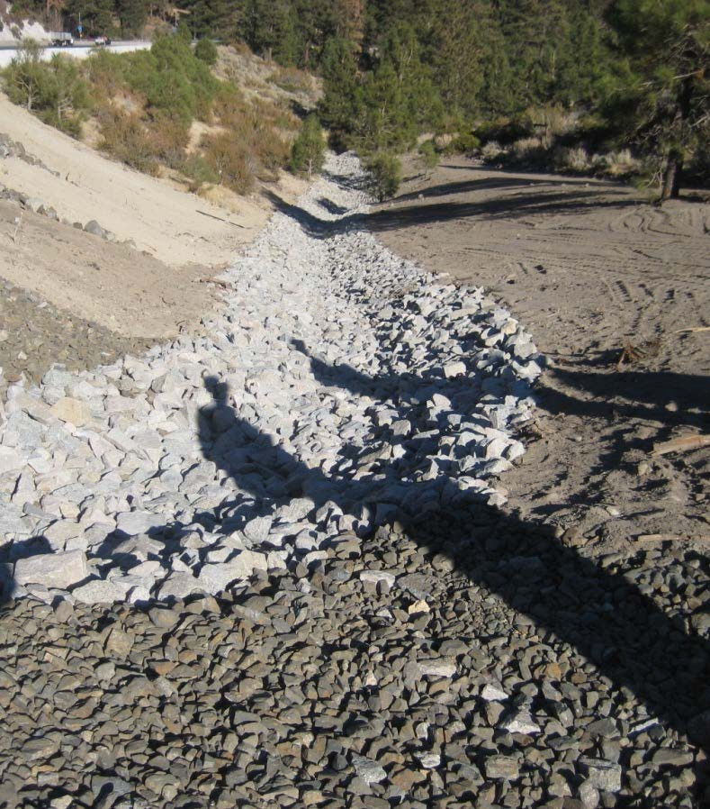
After
Before

Slide 28
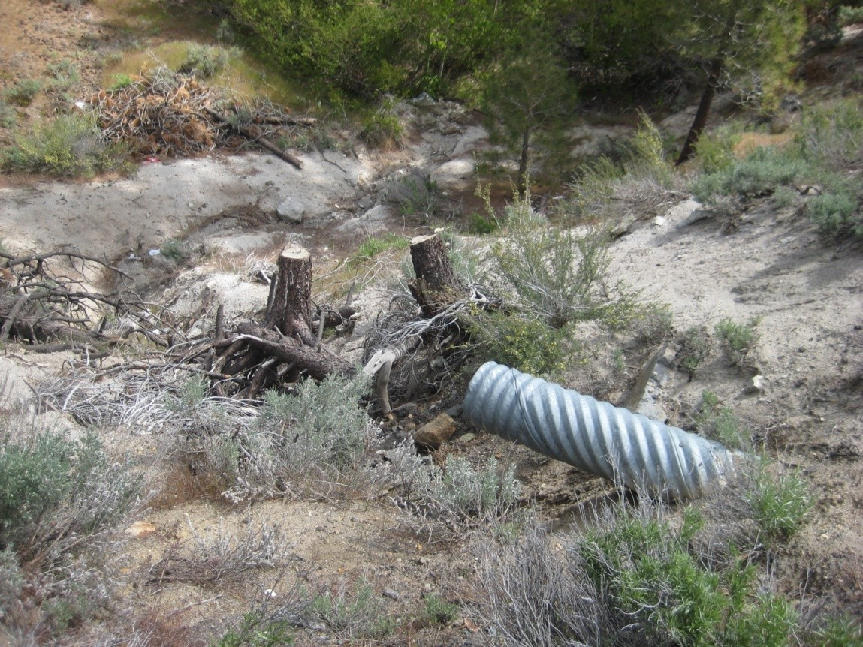
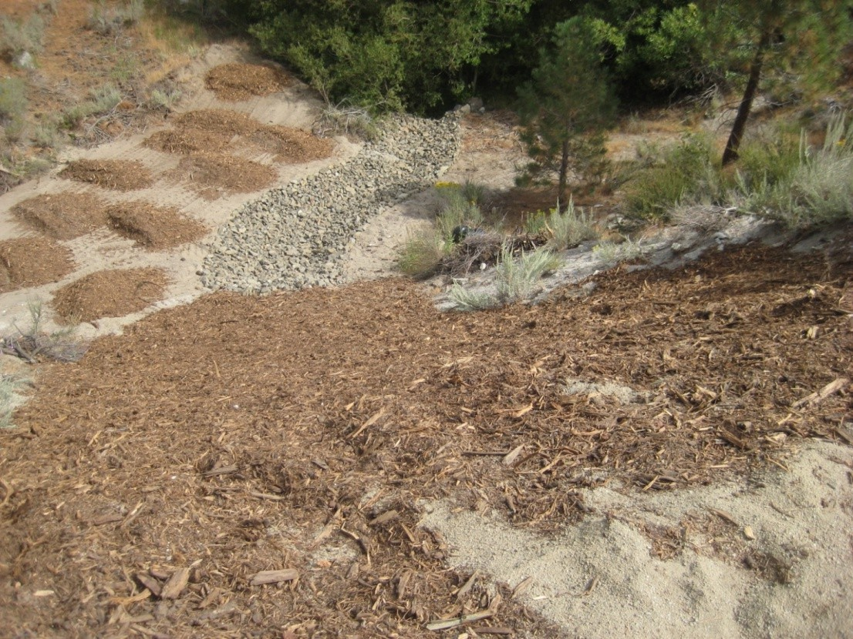
Before
After

Slide 29
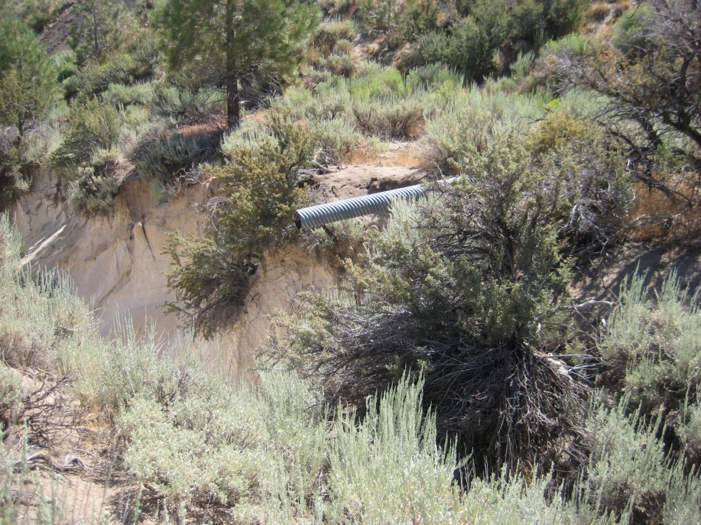
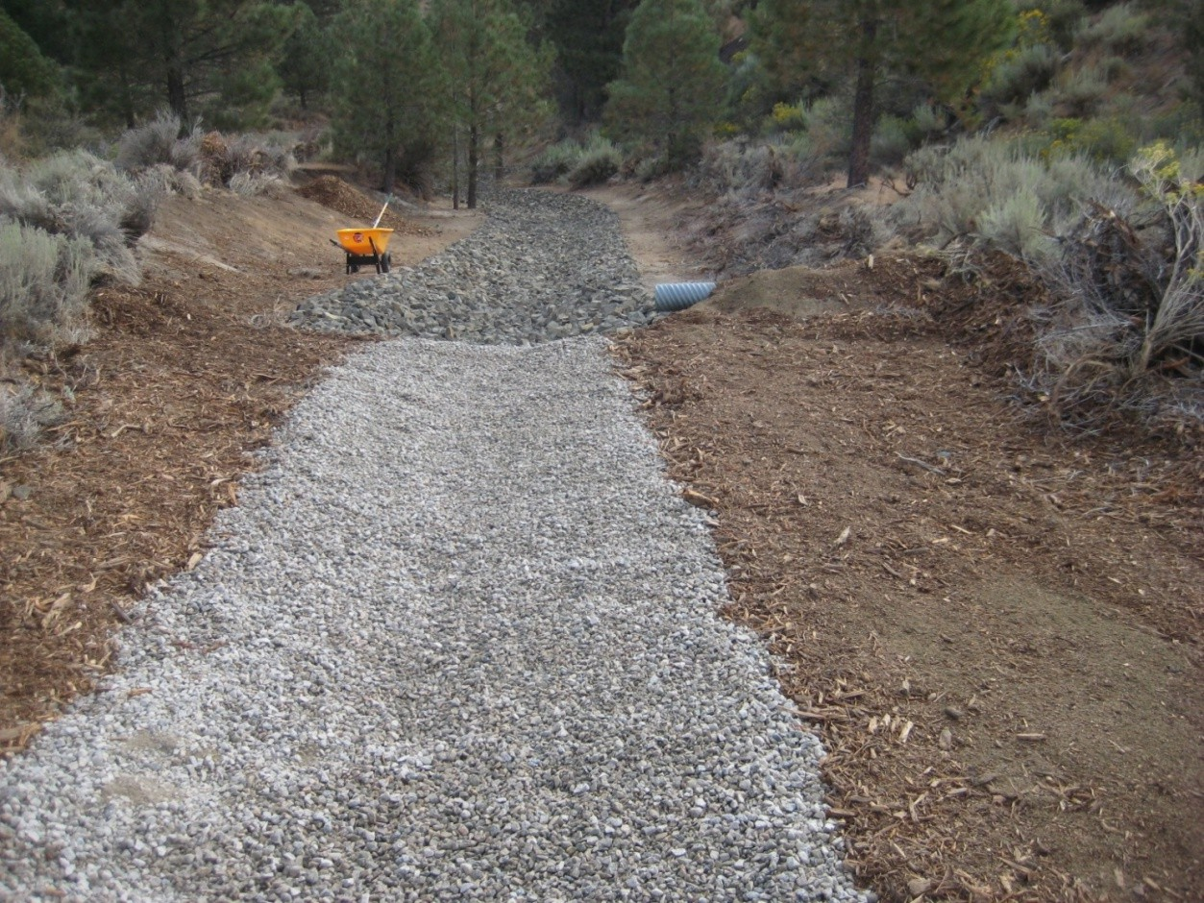
Before
After

Slide 30
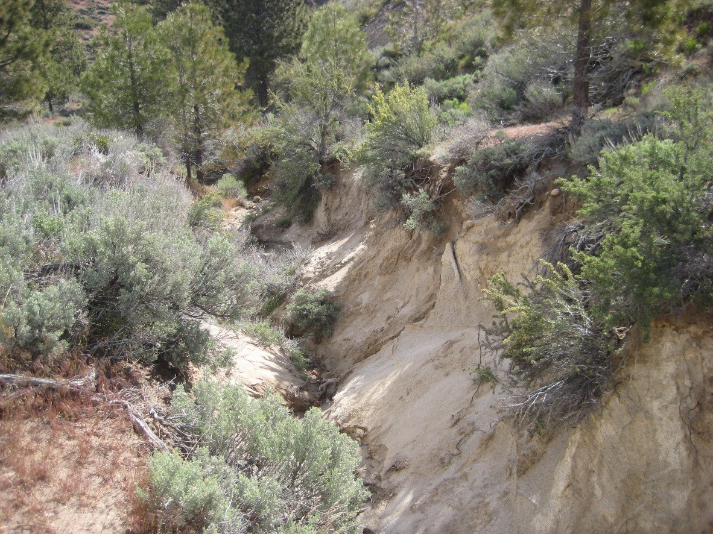
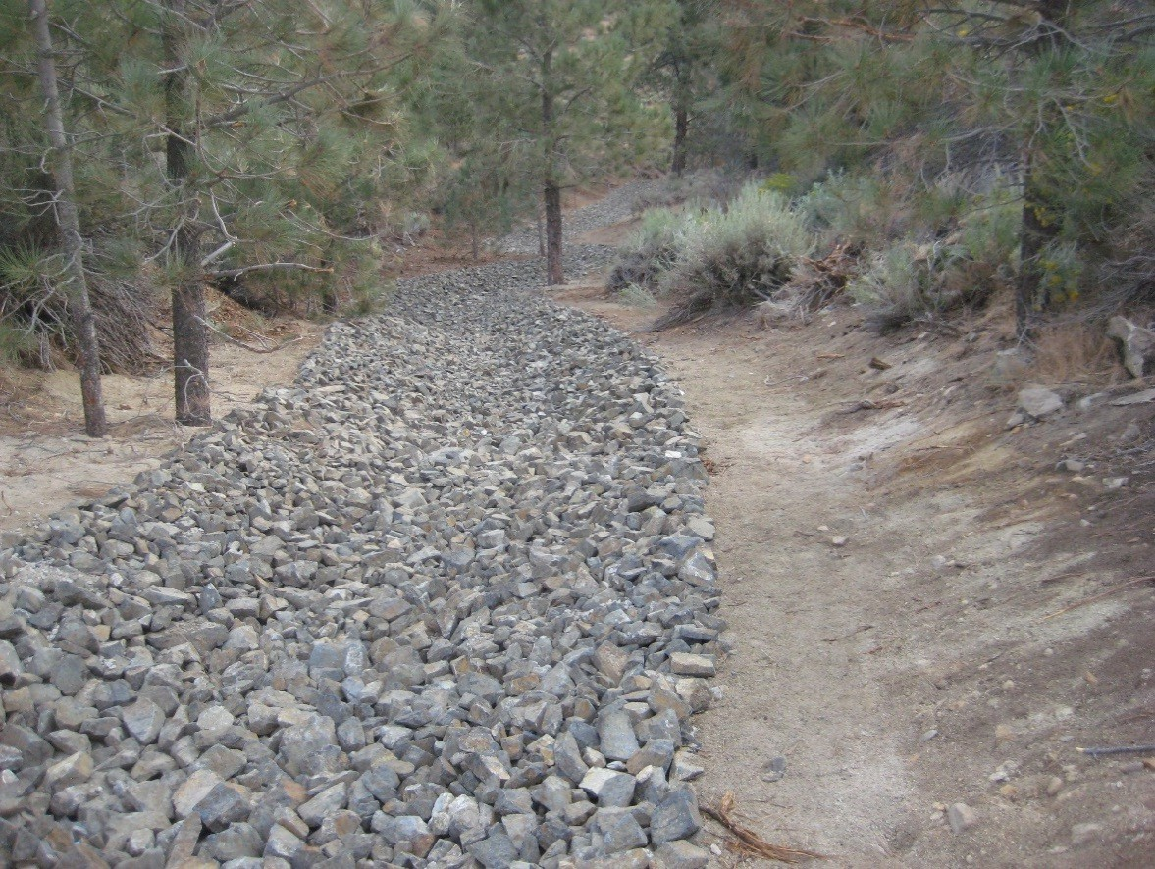
Before
After

Slide 31
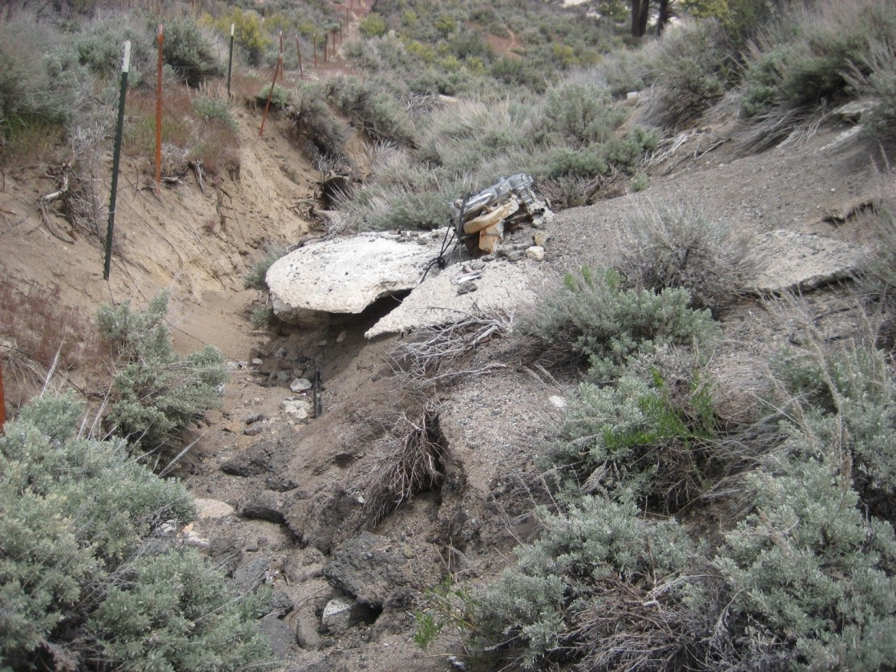
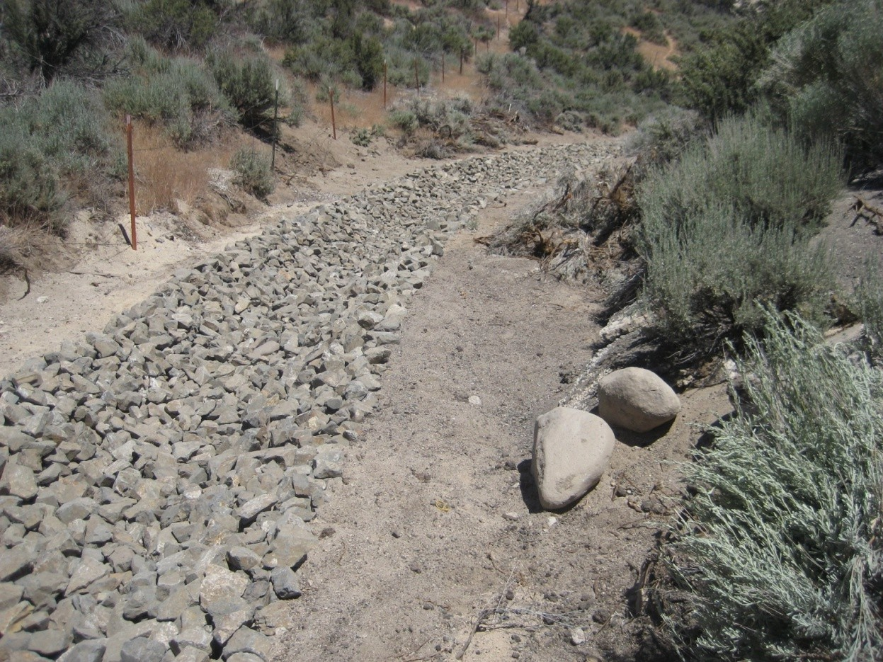
Before
After

Slide 32
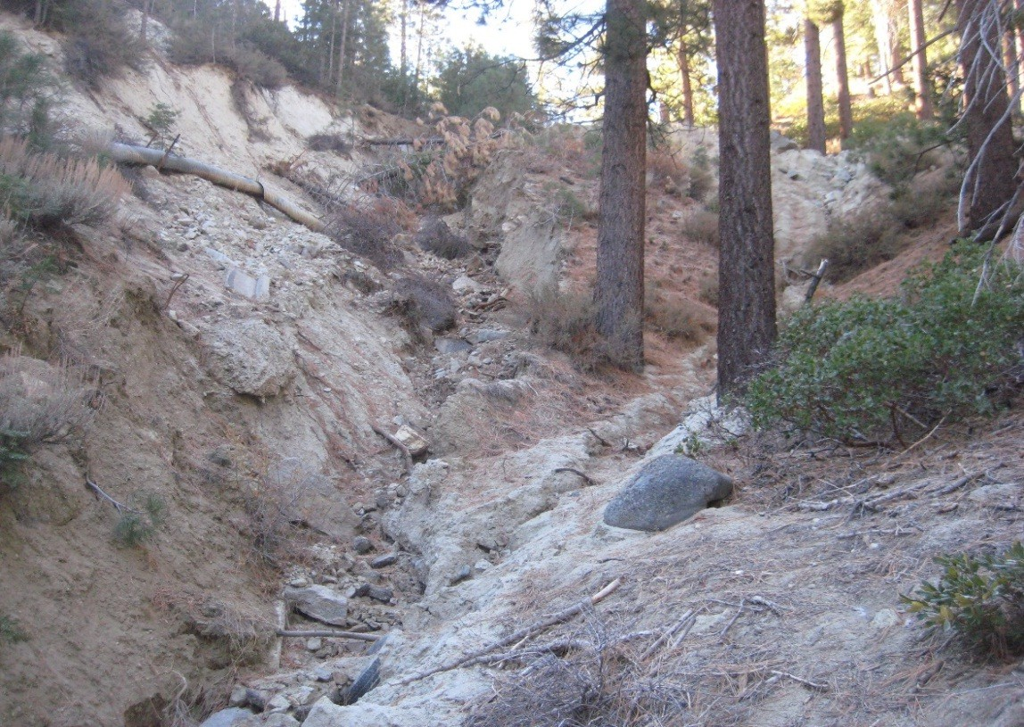
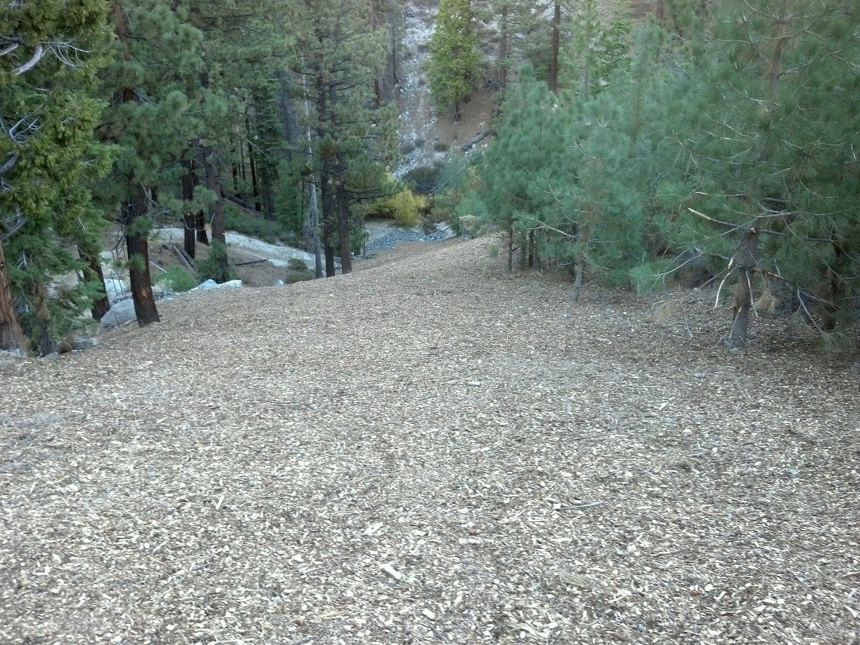
Before
After

Slide 33
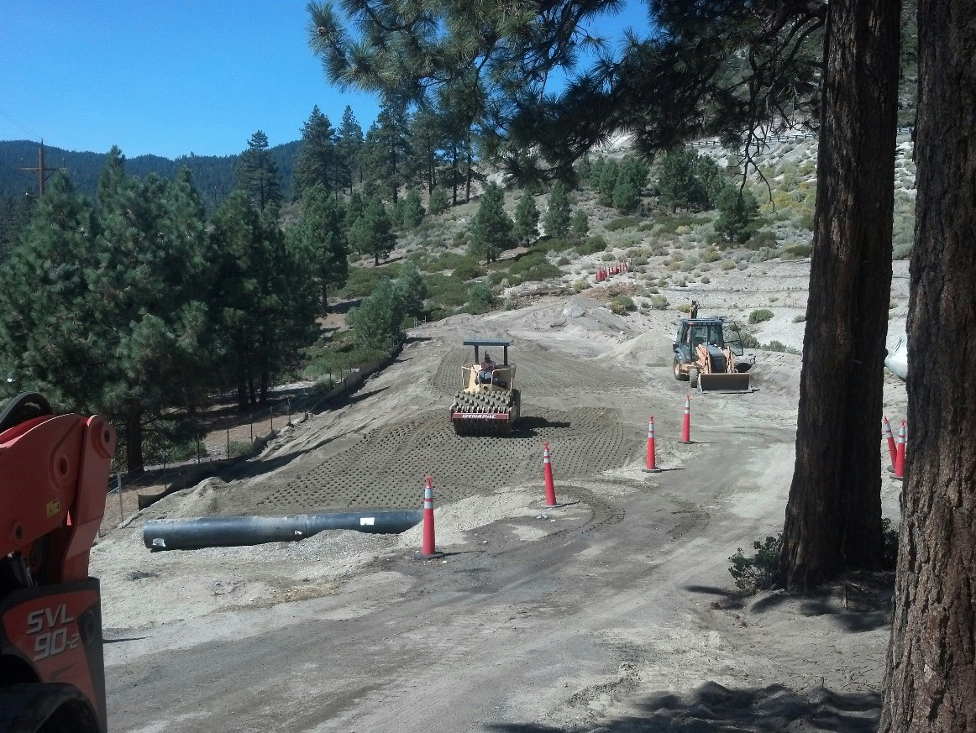
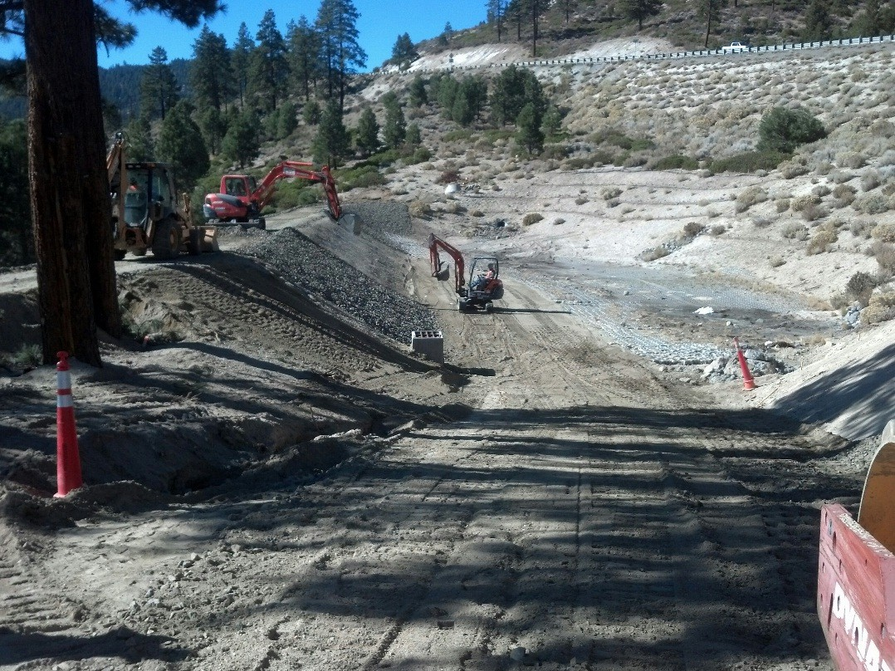
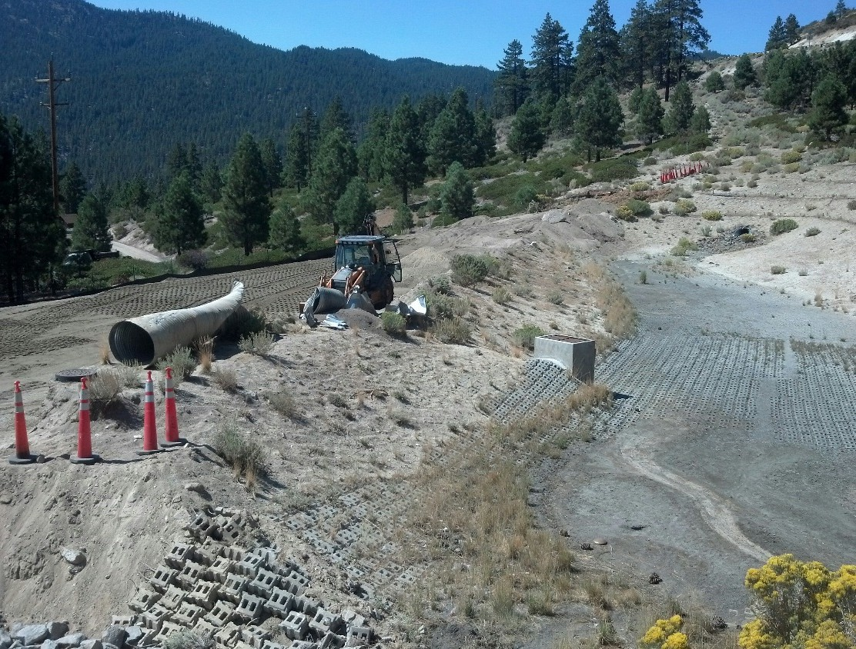
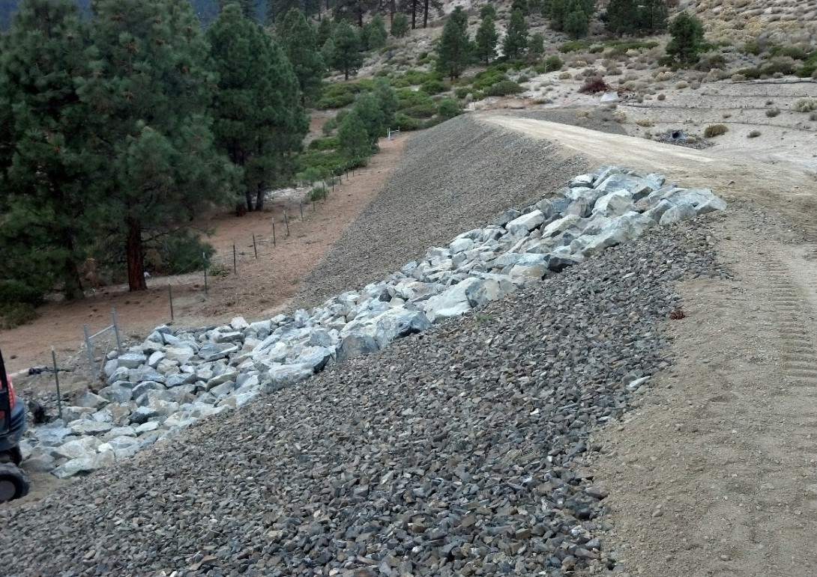
After
Before

Slide 34
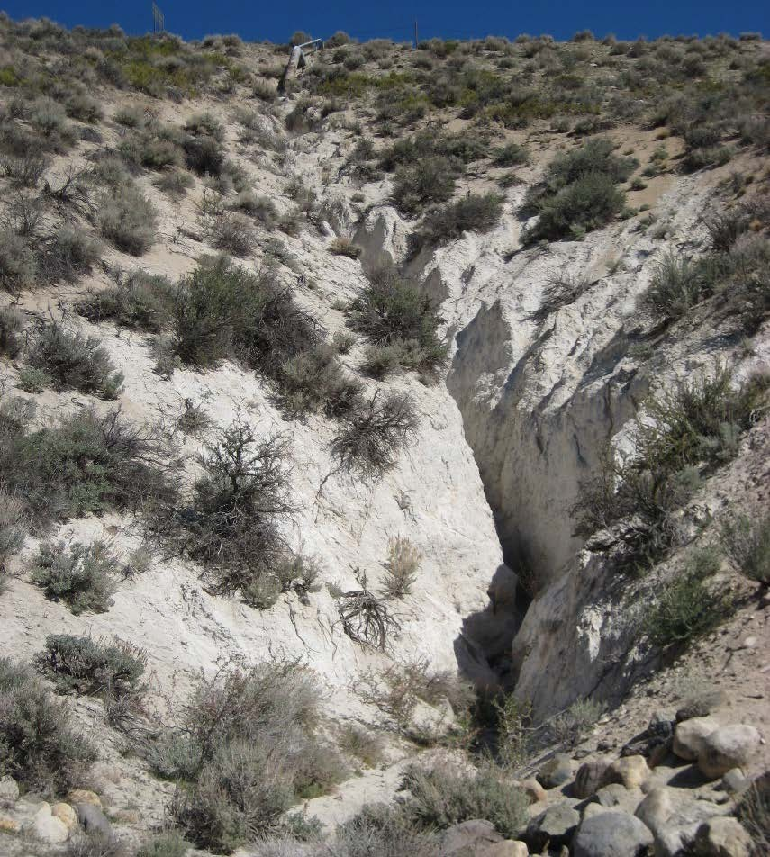
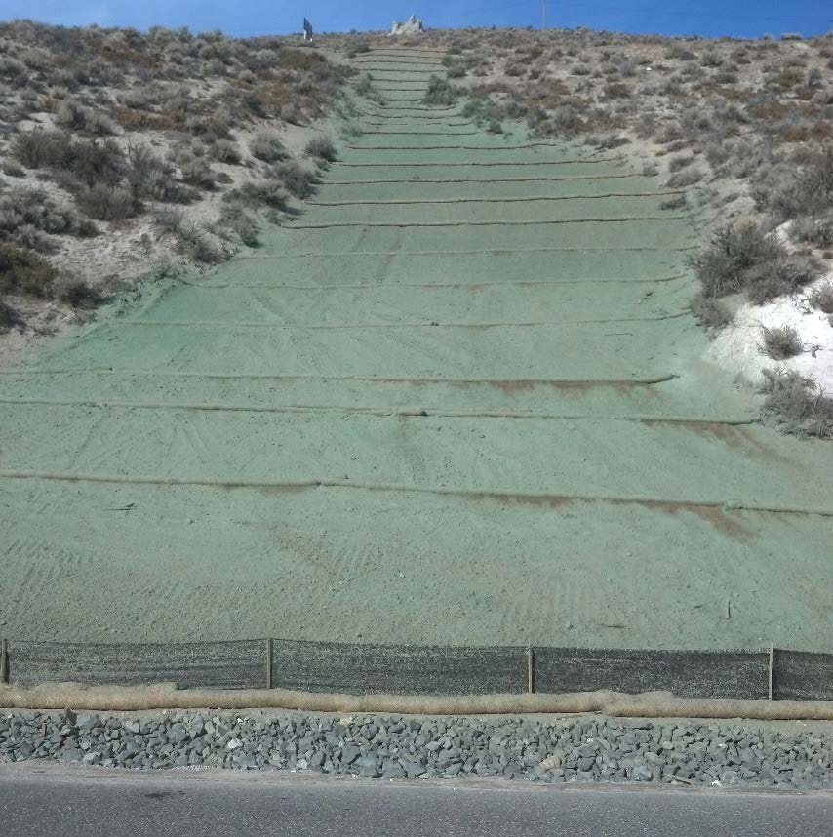
Before
After

Slide 35
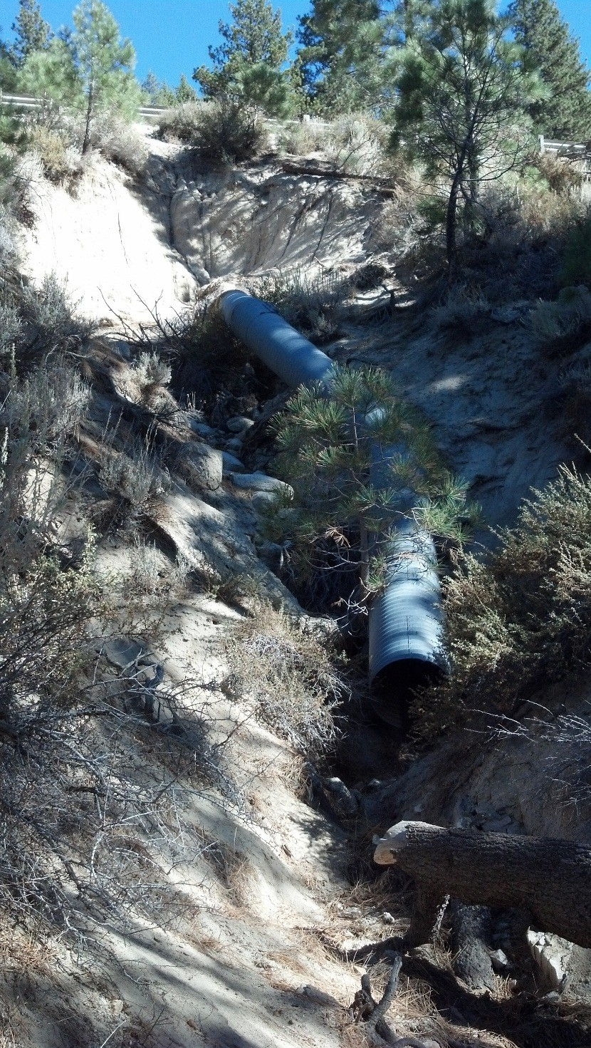
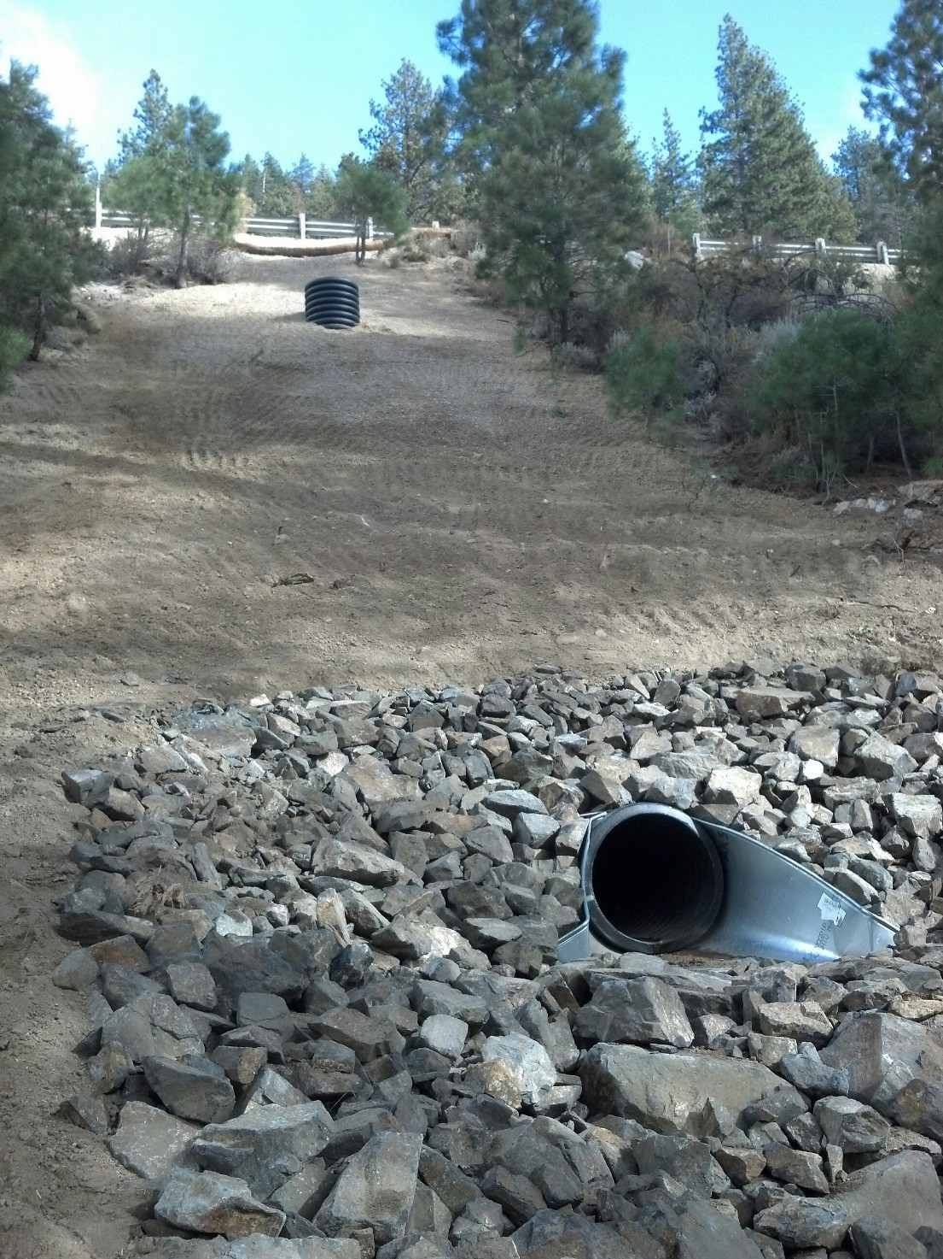
After
Before

Slide 36
2010 Construction program
Approximately 3300 feet of drainages stabilized.
2011 Construction program
Approximately 3600 feet of drainages stabilized.
2012 Construction program
Approximately 3800 feet of drainages stabilized.
2013 Construction program
Approximately 1600 feet of drainages stabilized.
Detention Basin – remove/mitigate impacts to 1620’ of drainage.
Slot Channel
2014 Construction program
Approximately 5000 feet of drainages stabilized.

Slide 37
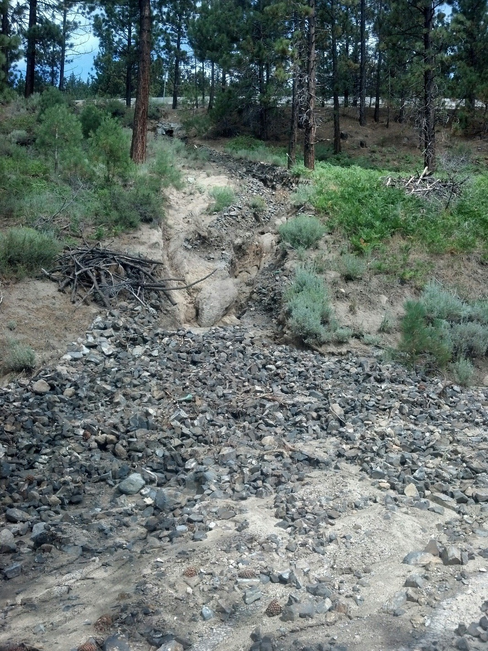
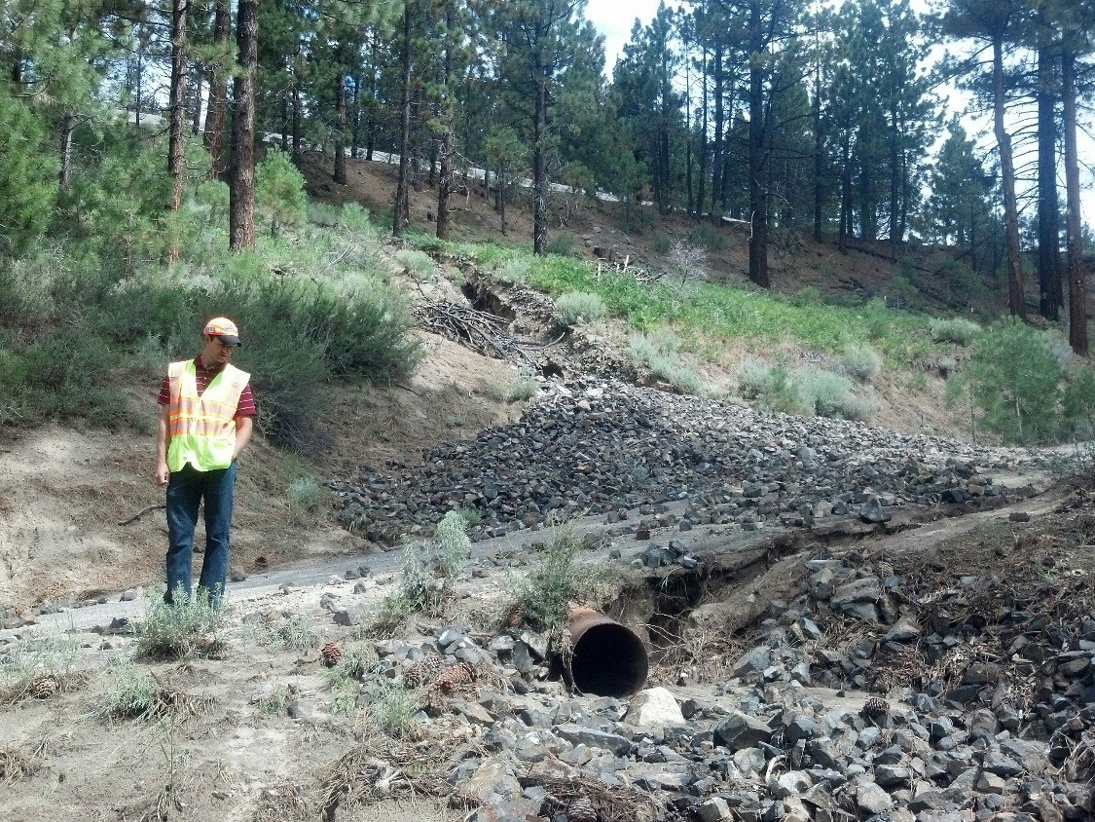

Slide 38
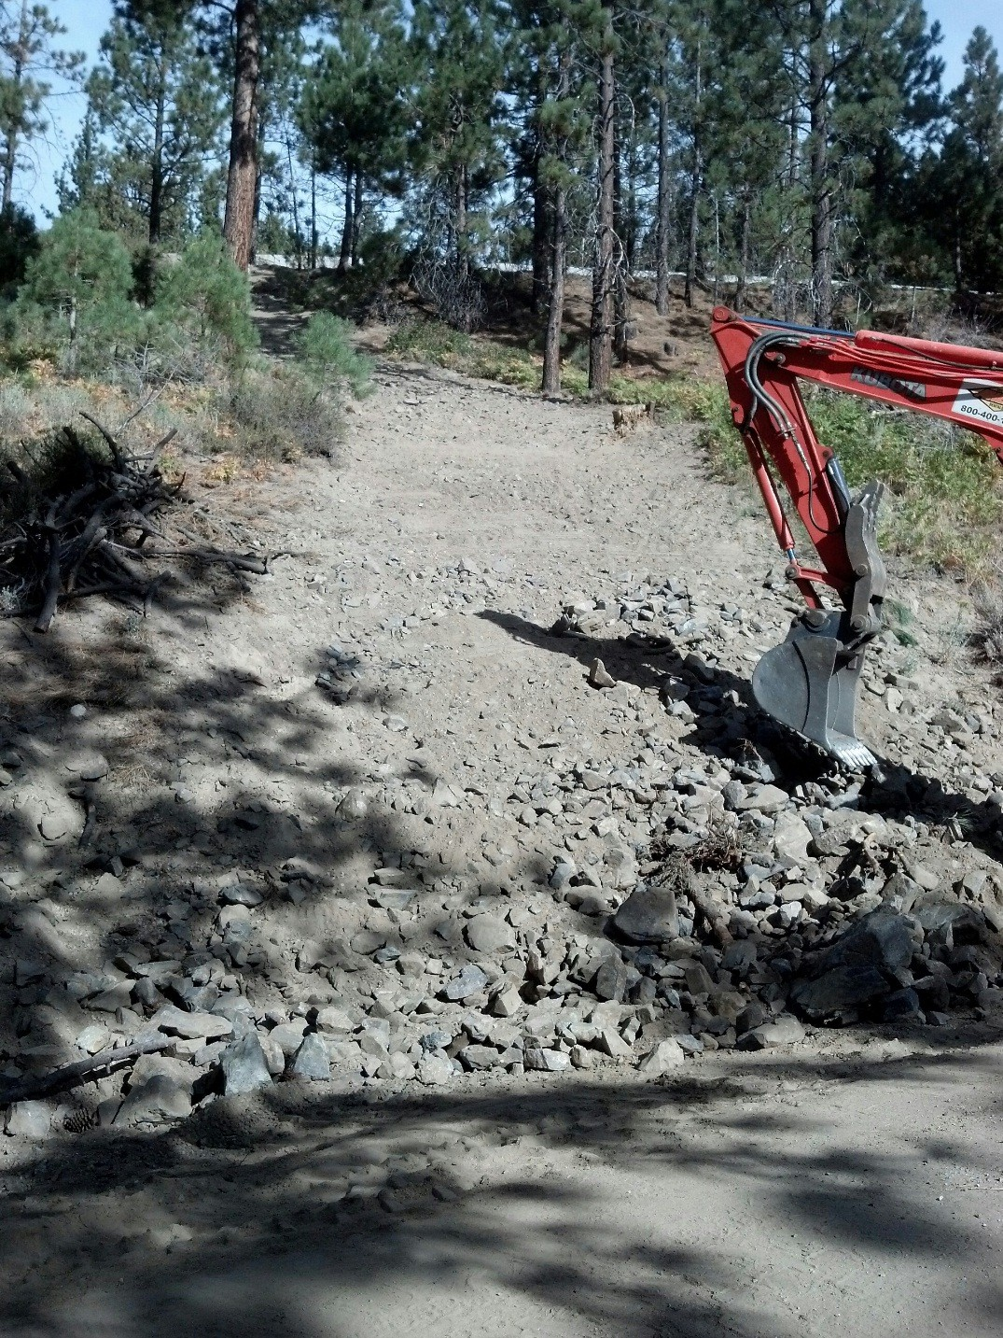
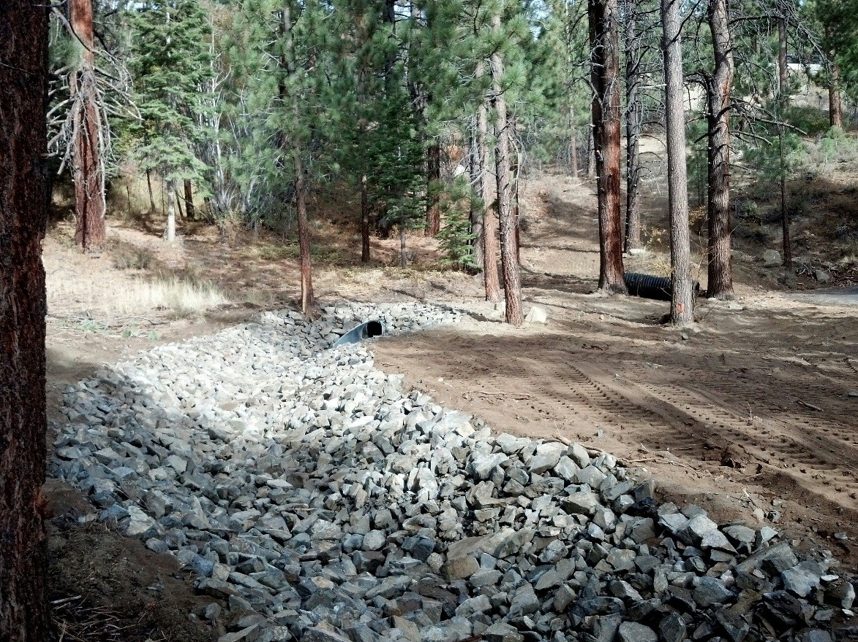
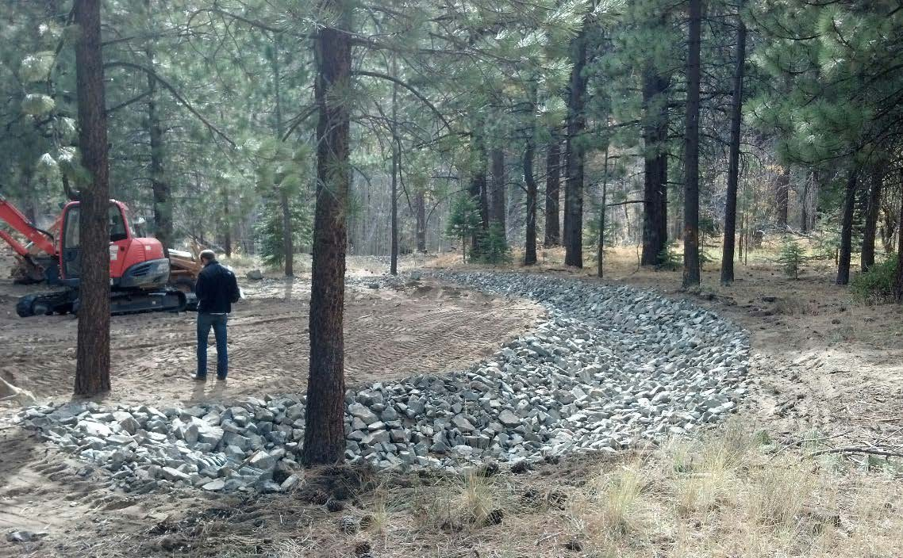

Slide 39
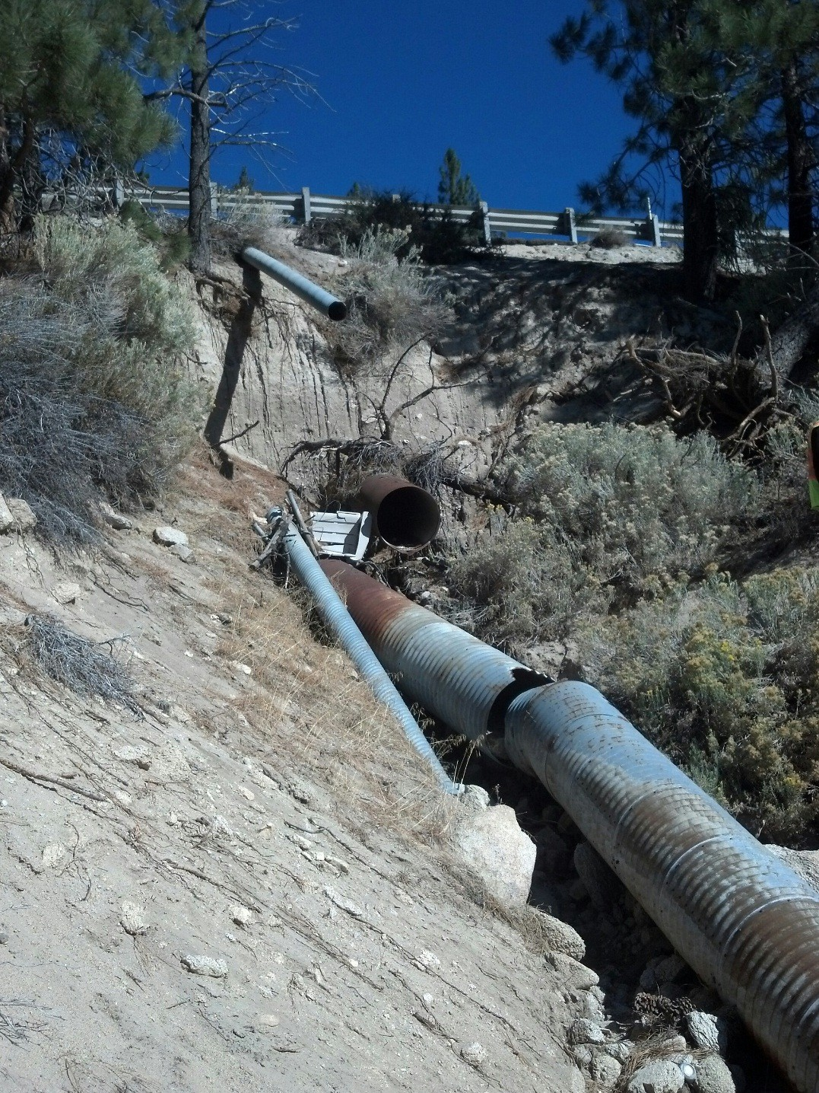

Slide 40
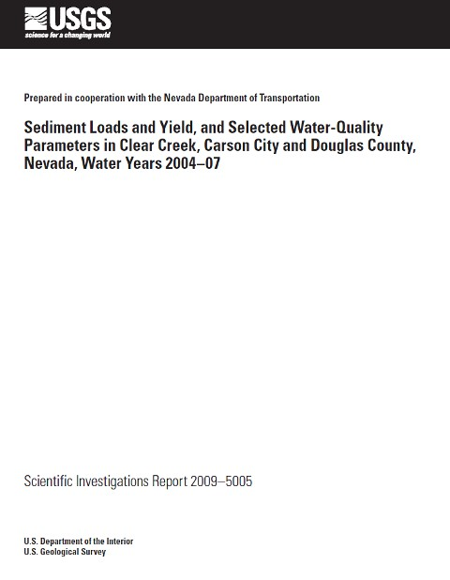
Monitoring began as part of the States MS4 permit in 2004.
1st Report for 2004 to 2007 available.
2nd agreement for 2009 to 2012
Report available soon.
3rd agreement for 2013 to 2016.
Report expected end of 2017.
$493,000
$247,000 (NDOT)
$247,000 (Federal USGS Matching Funds)

Slide 41
