Slide 1
West Fork Carson River Vision Plan Implementation
Danny McClure & Mo Loden
Lahontan Water Board
Carson River Forum, March 2023

Slide 2
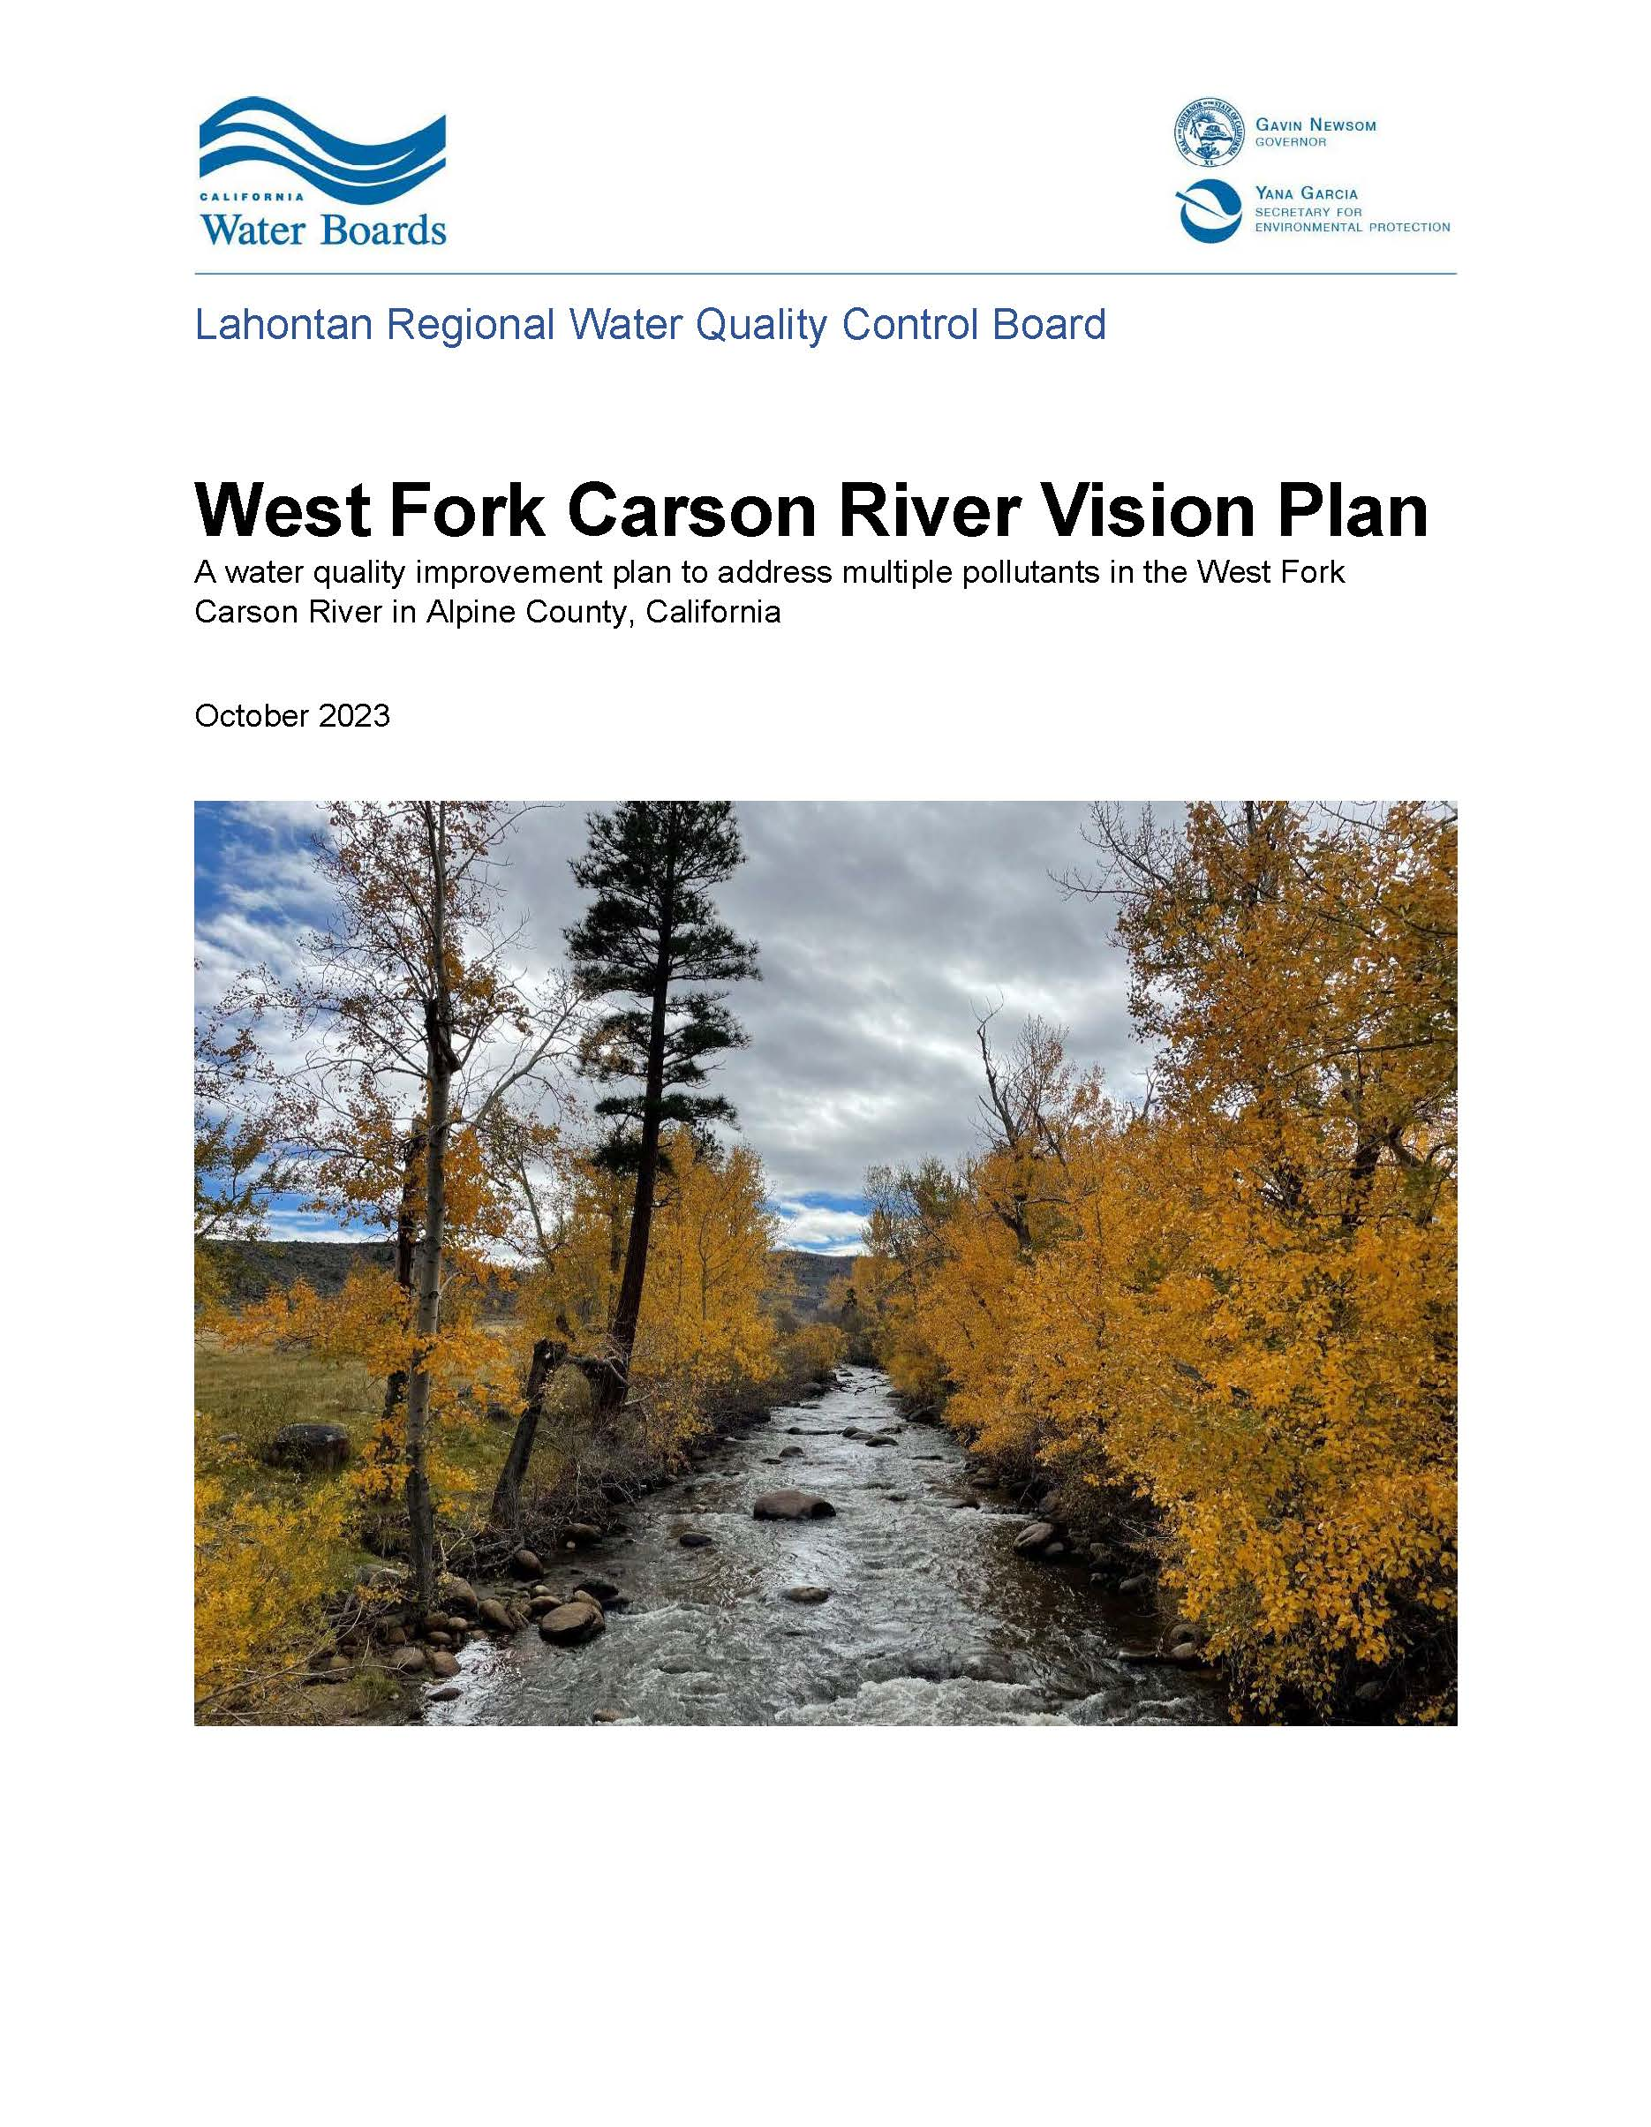
West Fork Carson River (WFCR) Vision Plan
Plan for meeting water quality standards & protecting against new impairments
Finalized in October 2023
Accepted by USEPA December 2023
In implementation

Slide 3
WFCR Vision Plan
Goal – attainment of water quality standards in the WFCR within 10 years
Not a formal regulation
  Developed and implemented in advance of TMDLs
  Refers to existing and expected actions
  Relies on collaboration with watershed groups (AWG, CWSD, CRC), agencies (USFS-HTNF, NRCS) and stakeholders
9-Element watershed-based plan - Clean Water Act Nonpoint source (section 319) funding

Slide 4
WFCR Vision Plan
Water quality impairments and sources
Actions to control sources & attain standards
Monitoring & information collection
Adaptive management

Slide 5
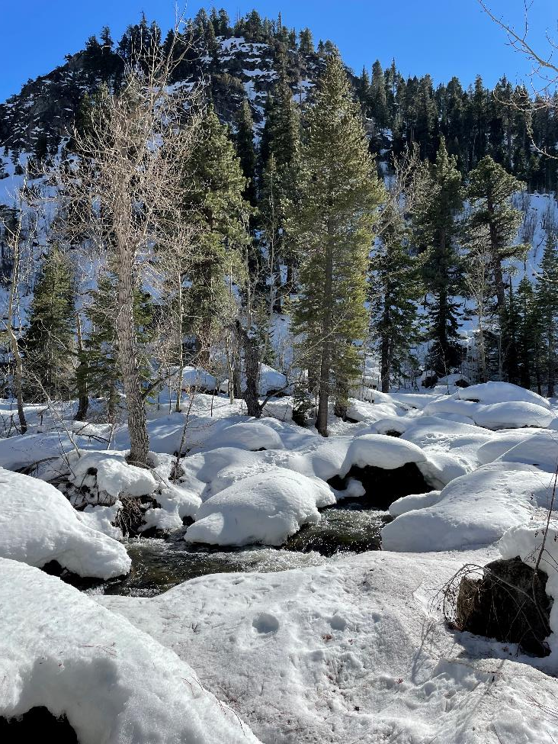
Carson River Adaptive Stewardship Plan (CRASP) & WFCR Vision Plan
CRASP
  EPA-approved watershed plan for Nevada, not California
  Needed specifics for CA to be eligible for Clean Water Act 319 funds
WFCR Vison Plan
  Companion to the CRASP
  Specifics for CA

Slide 6
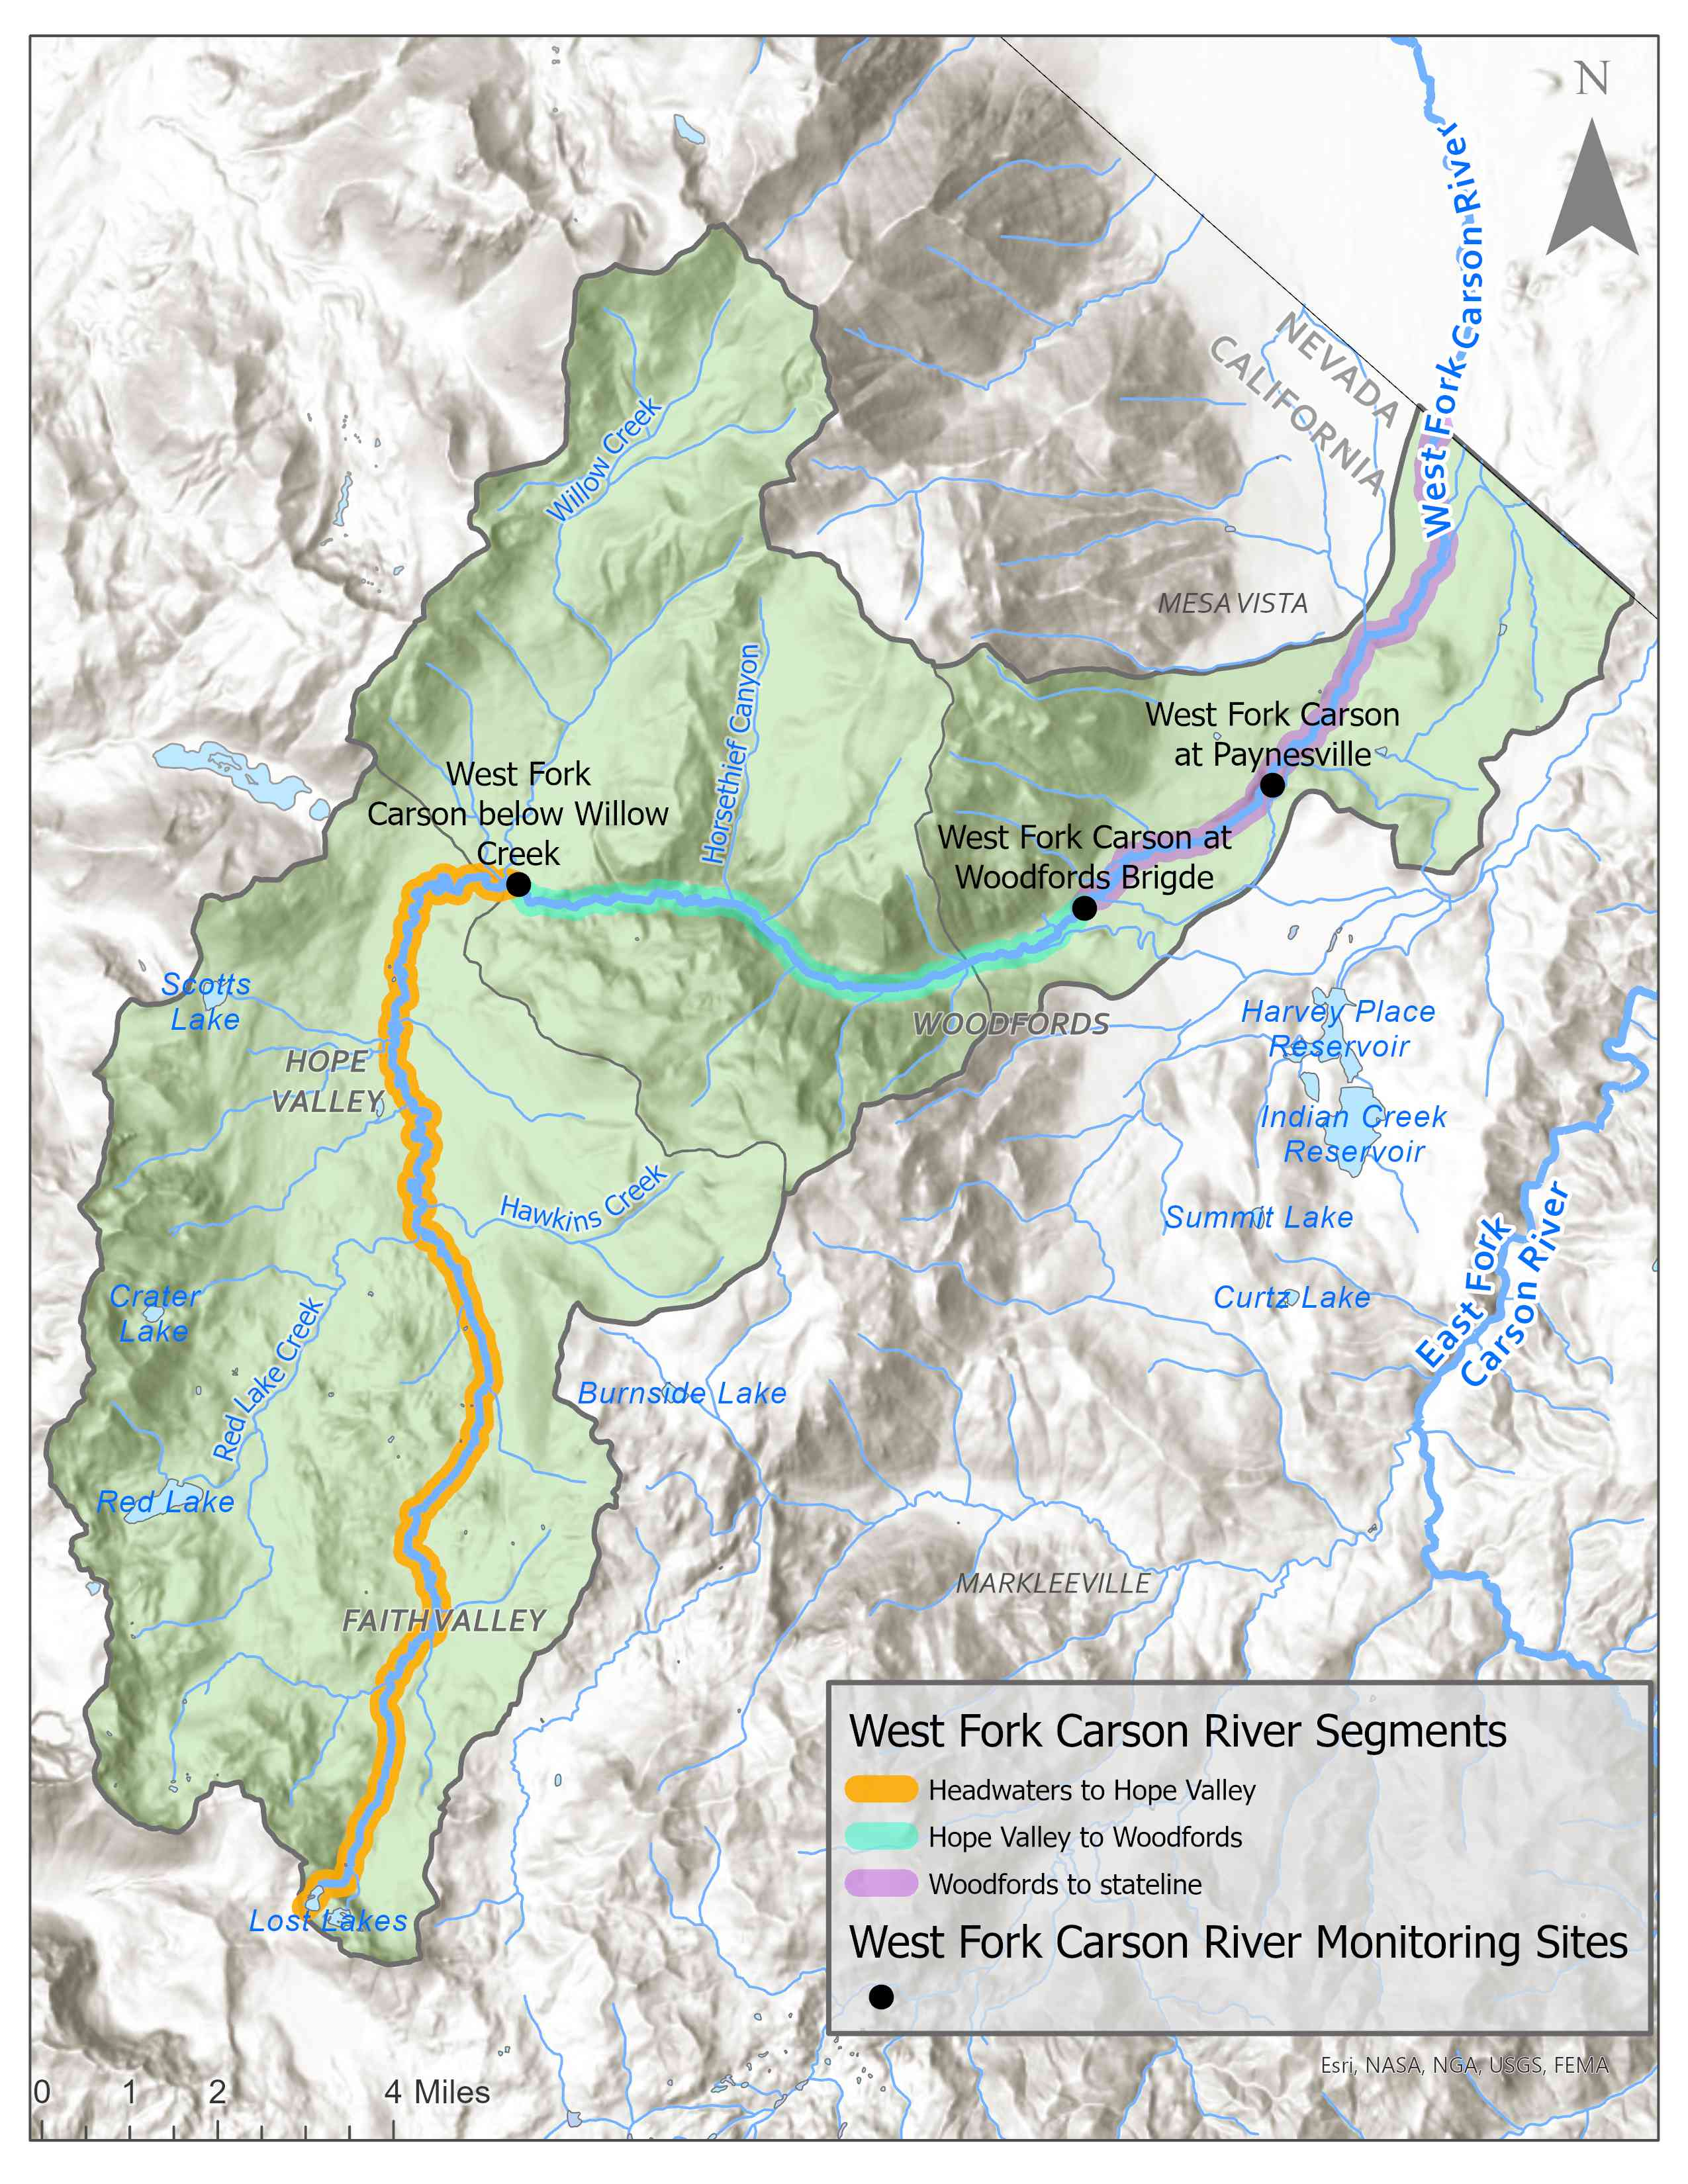
WFCR Water Quality Impairments
Segment | Impairments
Headwaters to Hope Valley | Nitrogen (Nitrate, TKN), Phosphorous, Sulfates
Hope Valley to Woodfords | Chloride, Nitrogen (N, Nitrate, TKN), Phosphorous, Sulfates, Total Dissolved Solids, Turbidity
Woodfords to State Line | Indicator Bacteria, Iron, Nitrogen (N, Nitrate, TKN), Sulfates, Total Dissolved Solids, Turbidity

Slide 7
Causes & Sources
Historical impacts
  grazing
  logging
Roads and road maintenance
Camping and recreational use
Onsite wastewater treatment systems (OWTS)
(e.g., septic tanks)
Grazing
Hydrologic modification
Climate change, fire
Notes:
, but here is a list of the identified causes and sources of water quality impairments in the West fork Carson river. They are the historical impacts most notably from logging and grazing, roads, recreational activities, septic tanks, grazing, and hydrologic modification and the plan also addresses other factors especially climate change and fire because of their potential to impact WFCR water quality in the future.

Slide 8
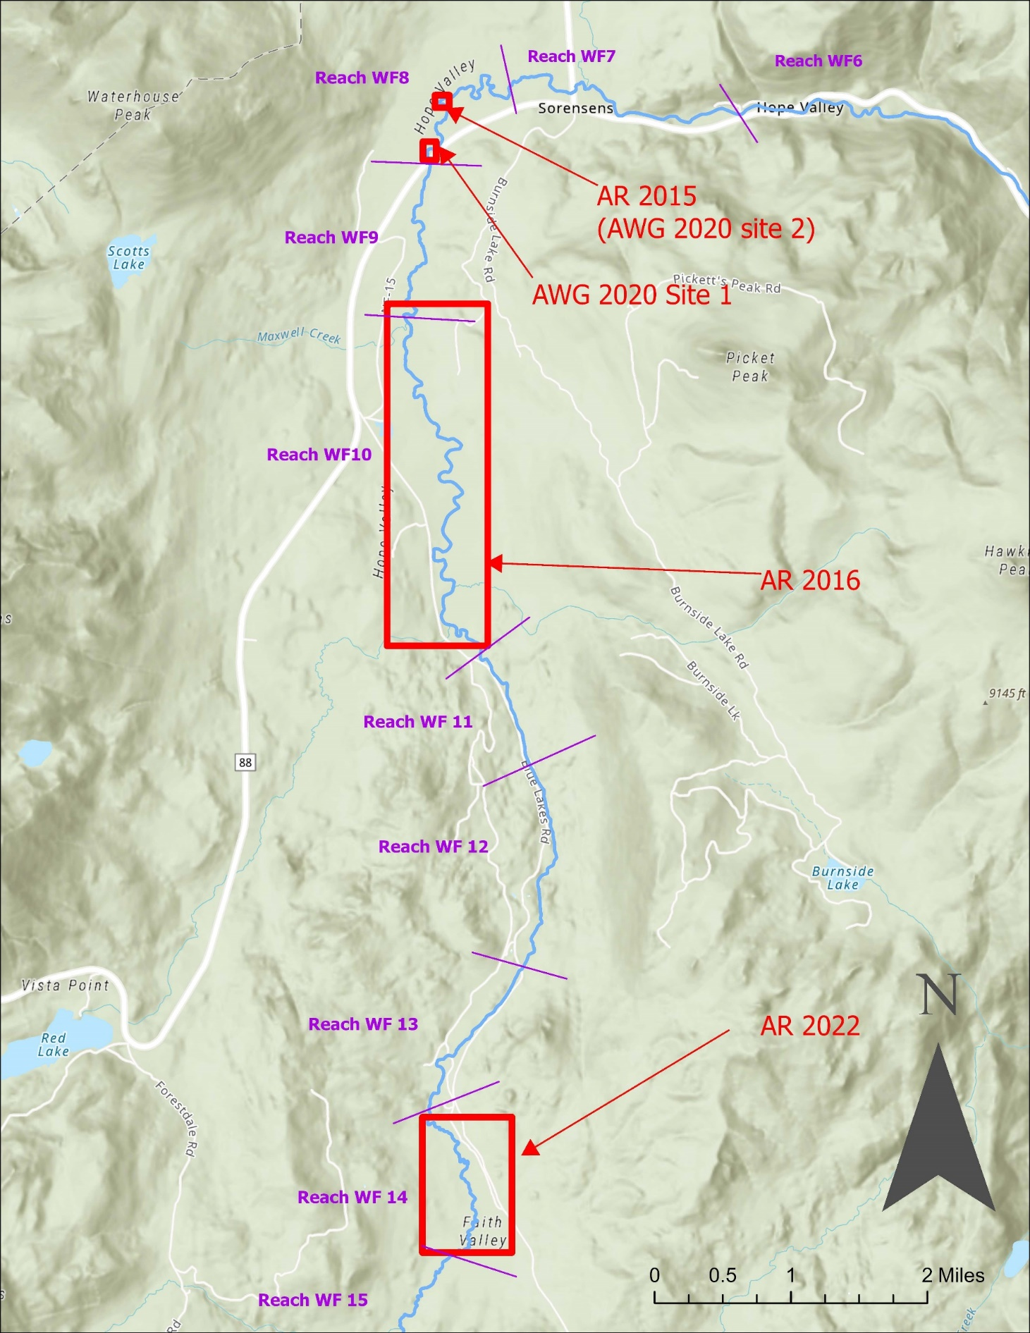
Historical Impacts/Restoration
Watershed extensively logged, grazed
Recent restoration projects (2015- present)
  Bank stabilization, dam structures (beaver dam analogues)
  Multi benefit – habitat, water quality, fire potential
  Washoe Tribe, AWG, American Rivers, Water Boards, CWSD, USFS-HTNF, Friends of Hope Valley, CDFW, Institute for Bird Populations, Trout Unlimited, National Fish and Wildlife Foundation, Sierra Nevada Conservancy, CA Wildlife Conservation Board, DWR, Wildlife Conservation Society, Bella Vista Foundation.
Notes:
Looking at the historical impacts
watershed historically was extensively logged and grazed that's caused a lot of erosion. There are restoration projects which are helping to mitigate those impacts.
There's been multiple recent restoration projects with some bigger projects starting in 2015. This map shows the location of the recent projects in the river channel in faith valley and hope valley.
These restoration projects have included bank stabilization, vegetation improvements and the construction of structures –beaver dam analogues - which slow the flow in the river reducing its erosion potential and helping it to reconnect with its floodplain. My next slide shows an example of one of these Beaver Dam Analogues.
These restoration projects are multi benefit. They improve water quality, habitat and also help reduce wildfire potential.
I'm not going to read them all, but this slide lists many of the entities involved in these restoration projects. These recent projects are part of why staff selected this as a vision project - to recognize and support these kids of projects.

Slide 9
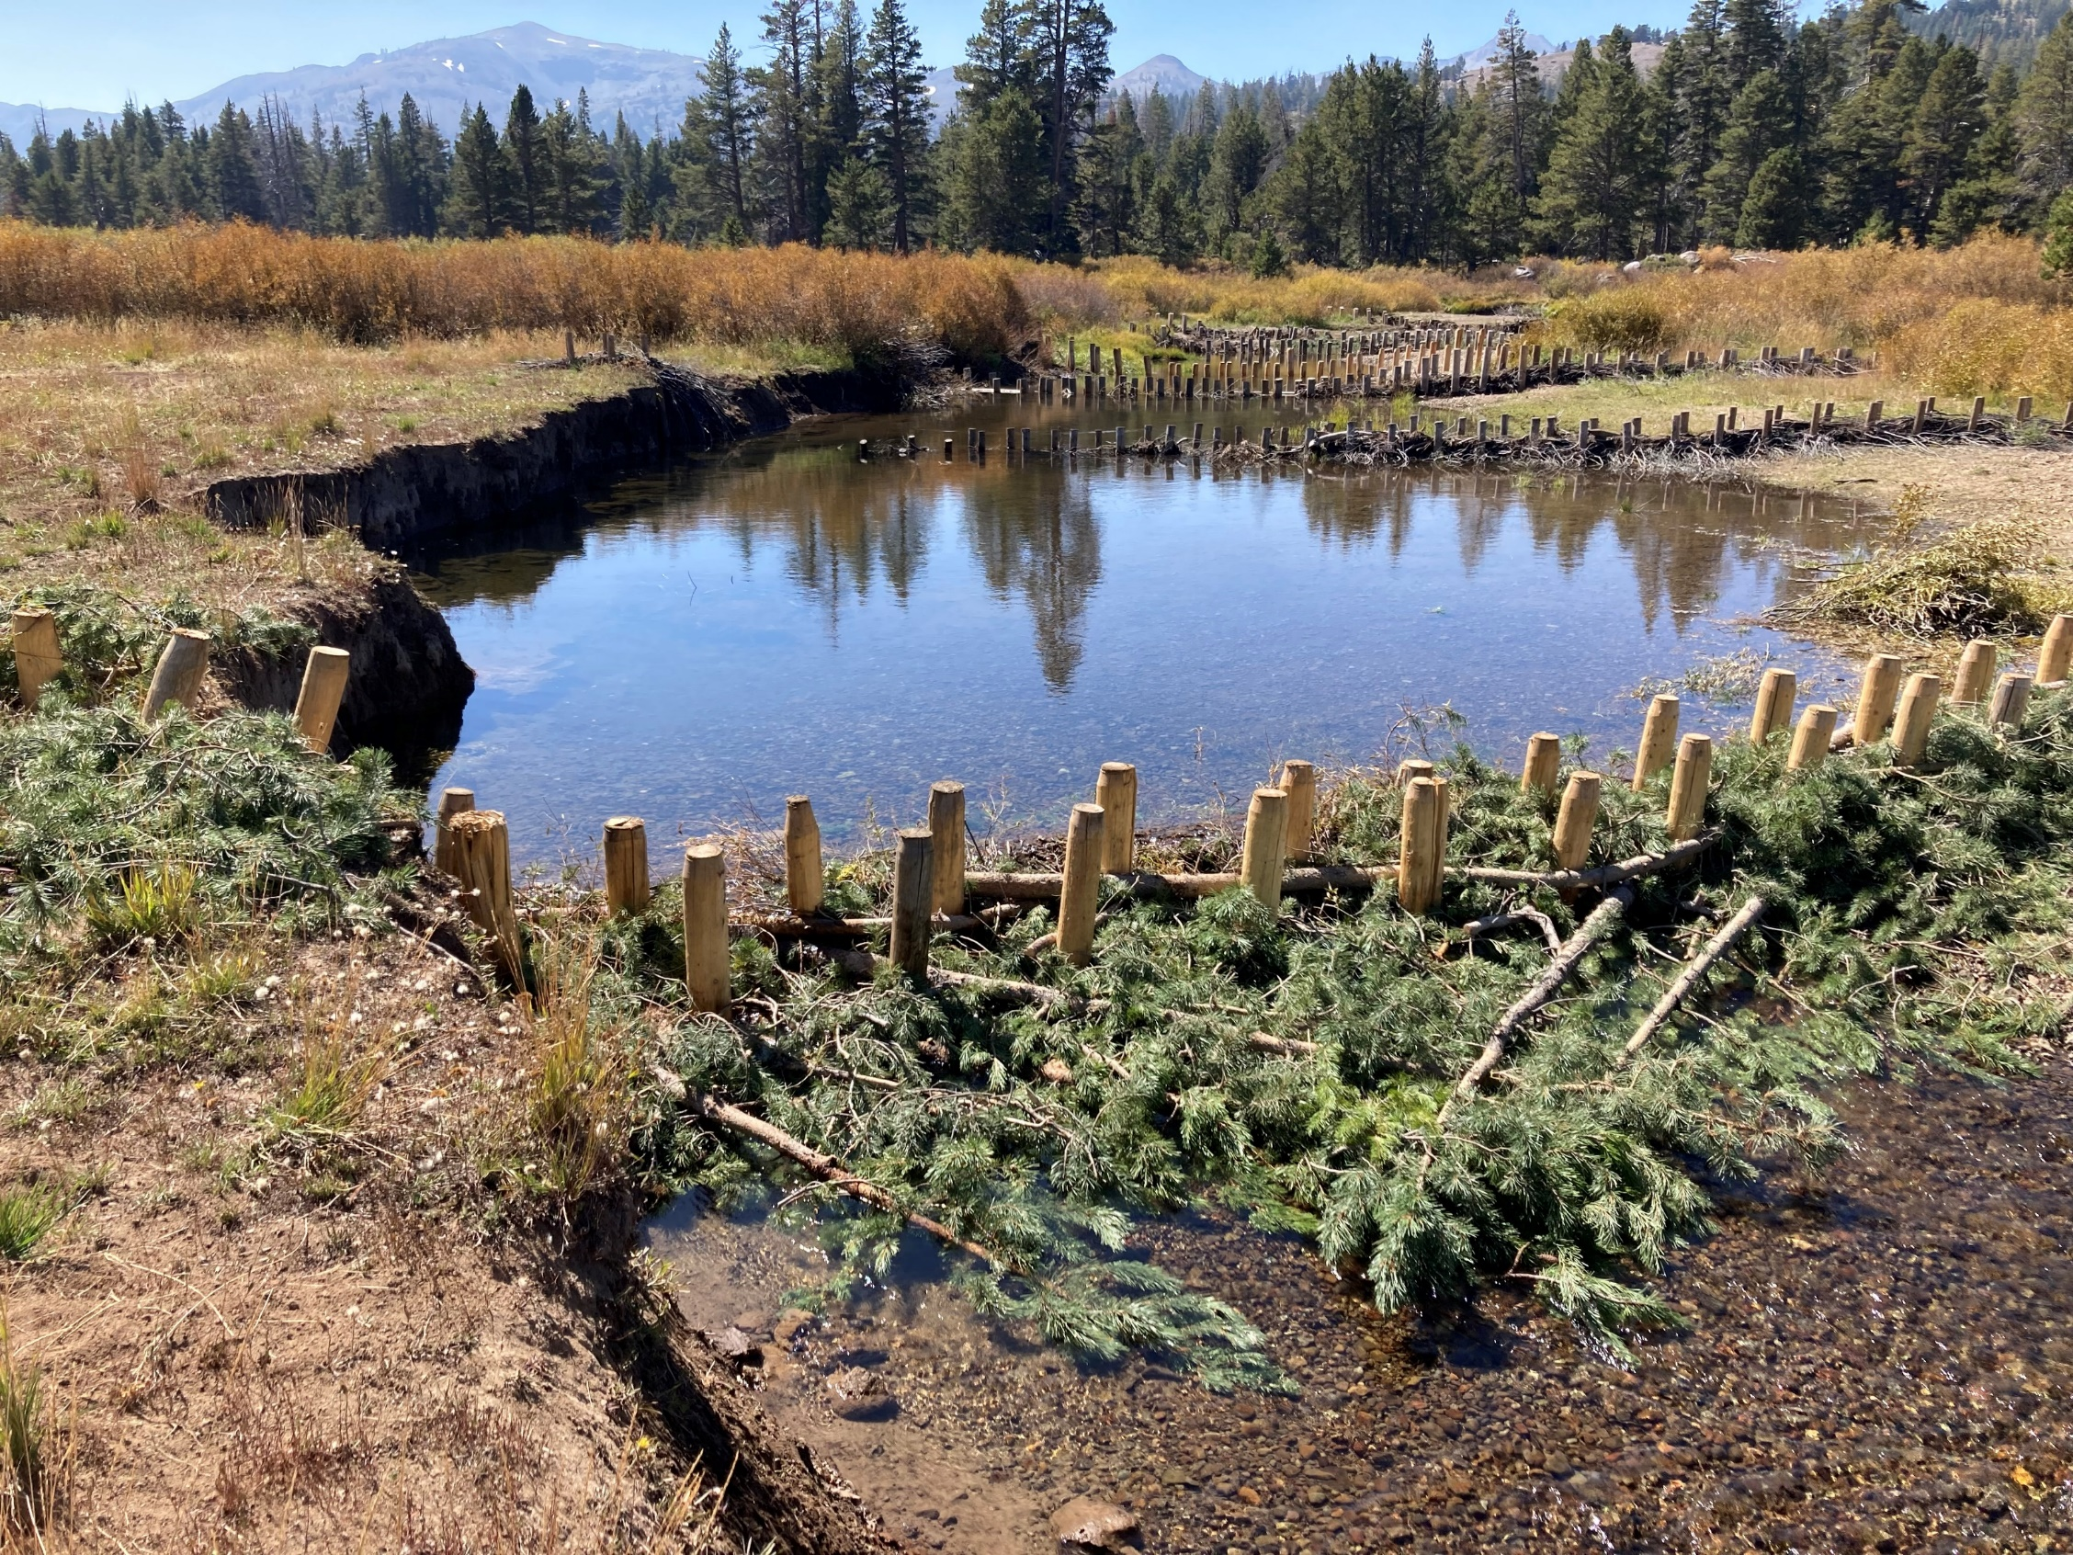
Historical Impacts/Restoration
Vision Plan Actions
AWG geomorphologic model & prioritization
    CWA 319 Planning Grant
    2024-2025
Support for additional restoration projects
  Informed by past studies and geomorphologic model
Appendix A
Notes:
Moving forward, the vision plan supports additional restoration projects. The selection of these projects will be informed by past studies and also by a recently funded CWA 319 planning grant that the Alpine watershed group received. That grant funded the development of a geomorphologic model of the watershed, and the use of that model to identify key areas for restoration.
This picture here is one of the Beaver Dam Analogues recently constructed by American Rivers in Faith Valley, just off of blue lakes road.

Slide 10
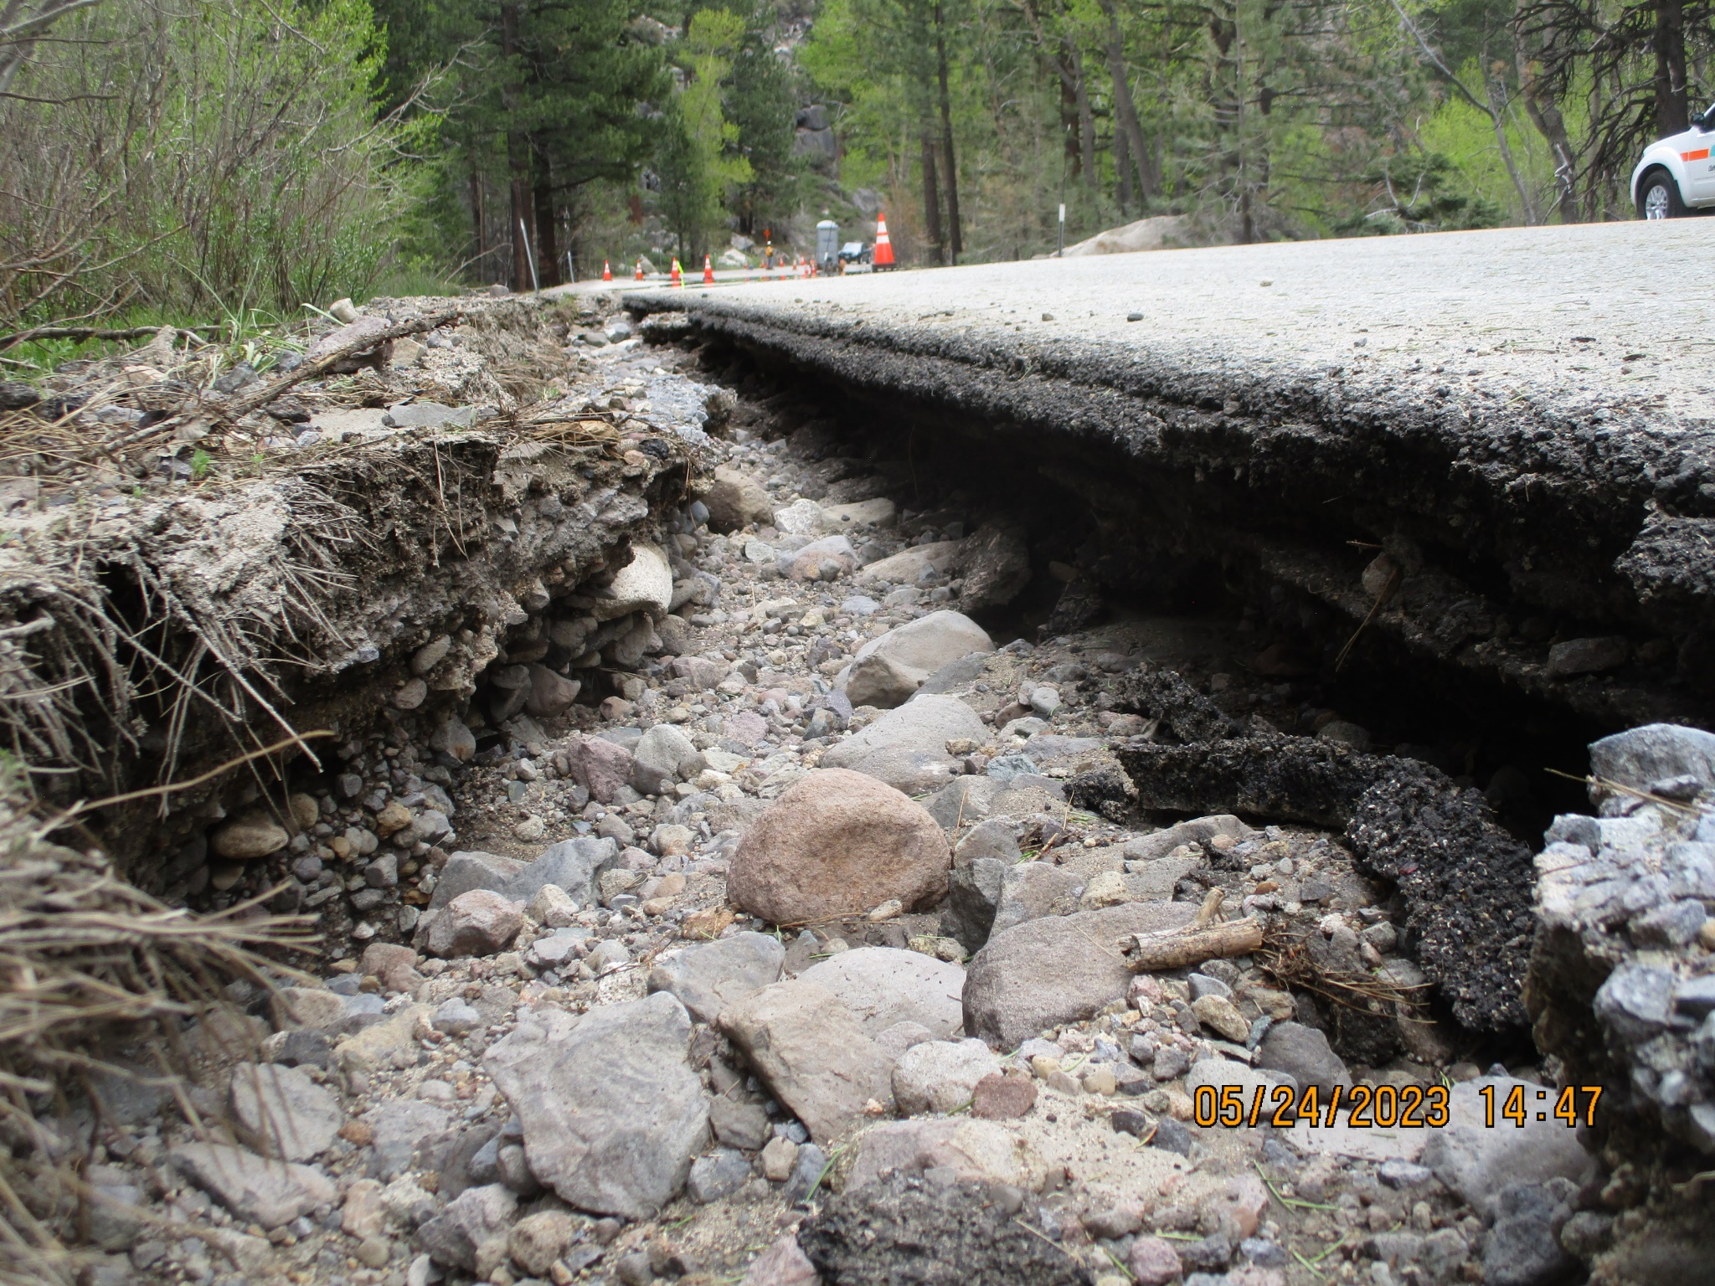
Roads and Road Maintenance
Caltrans, USFS, Alpine County
Erosion – road runoff, watercourse crossings
  2019 State Water Board study – identified watercourse crossings w. concerns
Salts and abrasives (sand etc.)
Notes:
Another source identified in the base vision plan is roads and road maintenance. The entities responsible for these are Caltrans, the US Forest Service, and Alpine county.
Roads can be a source of erosion do to road runoff, erosion of unpaved surfaces, alteration of watercourses, and issues at watercourse crossings.
In 2019 a state water board study identified several watercourse crossings in the watershed with potential to impact water quality.
Salts and abrasives used on roads during the winter can also impact water quality.
(Picture is from May 2023 along highway 88. - Taylor Zentner)

Slide 11
Roads and Road Maintenance – Vision Plan Actions
ID roads, structures (culverts) and road maintenance activities w/ greatest potential for discharge
Investigate the potential use of salt and abrasives with less impact to water quality
Identify sediment sources from dirt roads in identified problem areas
Annual reporting
  progress in identifying and resolving culvert, other road erosion issues, salt and abrasive use.
Notes:
There are a lot of practices which reduce impacts which the road management agencies are doing
The Vision plan asks for road management agencies identify road segments and structures, and road maintenance activities with the greatest potential for discharge.
The vision plan also asks the road management agencies to investigate the potential use of less impactful salt and abrasives materials and application practices.
The Vision plan also asks the HTNF to Identify sediment sources from dirt roads in identified areas of concern.
The Vision Plan requests that these entities to report annually on their practices and progress.

Slide 12
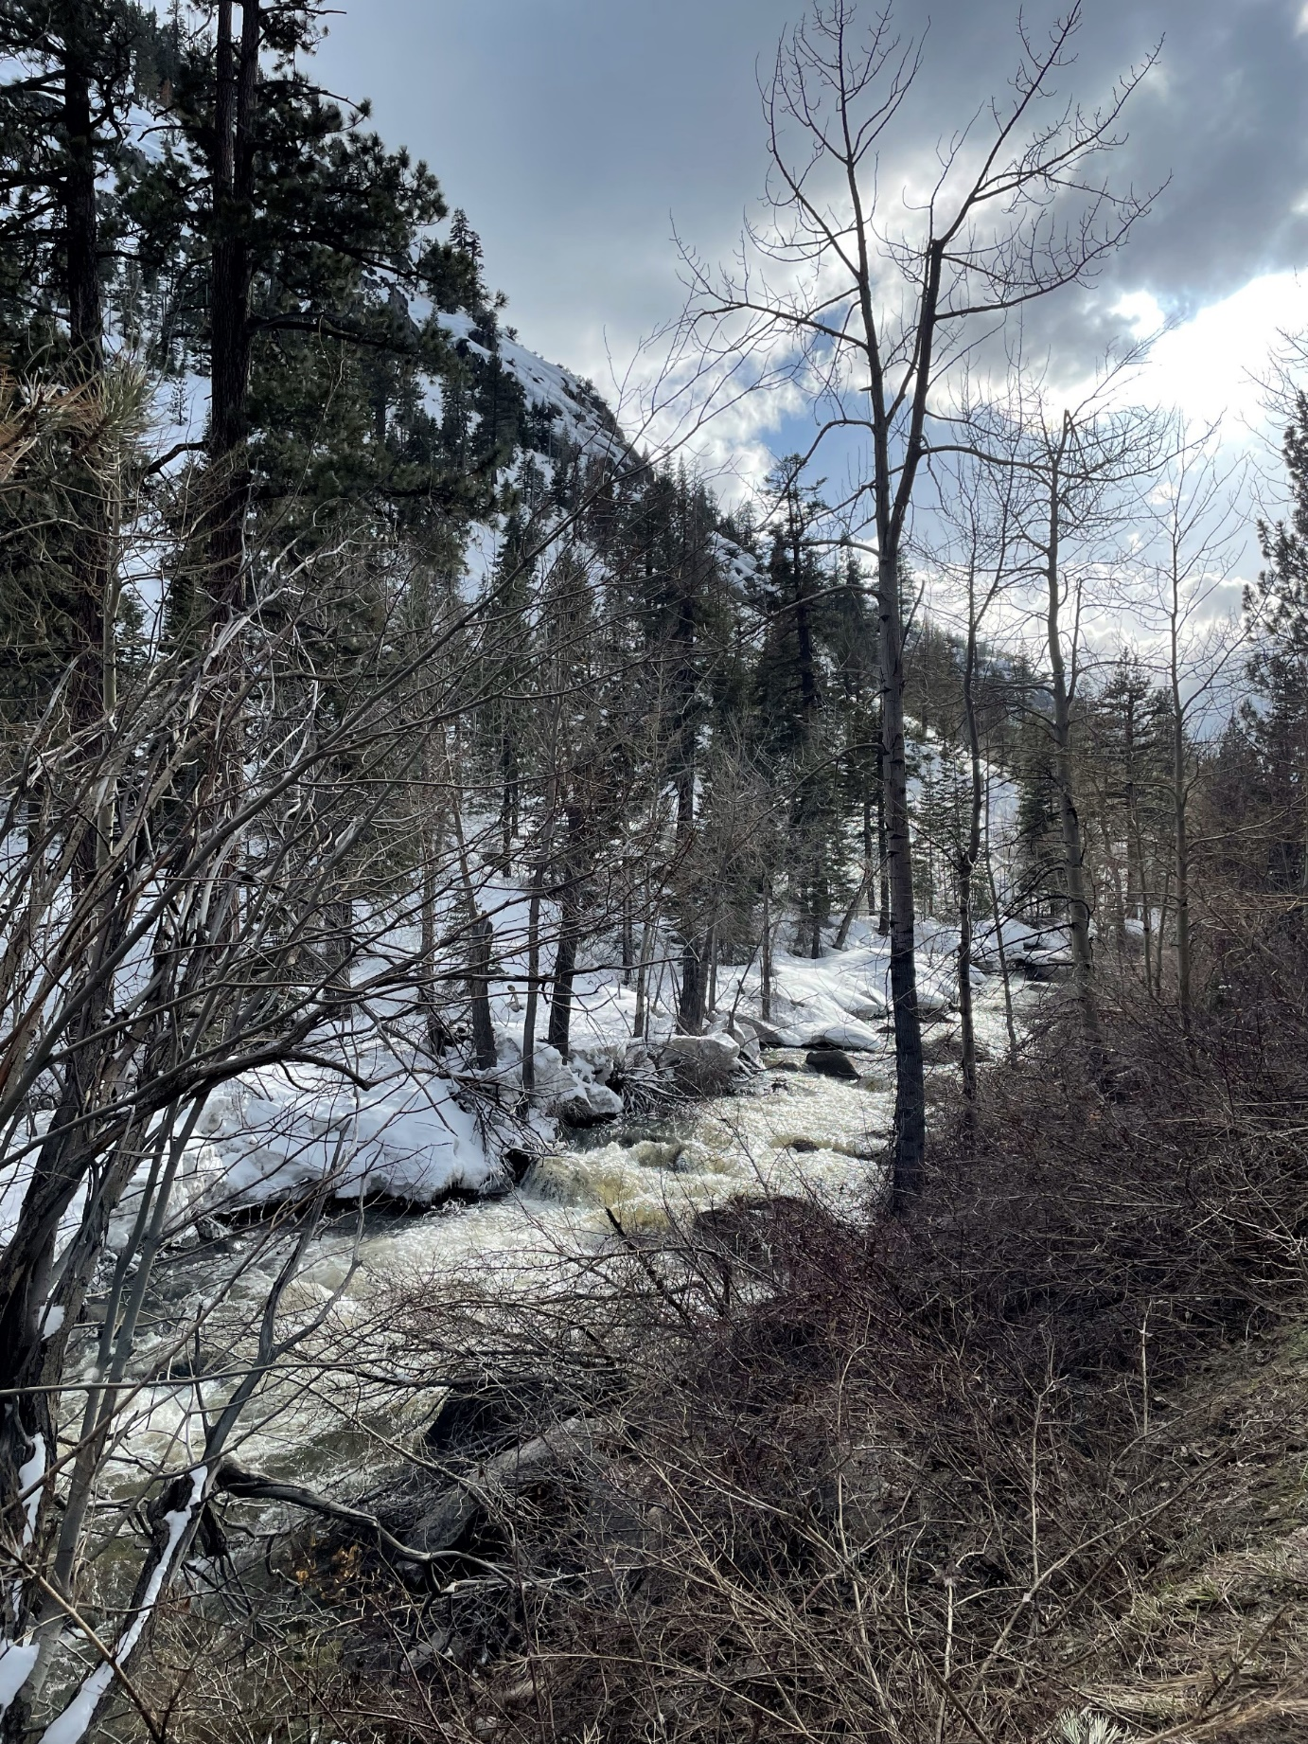
Septic Tanks/Onsite Wastewater Treatment Systems (OWTS)
Private residences and 1 hotel facility with OWTS near the river
Potential sources of nutrients and bacteria
Notes:
Another potential source is Onsite Wastewater Treatment Systems – both on private residences as well as one hotel facility near the river.
These are a potential source of nutrients and bacteria to the river

Slide 13
Septic Tanks/ Onsite Wastewater Treatment Systems (OWTS) - Vision Plan Actions
WDRs for hotel facility - upgrade OWTS
Continue work & collaboration with Alpine County Health Department to implement Local Area Management Plan (LAMP)
Outreach to homeowners along the river
Targeted monitoring study completed before 2029
Notes:
There are existing plans and permits addressing OWTS.
The vision plan notes that staff will continue working on waste discharge requirements for the hotel facility along the river which recently changed ownership and is in the process of upgrading its onsite treatment system.
Board staff will also continue working and collaborating with the Alpine County Health Department to implement its local area management plan for regulation of OWTS.
The board will also support outreach to homeowners along the river about the importance of properly maintaining septic systems.
The board will also conduct a targeted monitoring study before 2029 to investigate the potential impacts of these systems
(transition to MO!)

Slide 14
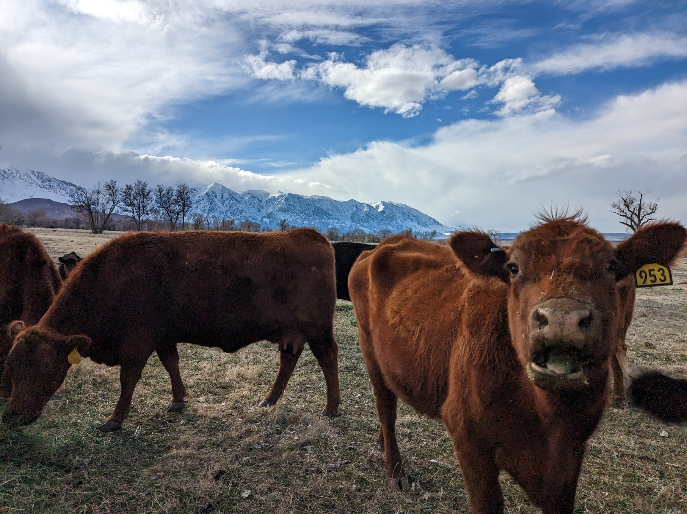
Grazing
Erosion, nutrients, bacteria
STPUD - Recycled water for irrigation
  Wastewater Reclamation Requirements (WRRs) (1989)
Improved practices
  Rivers and Ranches project
Notes:
Hi! My name is Mo. I work in the NPS Unit at Lahontan and I primarily handle grazing and 319 projects within our Region. So I will be giving a high-level summary of those topics and how they relate to the WFCVP here today.
Starting near Woodfords, there are several private grazing operations within the project area that are located along the river. Grazing can be a source of nutrients, bacteria, and a cause of erosion.
Some of the grazed lands along the river receive secondary treated wastewater for irrigation from the South Tahoe Public Utility District also referred to as stupid aka S.T.P.U.D. This use of recycled water is regulated by the Wastewater Reclamation Requirements which were issued by the Lahontan board in 1989. This source of irrigation water not only benefits the ranches but may also help reduce fire risk in the watershed. However, the irrigation water may also be higher in nutrients and could be a source to the West Fork Carson River. The VP requests STPUD prepare an assessment of the potential impacts of recycled water to the WFCR by the end of 2025.
There’s also been significant improvements in grazing practices along the river. A key project is the rivers and ranches project, which used Proposition 84 funding for multiple improvements at Ace Hereford ranch that helped reduce livestock’s direct access to the river.

Slide 15
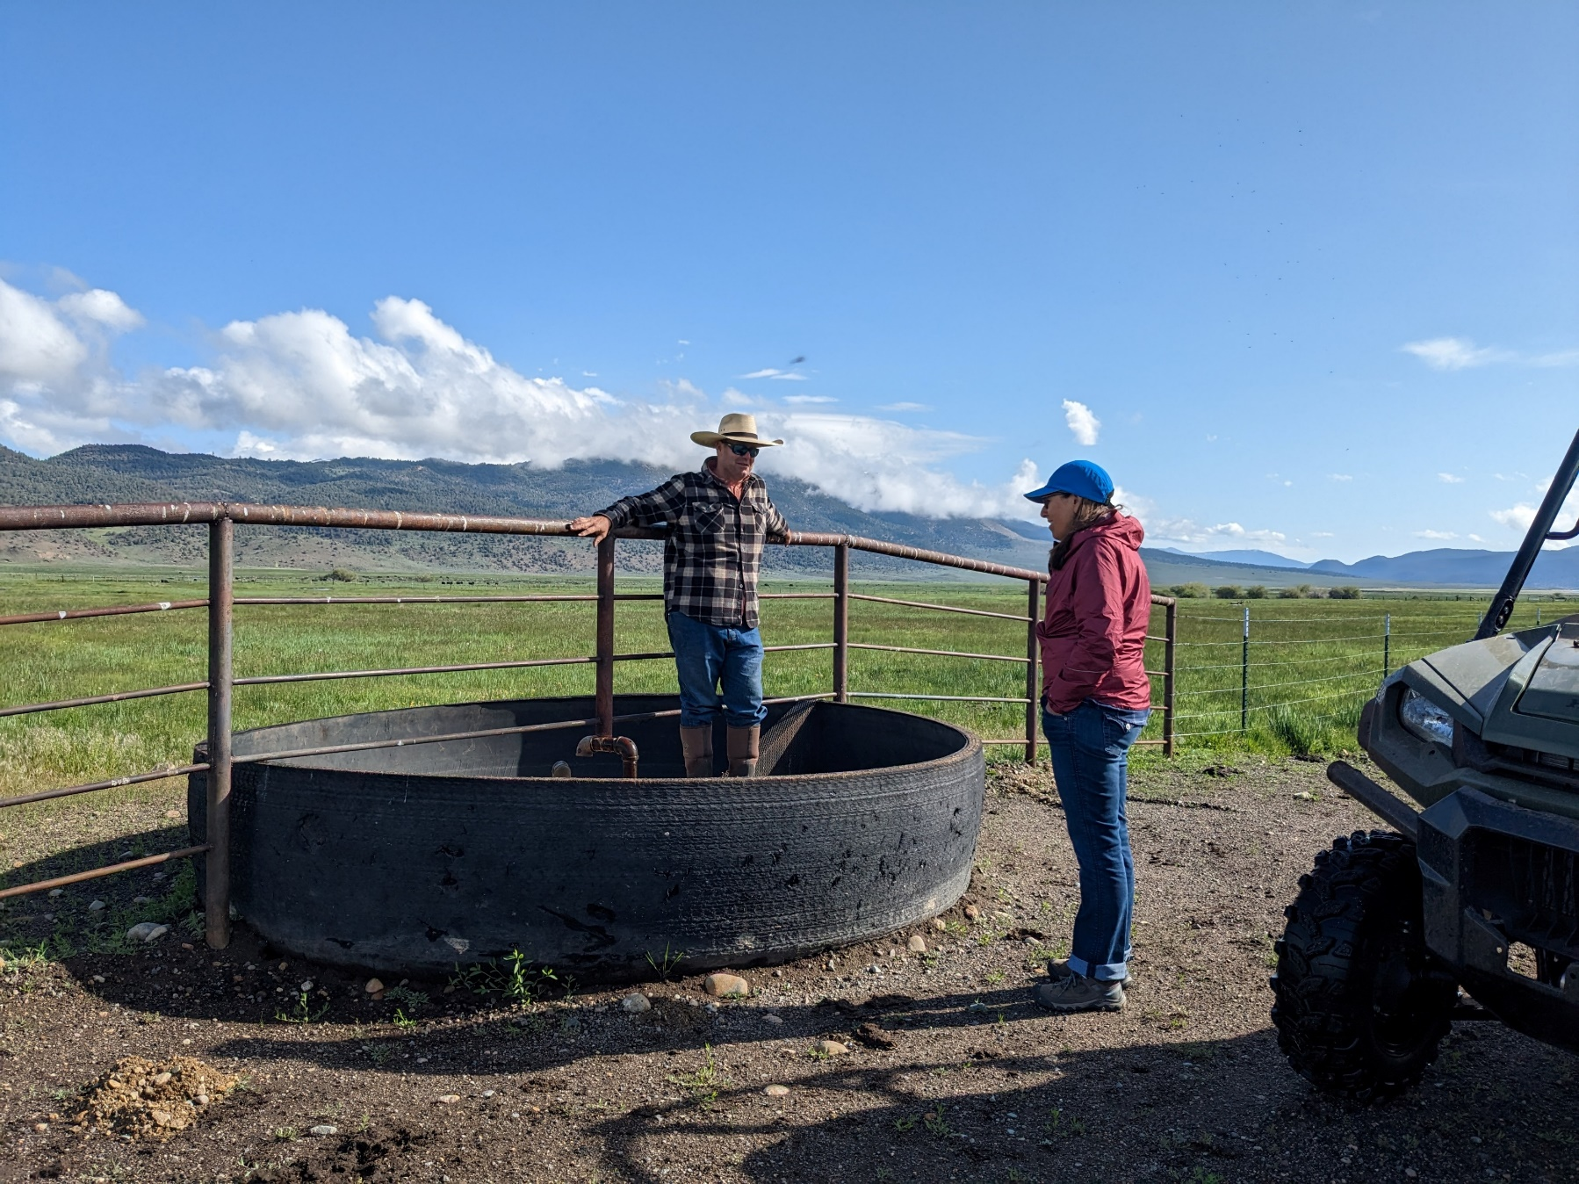
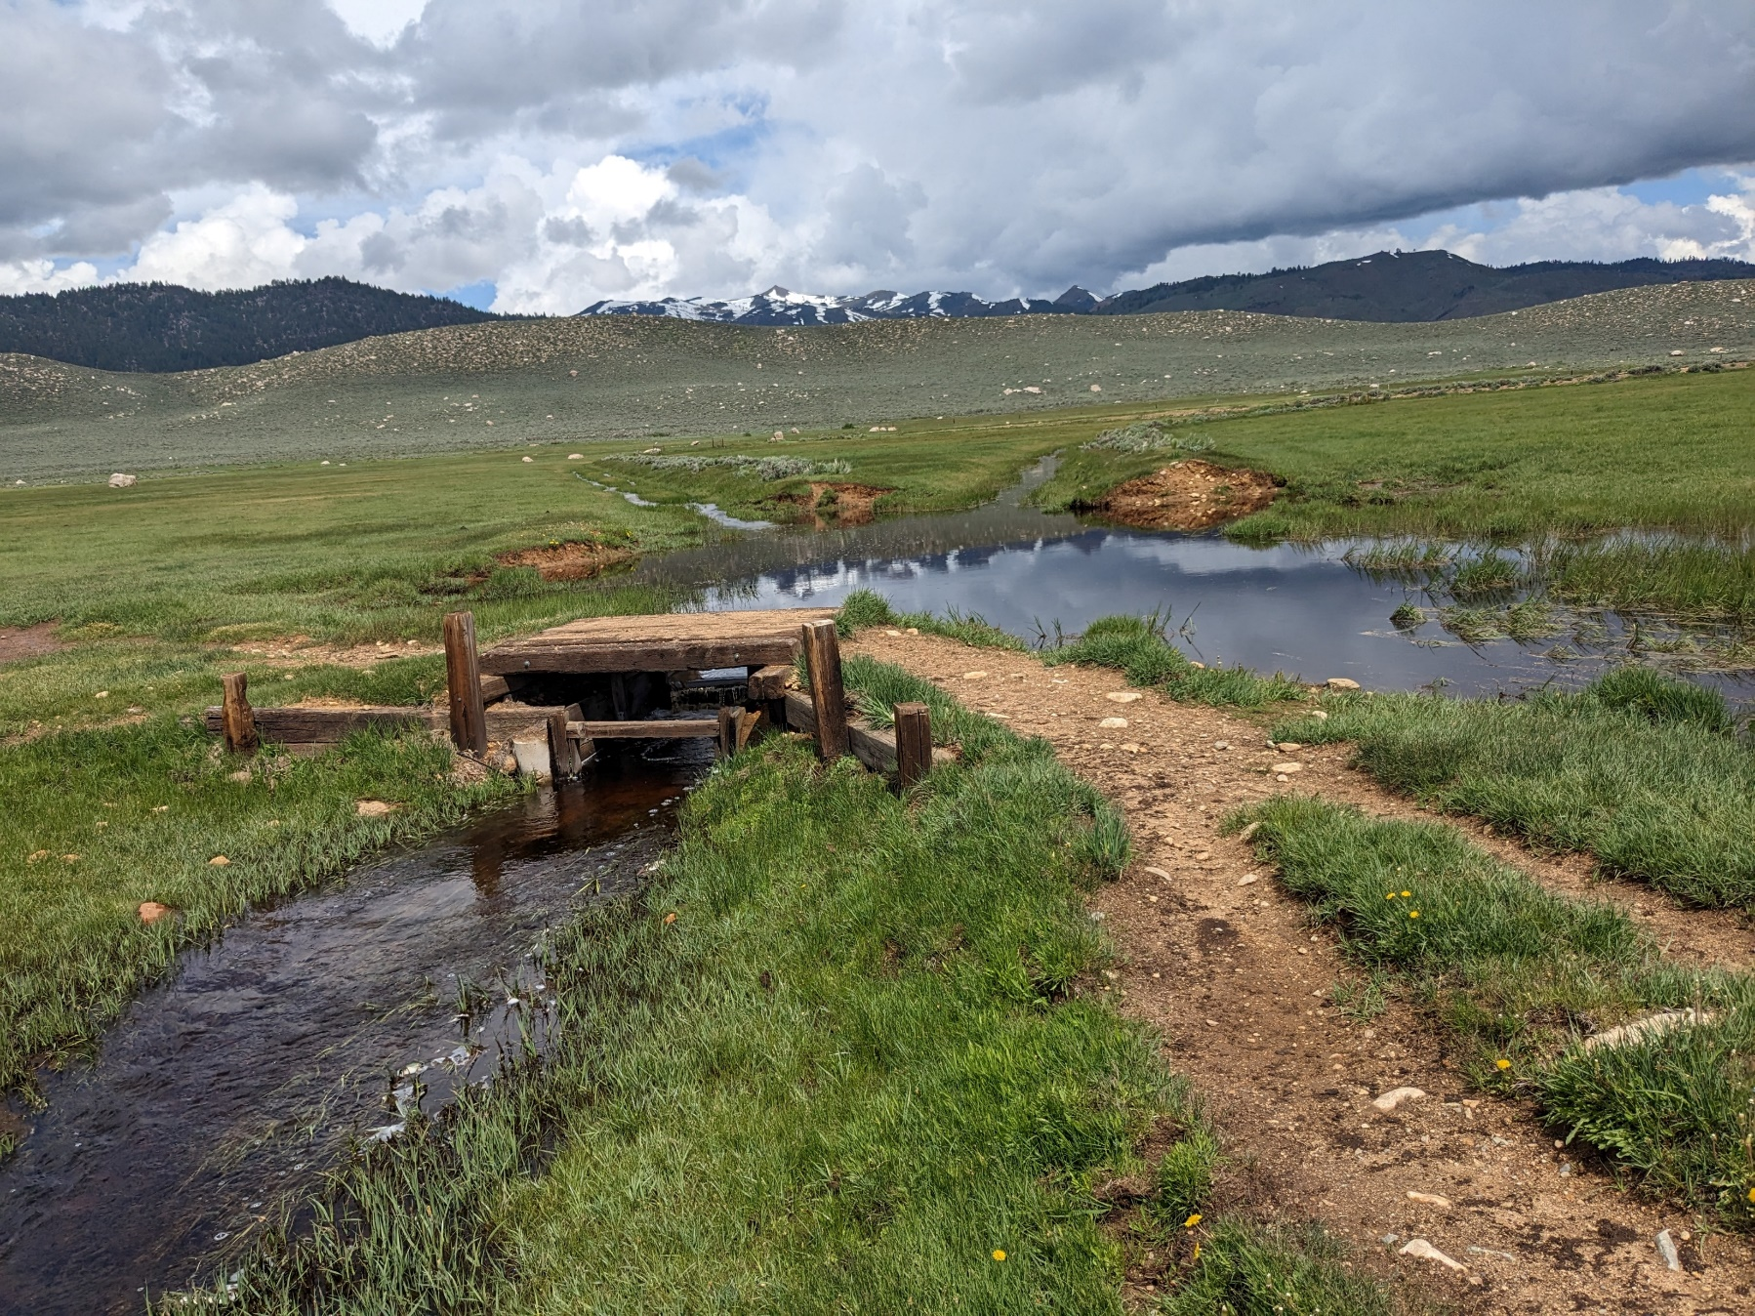
Grazing – Vision Plan Actions
Ranch Water Quality Plans by end of 2025
Implement management practices
Assistance from resource specialists (NRCS, UCCE), watershed groups
Grant funding
Notes:
In the coming months, I will begin to work with the ranchers to assess their land, grazing, and irrigation practices in order to develop Ranch Water Quality Plans specific to their parcels. The RWQP will help identify areas where water quality impacts may be occurring and will recommend management practices such as riparian fencing, off-stream drinking water systems, vegetated buffer strips, hardened water crossings, and irrigation structure improvements. Keep livestock out of the stream and reduce sedimentation.
There's potential assistance available from resource specialists such as Natural Resource Conservation Service, UC cooperative extension, as well as watershed groups.
There is also potential grant funding available from NRCS and the 319-grant program.

Slide 16

Nonpoint Source 319(h) Grant Program
Focus: To reduce and mitigate the effects of nonpoint source pollutants
Eligible Orgs: Nonprofits, Federally Recognized Tribes, Federal, state, local, or other public agency or public college
Eligible Projects: Implementation and planning projects
Funding Range: Implementation $250K-$1 million/Planning $50K - $250K
Match: 25%
Typical Due Date: Annually in December
Mo Loden, Environmental Scientist
Nonpoint Source Unit
Region 6 Grant Manager
mo.loden@waterboards.ca.gov
Notes:
The State Water Board receives grant funding from the US EPA under section 319 of the Federal Clean Water Act to fund projects to reduce nonpoint source pollution.
Eligible Applicants must fit under one of the categories listed here.
Most grant funding is earmarked for projects that improve impaired waters, but some funding may be awarded for protection of high-quality waters, post-fire recovery projects, or planning proposals. The Grant Program typically awards about $4 million per year to eligible projects.
New last year! The WFC watershed is eligible for implementation funding due to the WFCVP being adopted. And in an attempt to expand eligibility through the Lahontan region, we are now also accepting planning proposals for 303d listed waterbodies.
The implementation project funding range is from $250,000 to $1 million.
Planning projects can range from $50,000 to $250,000.
All projects must provide a 25% match unless the project qualifies for a waiver.
319 RFPs are usually released in the fall with applications typically being due in December. It is never too early to start chatting about your project idea and I would encourage you to do so. The application can be complex. So please feel free to shoot me an email if you’d like to talk more.
And now back to Danny to cover the other source categories.

Slide 17
Camping and Recreational Use
Hope Valley, Faith Valley, Scotts Lake areas
Erosion – vehicular use
Improper disposal of human and/or animal wastes – nutrients and bacteria
Notes:
Another source of water quality impacts in the watershed identified in the vision plan is camping and recreational use. Key areas of concern are dispersed camping areas in hope valley, faith valley and Scott slake areas where we can see some fairly heavy recreational use.
Potential impacts are erosion from vehicles in unpaved areas and improper disposal of human and or animal waste, which can be a significant source of nutrients and bacteria.

Slide 18

Camping and Recreational Use
- Vision Plan Actions
Increased field presence by HTNF, volunteers
Facilities improvements
Education
Funding through USFS RAC funds
  Recreation technician
  Scotts Lake facilities
  Educational kiosks
Potential future – local sanitary dump station
Notes:
These are actions identified in the Vision Plan to address potential impacts of camping and recreational use.
First is having in a increased field presence by Humboldt Toiyabe National Forest staff as well as volunteers.
Another action identified as improvements in facilities
Also continued education for people using these lands – I’ll talk about education efforts in a few slides.
There's been some recent progress on these front by HTNF staff. They have obtained resource advisory committee funds for requests an additional recreation technician for a year, construction of vault toilets at Scotts lake, and construction of educational kiosks. Along with the local watershed groups, we provided letters of support to for those projects.
Another potential future facilities improvement, which would be greatly beneficial would be construction of a local sanitary dump station for RVs. - this is a pretty heavily used and the closest dump stations are pretty far away.
Finally I will mention that our liaison with Humboldt Toiyabe National Forest, Bryan Talmadge meets with them on a regular basis to discuss issues. opportunities and progress at improving water quality protection on National Forest service land.
Dump station this is a heavy use area – many people could use it.

Slide 19
Hydrologic Modification
Historical channelization, separation from the floodplain
  Increased flood flows, decreased flows in dry season
Retention of water in reservoirs effects on algal growth – turbidity and organic loading
Vision Plan Actions
Support projects which benefit flows and hydrologic function
Request CDFW study options for management of Red Lake
Notes:
Another factor potentially contributing to water quality impairments its hydrologic modification. The River has been channelized and separated from the floodplain this is results in increased high flows and then decrease flows in the dry season – which can negatively effect water quality. Also retention of water in reservoirs can affect algal growth, resulting in turbidity and organic loading from those reservoirs to the River. Of particular concern is - Red Lake which has frequent harmful algal blooms in the summer.
The vision plan supports projects with benefit flow and hydrologic function in the WFCR. It also requests California Department of Fish and Wildlife, which manages Red Lake, to study options for how algal blooms in the lake can be reduced.

Slide 20
Fire, Climate Change, Other Factors
Potential devastating impacts of wildfire
  Tamarack Fire’s impact on East Fork Carson River
Invasive species & development
Vision Plan Actions
Fuels reduction, invasive species removal, floodplain protection
Notes:
The vision plan also addresses the potential impacts of fire climate change and other factors. We've recently seen in the east fork Carson river the devastating impacts on water quality from the Tamarac fire. Vision plan also recognize the potential impacts of invasive species and development in the floodplain.
Vision plan recognizes the benefits to water quality of fuels reduction invasive species removal and floodplain protection.

Slide 21


Information and Education
Key messages identified
Support existing campaigns/efforts
  CWSD/CRC watershed literacy campaign
  USFS-HTNF, NRCS, AWG education & outreach
  Participation in Carson River Forum, etc.
Annual progress evaluations
Notes:
There is also an information and education element in the Vision Plan.
The Vision Plan identifies key educational messages related to water quality
The Vision Plan identifies that staff will support existing education campaigns, including the CWSD watershed literacy campaign, which is the source of the materials pictured here, HTNF and AWG education and outreach efforts. Board staff will also participate in forums and events, most notably the annual Carson River form.
Finally, Board staff will provide an annual evaluation of progress on the implementation of the actions identified in the vision plan, which will help inform stakeholders and the public.

Slide 22
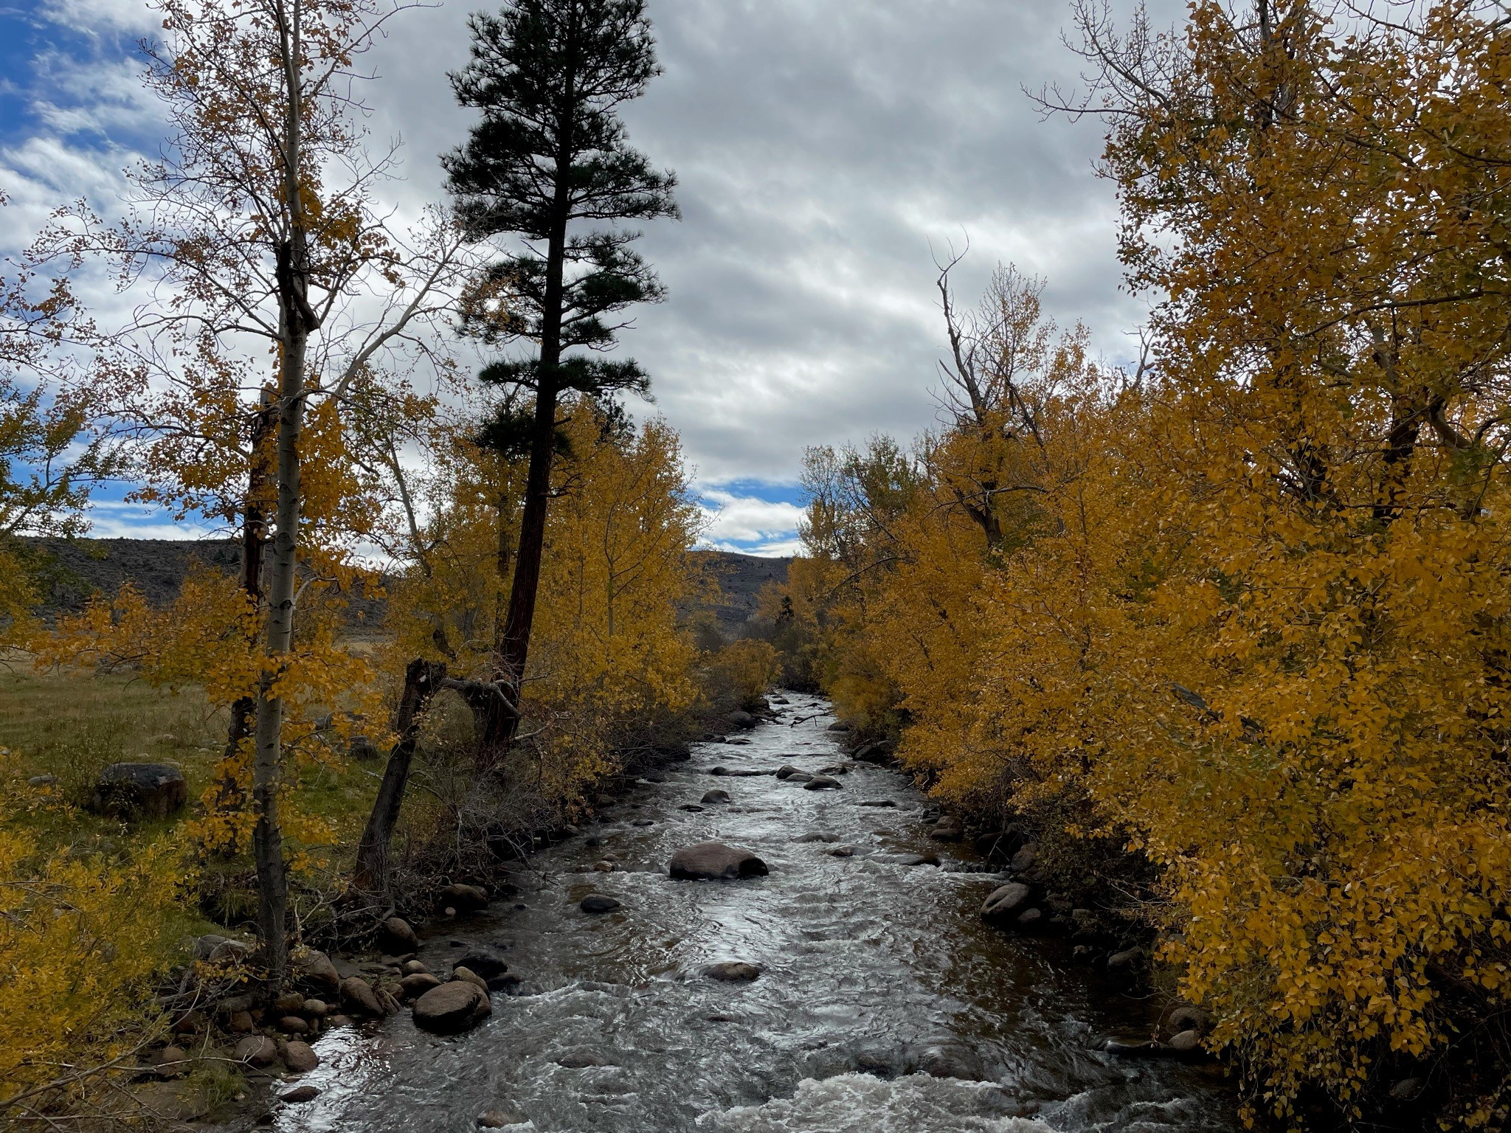
Monitoring
Continued monitoring by Lahontan Water Board, NDEP, STPUD, AWG
Notes:
The Vision plan describes key monitoring questions, and the ongoing water quality monitoring in the WFCR to answer those questions. There will be ongoing monitoring by our SWAMP program, Nevada Division of Env Protection, STPUD, and also AWG if they have resources and support to continue monitoring.

Slide 23
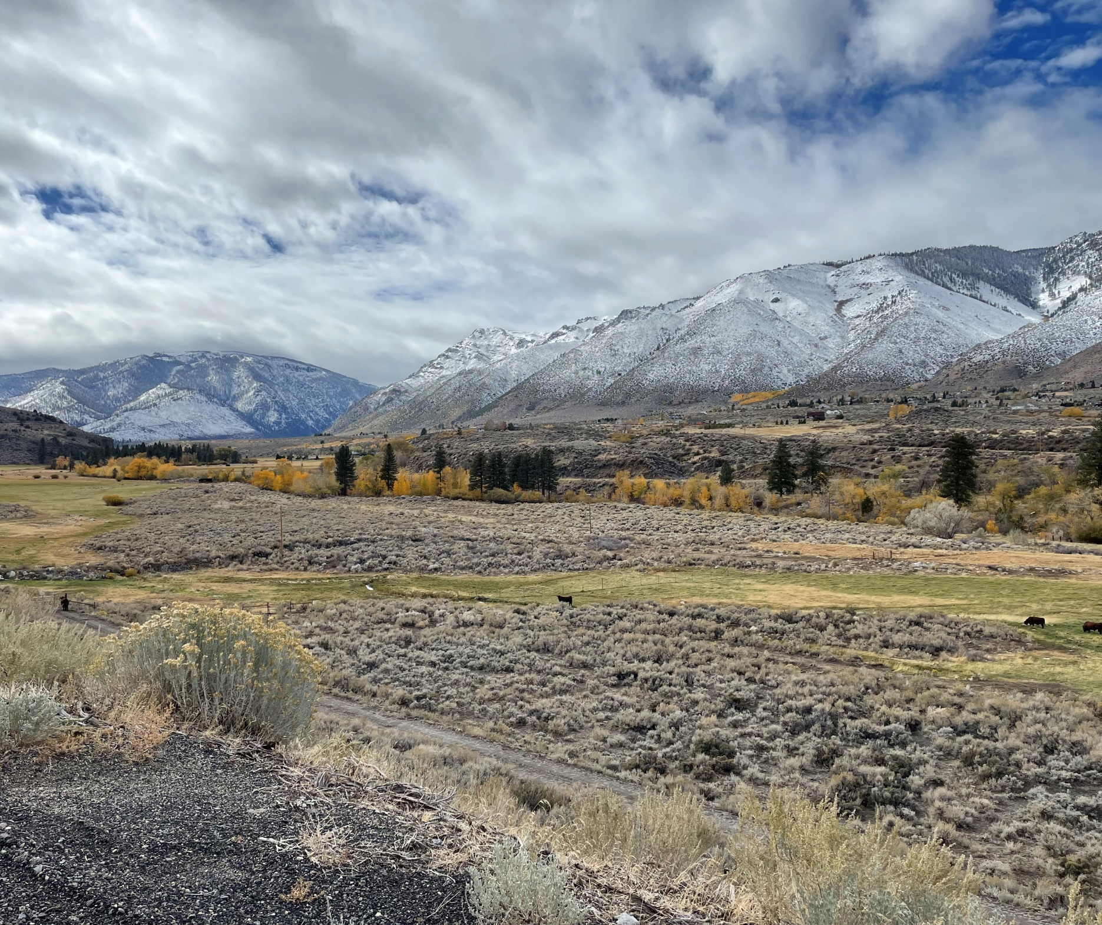
Evaluation &
Adaptive Management
Assess water quality data trends
Assess implementation progress vs milestones
Annual report/tracking
starting January 2025
Board Review 5 and 10 years
Potential changes to water quality objectives, e.g., chloride, sulfate
Potential changes to regulatory approach – move to TMDLs, permits etc.
Notes:
Finally the Vision Plan discusses the approach for evaluation and adaptive management.
Staff will assess water quality trends from the monitoring date.
Staff will track implementation and annually provide an evaluation on implementation versus milestones.
Staff will also bring this back to the board for review at 5 and 10 years
Those board meetings will provide chance to discuss potential changes to the regulatory approach and or potential changes to the water quality objectives.

Slide 24
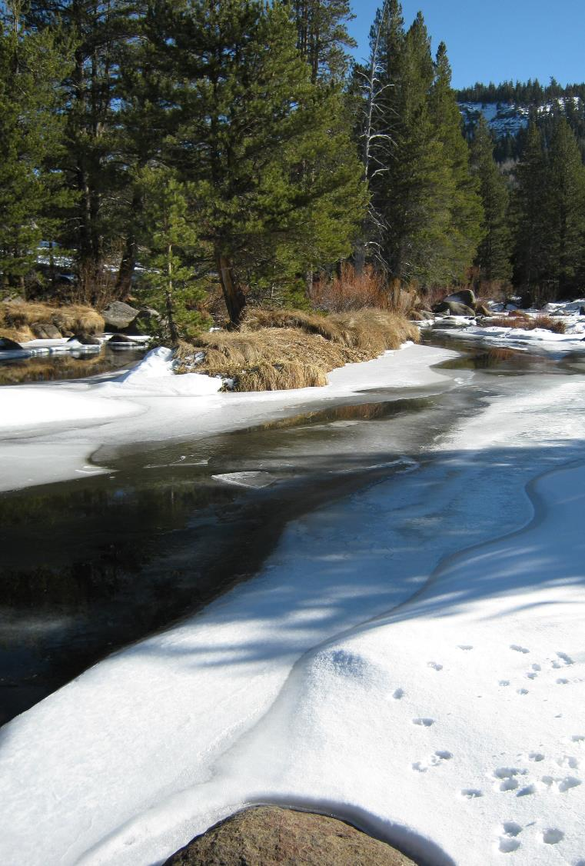
Conclusions
WFCR Vision Plan finalized in 2023, in implementation
  Complementary to the CRASP
Attainment of water quality standards in 10 yrs.
Identifies causes/sources, actions to reduce water quality impacts
Ongoing monitoring and adaptive management
Annual reports on progress
Ongoing collaboration will be key to success

Slide 25
