Slide 1
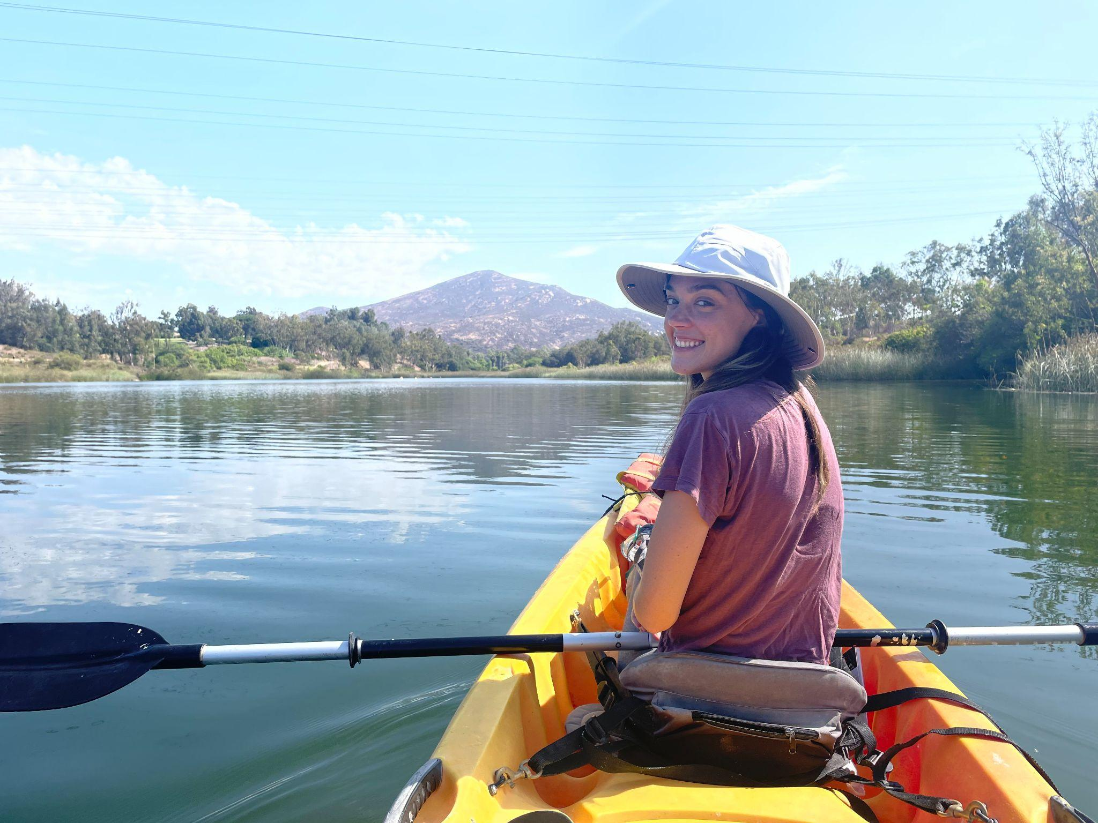
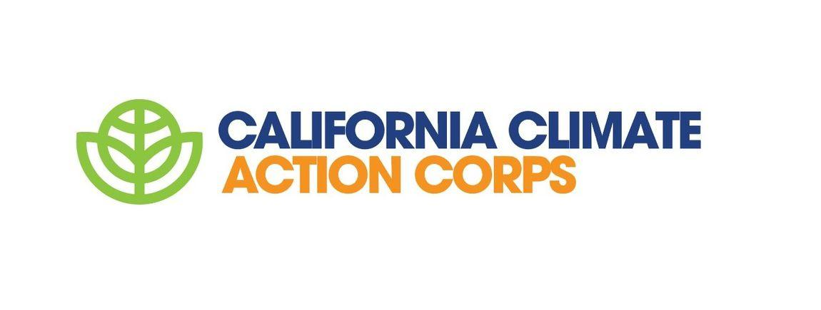
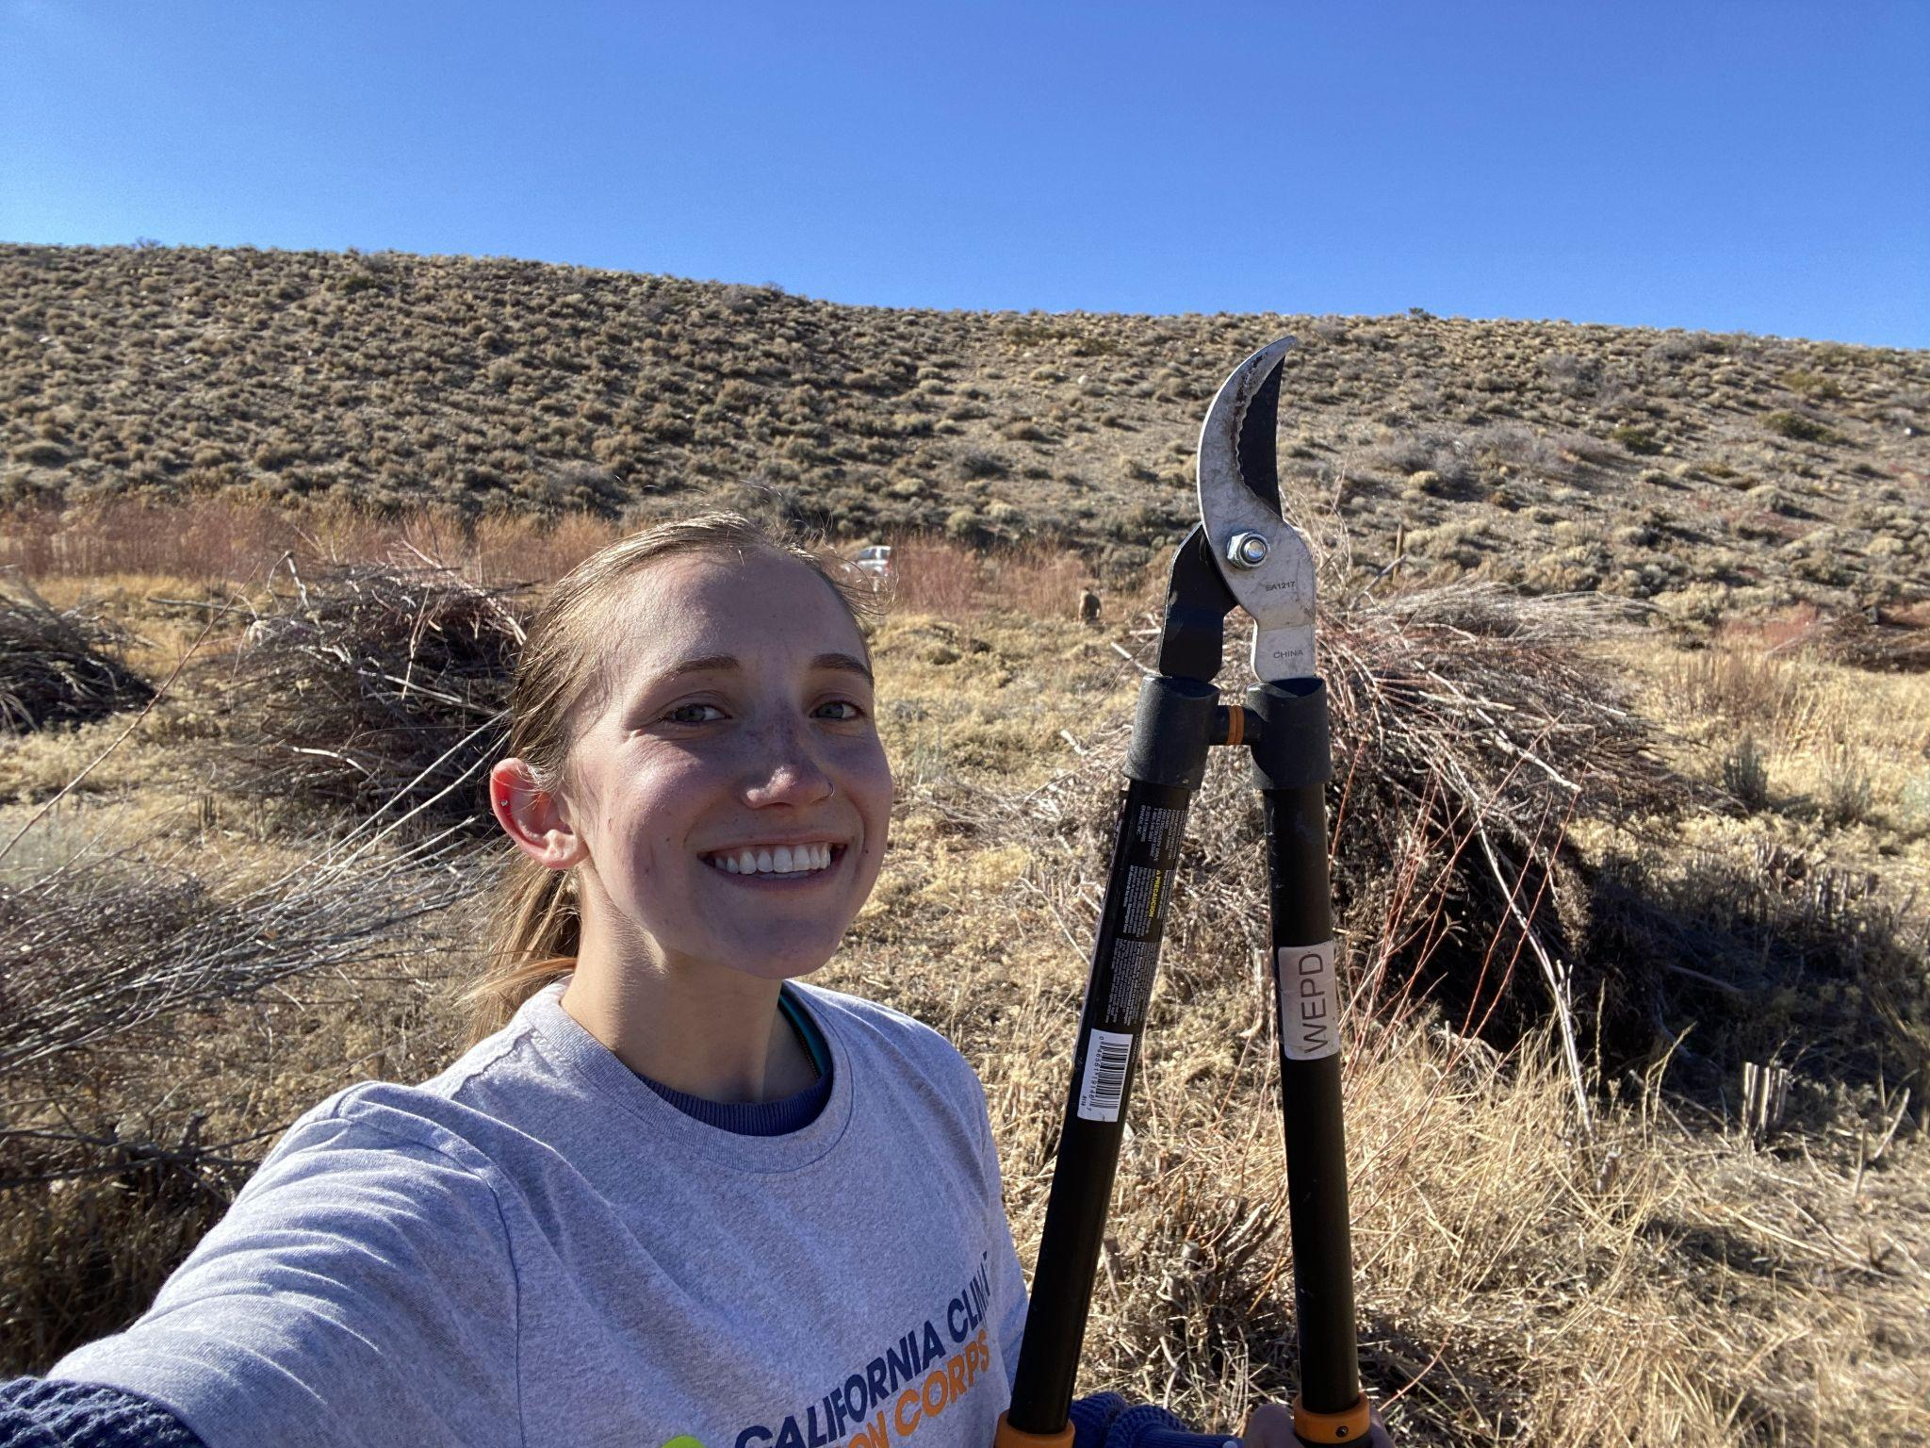
Addressing Climate Change with California Climate Action Corps
Kaitlyn Garber and Isabella Kurtz

Slide 2
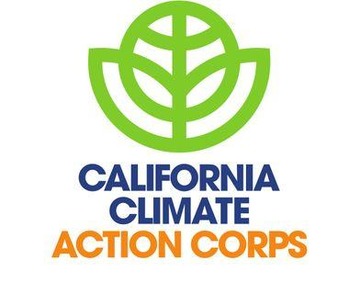
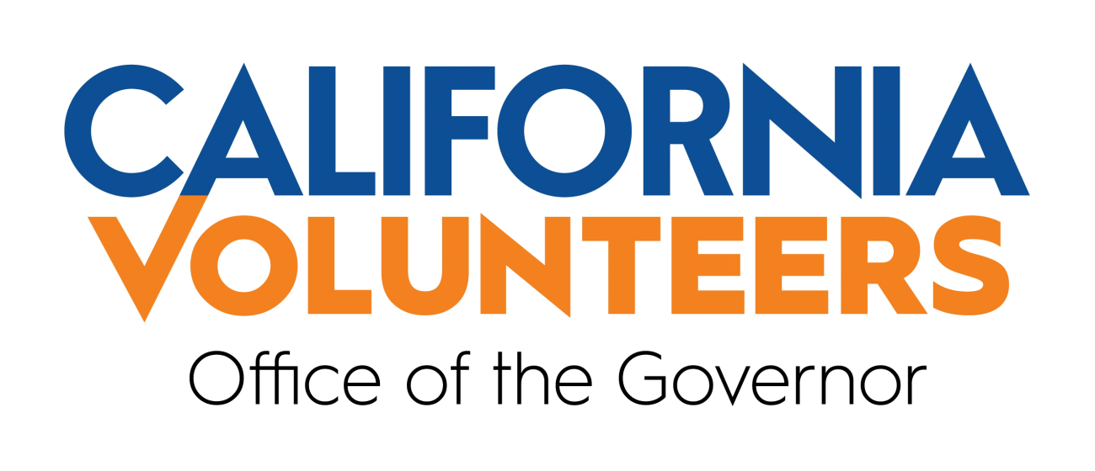
Goals of the CA Climate Action Corps Program
“As a part of California’s comprehensive strategy to address the climate crisis, California Volunteers, Office of the Governor created California Climate Action Corps, the country’s first state-level, climate service corps to empower all Californians to take meaningful action to safeguard the climate.”
As of September 2023, Arizona, Maryland, Minnesota, North Carolina and Utah are starting their own Climate Action Corps Programs.
Notes:
KG
California Climate Action Corps, or CCAC, is a state-funded program
The program functions by pairing individuals who are capable and passionate about climate change action with organizations that have the capacity and infrastructure in place to facilitate action.
Structuring the program this way has proven successful, because it both provides support to organizations that are doing great work, and gives opportunity, experience, and mentorship to those who are new to the workforce.
There are three focus areas for the state of California’s climate change resiliency that are reflected as the three focus areas in the program: wildfire resiliency, urban greening, and food recovery.
Next year, there will be a fourth area of focus: climate volunteerism.
California Climate Action Corps is spreading! Last September, the governors of 5 states announced the creation of their own Climate Action Corps, and are partnering with California to best implement the program. States that will be starting their own program are Arizona, Maryland, Minnesota, North Carolina and Utah.

Slide 3
Day-to-Day Life of a CA Climate Action Corps Fellow

Slide 4
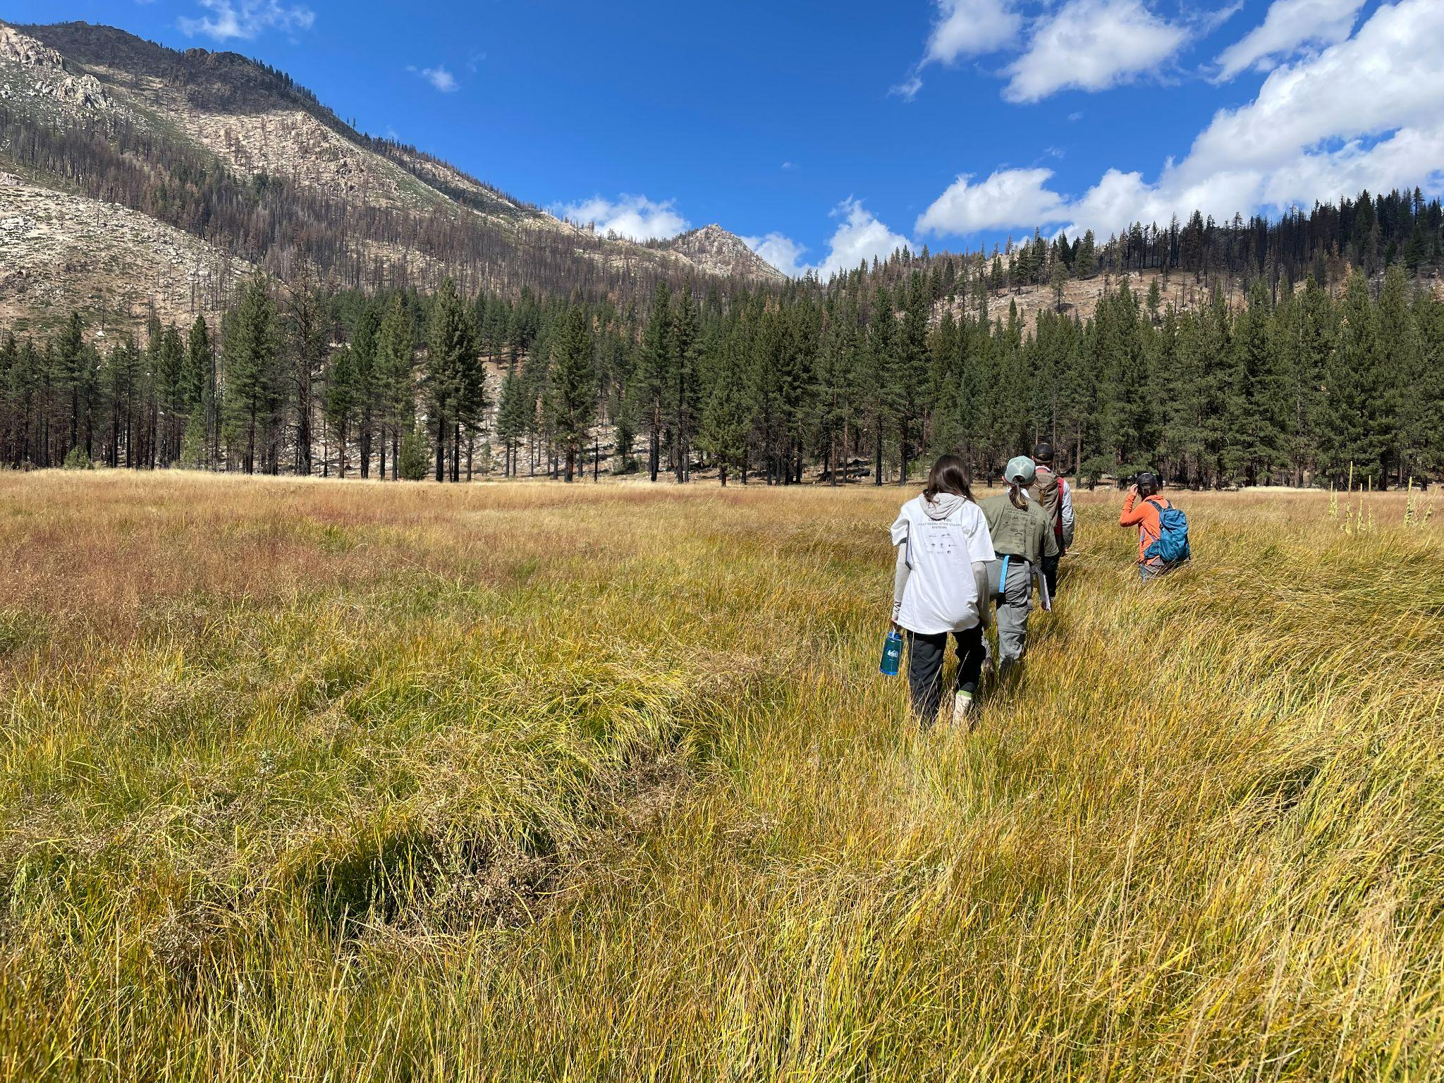
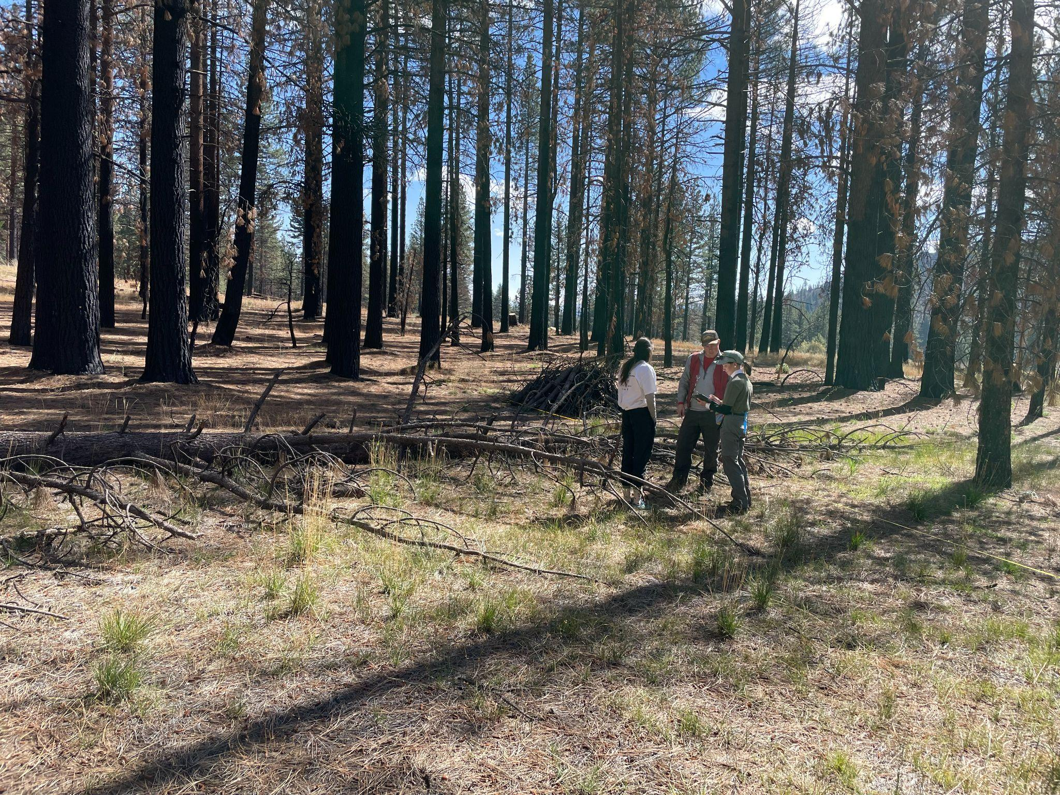
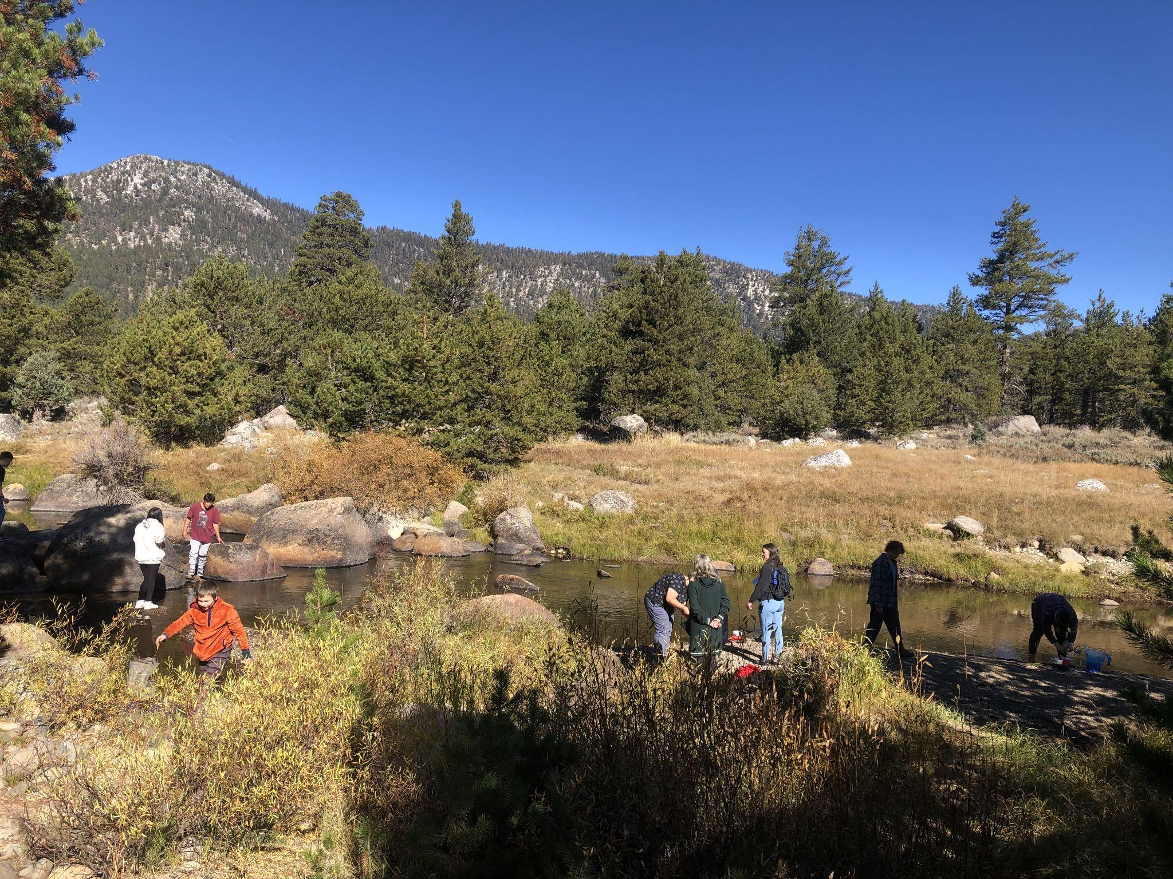
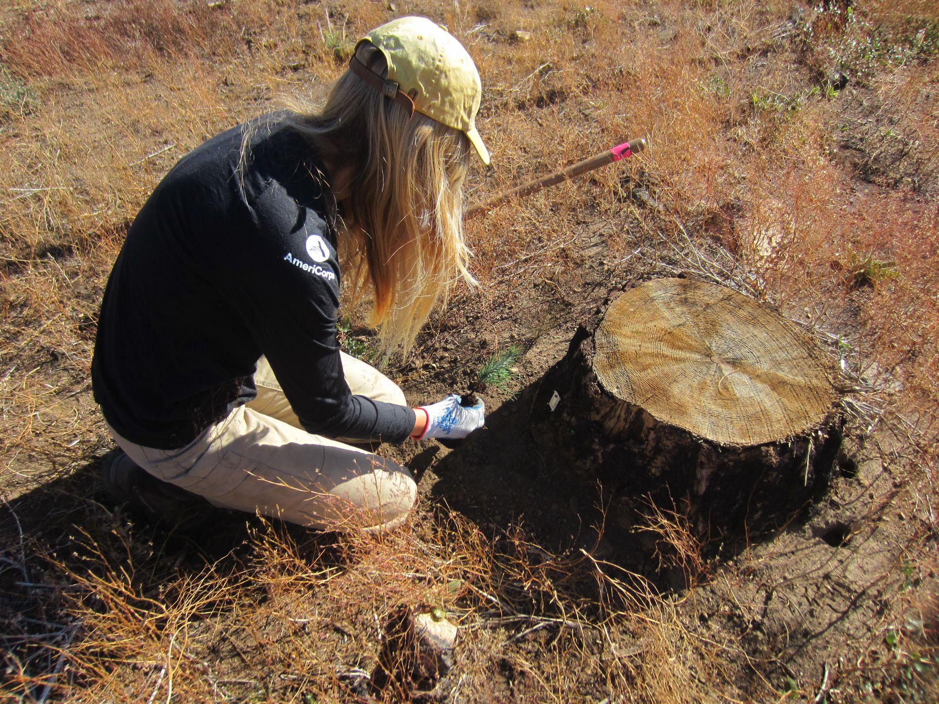
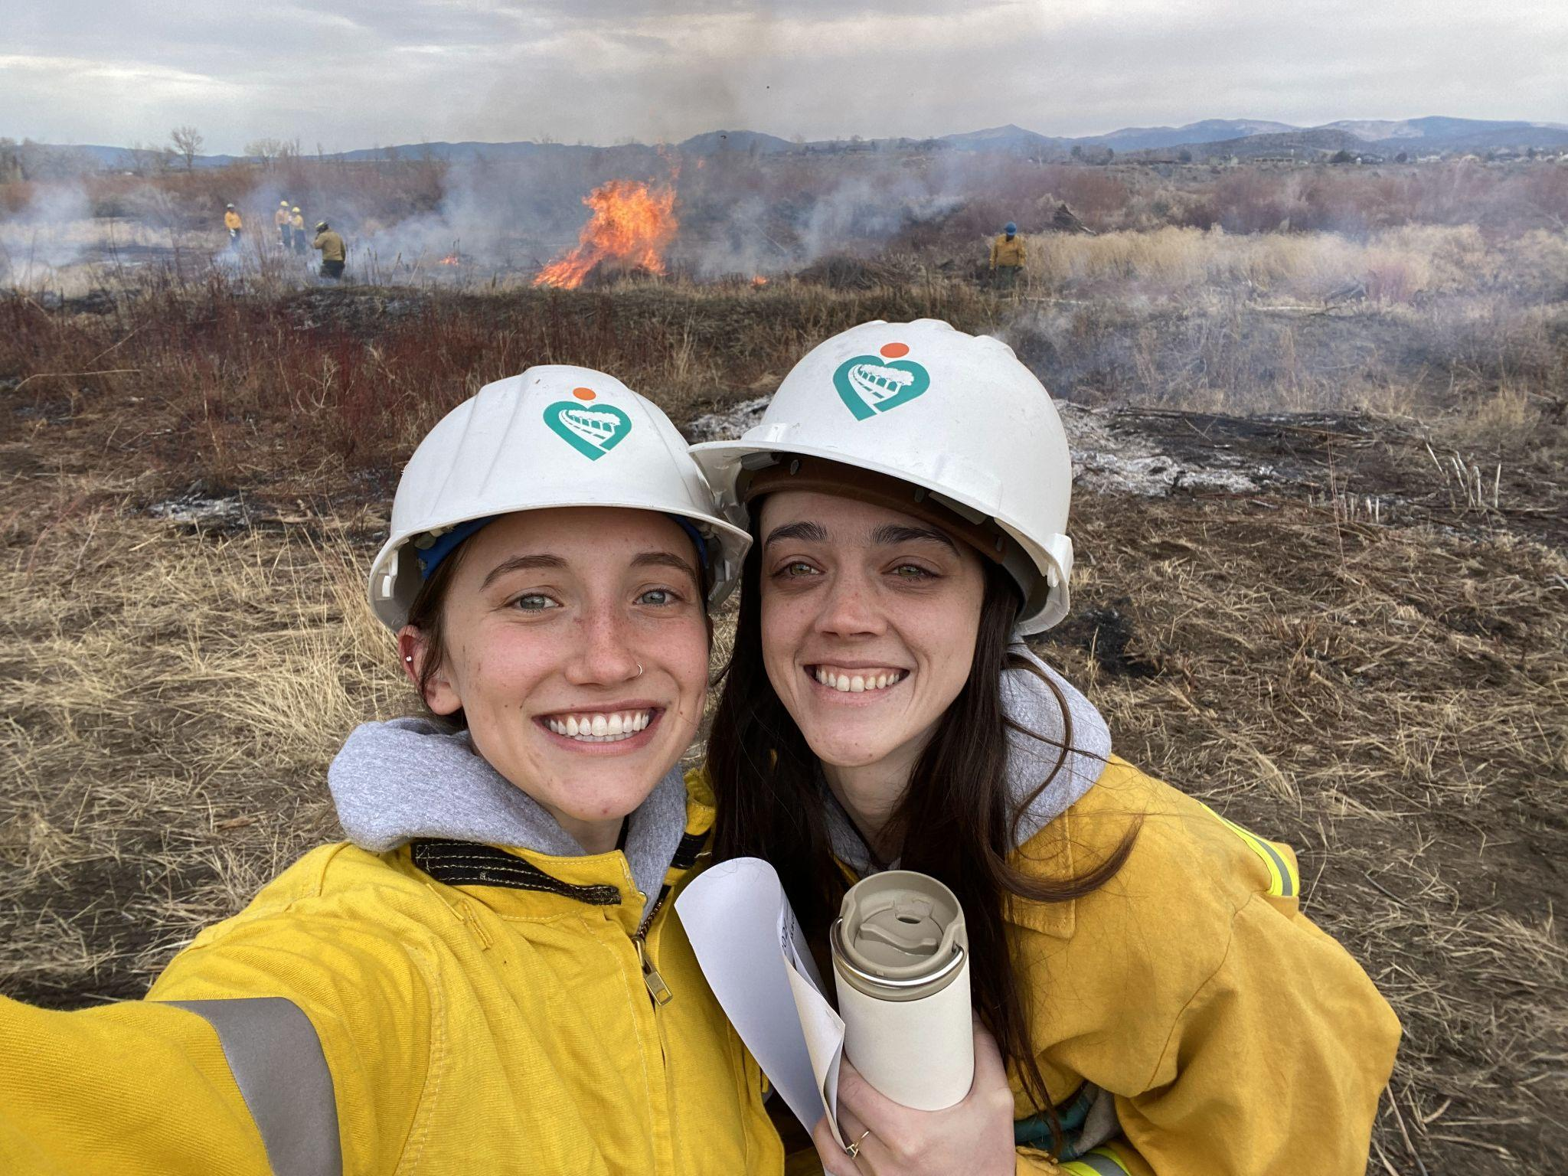
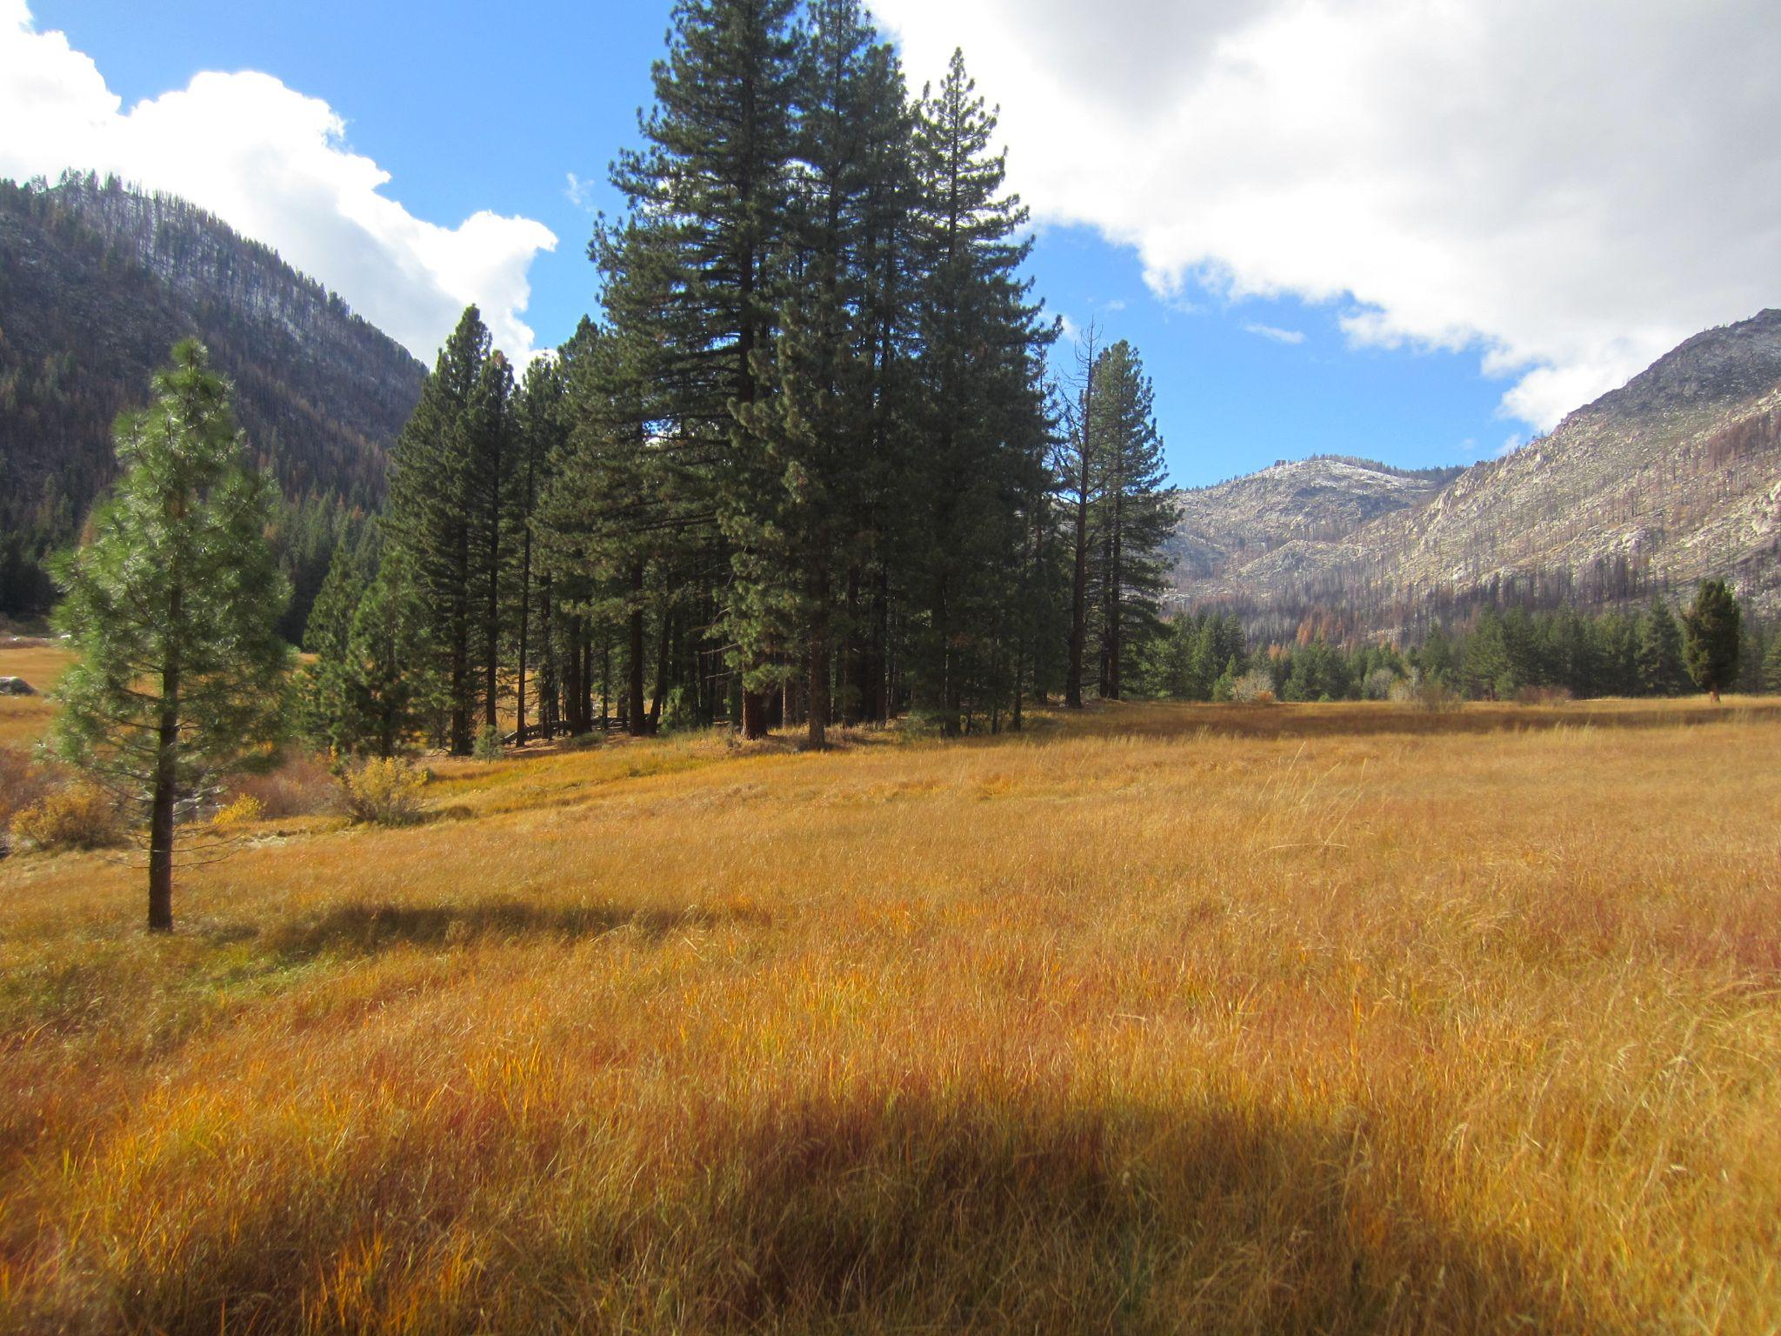
Meadow Assessment Training with AR
Common Stand Exam Survey at GHSSP
Snapshot Day at Hope Valley with DVS
Volunteer Tree Planting at TRP
Pile Burning with WEPD
Photo Monitoring at GHSSP
Notes:
BK
Learned a new rapid assessment technique for meadow assessment with American Rivers using a scorecard. We then used this knowledge to assess 3 meadows in Alpine County (Mountaineer Creek Meadow, Lower Meadow, Chicken Flat Meadow).
FMH-19/Common Stand Exam at Grover Hot Springs State Park, assessing the post fire vegetation, structure, and productivity in an ecological framework
Snapshot Day - A volunteer based annual event that allows students within the Carson River watershed, from different schools, to examine their watershed and to take a picture of the watershed at one moment in time
Volunteer tree planting at Turtle Rock Park, planted 720 trees provided by Sugar Pine Foundation along Millbury Creek in Turtle Rock Park. We later setup a Seedling Survivability Survey and tagged 50 trees from this planting event.
We got to participate in willow thinning and piling of the thinned material with the Washoe Environmental Protection Department, then we got to come back a few months later to watch and help with the burning of the piles.
Photo monitoring at Grover Hot Springs State Park was a super unique experience, in this picture you can see that the hillside on the left is fully vegetated, whereas the hillside on the right was completely impacted from the Tamarack fire. This shows that meadows act as a fire break and provide firefighters with a safer area to set-up and fight wildfires.
If we end up getting asked questions about more work, or if we have extra presentation time possibly discuss the below which are not pictured in this slide:
1. Photo & Vegetation Monitoring, Musser and Jarvis Watershed
2. Event Tabling:
1. Tour des Trees @ Turtle Rock Park
2. Aspen Festival @ Burnside Road / Picketts Junction
3. Eagles & Ag
4. FEMA - Floodplain Management
3. Aspen Monitoring - Humboldt Toiyabe National Forest, Scotts Run Trail/Scotts Lake
4. Faith Valley Beaver Monitoring with American Rivers in Faith Valley (Gordan)
5. Thompson Meadow Monitoring with Becky Estes (USFS) - focus on conifer encroachment/removal
6. HAB Monitoring @ Red Lake /Red Lake Creek
7. Arbor day tree monitoring
8. Tour & Talk with local Ace Hereford rancher Valerie Gordon
9. Tune into monthly MCRP calls
10. Meetings with: FHCWG, CRC Ag Producers WG, CWSD

Slide 5
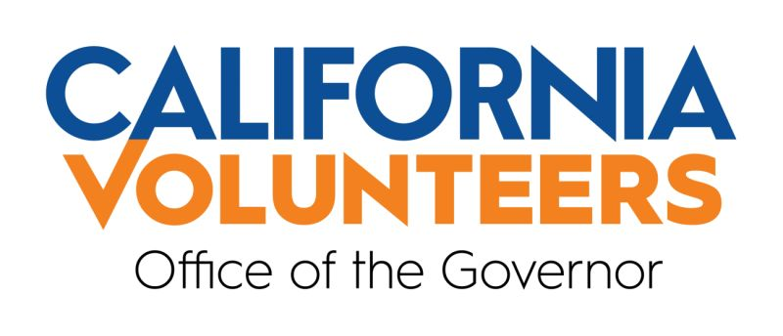
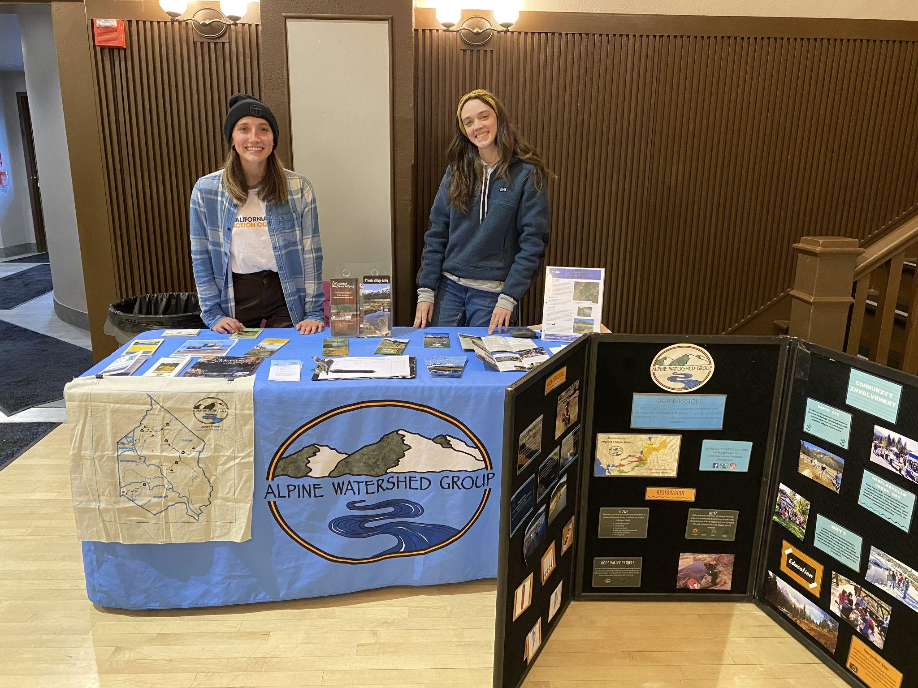
CA Climate Action Corps Structure
California Volunteers, Office of the Governor
Bay Area Community Resources
Host Sites
Fellows!
Notes:
KG
The program is funded by California Volunteers, Office of the Governor, in essence the state of California.
The implementing partner is Bay Area Community Resources (BACR), which is based in Oakland.
BACR provides us with guidelines of behavior and program structure, as well as monthly professional development training.
Host Sites are the next part of the structure. These are the organizations that individuals serve, and receive mentorship from, in their term. They can range from non-profits to city offices to state and federal natural resource management agencies.
Individuals, like Bella and I, are the last piece of the puzzle. We are paired up with a host site that’s a good fit for both us and the host site, and we both support them and learn from them over the course of our service year.

Slide 6
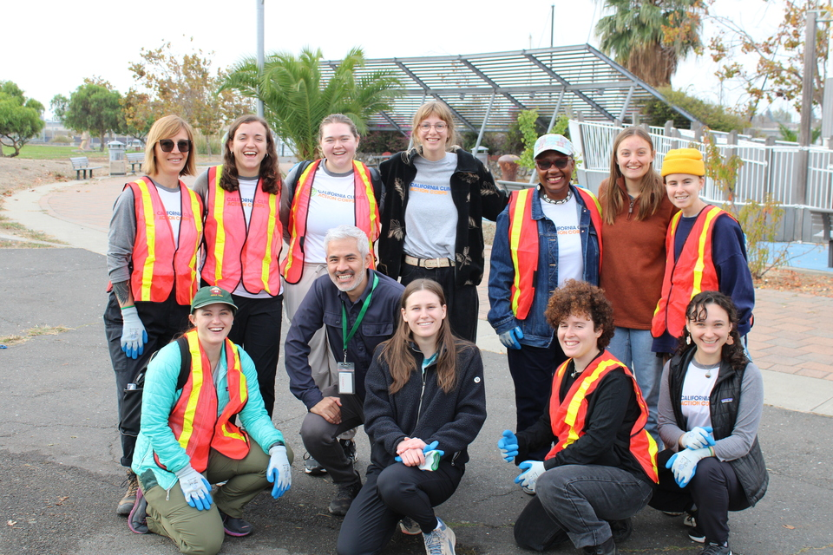
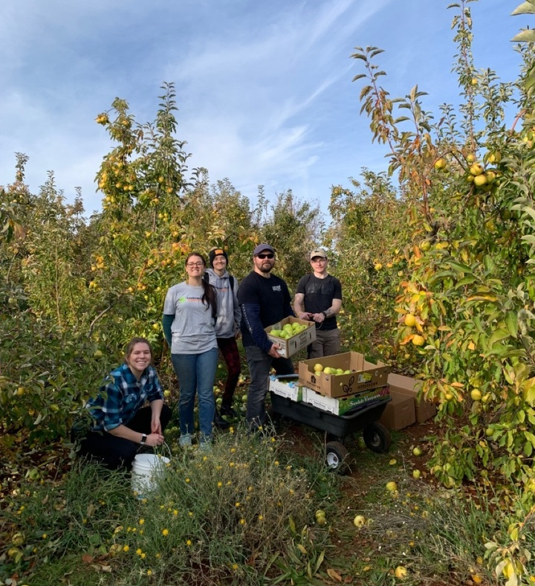
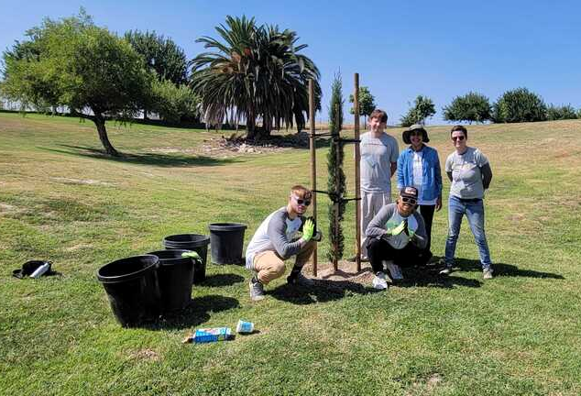
CA Climate Action Corps Community
Program prefers host site applications that are applying for four or more fellows
Rapidly growing community
Community newsletter
Notes:
BK
CCAC prefers host site applications that are seeking 4 fellows or more per site
AC is small and new territory, AWG office is small (2 max)
Currently only 2 other CCAC fellows in SLT, many of the fellows in the northern region are currently located in Chico/Butte County
325 fellows this year (2023-2024), the program was only initiated 3 years ago and the size of the program has pretty much doubled every service term. CA Climate Action Corps started out with about 50 fellows during the programs first year, then around 100-120 fellows, and now 325 fellows)
The CCAC 411 newsletter is a monthly newsletter created by CCAC Team Leaders. The Team Leaders put together a summary of work that fellows have accomplished in the most recent month, they feature host site and volunteer spotlights, and discusses upcoming events being held by host site partners.

Slide 7
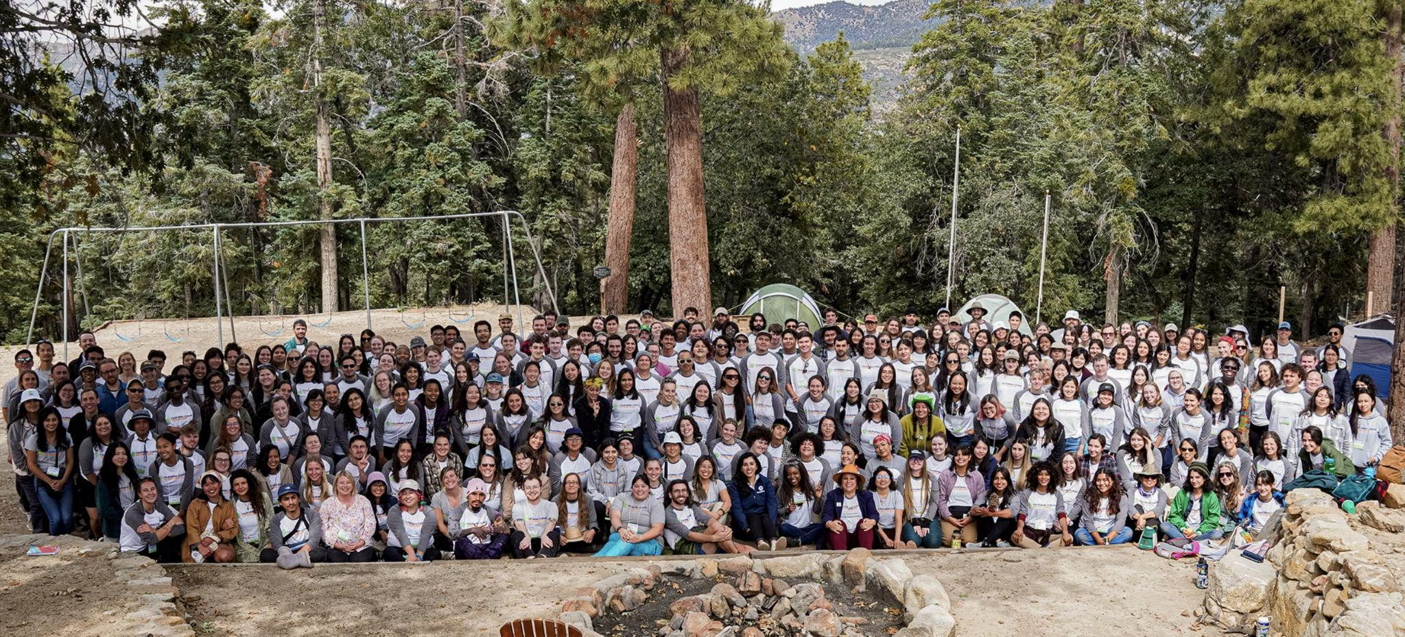
By the Numbers
4,000 trees planted
40,000 trees maintained
900 acres treated for wildfire resiliency
5,000,000 lbs of food diverted
21,000 volunteer hours
6,000 volunteers
325 fellows
70 host sites
Notes:
KG
As Bella mentioned, this year there are 325 fellows, just like us, across the state.
Those fellows are serving at over 70 host sites across the state.
Impact: As of January, California Climate Action Corps Fellows have:
planted over 4,000 trees (4,245)
maintained almost 40,000 trees (39,983)
treated almost 900 acres for wildfire resiliency (896)
Diverted over 5,000,000 lbs of food from landfills (5,339,038)
Orchestrated over 21,000 volunteer hours (21,182), engaging over 6,000 volunteers (6,309)

Slide 8
Benefits of CA Climate Action Corps Fellowship Position
Notes:
BK
***Participation in 170-340 hours (not to exceed 20% of total service term) of training and professional development
AmeriCorps Members are individuals enrolled for a specific term of service with an Americorps program
Terms of service are between 300 and 1700 hours
Americorps members are engaged in National Service and are not volunteers or employees
Some members receive a living allowance, health insurance and child care assistance
Biweekly stipend ($33,000 before taxes, distributed evenly over 11 month term)
Healthcare benefits: Dental and Medical
Food assistance through CalFresh because we are living off of a stipend that is not considered income.
Child care assistance from Americorps to qualifying Fellows paid to an eligible provider of their choice
Forbearance on existing QUALIFYING student loans & interest payments accrued during the service term
$10,000 combined Segal Education Award and California For All Education Award (before taxes & upon COMPLETION of service term)
Reimbursed for driving to events like the CA Climate Action Corps orientation and midterm retreat.

Slide 9
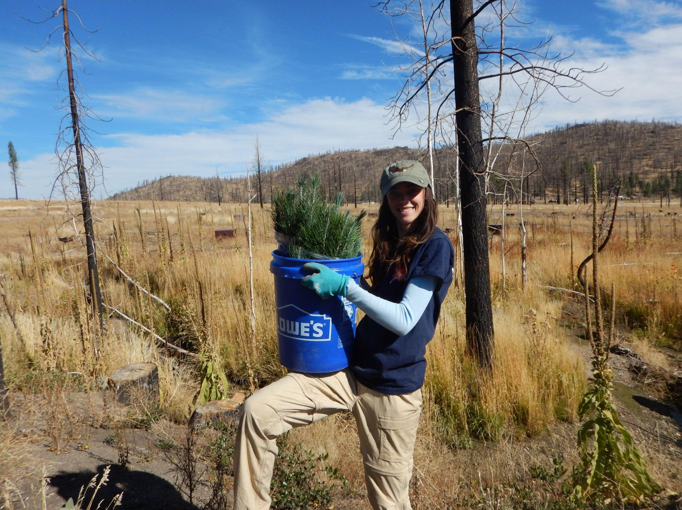
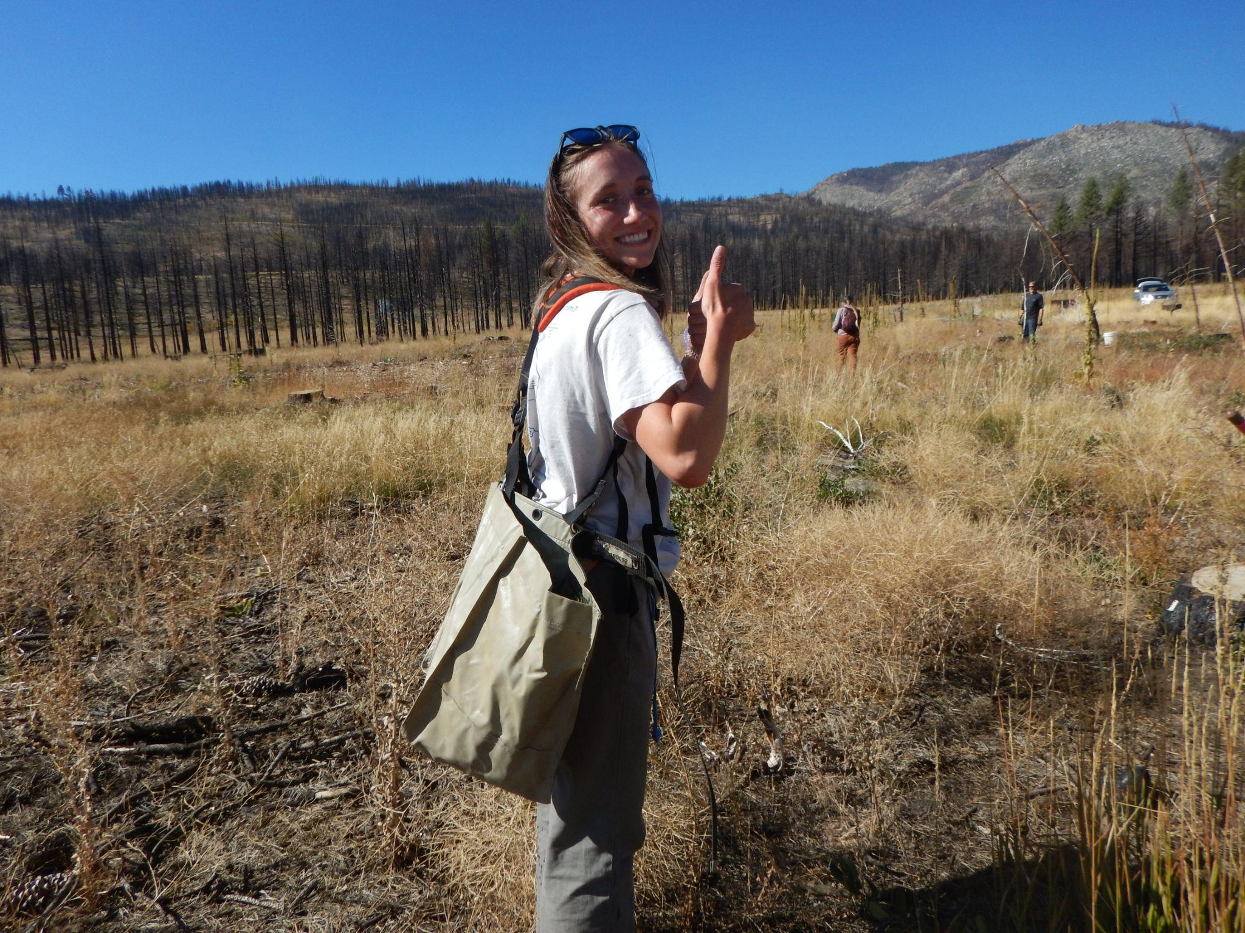
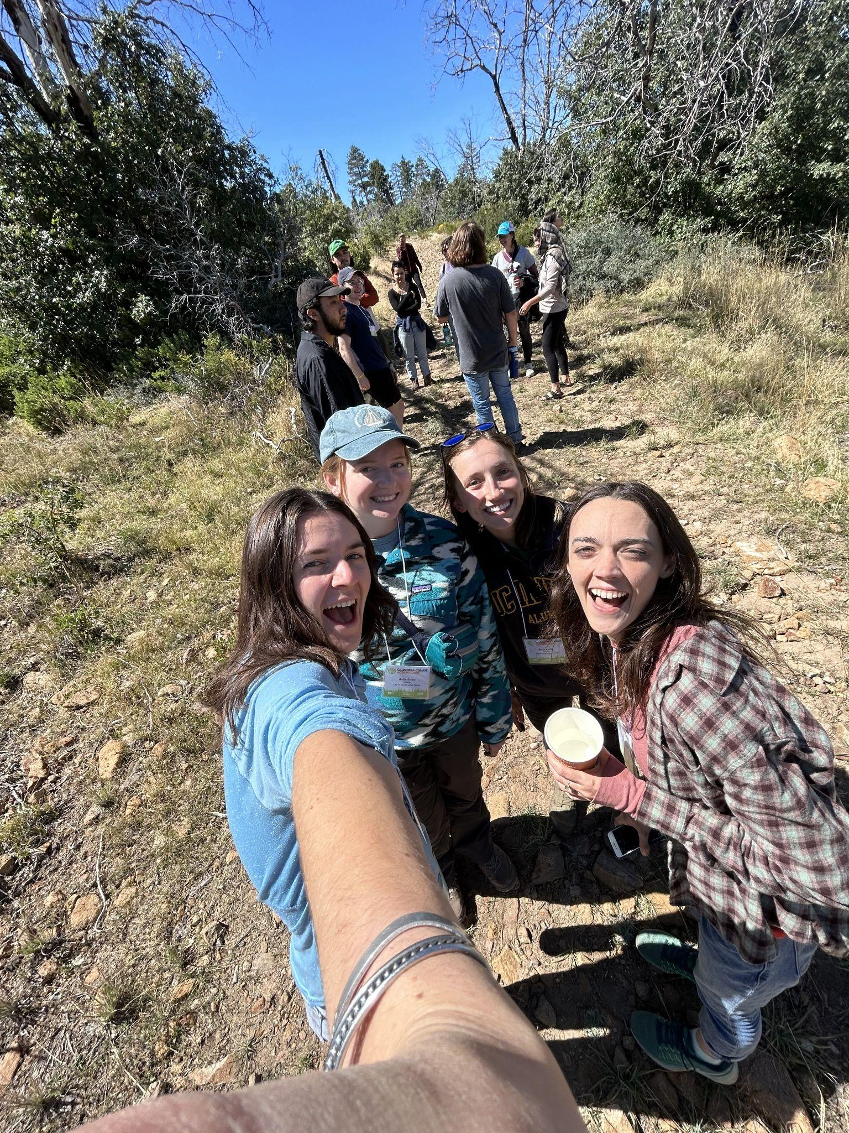
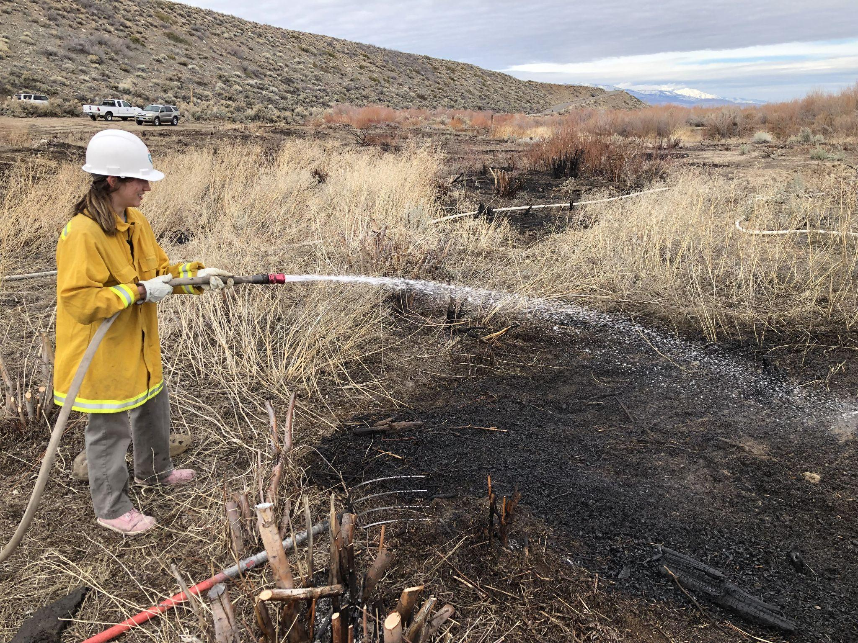
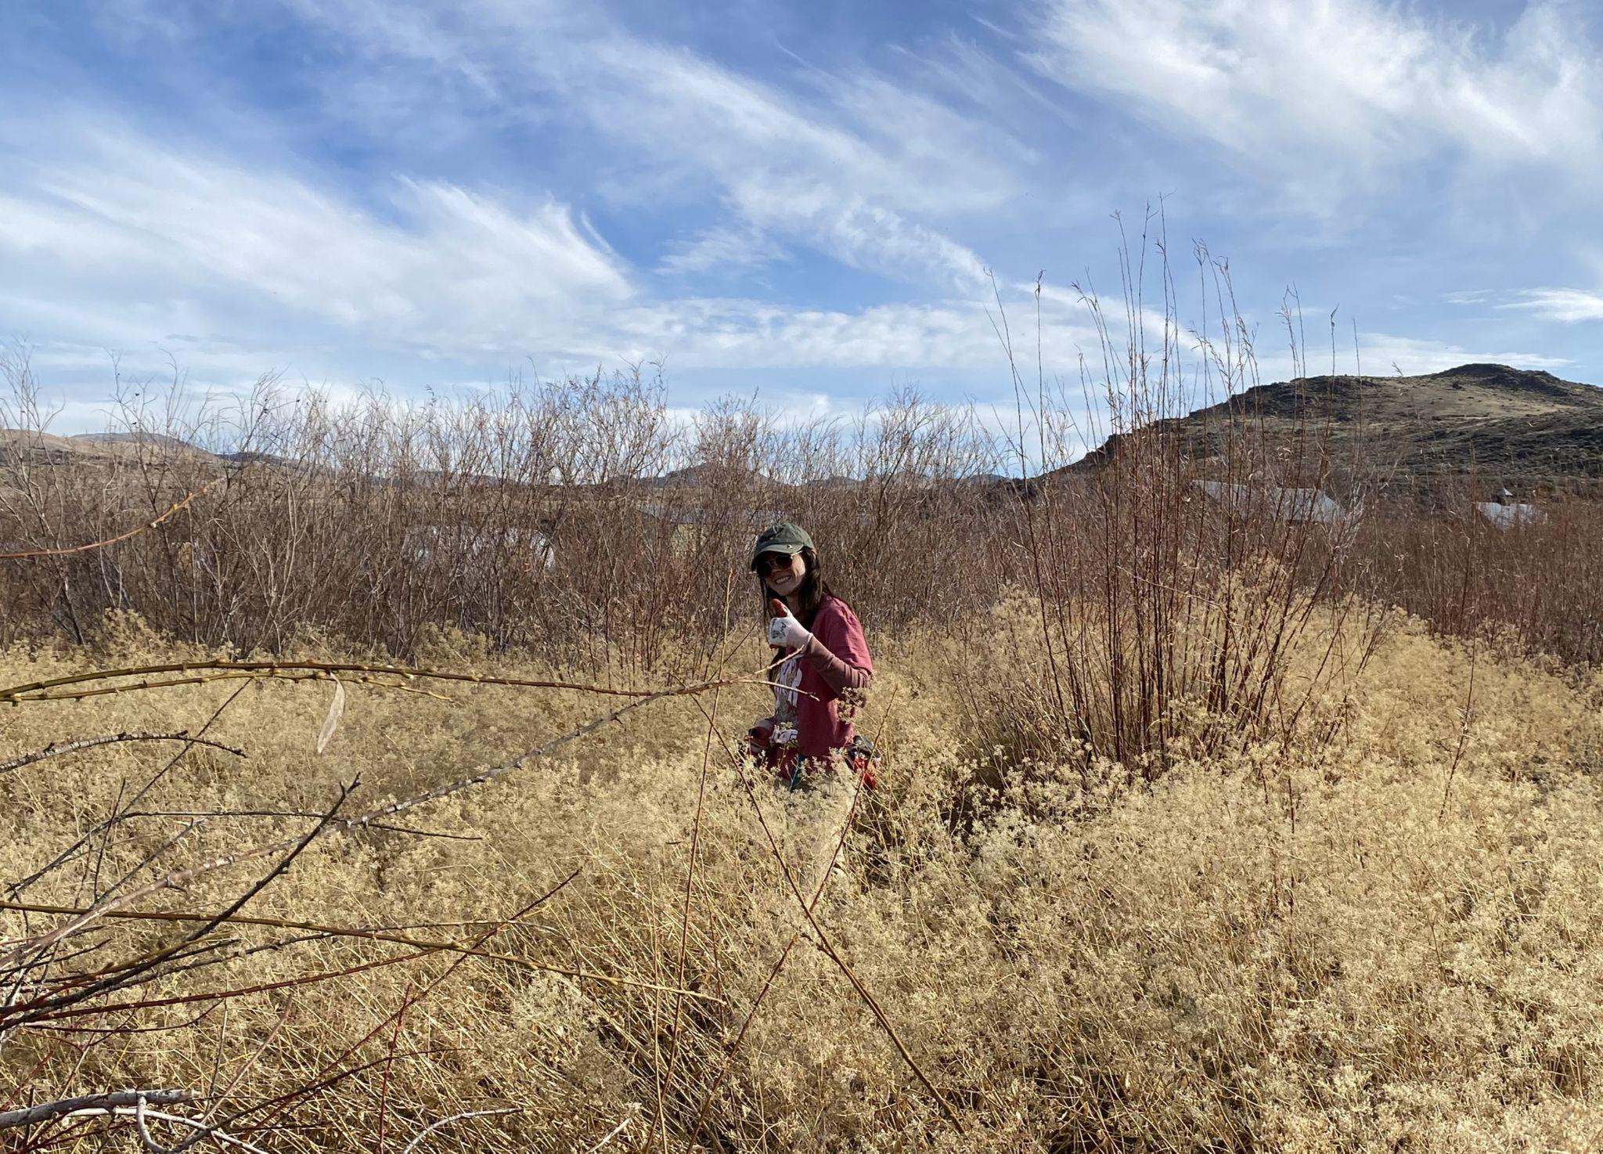
Overall Impressions of CCAC
Notes:
(KG): Great experience! As someone who is new to the workforce, I really appreciate the opportunity to take on a role that is both relevant to my career and focused on helping me learn and grow within the industry. We’ve gotten to participate in a wide variety of projects, with many organizations and individuals, and in different fields which are connected to climate change, such as watershed management, wildfire resiliency, and agriculture. The program has been insightful, fun, and meaningful!
I’m interested in wildlife and agriculture. After the program, I’m looking into a career in wildlife management or regenerative agricultural management. A perfect career might be one that incorporates wildlife management into agricultural land management, facilitating collaborations and connections with landowners.
(BK):
Immediate hands-on field work
Wide variety of gained field experience and knowledge
Ability to personalize the experience by getting more involved in projects I have a particular interest
Ability to attend informative webinars related to our position
In the future I would like to work with plants, particularly native plants
Whether this is working in a greenhouse or continuing forest health work
This program has also increased my interest in pursuing a career that works with and addresses wildfire → Post fire incorporation of native plants

Slide 10
Question & Answer
Contact Information:
Kaitlyn Garber: awg.kaitlyn@gmail.com, (530) 694-2327
Bella Kurtz: awg.isabella@gmail.com, (530) 694-2327

