Slide 1
Rivers, Trails and Conservation Assistance Program (RTCA)
National Park Service
Technical Assistance for Locally Driven Conservation & Recreation Projects

Slide 2
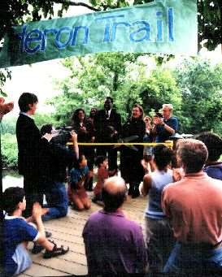
A Community Resource of NPS
RTCA staff work with community groups and local and State governments to:
Conserve rivers
Preserve open space
Develop trails & greenways.

Slide 3
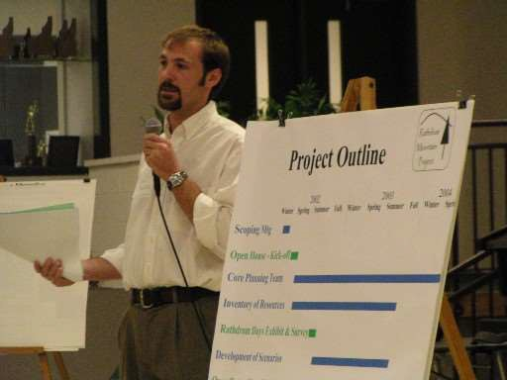
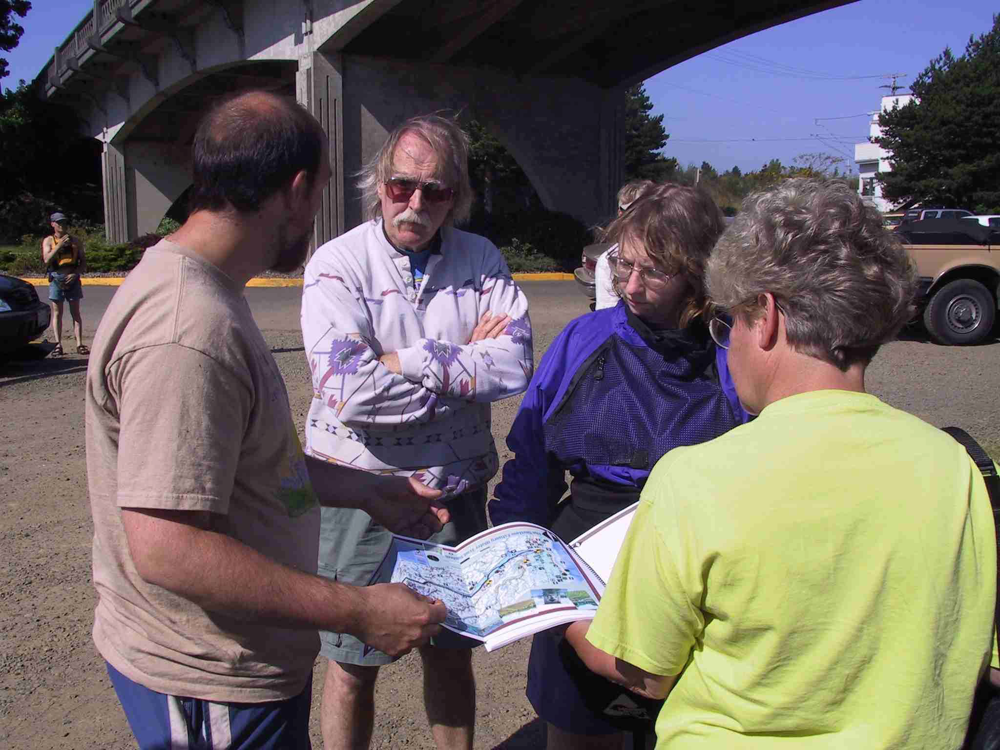
What We Do
Respond to requests for assistance
Work on locally-led, locally-driven projects
Provide planning & project management expertise

Slide 4
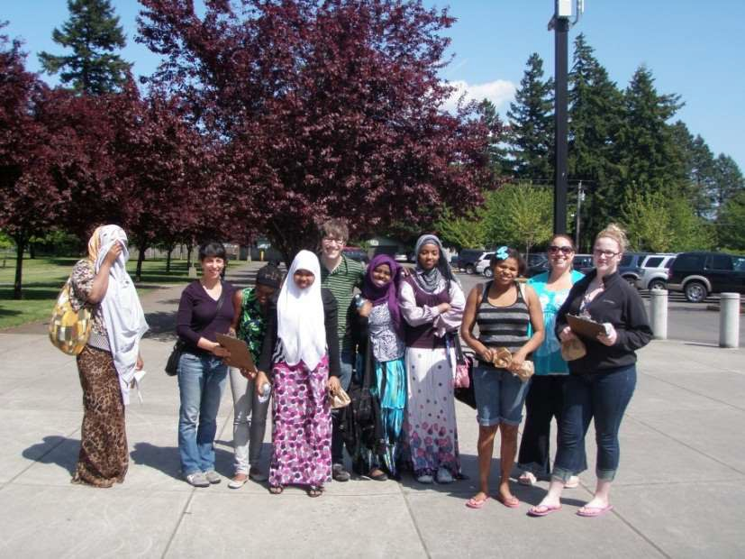
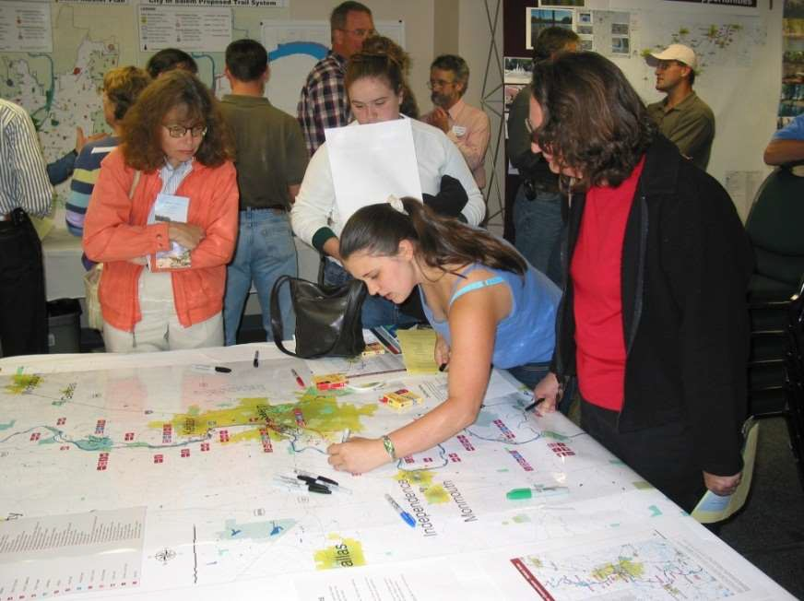
How We Work
Work with a primary cooperator & a planning group
Projects are collaborative & consensus-driven
Heavy emphasis on stakeholder & public involvement

Slide 5
For More Info & How To Apply
-- Visit our website: www.nps.gov/rtca
-- Discuss your project with RTCA staff Contact Dan Miller dan_miller@nps.gov
-- Submit an application before March 1st
have a clear project vision in mind
be ready to go, with most partners on board
get letters of support
line up resources (meeting spaces, maps, etc.)

Slide 6
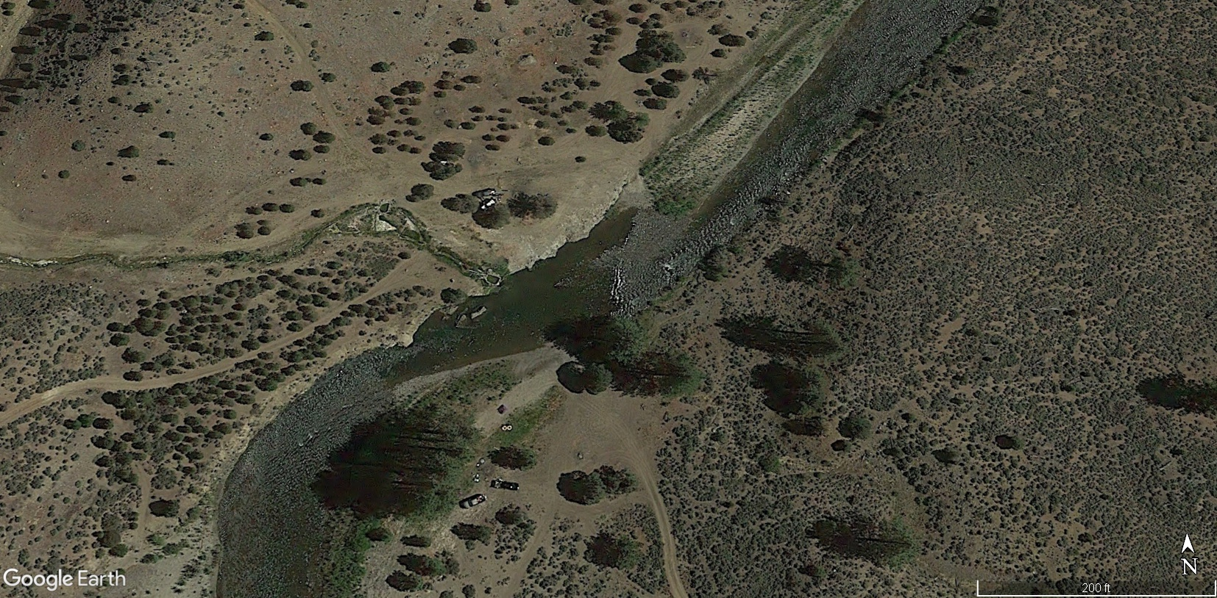
East Fork Carson Hot Springs
A Collaborative Planning Effort
For the East Fork Carson River Hot Springs Area

Slide 7
Location of East Fork Carson Hot Springs

Slide 8
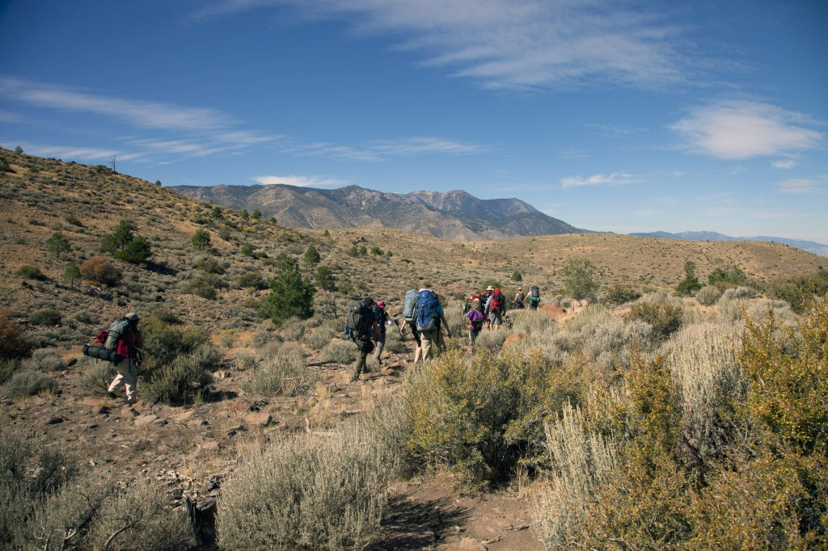
Need for Planning & Management
Increase in visitation & related impacts

Slide 9
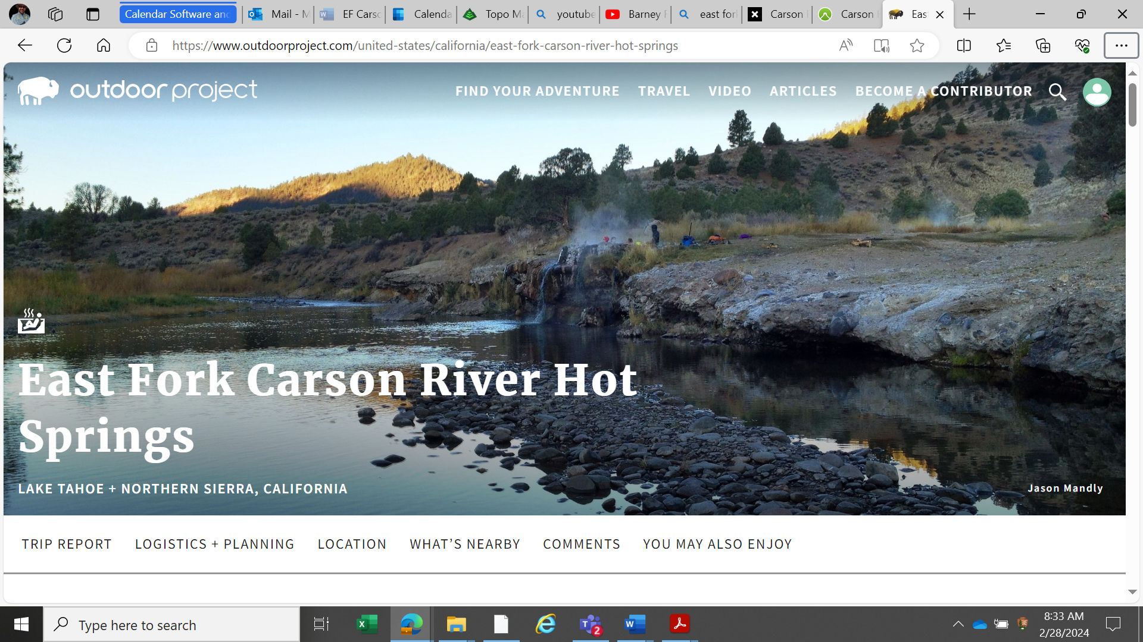
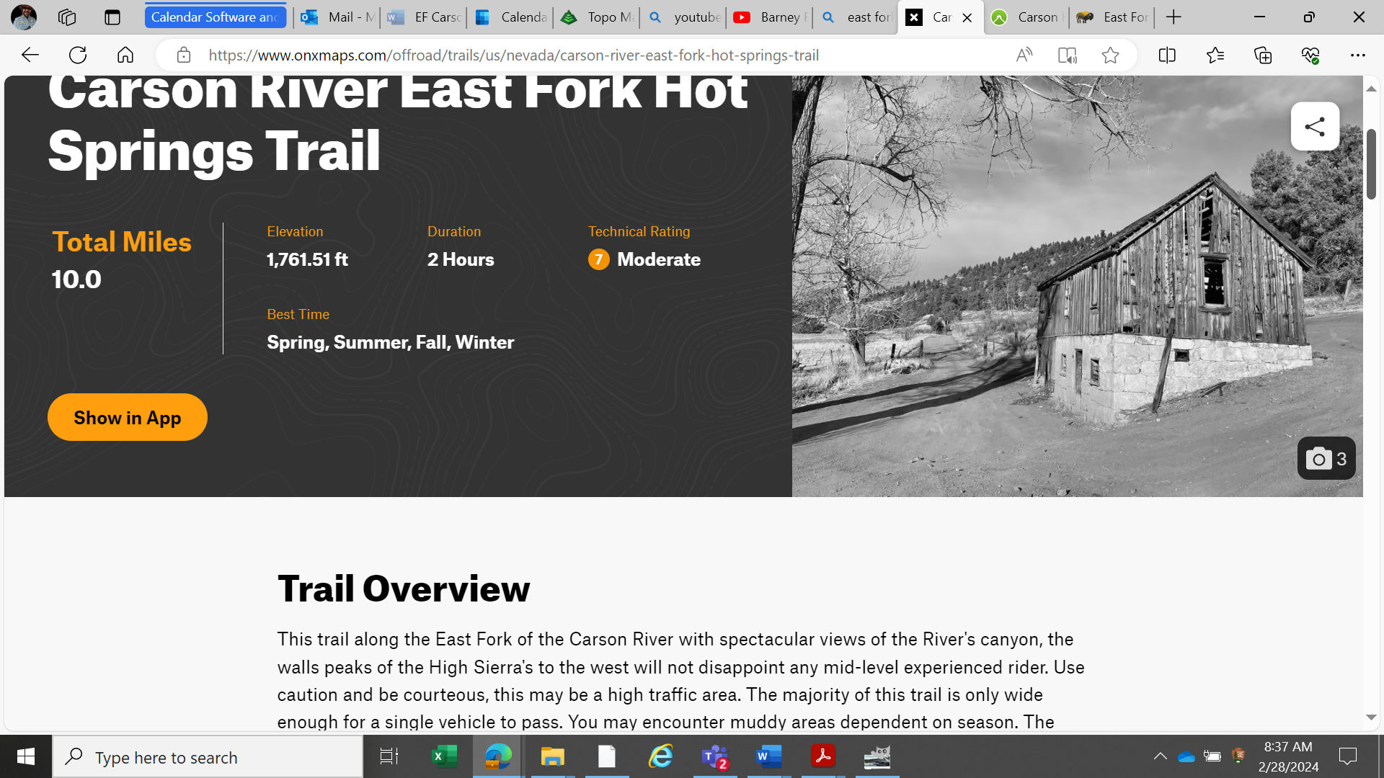
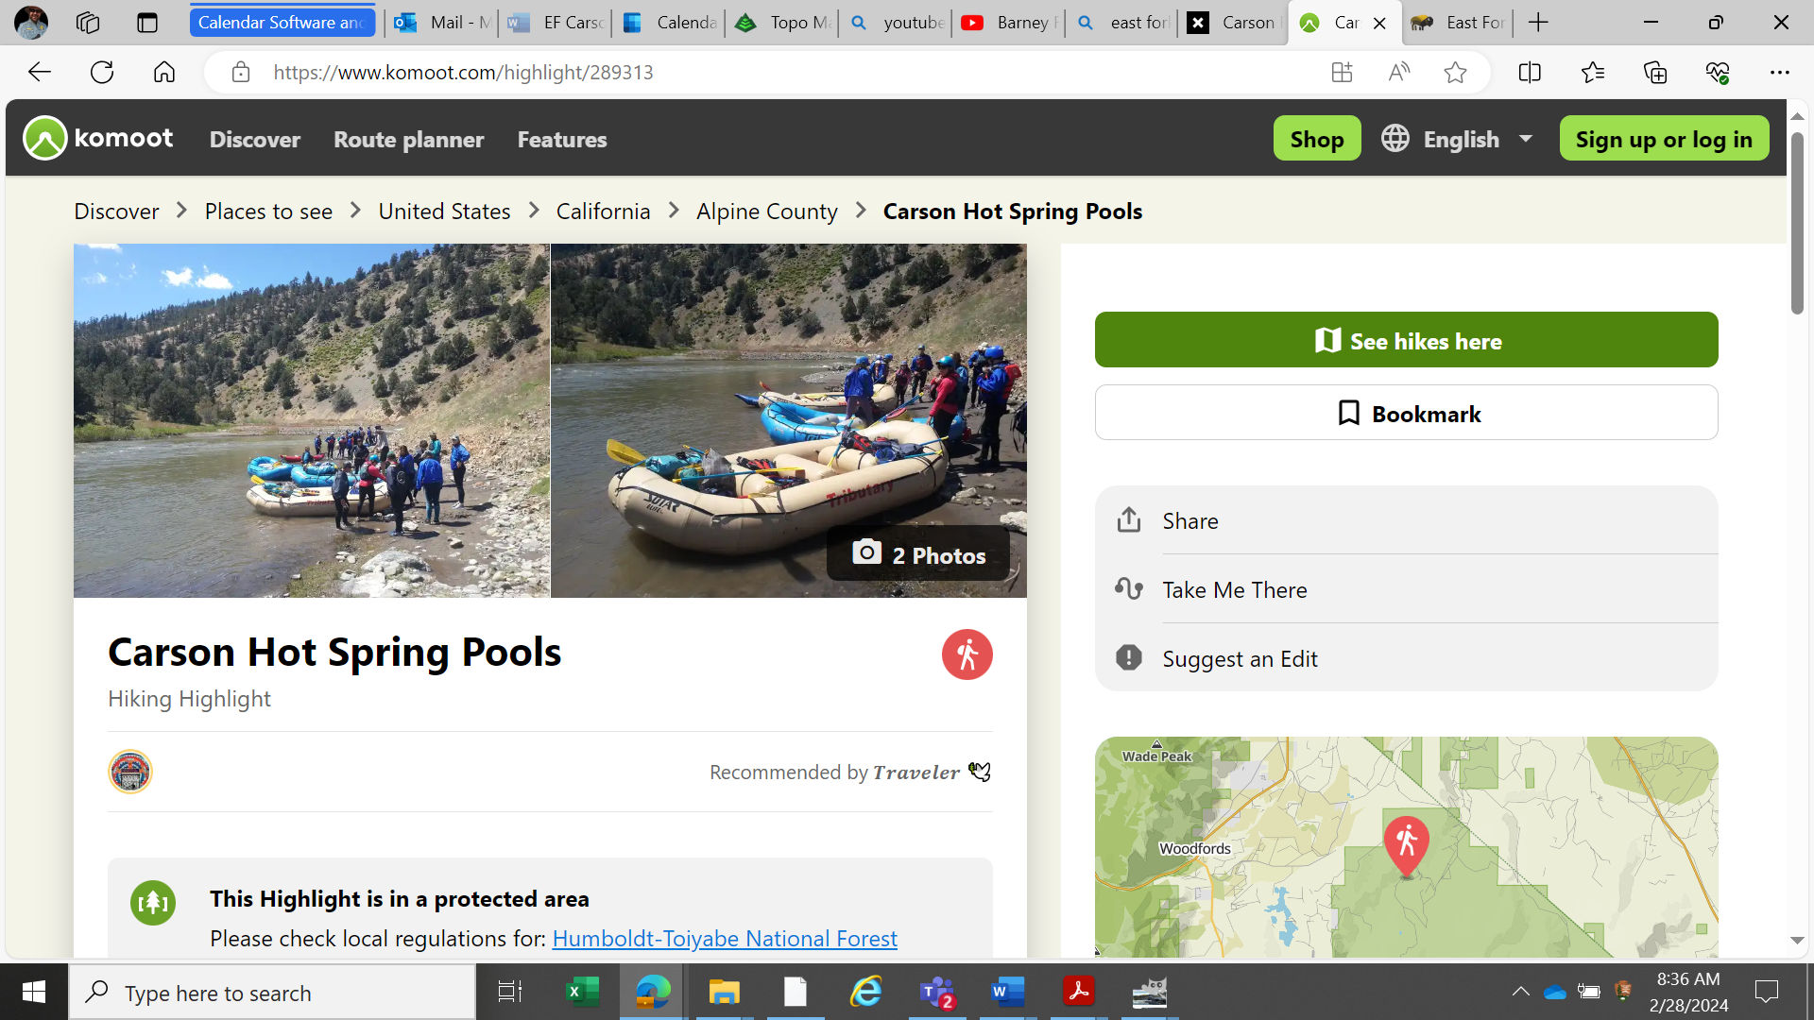
Need for Planning & Management
Readily available information on websites & youtube

Slide 10
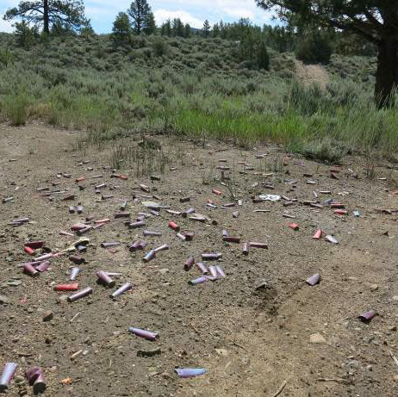
Need for Planning & Management
Litter, Human Waste & Other Wanted Activities

Slide 11
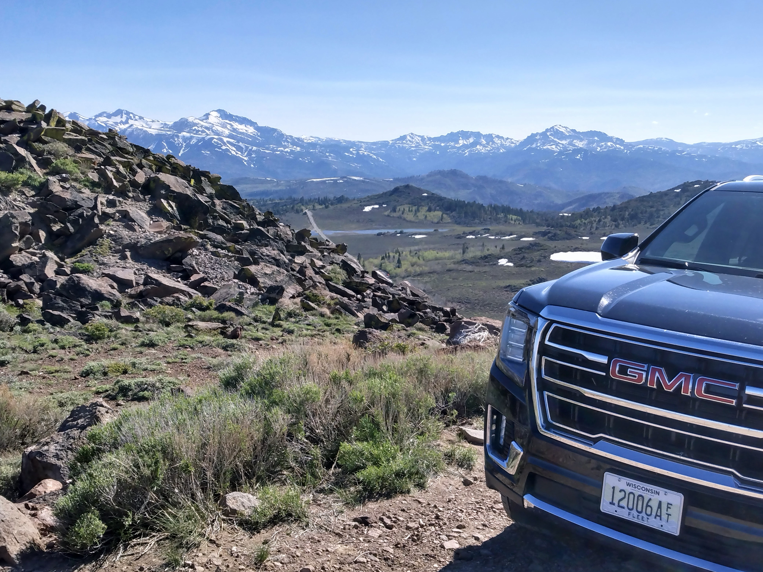
Need for Planning & Management
Motorized Vehicle Use On Undesignated Routes

Slide 12
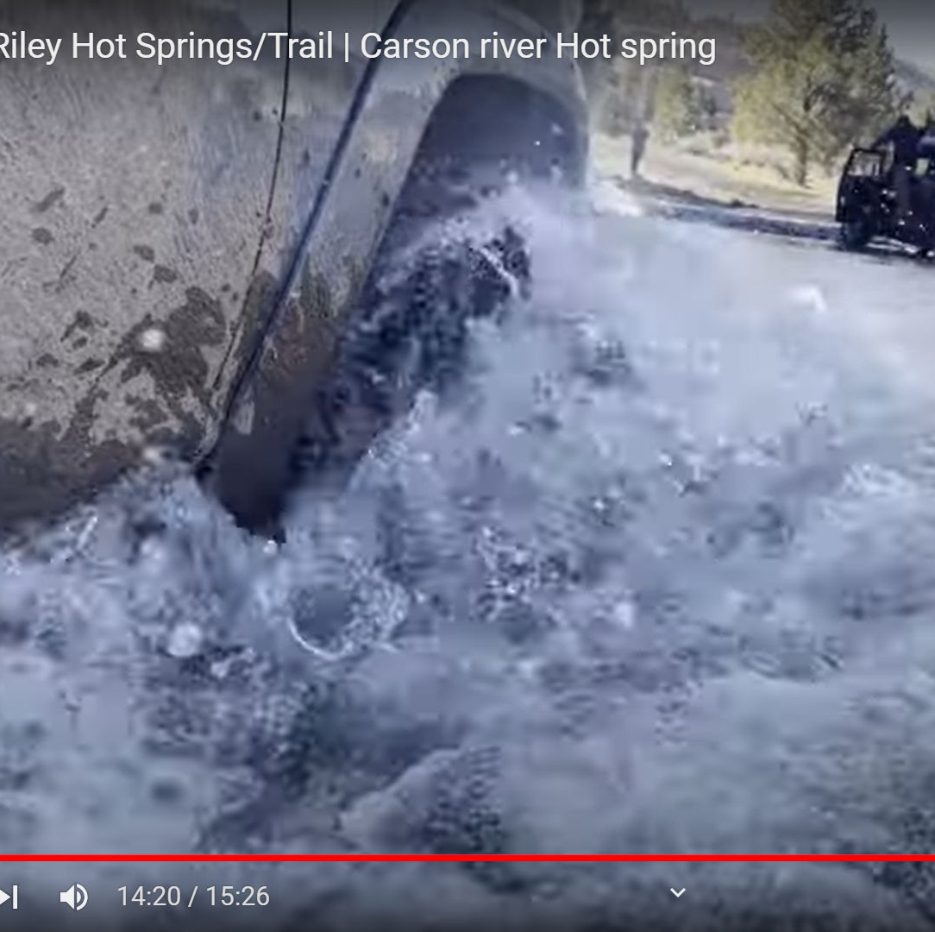
Need for Planning & Management
Vehicles crossing the East Fork Carson River…

Slide 13
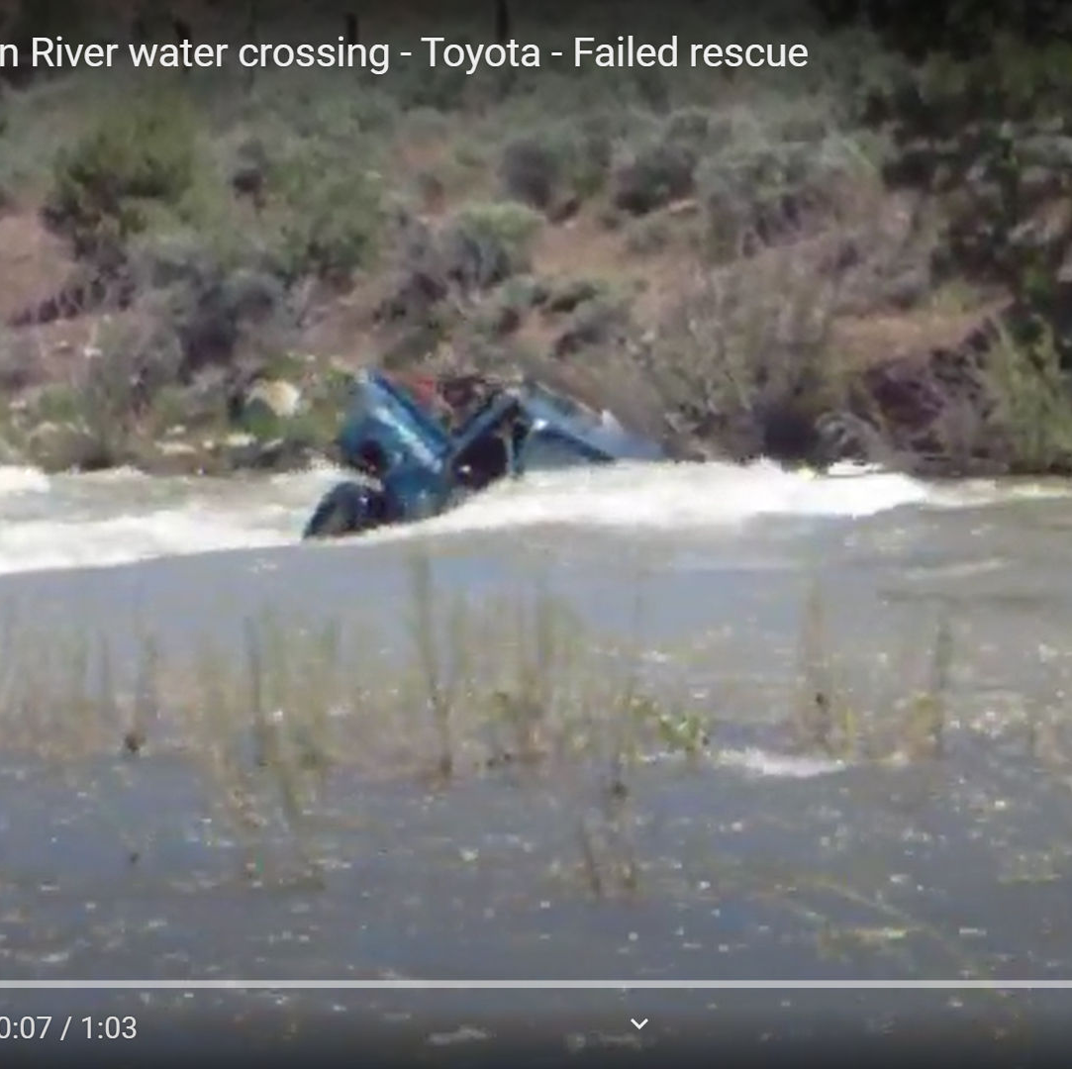
Need for Planning & Management
And vehicles getting stuck in the river!

Slide 14
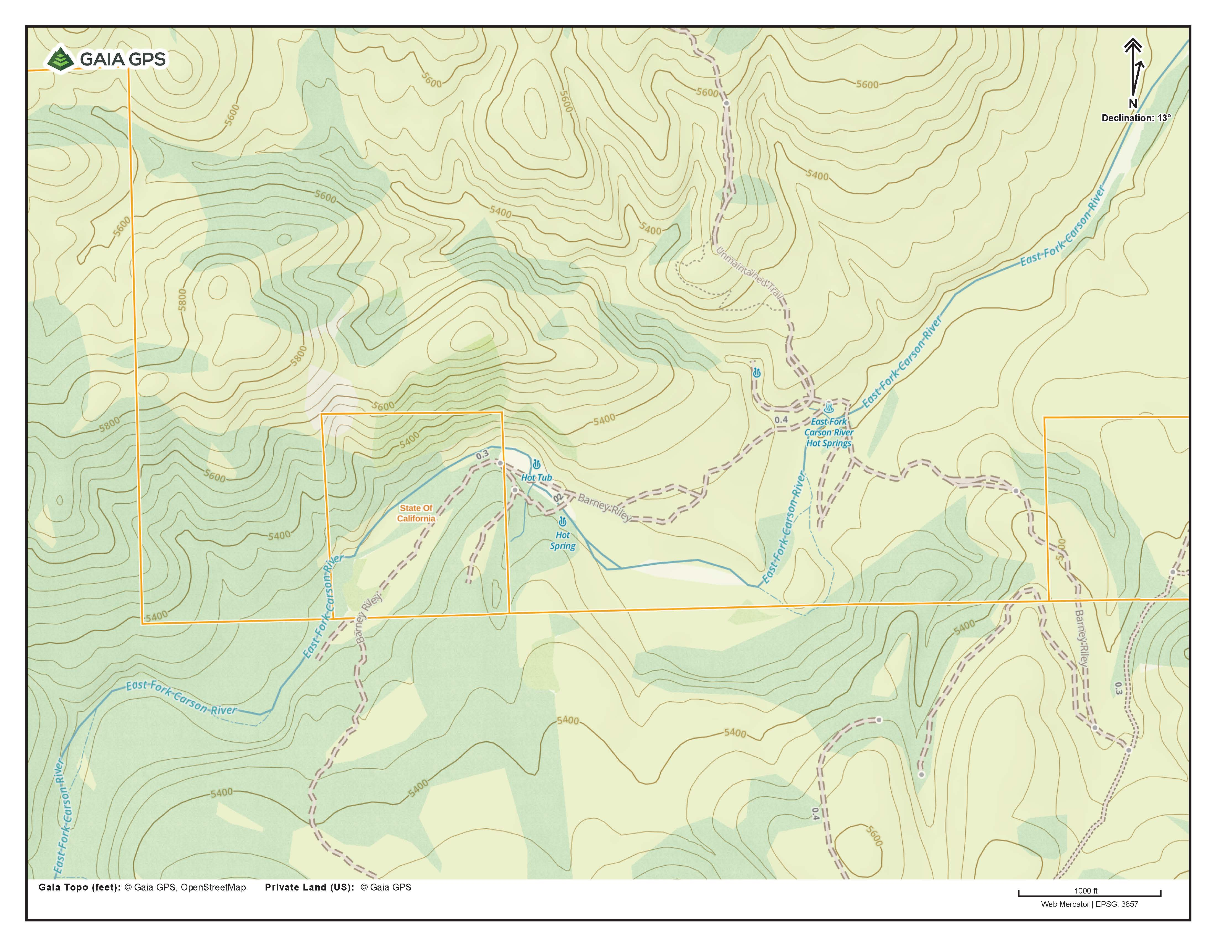
Existing Conditions

Slide 15
Hot Springs Area

Slide 23
ACCESS

Slide 24
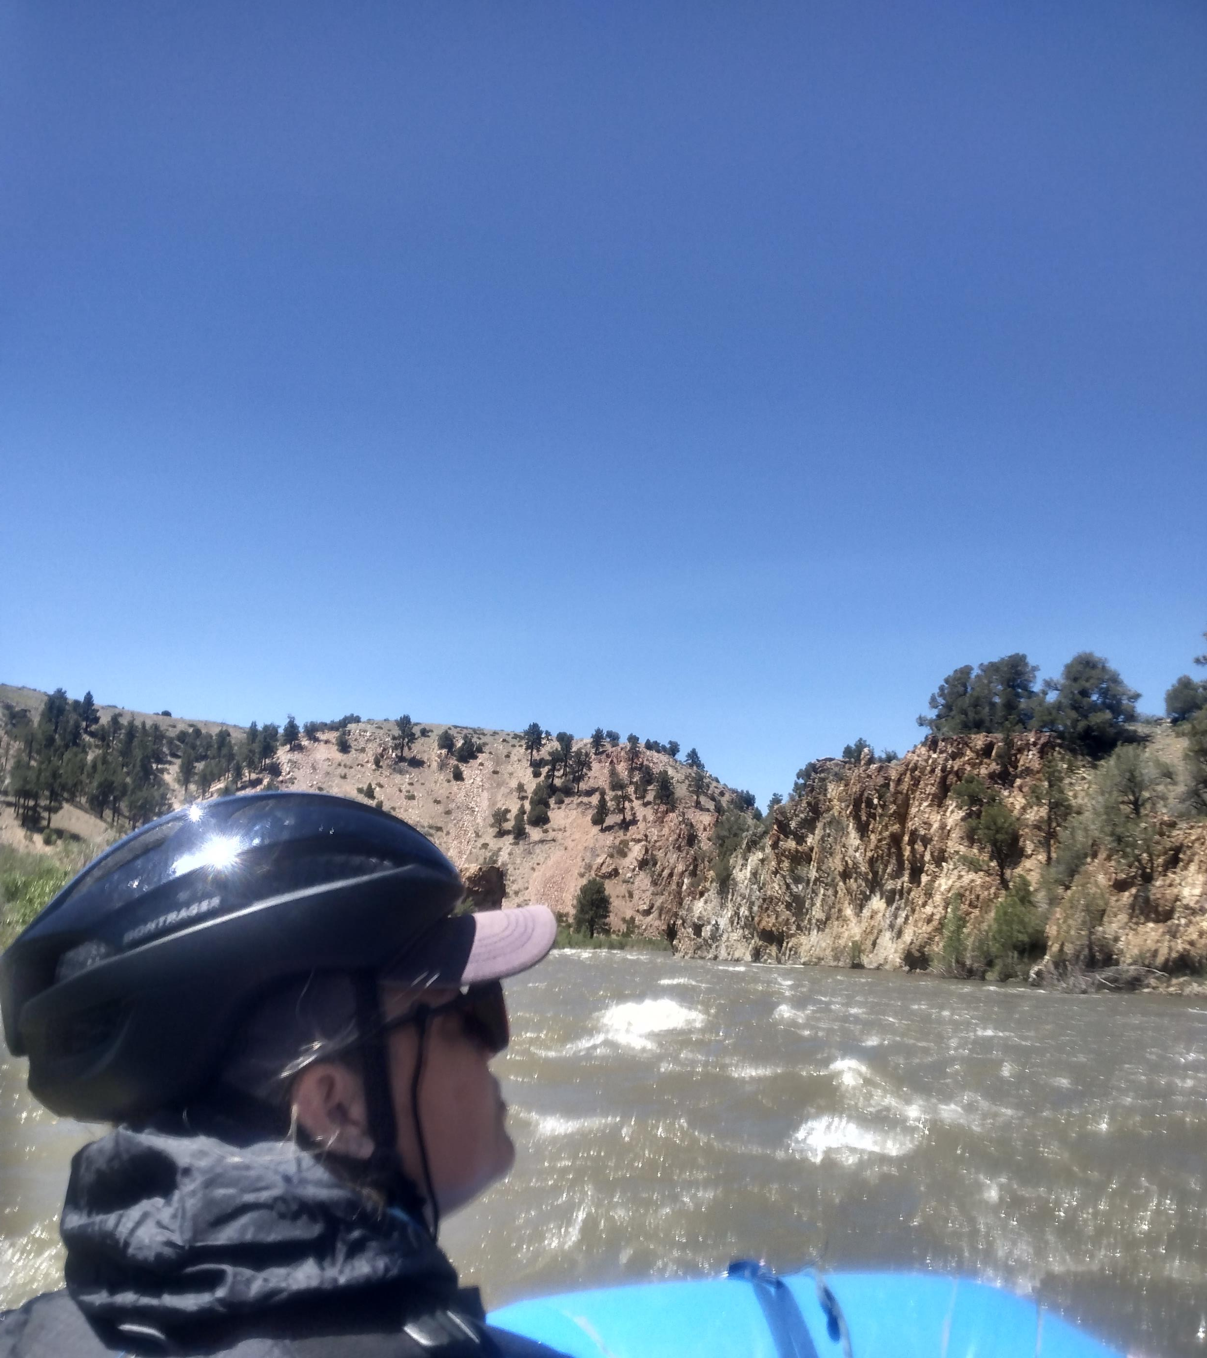
Access – Floating the East Fork Carson
Class 2-2+
Approximately 19 miles = 1 or 2 days (overnight)
Put-in @ Hangman’s Bridge
Take-out @ Washoe Road – Ruhenstroth, NV
CA Wild & Scenic River (10 miles to border)

Slide 25
Access – Non-motorized
No designated non-motorized routes
Hikers & mtn bikers use same roads that motorized use
Shortest route is 5 miles one-way (Airport Rd/Barber Peak)

Slide 26
Access To The Hot Springs Area – Airport Rd/Barber Peak

Slide 28
Access To The Hot Springs Area – Leviathan Canyon/Youngs Crossing

Slide 30
Leviathan/Youngs Canyon Route Crosses Through Pvt Lands

Slide 31
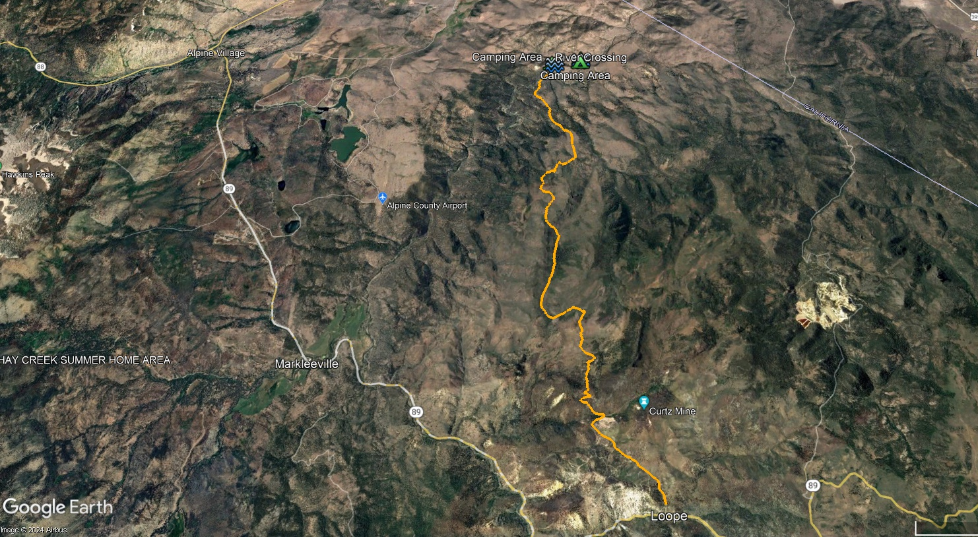
Access To The Hot Springs Area – Barney Riley/Mogul Peak/Loope Canyon

Slide 33
East Fork Carson Hot Springs (EFCHS) Planning
USFS & Alpine Watershed Group (AWG) applied to the Rivers, Trails & Conservation Assistance for help on the EFCHS in 2023.
Goal of the project is to develop a proposal that land managers can use on their lands.

Slide 34
Why A Proposal?
To allow for a collaborative approach
To be nimble – not an agency document
Not formally binding – landowners have final say on their lands
Needs to go through NEPA (CE or EA)
For an example go to http://www.cascadeheadtrails.org/

Slide 35
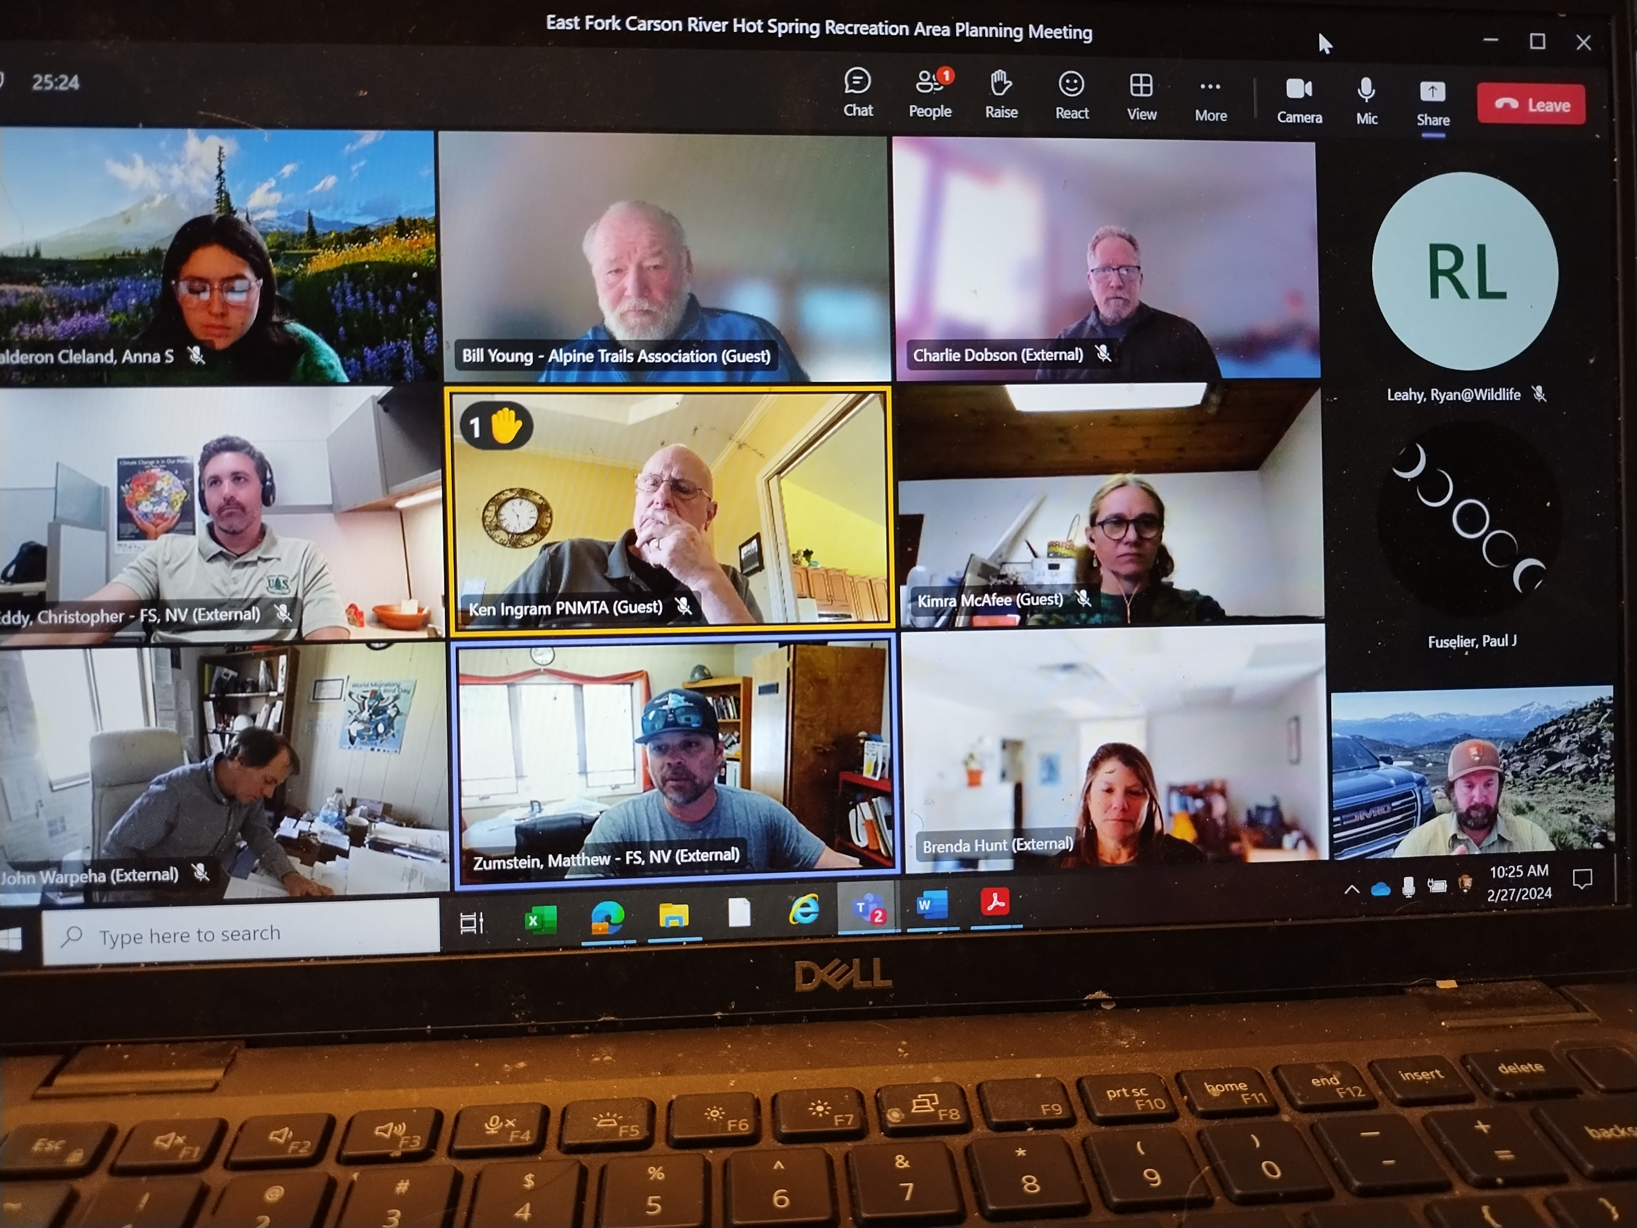
Stakeholder Planning Team
23 team members including:
Local, state & federal agencies
Washoe Tribe of NV/CA
Alpine Watershed Group
Carson Water Subconservancy District
Alpine County Sherrif’s Office
Lahontan Water Board
Pine Nut Mtn Off Road Association
Whitewater Paddlers
Washoe Environmental Protection
Alpine Trails Association
& more

Slide 36
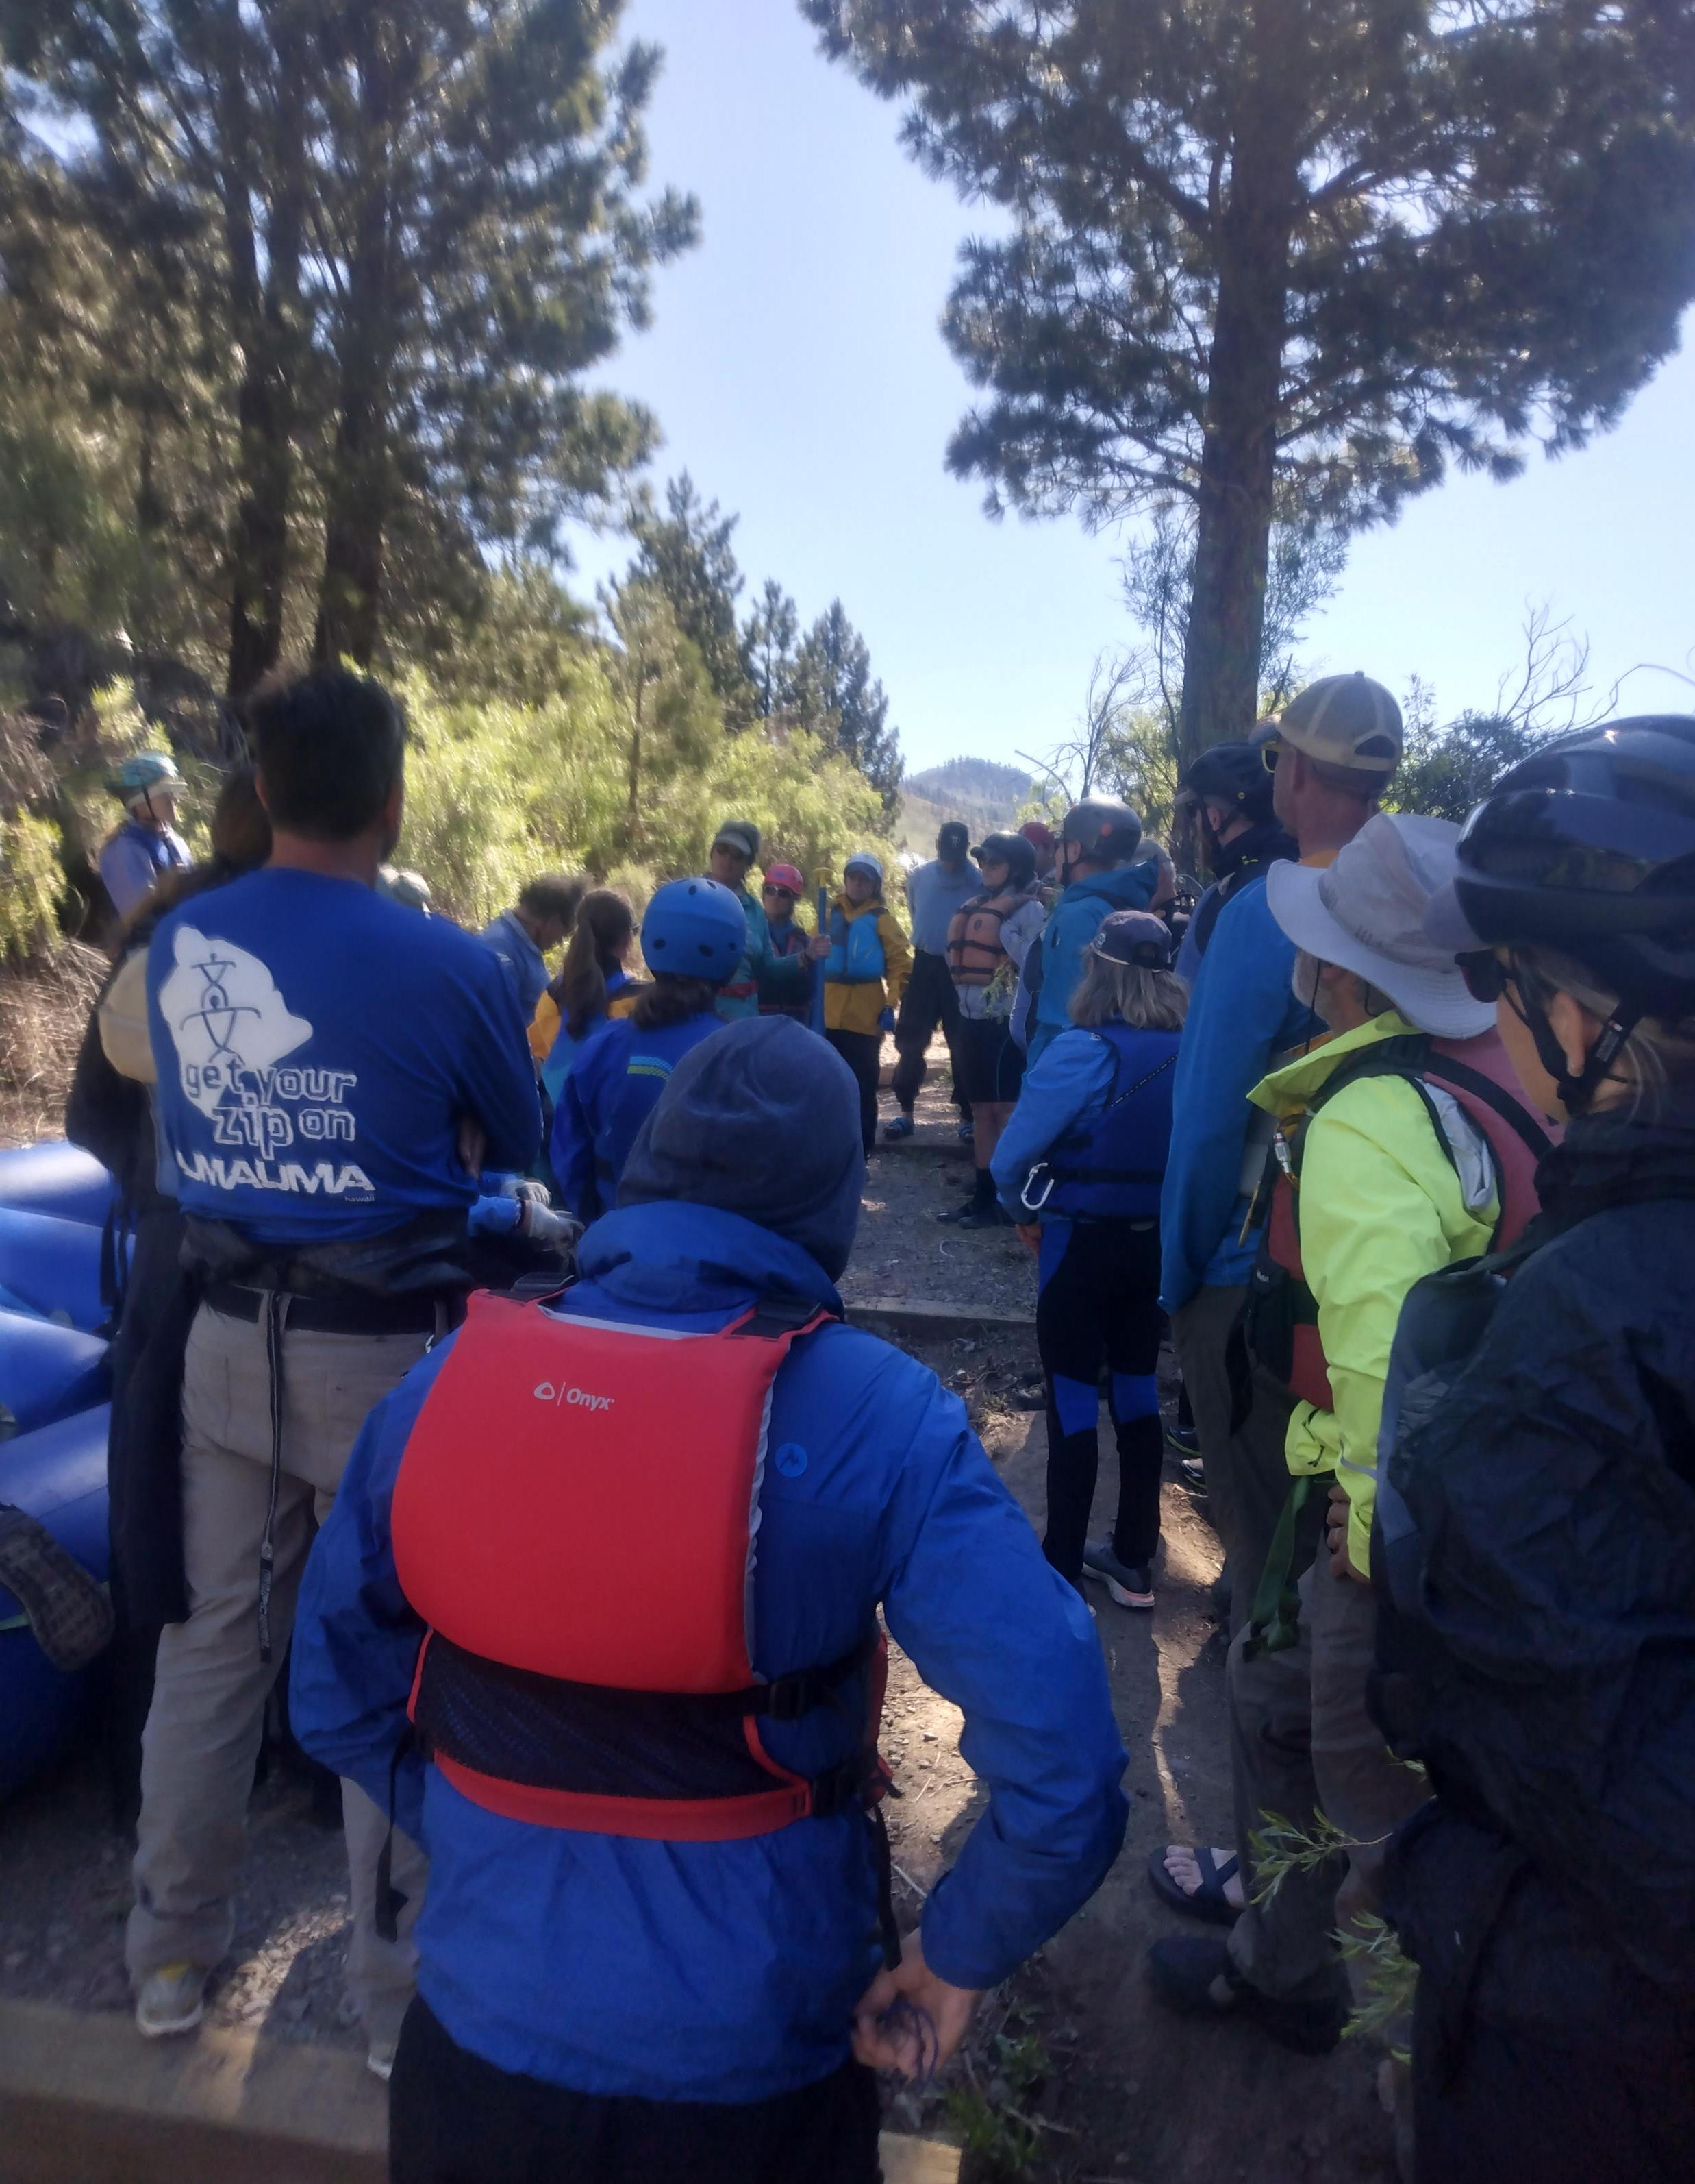
Stakeholder Planning Team
Neutral Facilitator (NPS-RTCA)
Meet approximately monthly
Mostly Online
Consensus

Slide 38
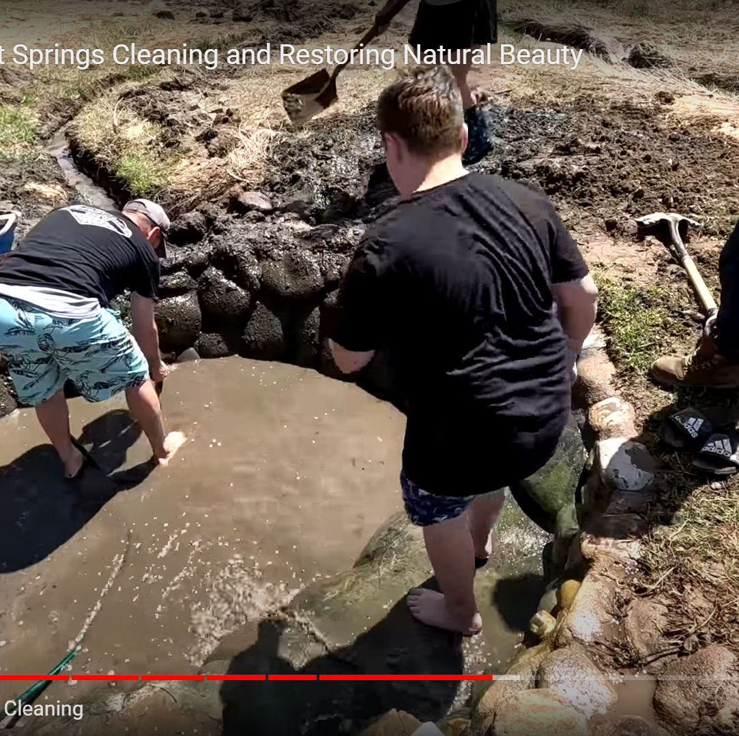
Western Hot Springs Case Studies
Wanted similar characteristics
Included 16 different hot springs
1. What is the distance to hike/paddle/drive to get to the hot springs?
2. Is there a “friends” group that manages/cares for the spring?
3. Does the spring have a management plan, or some other type of management agreement?
4. Who owns the land?
5. How many visitors do they get to the hot springs?
6. Are there any resource damage issues?
7. Fee or permit required to access?

Slide 39
Stakeholder Planning Team Input Assignment
Vision
Level of Development
Issues
Access
Opportunities
Management

Slide 40
Stakeholder Planning Team Input Assignment Findings
Wanted a low level of development– keep it a dispersed site
Designate 1 or 2 formalized routes – but don’t improve roads
Look into providing a non-motorized route
“Light-touch” management - Signage; LNT & Tread Lightly
Improve water crossings/erosion issues
Delineate camping sites/areas
Reduce the need to ford the East Fork Carson River.

Slide 43
To View The Hot Springs Case Studies & The Summary Of Stakeholder Input Assignment
https://tinyurl.com/EFCHotsprings

