Slide 1
Carson Watershed Forum
NDA Noxious Weed Program
Jake Dick
Noxious Weed Coordinator
3/5/24

Slide 2
What is a Noxious Weed?
Nevada Noxious Weed Definition
d
“Any species of plant which is, or is likely to be, detrimental or destructive and difficult to control or eradicate”
(NRS 555.005, 3)

Slide 3
Process of classifying a weed as Noxious
List is defined in NAC 555
Last revision made in 2018
Weeds can be added or removed from list
Select a committee for review & determination
Submit to Board of Agriculture for review
Advertise and hold a public workshop
Submit to Legislative Council Bureau (LCB)
If accepted by LCB hold a hearing
Submit back to the Board of Agriculture
If adopted submit to Secretary of State to sign

Slide 4
Previous Review Committee
Made up of 24 members
Represented 5 geographic regions around the state
Comprised of:
  Extension Educators
  Government Land Managers
  CWMA Members
  Conservation District Leads
  Private Weed Management Professionals

Slide 5
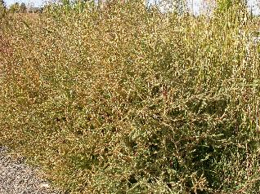
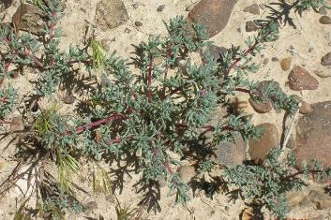
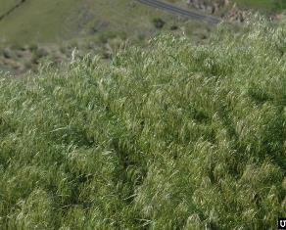
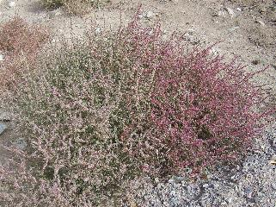
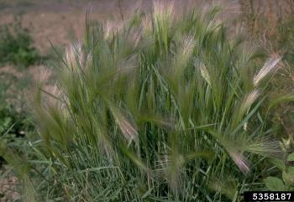
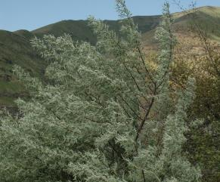
How Do Plants get listed, State of NV
OUTDATED!
“A weed must not be designated as noxious which is already introduced and established in the state to such an extent as to make its control or eradication impracticable in the judgement of the State Quarantine Officer” (NRS 555.130)
Kochia, Kochia scoparia
Halogeton, Halogeton glomeatus
Cheatgrass, Bromus tectorum
Russian thistle, Salsola tragus
Foxtail, Hordeum jubatum
Russian Olive, Elaeagnus angustifolia
Notes:
Clockwise from the top left- Kochia, Halogeton, Cheat grass, Russian thistle, Foxtail, Russian Olive

Slide 6
NAC 555.010
Designation and Categorization of Noxious Weeds
Category A weeds are weeds that are generally not found or that are limited in distribution throughout the State. Such weeds are subject to:
(a) Active exclusion from the State and active eradication wherever found.
(b) Active eradication from the premises of a dealer of nursery stock.
Category B weeds are weeds that are generally established in scattered populations in some counties of the State. Such weeds are subject to:
(a) Active exclusion where possible.
(b) Active eradication from the premises of a dealer of nursery stock.
Category C weeds are weeds that are generally established and generally widespread in many counties of the State. Such weeds are subject to active eradication from the premises of a dealer of nursery stock.

Slide 7
Current Nevada Noxious Weed Statutes
NRS 555.150 Every landowner or occupier whether private, city county, or federal shall control all noxious weeds. (puts responsibility of control on property owner).
NRS 555.160 The State Quarantine Officer may serve notice upon the owner or occupant to control noxious weeds on their property.
  In this notice the NDA Noxious Weed Program specifies which noxious weeds are present, effective control measures, and required time range for controls to be completed to gain compliance with statutes

Slide 8
NDA Noxious Weed Programs
Outreach and Education
Weed Free Certification
Regulatory Program
Biological Control Program
Cooperative Weed Management Subgrants

Slide 9
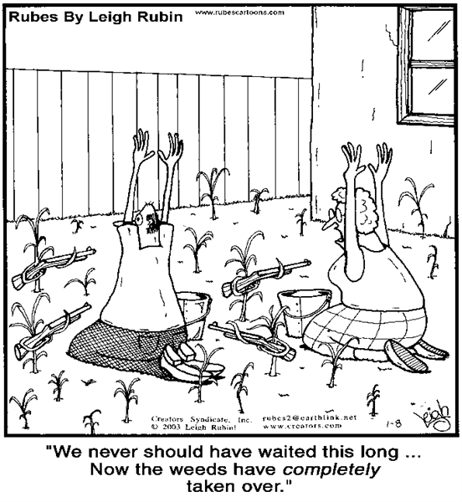
Notes:
https://appliedplantecology.files.wordpress.com/2014/12/cartoon-1.png

Slide 10
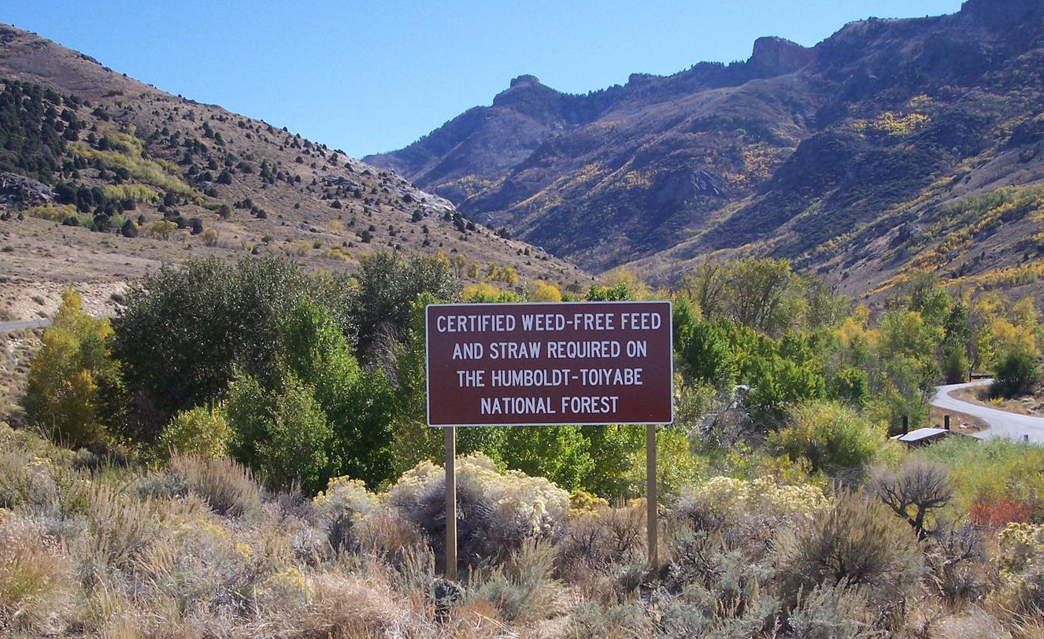

Prevention
NAC 555.015: Establishment; application; standards adopted by reference (NRS 555.010)
- creation and administration of a Weed Free Certification Program pursuant to the North American Invasive Species Management Association (NAISMA) standards

Slide 11
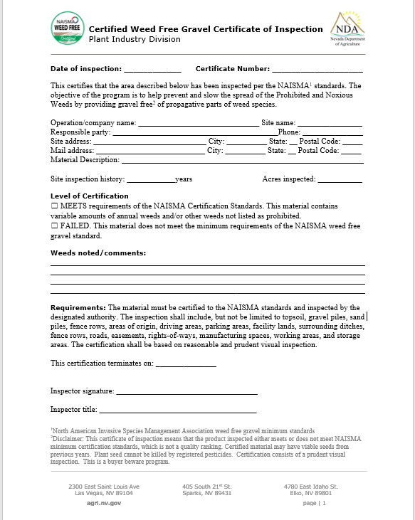

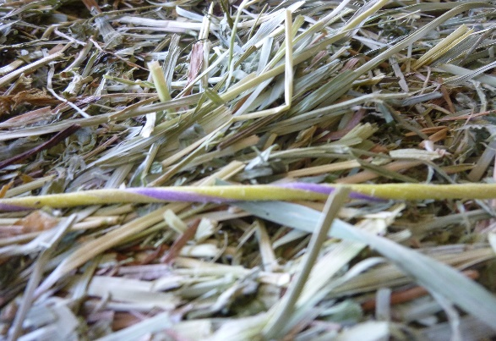
Weed Free Certification

Slide 12
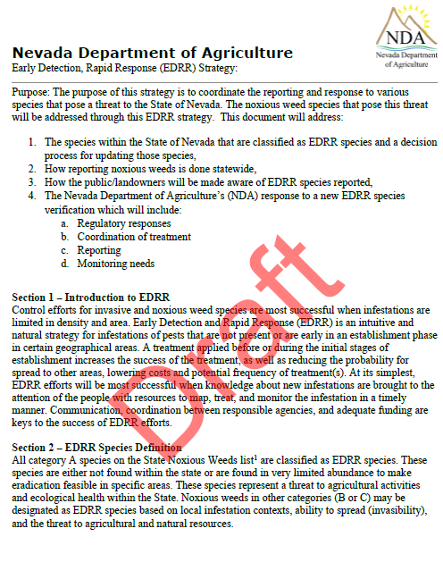
Early Detection Rapid Response

Slide 13
Regional Breakout Disscussions
Western
  Spring Meeting 3/21/24
  Washoe, Pershing, Churchill, Storey, Lyon, Douglas, Mineral, Carson City
Central/Eastern
  Spring Meeting 3/20/24
  Humboldt, Elko, Lander, Eureka, White Pine
Southern
  Spring Meeting 3/13/24
  Esmeralada, Nye, Lincoln, Clark

Slide 14
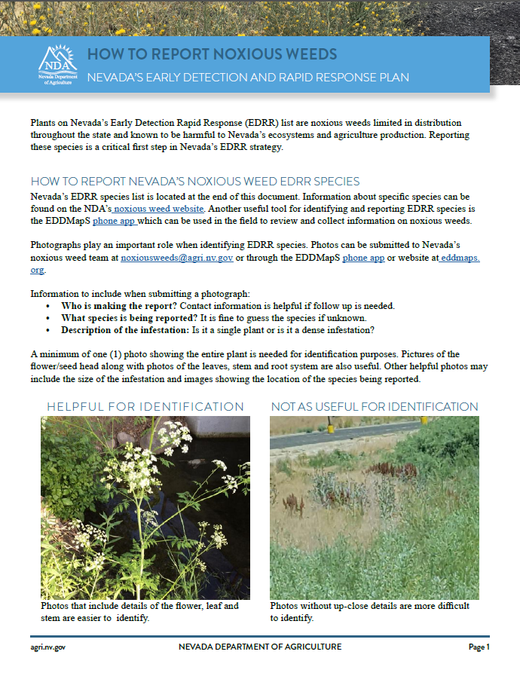
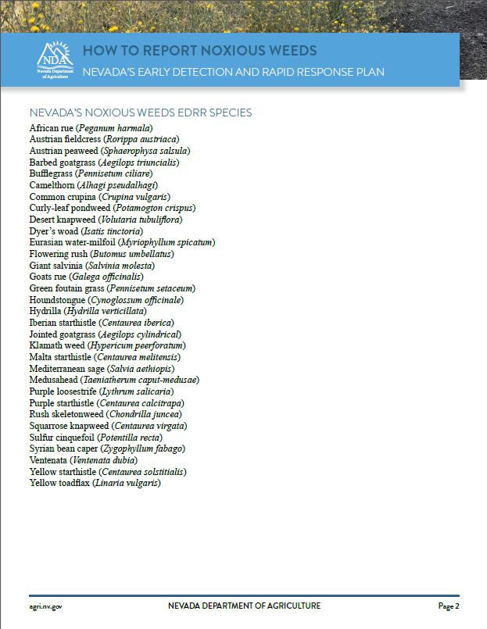
https://agri.nv.gov/NoxiousWeeds/

Slide 15
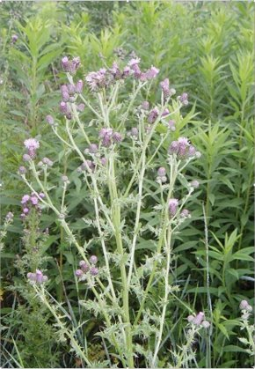
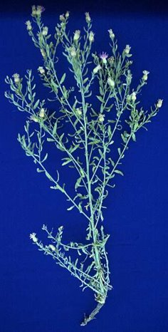
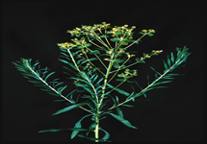
Biocontrol in Nevada
Host Species of focus:
  Russian knapweed
  Leafy spurge
  Canada thistle

Slide 16
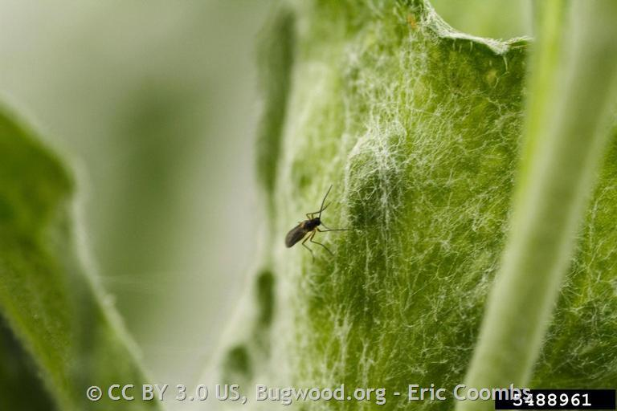
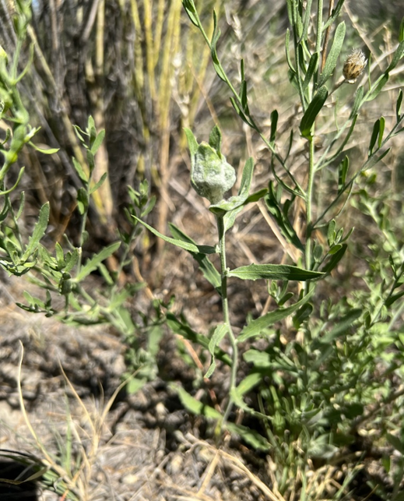
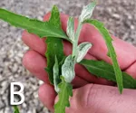
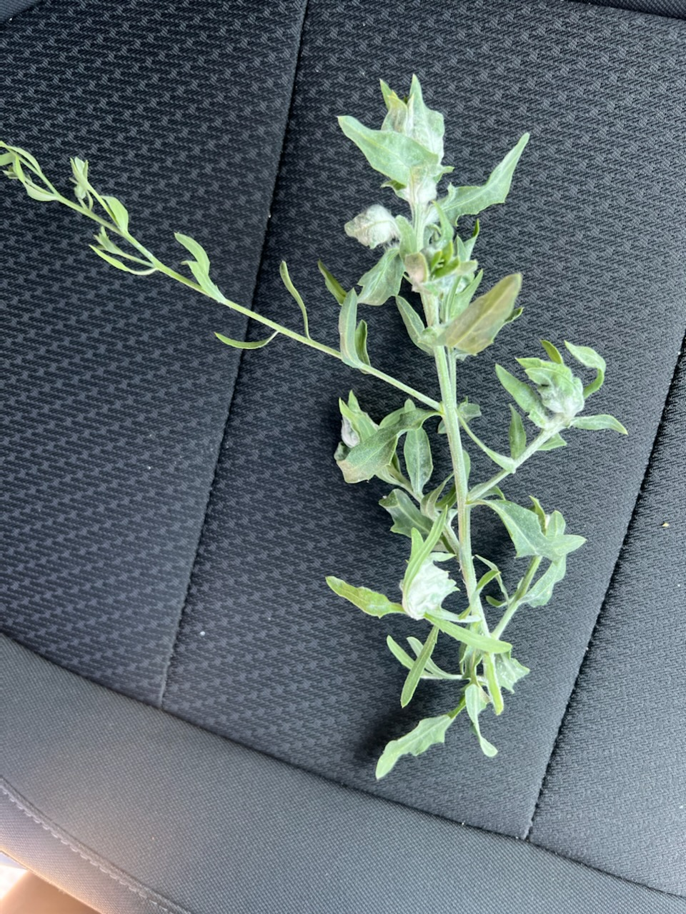
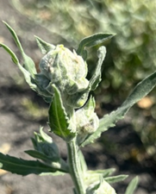
Jaapiella ivannikovi

Slide 17
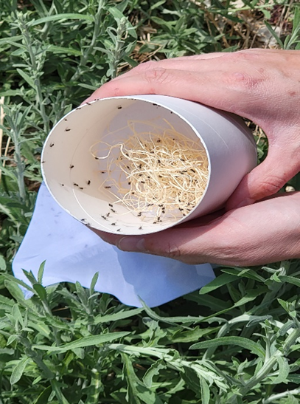
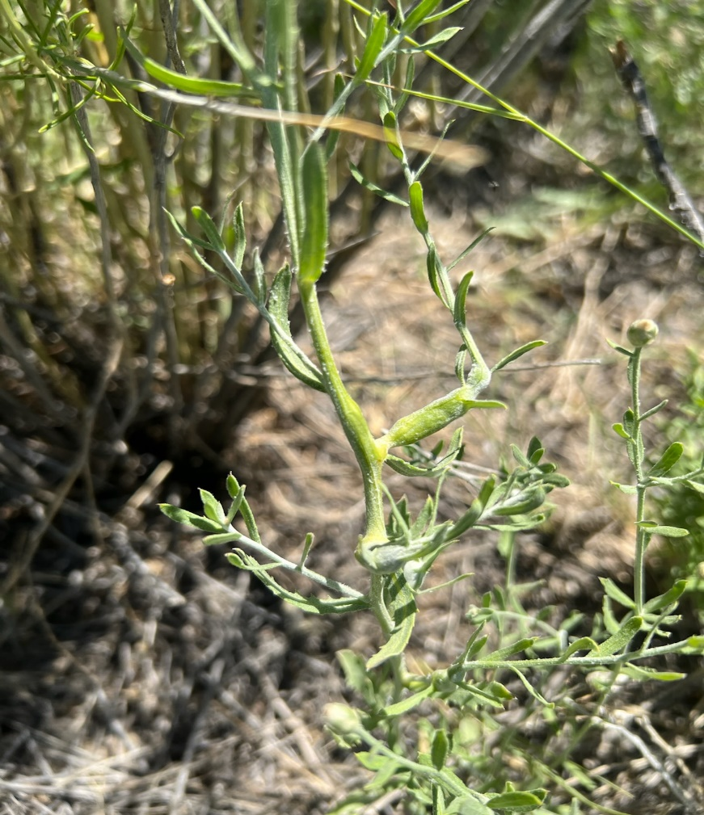
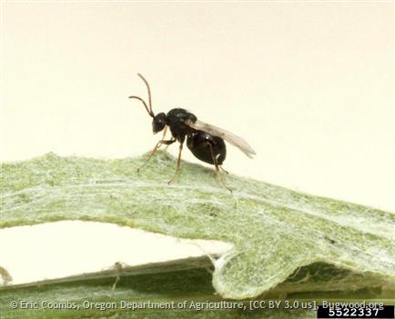
Aulacidea acroptilonica

Slide 18
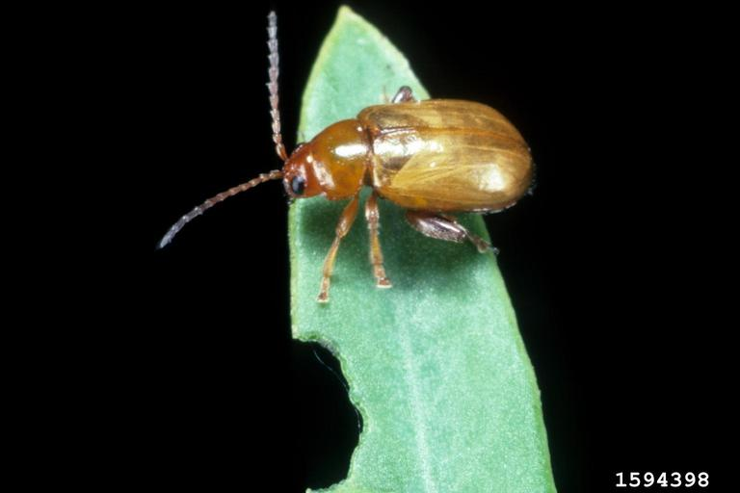
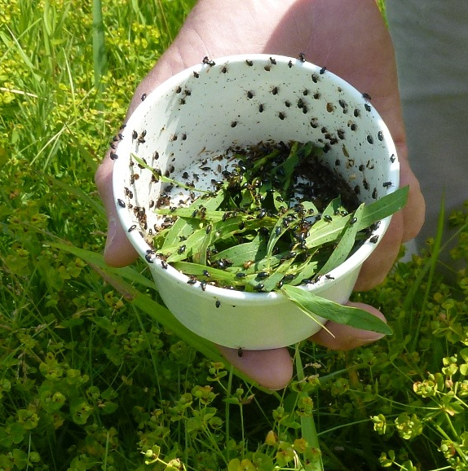
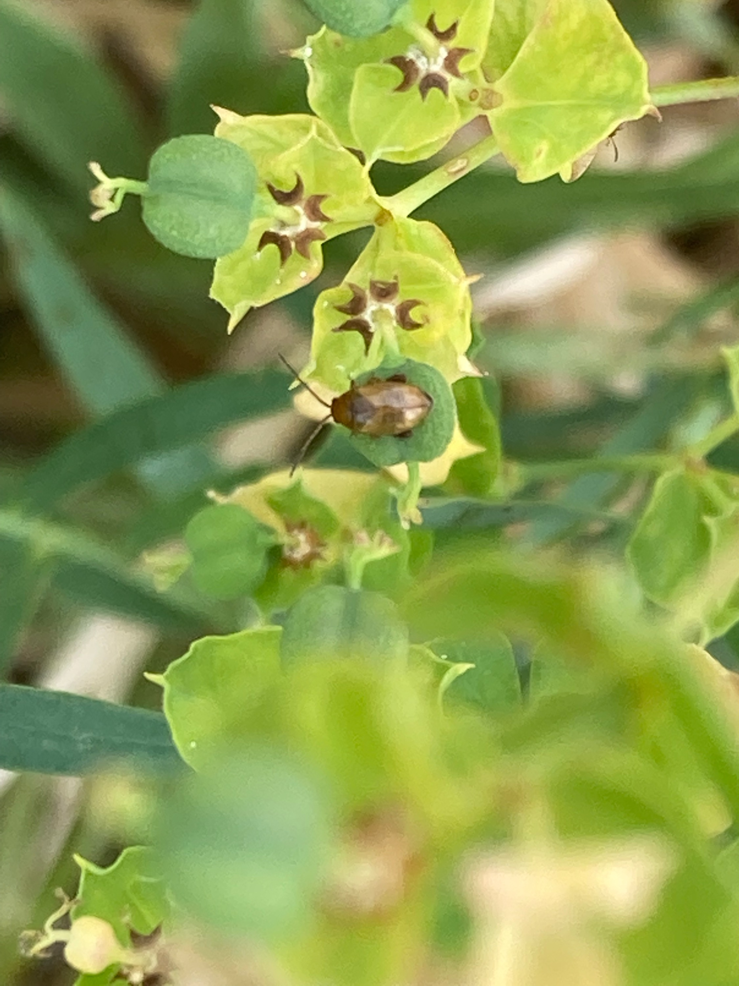
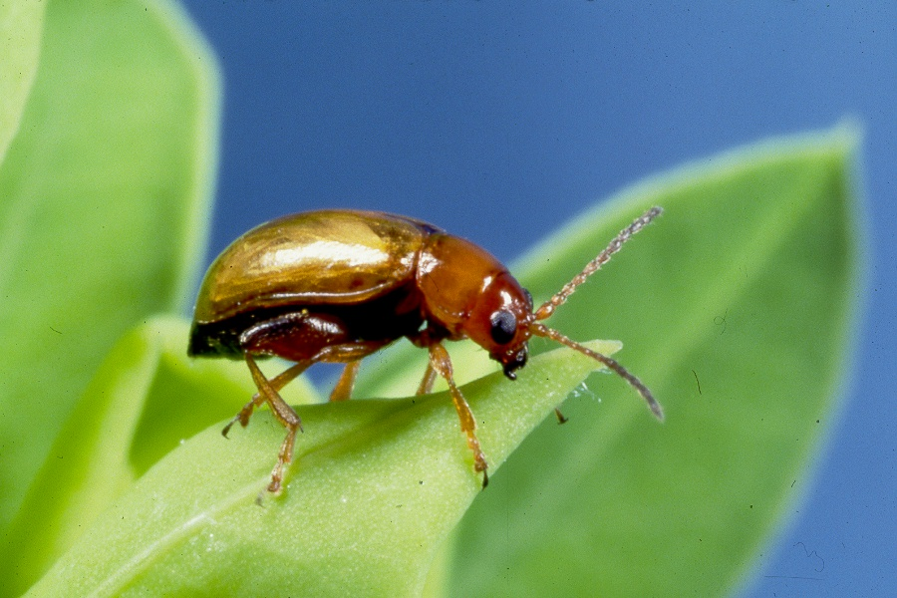
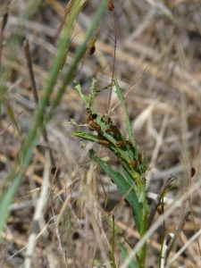
Aphthona nigriscutis

Slide 19
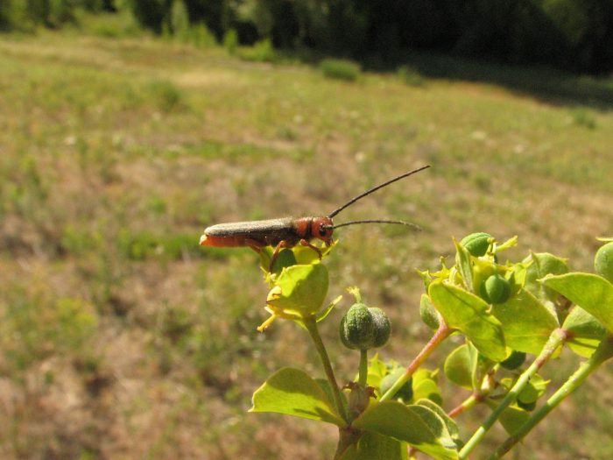
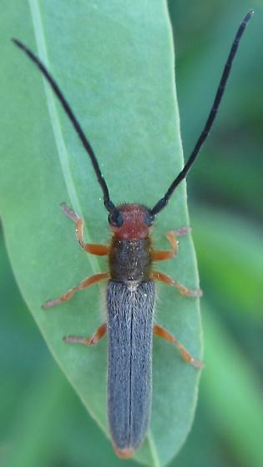
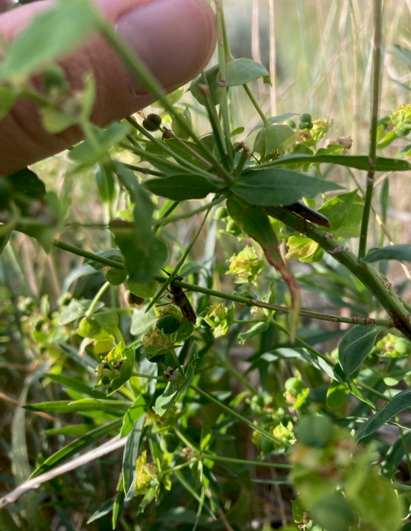
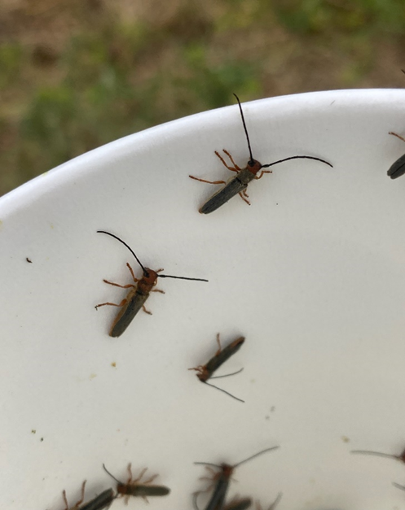
Oberea erythrocephala

Slide 20
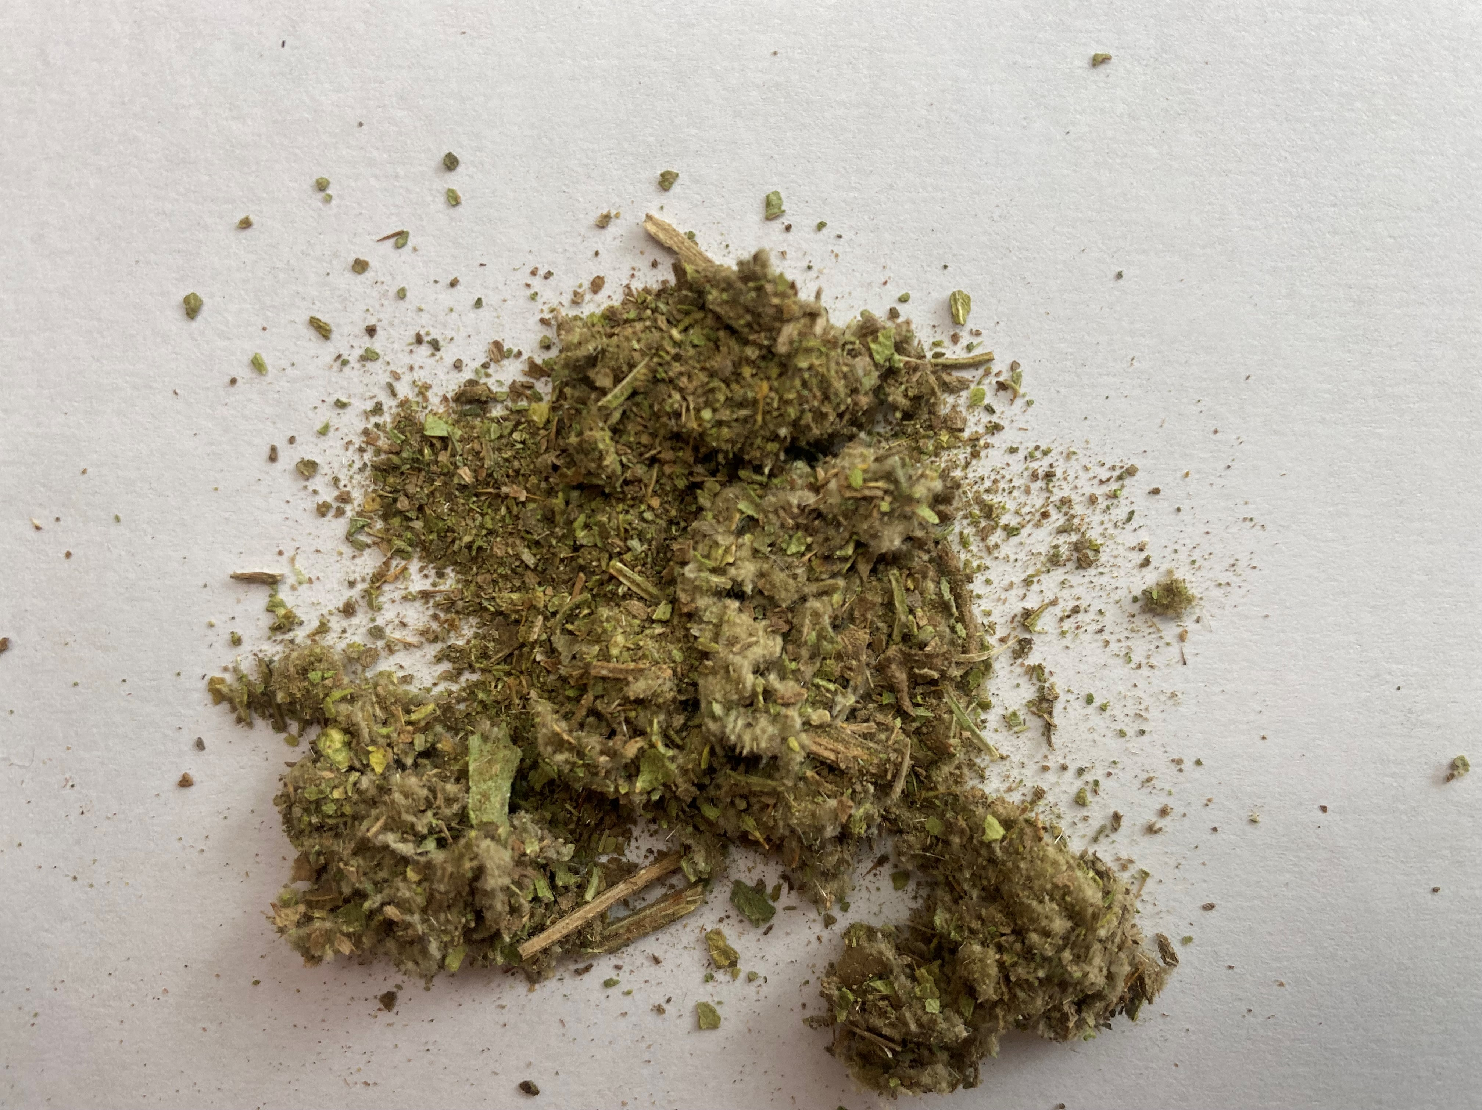
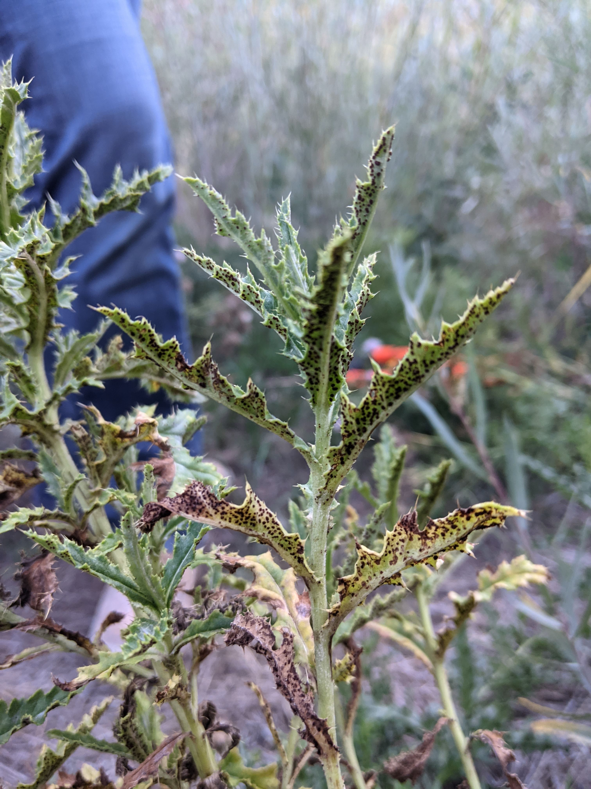
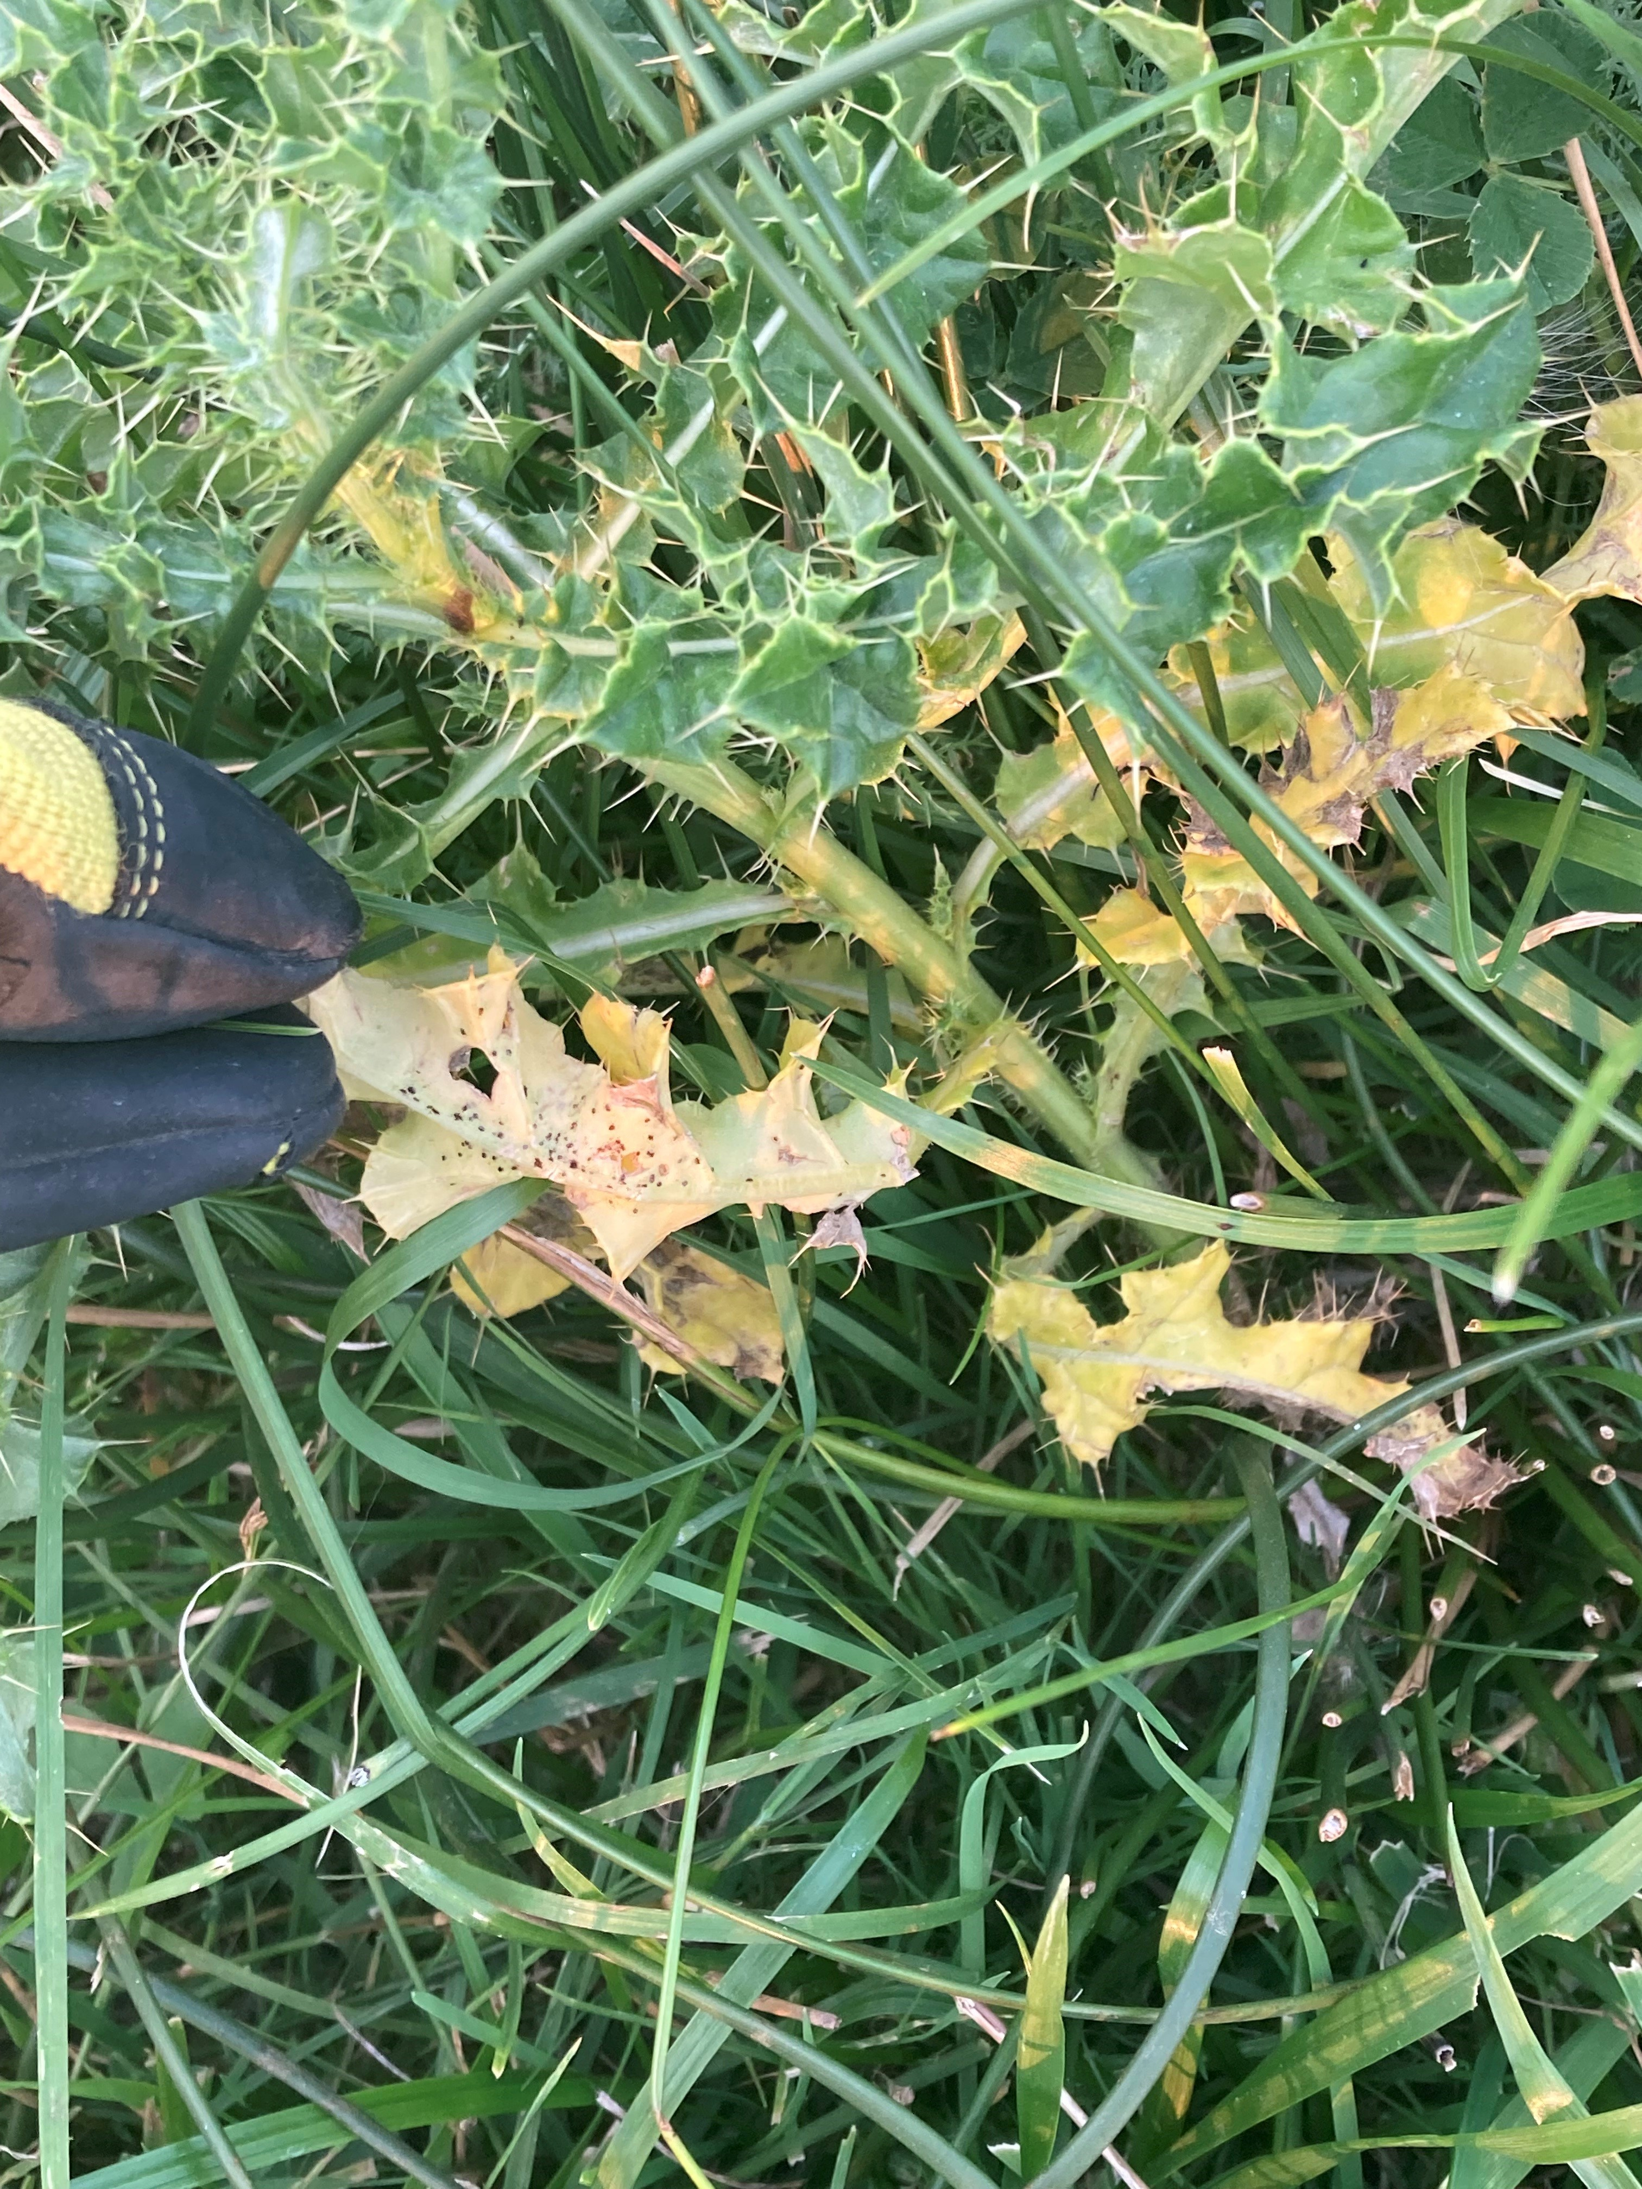
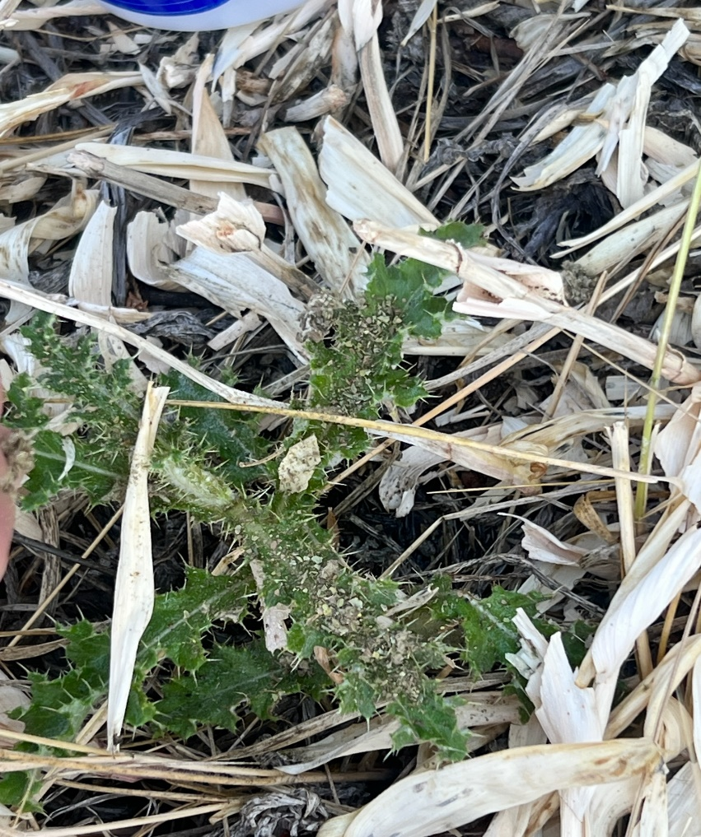
Puccinia punctiformis

Slide 21
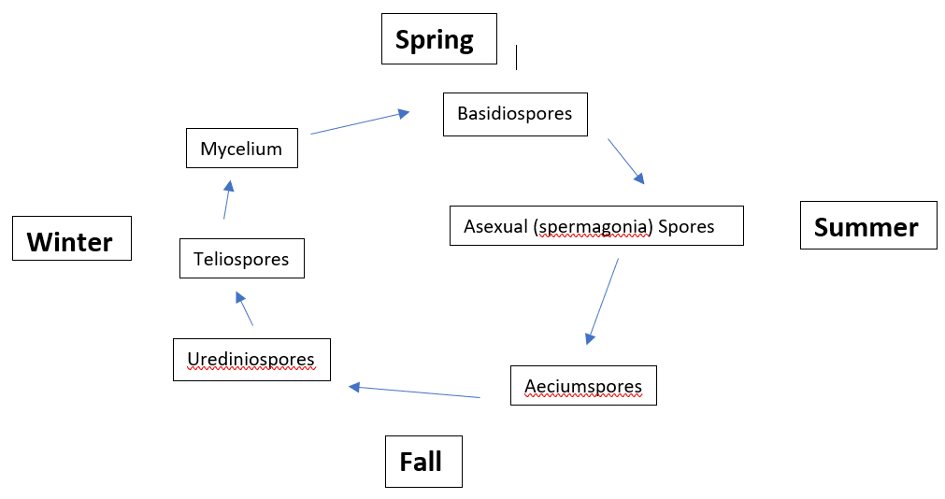
Rust Fungus

Slide 22
Grant Funding
USDA F.S. State, Private & Tribal Forestry
  Cooperative Invasive Plant Cost Share Program
USDA F.S. Good Neighbor Agreement
  Sierra and Elko Fronts Crisis Strategy Landscape Implementation Support
BIL Invasive Species Funding
  Priorities for Wester Regional Priority Projects
    EDRR
    Riparian action
    Classical Biocontrol

Slide 23
Coop. Invasive Plant Cost Share
Competitive process
Applicants must be a CWMA, CD or WD
1:1 match of federal to non-federal dollars
Last focus
  Early Detection and Rapid Response
  Riparian action

Slide 24
Sierra and Elko Fronts Support
Treatments of invasive species infestations on private lands adjacent to treatments proposed on National Forest System lands.
Recreation vector priority treatments.
Early Detection and Rapid Response survey and treatments.
Supporting proposed partner projects for weed and fuels reduction.
Purchasing materials and chemicals for project work.
Supporting maintenance of treated areas.
Site monitoring to evaluate the efficacy of control efforts.
Outreach and education focusing on invasive plant species that occur in or may be issues for specific communities.

Slide 25
Sierra Front

Slide 26

Notes:
Voluntary organization made up of state and federal agencies, state weed coordinators, NGO’s concerned about invasive species with a focus on invasive plants.

Slide 27
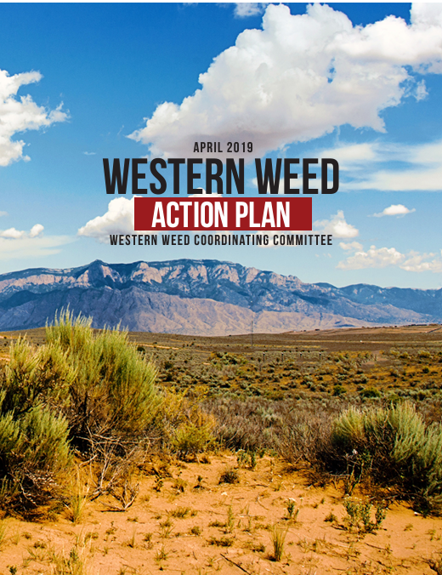
Western Weed Action Plan
Funding
Policy and Regulation
Coordination, Collaboration and Data Sharing
Research

Slide 28
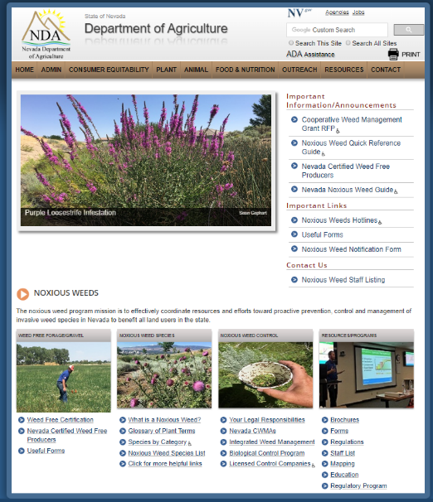
Other Resources
http://agri.nv.gov/Plant/Noxious_Weeds/Noxious_Weeds_Home/
Certified weed free material
Noxious weed field guide
Report noxious weed infestations

Slide 29
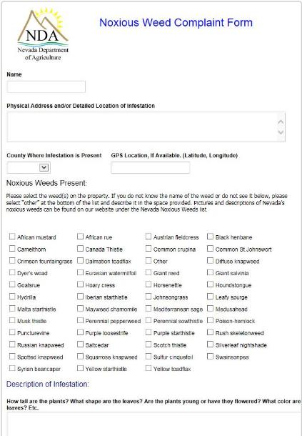
Other Resources
Reports sent directly to noxious weed program.
Anyone can fill it out.
NDA will contact the property owners with an outreach letter.
Can be the first stage in regulatory action.
Creates a record of the infestation.
Description of plant, and infested area, Always attach a picture if possible.
d
Notes:
Trying to provide a complete map of invasive plants. A combination of different agencies, organizations and individuals all contributing to one system.

Slide 30
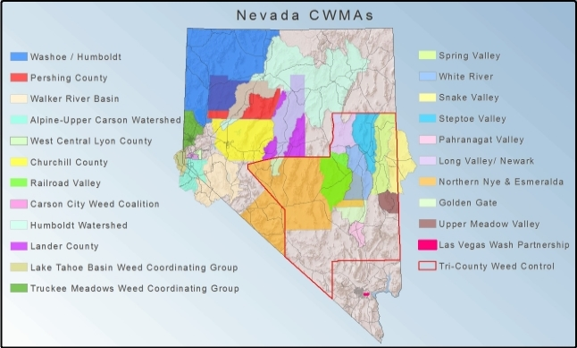
Other Resources
Participate with a CWMA or other weed groups in your area
Notes:
Trying to provide a complete map of invasive plants. A combination of different agencies, organizations and individuals all contributing to one system.

Slide 31
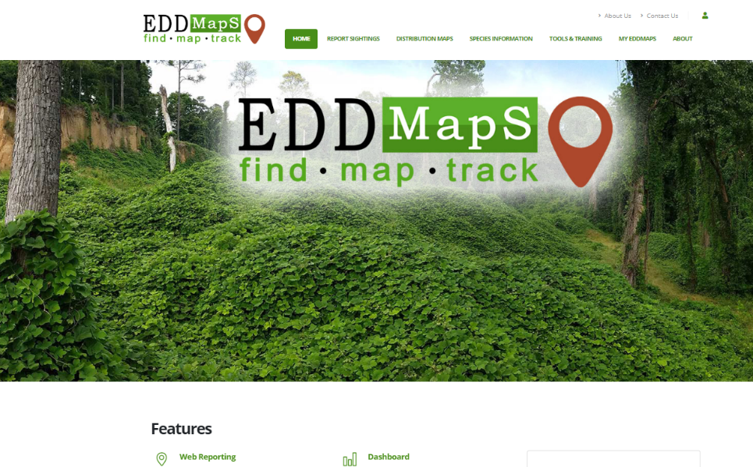
Other Resources
Notes:
An account it required to use EDDMapS, good news is that the account is free.
An account also give NDA a point of contact if needed for confirmation.

Slide 32
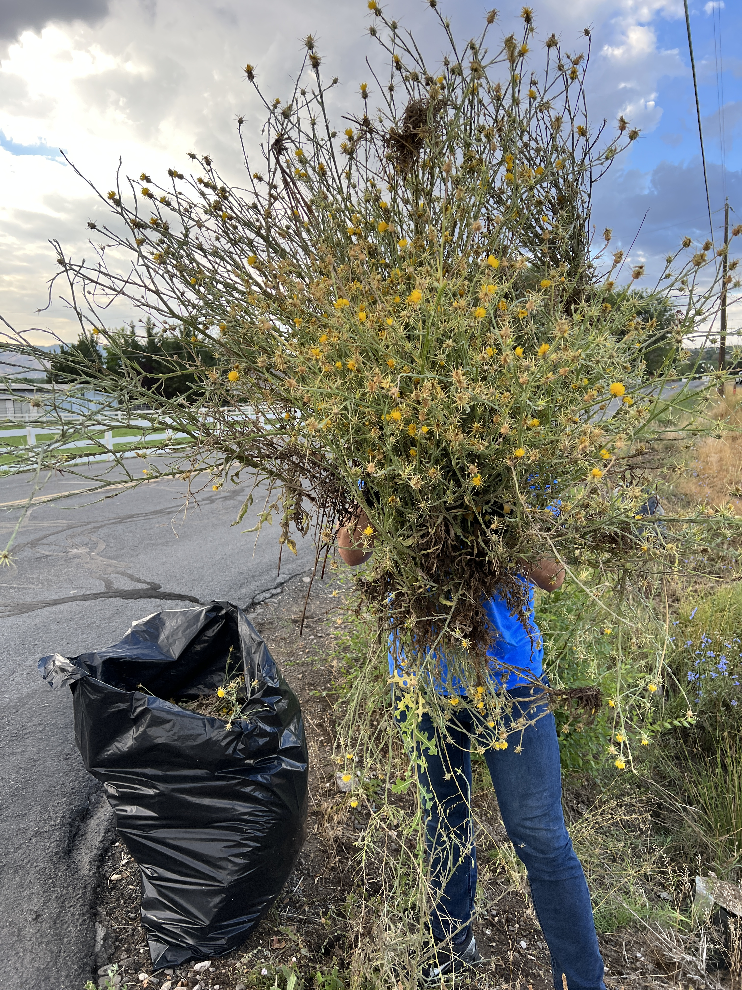
Questions?
Jake Dick
Nevada Department of Agriculture
Noxious weed program
(775) 353-3640 (office)
(775) 560-3683 (cell)
jdick@agri.nv.gov
Thank You!

